Slide 1
ENTO-306
Agricultural pests and their management
Identification of important agricultural pests
Their mode of damages
Control measures
By: Dr. Muhammad Zeeshan Majeed

Slide 2
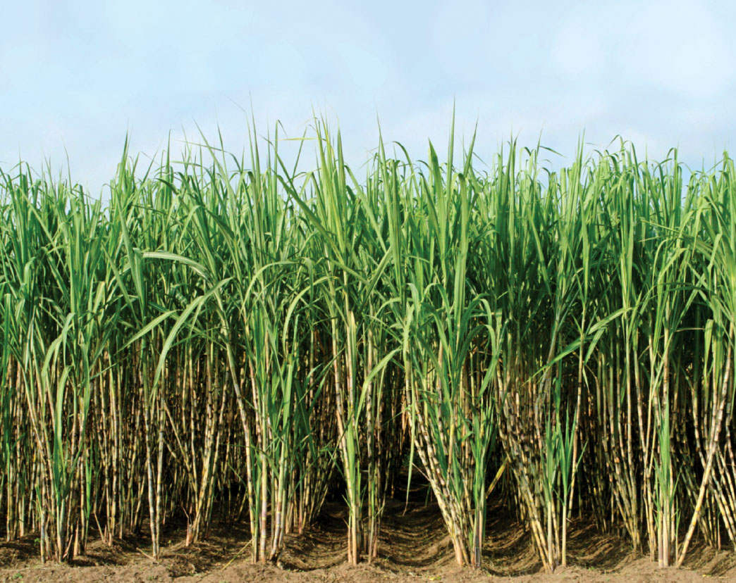
Major Insect Pests of Sugarcane Crop in Pakistan
Notes:
Important cash crop of Pakistan (Saccharum officinarum / S. spontaneum) tropical and sub-tropical climate crop. source of income and employment for the farming community.
fifth position in cane acreage and production and almost 15th position in sugar production. Brazil India China (with about 60 t/ha and sugar recovery 10-13 t/ha) Pakistan 35 t/ha with sugar recovery of 5 t/ha.
Provides essential items for industries like sugar, chip board, paper, barrage, confectionery, uses in chemicals, plastics, paints, synthetics, fiber, insecticides and detergents.
According to officials, total sugarcane cultivated area in 2019-20 was 1.06 million hectares against an area of 1.1 million hectares the year before; Pakistan's Marketing Year 2019/20 sugar production is forecast at 5.2 million tons, 2017-18 it was 6.5 million tons
2012-2013_area 1.13 million ha (India 4.5million) and production 63.7 million tonnes (India more than 300) with 5.05 million tonnes sugar at end of crushing season. Domestic needs of sugar in country is about 4.5 millon tonnes.
Per capita sugar consumption in Pakistan is 25 Kg. Global is 24.8 Kg. In India it is 20 kg
Almost 200 species of insects pests have been reported to attack sugarcane crop in Indo-PaK. Cause 15-35% yield loss.

Slide 3
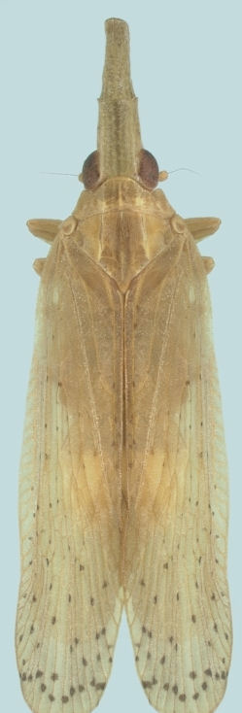
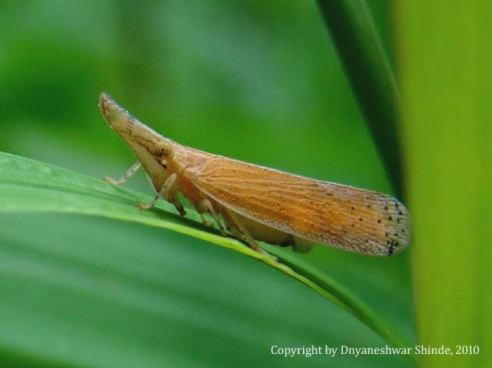
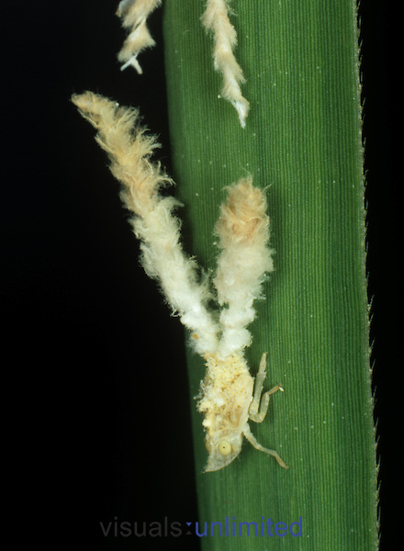
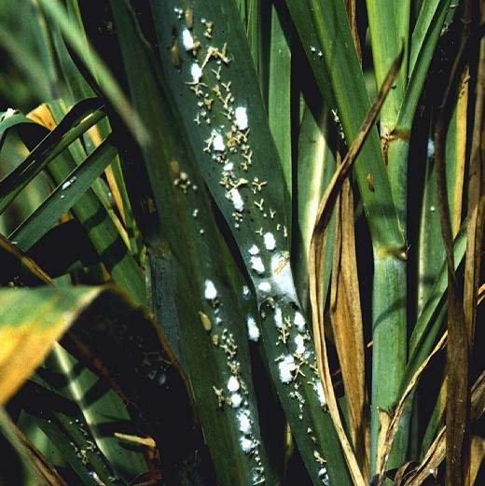
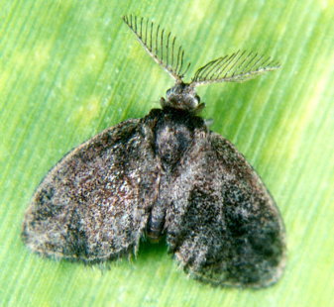
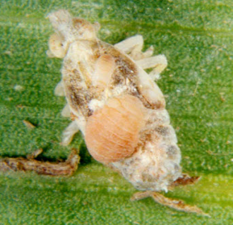
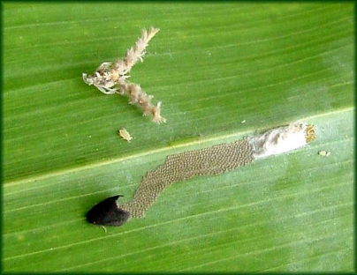
ENTO-306 Agricultural pests and their management 4(3-1)
Insect pests of Sugarcane Leaf hopper (Pyrilla perpusilla Lophopidae, Homoptera)
Notes:
Pyrilla perpusilla (Adult straw-colored (10-15mm long) and nymph yellowish white with long prominent white feather like filaments at end of abdomen) both suck sap from underside of leaves.
Very active and agile active making a fainted low noise as somebody walks through infested sugarcane.
foliage-sucking pest
Alternate hosts wheat, barley, maize, sorghum and different wild grasses (Baru grass/sudan grass/swank).
By Pyrilla infestation, cane yield loss could be about 28%, while 1.6 unit loss in sugar recovery.
leaves turn yellowish white and wither away.
Lateral shoots
Sooty mould on honeydew which interferes with normal photosynthetic activity.
Sugarcane trash destruction after harvesting.
Spray of some systemic and contact insecticide.
Breeds throughout year. About 300 eggs are laid by females underside leaves. 3 to 4 generations per year. Life cycle 2-3 months.
Control:
BC: Epipyropes (Epipyropidae) small months.
The parasitized nymphs of Pyrilla spp. can be immediately recognized by the presence of fleshy, ellipsoidal larvae with white waxy cover carried on the body of the nymphs. Presence of parasitic larvae on the body of the leafhopper adult is always indicated by the elevated position of the wing on one side. Boat-shaped white cocoons can be observed on leaves with hopper infestation. Epipyrop adult moths of both sexes are small, dark brown or blackish wings, triangular in outline, with prominent bipectinate antennae.

Slide 4
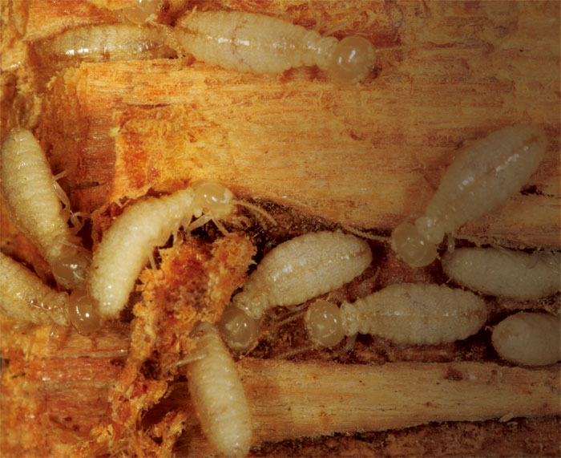
ENTO-306 Agricultural pests and their management 4(3-1)
Insect pests of Sugarcane Termites (Odontotermes obesus/Microtermes obesi)
(Termitidae, Isoptera)
Notes:
Macrotermes spp.
Odontotermes guptai
Setts are infested by termites. So pre-sowing treatment with some insecticide is effective against termites.
Add well rotten FYM in field.
Remove deeply crop stubbles after harvest to ensure eradication of termite infestation and flood irrigate with some insecitcide or kerosine oil dripped after deep soil ploughing.

Slide 5
Minor/Occasional Insect Pests of Sugarcane
(Sucking Insect Pests of Sugarcane)

Slide 6
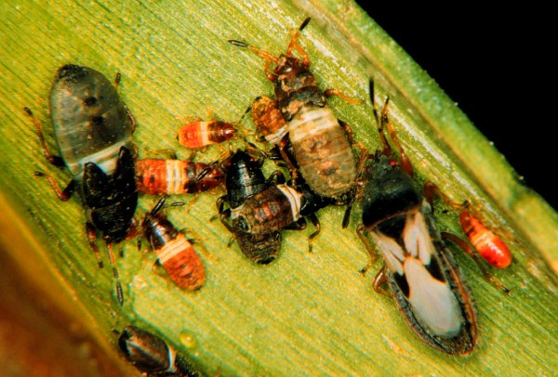
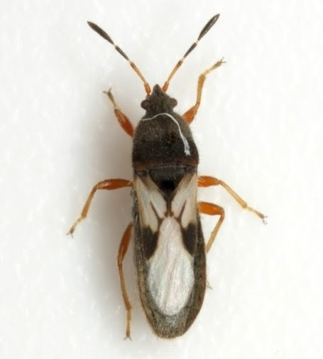
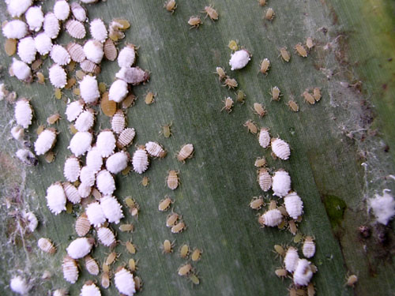
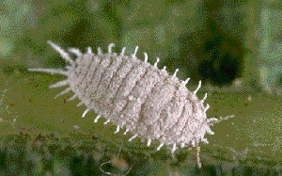
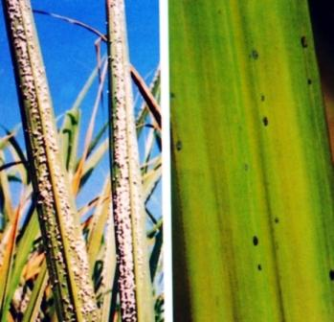
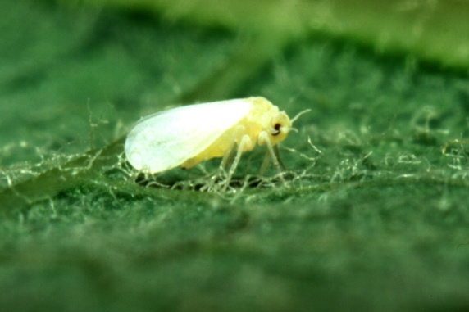
ENTO-306 Agricultural pests and their management 4(3-1)
Insect pests of Sugarcane Mealybug
Black bug
Whitefly
Notes:
Saccharicoccus sacchari (minor pest, 2.5-5mm long females, male adults sluggish one pair of wings and short-lived, active throughout year, several generations per year, sugar content reduction potential upto 20% in case of severe infestation, tight-sheathed varieties are less attacked. Blackish/sickly appearance due to sooty mold.) Methidathion, profenofors, lambda-cyhalothrin.
Cavelerius excavatus (ratooning major factor. Alternate hosts rice, maize etc., congregated under leaf sheaths or in top whorl. Adult 6-7mm long, black with white patches on wings, abdomen is reddish, eggs laid in clusters in sheath inner-sides (in soil in winter season), 5 nymphal instars complete in 4-6 weeks, 5 generations per year, Spray in sheaths or whorls for effective results.)
Aleurolobus barodensis (alternate host wild grasses like sarkanda, baru etc., body size 3mm, pale-yellow colored, 9 generations per year, severe infestation causes 15-25% sugar recovery. Sooty mold grow, sickly appearance of crop)

