Slide 1
Endocrine system
Dr. M. Asam Riaz
Assistant Professor-Entomology

Slide 2
Classification based on chemical structure
Juvenile hormone (JH)
Molting hormones (Ecdysone)
Peptide hormones
short sequence proteins
Perform different functions

Slide 3
A, alanine; C, cysteine; D, aspartic acid; E, glutamic acid; F, phenylalanine; G, glycine; H, histidine; I, isoleucine; K, lysine; L, leucine; M, methionine; N, asparagine; P, proline; Q, glutamine; R, arginine; S, serine; T, threonine; V, valine, W, tryptophan.

Slide 8
Endocrine organs
Endocrine organs are of two types
Neurosecretory cells
within CNS
Other ganglia
More in number in Bombyx
Less in number in Schistocerca
Specialized endocrine glands
Corpora allata
Corpora cardiaca
Prothoracic gland
Ring gland of cyclorrhaphous Diptera
Endocrine cell of midgut
Epitracheal glands

Slide 9
1-Neurosecretary cells
within CNS
More in number in Bombyx
Less in number in Schistocerca
Cluster found medially and laterally in insect brain
Provide nerves to corpora cardiaca and corpora allatum
produce brain hormones which are carried by carrier protein
Regulate molting, metamorphosis, reproduction, lipids, carbohydrates, protein, flight energy, feeding activity and excretion

Slide 10
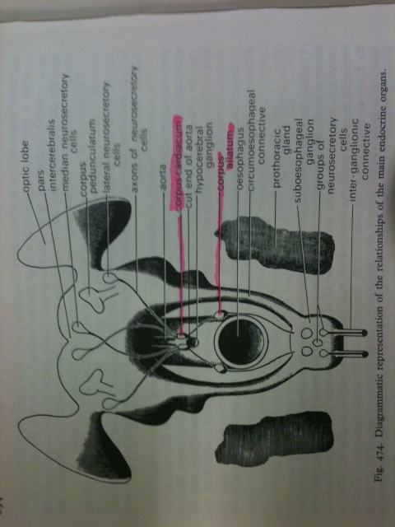
Endocrine system

Slide 11
1-Corpora allata (Corpus allatum)
A pair of gland connected to corpus cardiaca
Secrete JH (Juvenile hormone)JH0, JH-I, JH-II, JH-III
JH inhibits development of adult characteristics during immature stage

Slide 12
Juvenile hormone biosynthesis.
Figure 21.2. (b) The diagram shows the mevalonate pathway leading to juvenile hormone. For details, see Belle´s et al. (2005).
Two different routes are available from farnesoic acid to juvenile hormones.
In Orthoptera, Dictyoptera, Coleoptera and Diptera, farnesoic acid is first esterified to yield methylfarnesoate and then an epoxide group is added to yield JHIII.
In lepidopteran insects, epoxidation takes place first, and epoxyfarnesoic acid is then esterified. Where methylation is required to form JHII, etc., it takes place after this.
In some adult moths, epoxyfarnesoic acid is secreted and stored outside the corpora allata.

Slide 13
MF, methylfarnesoate
Epoxy group
Figure 21.2 (a) Juvenile hormones and related molecules.
JHB3, juvenile hormone III bisepoxide

Slide 14
Promotes sexual maturity during adult stage
Egg maturation
Regulated by brain hormone
Similar to sesquiterpene (a semiochemicals or defense chemicals in plants)

Slide 15
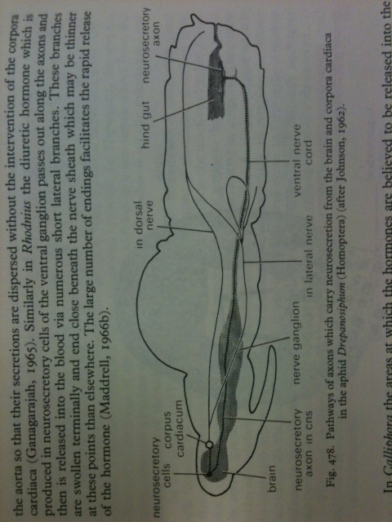

Slide 16
2-Corpora cardiaca (corpus cardiacum)
A pair of glands connected to protocerebrum through nerves and associated with aorta
Secrete PTTH (prothoracicotropic hormone) under the influence of brain hormone
Store brain hormones

Slide 17
3-Prothoracic glands
Present in prothorax
Secrete ecdysone (steroid hormone)
Ecdysone stimulate synthesis of chitin and protein and causes moulting. It is also known as moulting hormone.
Ecdysone is produced under the influence of PTTH

Slide 18
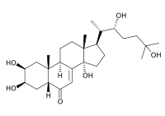
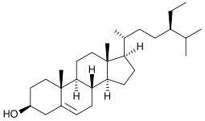
β-Sitosterol, a phytosterol showing the hydroxyl group at C-3.
Ecdysone is steroid

Slide 19
Biosynthesis of ecdysone
Ecdysteroid biosynthesis and the involvement of
cytochrome P450 (CYP) enzymes.
occurs in the prothoracic gland
P450 enzymes are involved in this pathway (steroidogenesis)
steroid at the start of the pathway may be a phytosteroid rather than cholesterol, and this may cause the final ecdysteroid product to differ.
in Manduca sexta, 3-dehydroecdysone replaces ecdysone as the secretory product of the prothoracic gland, and this is then converted to ecdysone by a 3-b reductase enzyme in the hemolymph.
Notes:
The reactions occurring in the “black box” during transformation of 7dC to 2,22,25dE have not been fully elucidated but involve multiple steps;

Slide 20
Ecdyson stimulate synthesis of chitin and protein and causes moulting. It is also known as moulting hormone.
Ecdysone is produced under the influence of PTTH

Slide 21
5-Endocrine cells of midgut
Present in midgut wall
Produce their secretion into the hemolymph
Have microvilli at the end
Cells vary in number
500 cells in midgut of A. aegypti
30000 in Periplaneta americana
Secrete peptide hormones
Diuretic peptides, regulate water balance
Regulate the synthesis of digestive enzymes
Regulation of food intake by signalling when gut it full

Slide 22
6-Epitracheal glands
Present in higher orders (some coleoptera, Hymenoptera, All Lepidoptera and Diptera)
16-18 neurosecretory cells attached to trechea near each spiracle
Source of ETH (ecdysis-triggering hormone), and PETH (pre- ecdysis-triggering hormone)

Slide 23
7-Ovaries and testes
Produce gonadal hormones
Cause courtship and mating behaviour
8-Ventral ganglion
Produce eclosion hormone (helps to shed the old skin)
Produce bursicon that causes hardening and tanning of the youngone

