Slide 1
HORT 308
MEDICINAL AND AROMATIC PLANTS

Slide 2
Siberian Ginseng

Slide 3
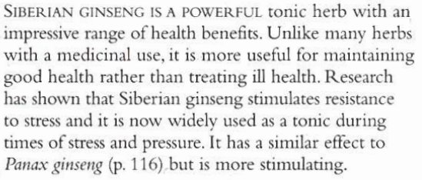
B.N Eleutherococcus senticosus Family: Araliaceae

Slide 4
Habitat & Cultivation
Native to Eastern Russia
China
Korea
Japan

Slide 5
Key Constituents
Eleutherosides
Phenylpropanoids
Lignans
Coumarins
Sugars
Polysaccharides
Triterpenoid saponins
Glycans

Slide 6
Key Actions
Adaptogenic
Tonic
Stimulant
Protects immune system

Slide 7
Research
In Russia since 1950, the exact method by which it stimulates stamina and resistance to stress is yet unknown

Slide 8
Traditional & Current Uses
Enhancing Resilience (reduce physical stress)
Exhaustion remedy
Treatment of Impotence

Slide 9
Parts Used
Roots

Slide 10
Key Preparations
Tincture
Decoction
Capsule
Tablets

Slide 11
Caution
Do not use more than 6 weeks continuously

Slide 12
Eucalyptus

Slide 13
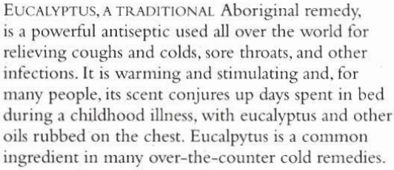
B.N Eucalyptus globulus Family: Myrtaceae

Slide 14
Habitat & Cultivation
Native to Australia
Grown in Tropics, Subtropics and temperate areas because of ecological problems
Recommended for marshy areas

Slide 15
Key Constituents
Volatile Oil
Flavonoids
Tannins
Resin

Slide 16
Key Actions
Antiseptic
Expectorant
Stimulates local blood flow

Slide 17
Research
Last 50 years showed marked antiseptic action

Slide 18
Traditional & Current Uses
Against infection (aboriginal)
Antiseptic
Expectorant
Warming (chest rubbing)
Pain relief (rheumatic essential oil)

Slide 19
Parts Used
Leaves (Fresh and Dry)

Slide 20
Key Preparations
Lozenges
Capsules
Inhalation (Essential oil)
Infusion
Tincture

