Slide 1
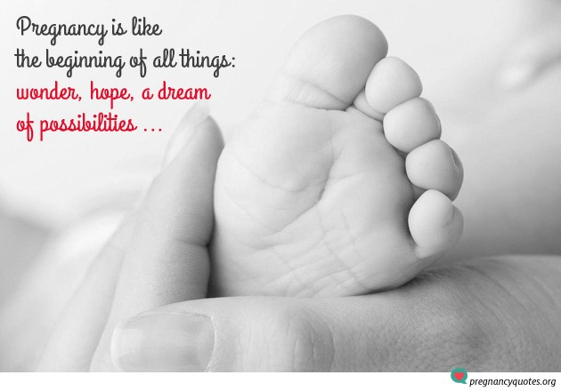

Slide 2
Anatomical and physiological changes of pregnancy

Slide 3
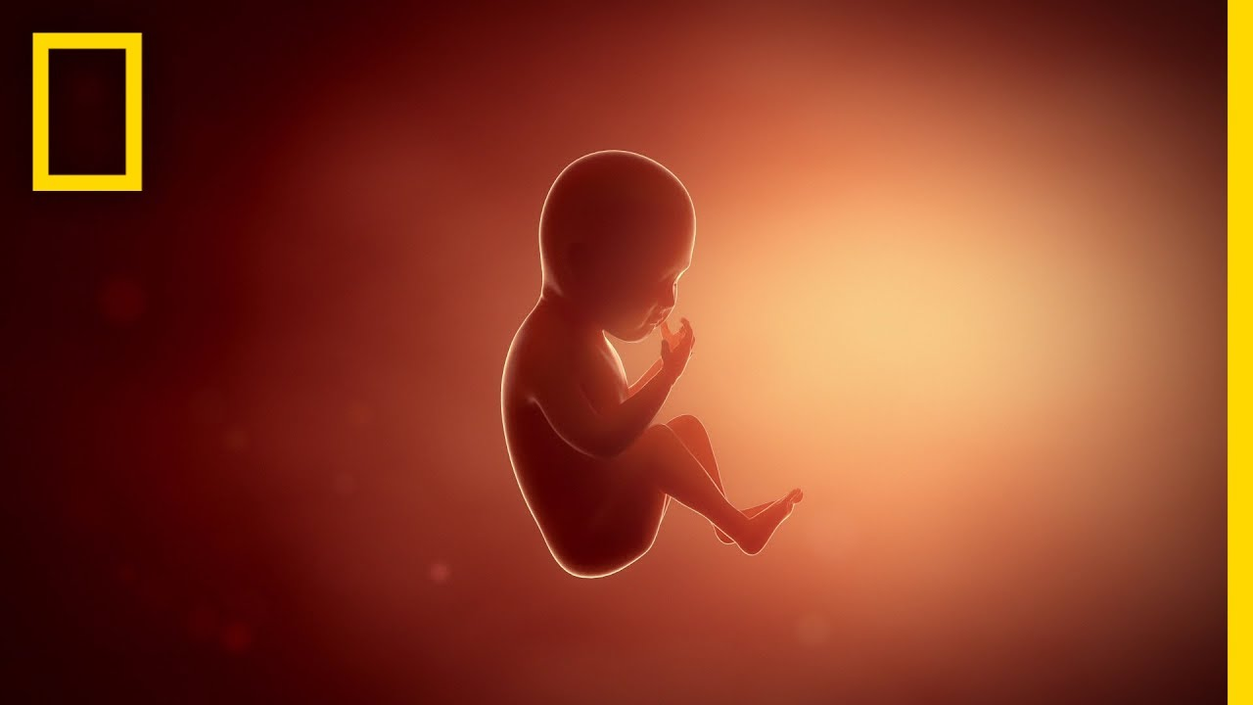
PREGNANCY
Pregnancy, which spans 40 weeks from conception to delivery, is divided into three trimesters, with characteristic changes during each.

Slide 4
1st trimester
(weeks 0 through 12)
2nd trimester
(weeks 13 through 26)
3rd trimester
(weeks 27 through 40)

Slide 5
Weight gain during pregnancy
Changes in organ systems
Uterus and related connected tissue
Changes in posture and balance
Center of gravity
Urinary system
Pulmonary system
Cardiovascular system
Musculoskeletal system
Thermoregulatory system
Balance
Changes in Endocrine system

Slide 6
Weight Gain During Pregnancy

Slide 7
Changes in endocrine system

Slide 8
EFFECTS OF PROGESTERONE
1. Reduction in tone of smooth muscle:
Food may stay longer in the stomach; peristaltic activity is reduced
Water absorption in the colon is increased leading to tendency to constipation
Uterine muscle tone is reduced
Detrusor muscle tone reduced
Dilatation of the ureters favouring urine stasis with elongation to accommodate the increasing size of the uterus; this may contribute to the likelihood of urinary tract infections
Urethral tone reduced, which may result in stress incontinence
Reduced tone in the smooth muscle of the blood vessel walls leading to dilation of blood vessels, lowered diastolic pressure.
Notes:
is smooth muscle found in the wall of the bladder. The detrusor muscle remains relaxed to allow the bladder to store urine, and contracts during urination to release urine.

Slide 9
2. Increase in temperature (0.5–1°C).
3. Reduction in alveolar and arterial PCO2 tension, hyperventilation.
4. Development of the breasts’ alveolar and glandular milk-producing cells.
5. Increased storage of fat.

Slide 10
EFFECTS OF ESTROGENS
Increase in growth of uterus and breast ducts.
Increasing levels of prolactin to prepare breasts for lactation; oestrogens may assist maternal calcium metabolism.
May prime receptor sites for relaxin (e.g. pelvic joints, joint capsules, cervix).
Increased water retention, may cause sodium to be retained.
Higher levels result in increased vaginal glycogen, predisposing to thrush.

Slide 11
EFFECTS OF RELAXIN
Gradual replacement of collagen in target tissues (e.g. pelvic joints, joint capsules, cervix) with a remodelled modified form that has greater extensibility and pliability. Collagen synthesis is greater than collagen degradation and there is increased water content, so there is an increase in volume.
May have a role in the remarkable ability of the uterus to distend and in the production of the necessary additional supportive connective tissue for the growing muscle fibres.

Slide 12
3. Towards the end of pregnancy,
rising levels of relaxin effect softening
of the collagenous content of the cervix.
May have a role in mammary growth.
Affects relaxation of the pelvic floor muscles .

Slide 14
Changes in organ system

Slide 15
Reproductive system

Slide 16
Ammenhorea is the first sighn of pregnancy in most women
Uterus.
The uterus increases from a prepregnant size of 5 by 10 cm (2 by 4 in.) to 25 by 36 cm (10 by 14 in.).
It increases five to six times in size, 3,000 to 4,000 times in capacity, and 20 times in weight by the end of pregnancy.
By the end of pregnancy, each muscle cell in the uterus has increased approximately 10 times over its prepregnancy length
Once the uterus expands upward and leaves the pelvis, it becomes an abdominal rather than a pelvic organ.

Slide 17
Connective tissues.
Ligaments connected to the pelvic organs are more fibroelastic than ligaments supporting joint structures.
The fascial tissues, which surround and enclose the organs in a continuous sheet, also include a significant amount of smooth muscle fibers.
The round, broad, and uterosacral ligaments in particular provide suspensory support for the uterus.

Slide 18
Urinary system

Slide 19
Kidneys.
The kidneys increase in length by 1 cm (0.5 in.).
Ureters.
The ureters enter the bladder at a perpendicular angle because of uterine enlargement.
This may result in a reflux of urine out of the bladder and back into the ureter;
therefore, during pregnancy, there is an increased chance of developing urinary tract infections because of urinary stasis.

Slide 20
Pulmonary system

Slide 21
Hormonal influences.
Hormone changes affect pulmonary secretions and rib cage position.
Edema and tissue congestion of the upper respiratory tract begin early in pregnancy because of hormonal changes. Hormonally stimulated upper respiratory hypersecretion also occurs.
Changes in rib position are hormonally stimulated and occur prior to uterine enlargement. The subcostal angle progressively increases; the ribs ﬂare up and out. The anteroposterior and transverse chest diameters each increase by 2 cm (1 in.). Total chest circumference increases by 5 to 7 cm (2 to 3 in.) and does not always return to the prepregnant state.
The diaphragm is elevated by 4 cm (1.5 in.); this is a passive change caused by the change in rib position.

Slide 22
Respiration
Respiration rate is unchanged, but depth of respiration increases.
Tidal volume and minute ventilation increase, but total lung capacity is unchanged or slightly decreased.
There is a 15% to 20% increase in oxygen consumption; a natural state of hyperventilation exists throughout pregnancy to meet the oxygen demands of pregnancy.
The work of breathing increases because of hyperventilation; dyspnea is present with mild exercise as early as 20 weeks into the pregnancy.

Slide 23
Cardiovascular system

Slide 24
Blood volume and pressure.
Blood volume progressively increases 35% to 50% (1.5 to 2 L) throughout pregnancy and returns to normal by 6 to 8 weeks after delivery.
Plasma increase is greater than red blood cell increase, leading to the “physiologic anemia” of pregnancy, which is not a true anemia but is representative of the greater increase of plasma volume.
The increase in plasma volume occurs as a result of hormonal stimulation to meet the oxygen demands of pregnancy.

Slide 25
Venous pressure in the lower extremities increases during standing as a result of increased uterine size and increased venous distensibility.
Pressure in the inferior vena cava rises in late pregnancy, especially in the supine position, because of compression by the uterus just below the diaphragm.
In some women, the decline in venous return and resulting decrease in cardiac output may lead to symptomatic supine hypotensive syndrome.
The aorta is partially occluded in the supine position

Slide 26
Blood pressure decreases early in the ﬁrst trimester.
There is a slight decrease of systolic pressure and a greater decrease of diastolic pressure.
Blood pressure reaches its lowest level approximately midway through pregnancy and then rises gradually from mid-pregnancy to reach the prepregnant level approximately 6 weeks after delivery.
Although cardiac output increases, blood pressure decreases because of venous distensibility.

Slide 27
Heart
Heart size increases, and the heart is elevated because of the movement of the diaphragm.
Heart rhythm disturbances are more common during pregnancy.
Heart rate usually increases 10 to 20 beats per minute by full term and returns to normal levels within 6 weeks after delivery.
Cardiac output increases 30% to 60% during pregnancy and is most signiﬁcantly increased when a woman is in the left side-lying position, in which the uterus places the least pressure on the aorta.

Slide 28
Musculoskeletal system

Slide 29
Abdominal muscles
The abdominal muscles, particularly both sides of the rectus, as well as the linea alba, are all subjected to significant biomechanical changes and become stretched to the point of their elastic limit by the end of pregnancy.
This greatly decreases the muscles’ ability to generate a strong contraction and thus decreases their efficiency of contraction.
The shift in the center of gravity also decreases the mechanical advantage of the abdominal muscles.

Slide 31
Pelvic floor muscles
The pelvic floor muscles, in their antigravity position, must withstand the total change in weight; the pelvic floor drops as much as 2.5 cm (1 in.) as a result of pregnancy.

Slide 32
Connective tissues and joints
The hormonal influence on the ligaments is profound, producing a systemic decrease in ligamentous tensile strength.
Joint laxity has been measured in multiple joints during pregnancy and postpartum. These changes in joint stability have been noted as many as 4 months postpartum.
The thoracolumbar fascia is lengthened via its connection to the abdominal wall, which diminishes its ability to support and stabilize the trunk effectively.
Joint hypermobility occurs as a result of ligamentous laxity and may predispose the patient to injury, especially in the weight-bearing joints of the back, pelvis, and lower extremities.

Slide 33
Thermoregulatory system

Slide 34
Metabolic rate.
During pregnancy, basal metabolic rate and heat production increase.
An additional intake of 300 calories per day is needed to meet the basic metabolic needs of pregnancy.
In pregnant women, normal fasting blood glucose levels are lower than in non-pregnant women.

Slide 35
Changes in posture and balance

Slide 36
Center of Gravity
The center of gravity shifts upward and forward because of the enlargement of the uterus and breasts. This requires postural compensations to maintain balance and stability.

Slide 37
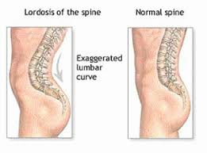
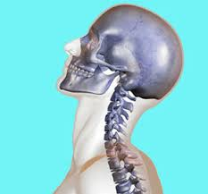
The lumbar and cervical lordoses increase to compensate for the shift in the center of gravity.

Slide 38
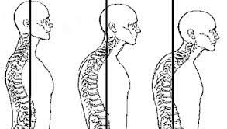
The shoulder girdle and upper back become rounded with scapular protraction and upper extremity internal rotation because of breast enlargement; this postural tendency persists in the postpartum period due to infant care demands.
Tightness of the pectoralis muscles and weakness of the scapular stabilizers may be preexisting to or induced by the pregnancy postural changes.

Slide 39
The suboccipital muscles respond in an effort to maintain in an appropriate eye level(optical righting reflex) and to moderate forward head posture along with the change in shoulder alignment.

Slide 40
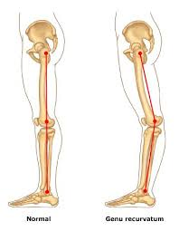
A tendency toward genu recurvatum will shift weight toward the heels in an attempt to counteract the anterior pull of the growing fetus.

Slide 41
Changes in posture do not automatically correct after childbirth, and the pregnant posture may become habitual. In addition, many child care activities contribute to persistent postural faults and asymmetry.

Slide 42
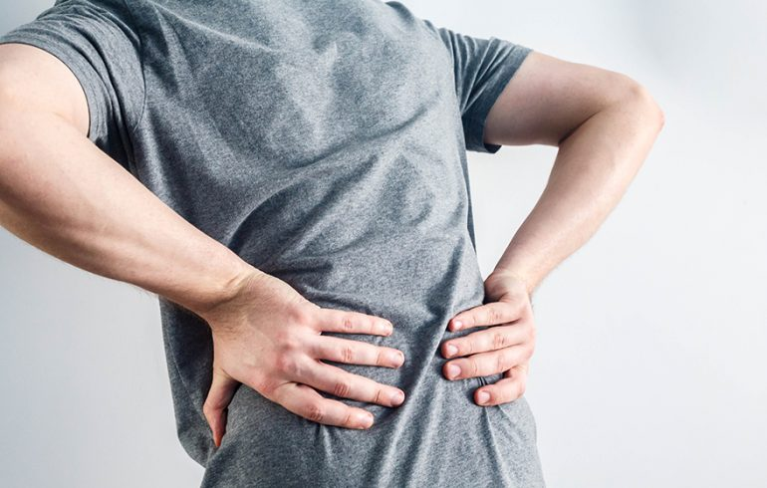
Balance (wider base of support & complaints of back ache)

Slide 43
Balance
With the increased weight and redistribution of body mass, there are compensations to maintain balance.
The pregnant woman usually walks with a wider base of support and increased external rotation at the hips.
This change in stance, along with growth of the baby, makes some activities such as walking, stooping, stair climbing, lifting, reaching, and other activities of daily living (ADLs) progressively more challenging.
Activities requiring ﬁne balance and rapid changes in direction, such as aerobic dancing and bicycle riding, may become inadvisable, especially during the third trimester.

