Slide 1
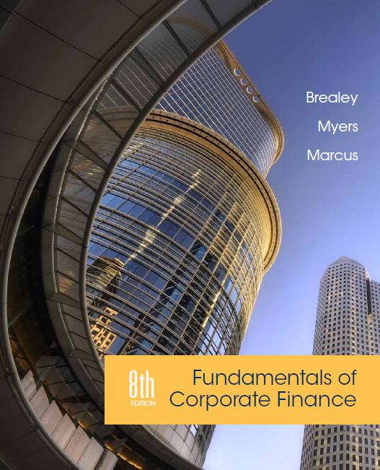
Chapter 15
How Corporations Raise Venture Capital and Issue Securities
Copyright © 2015 by The McGraw-Hill Companies, Inc. All rights reserved

Slide 2
Topics Covered
15.1 Venture Capital
15.2 The Initial Public Offering
15.3 General Cash Offers by Public Companies
15.4 The Private Placement
Notes:
2

Slide 3
Venture Capital
Young firms often require venture capital to finance growth
The issuance of securities is a complex process that the successful financier must comprehend
Venture capital provides entrepreneurs with financing to grow their firms
Firms issue securities to further finance their growth

Slide 4
Venture Capital
Steps to obtaining venture funding:
Prepare a business plan.
first-stage financing.
subsequent staged financing.

Slide 5
Venture Capital
Venture Capital
Money invested to finance a new firm
Since success of a new firm is highly dependent on the effort of the managers, restrictions are placed on management by the venture capital company and funds are usually dispersed in stages, after a certain level of success is achieved.
Notes:
4

Slide 6
Venture Capital
First Stage Market Value Balance Sheet ($ millions)
Assets |  | Liabilities and Equity
Cash from new equity | 0.5 | New equity from venture capital | 0.5
Other assets | 0.5 | Your original equity | 0.5
Value | 1.0 | Value | 1.0
Notes:
6

Slide 7
Venture Capital
Second Stage Market Value Balance Sheet ($ millions)
Assets |  | Liabilities and Equity
Cash from new equity | 1.0 | New equity from 2nd stage | 1.0
Other assets | 2.0 | Equity from 1st stage | 1.0
 |  | Your original equity | 1.0
Value | 3.0 | Value | 3.0
Notes:
6

Slide 8
Venture Capital
Sources of Venture Capital
Angel investors
Investors who finance companies in their earliest stages of growth
Corporate venturers
Corporations that offer venture assistance to finance young, promising companies
Private equity investing
Investors who offer funds to finance firms that do not trade on public stock exchanges such as the NYSE or NASDAQ
Notes:
4

Slide 9
Initial Public Offering
Initial Public Offering
When a firm requires more capital than private investors can provide, it can choose to go public through an initial public offering, or IPO
Primary Offering
When new shares are sold to raise additional cash for the company
Secondary Offering
When the company’s founders and venture capitalists cash in on some of their gains by selling shares
Does a secondary offering provide additional capital to the firm?
Notes:
Initial Public Offering (IPO) – First offering of stock to the general public.
Primary Offering – An offering when new shares are sold to raise additional cash for the company.
Secondary Offering – An offering when the company’s founders and venture capitalists cash in on some of their gains by selling shares.

Slide 10
Initial Public Offering
Initial Public Offering (IPO) - First offering of stock to the general public
Underwriter - Firm that buys an issue of securities from a company and resells it to the public
Spread - Difference between public offer price and price paid by underwriter
Prospectus - Formal summary that provides information on an issue of securities
Underpricing - Issuing securities at an offering price set below the true value of the security
Notes:
7

Slide 11
Initial Public Offering
Benefits of Going Public
Ability to raise new capital
Stock price provides performance measure
Information more widely available
Diversified sources of finance
Reduced borrowing costs

Slide 12
Arranging Public Issues
Steps to issue a new public security:
SEC Registration
Prospectus—a formal summary that provides information on an issue of securities
Select Underwriter / Undertake Roadshow
Set final issue price for public
Notes:
Companies must prepare a prospectus and register with the Securities and Exchange Commission before they can sell any new stock to the public.
Prospectus – Formal summary that provides information on an issue of securities.
The roadshow attempts to gauge the interest that potential investors would have in purchasing the new securities.
If enough public interest, the underwriters issue shares to the public. Typically underwriters underprice shares upon issue.
Underpricing – Issuing securities at an offering price set below the true value of the security.

Slide 13
IPO Flowchart
1
Underwriter
Firm
Investors
2
3
4
5
Underwriter provides advice to firm
Underwriter pays firm for a number of shares
Firm provides shares to underwriter to be resold
Underwriter offers shares to investors
Investors purchase shares from underwriter
Notes:
Underwriter – Firm that buys an issue of securities from a company and resells it to the public.
Underwriters serve three roles:
Provide firm with procedural and financial advice.
Buy the firm’s stock.
Resell the stock to the public.
Note: Underwriters do not simply help the company make its IPO; they are called in whenever a company wishes to raise cash by selling securities to the public.

Slide 14
Underwriter Spread
Spread - the difference between the public offer price and the price paid by underwriter
Example
Assume the issuing company incurs $1 million in expenses to sell 3 million shares at $40 each to an underwriter; the underwriter sells the shares at $43 each. What is the spread for this deal?
$$3 million×\left(\$43−\$40\right)=\$9 million$$
Notes:
Spread – Difference between public offer price and price paid by underwriter.

Slide 15
Underwriting Arrangements
Firm Commitment - Underwriters buy the securities from the firm and then resell them to the public
Best Efforts Commitment - Underwriters agree to sell as much of the issue as possible but do not guarantee the sale of the entire issue
Flotation Costs - The costs incurred when a firm issues new securities to the public
What are some of the specific costs incurred when a firm issues new securities?
Notes:
Firm commitment – Underwriters buy the securities from the firm and then resell them to the public. Underwriter pays for any shares they cannot resell to the public.
Best efforts basis commitment – Underwriter agrees to sell as much of the issue as possible but does not guarantee the sale of the entire issue.

Slide 16
Underwriting Arrangements
Example
How much will a firm receive in net funding from a firm commitment underwriting of 250,000 shares priced to the public at $40 if a 10% underwriting spread has been added to the price paid by the underwriter? Additionally, the firm pays $600,000 in legal fees.
Cost to public = $40
Net to issuer = $40/1.10 = $36.36
Therefore, the spread was $3.64 per share
Net to issuer = 250,000 × $36.36 = | $9,090,000
Less legal fees | 600,000
 | $8,490,000

Slide 17
Underpricing of an IPO
Underpricing: Issuing securities at an offering price set below the true value of the security
Example – (continued)
Assume the issuer incurs $1 million in other expenses to sell 3 million shares at $40 each to an underwriter and the underwriter sells the shares at $43 each. By the end of the first day’s trading, the issuing company’s stock price had risen to $70. What is the total cost of underpricing?
Cost of underpricing:
3 million($70 - $43) = $81 million
Notes:
Underpricing — Issuing securities at an offering price set below the true value of the security.

Slide 18
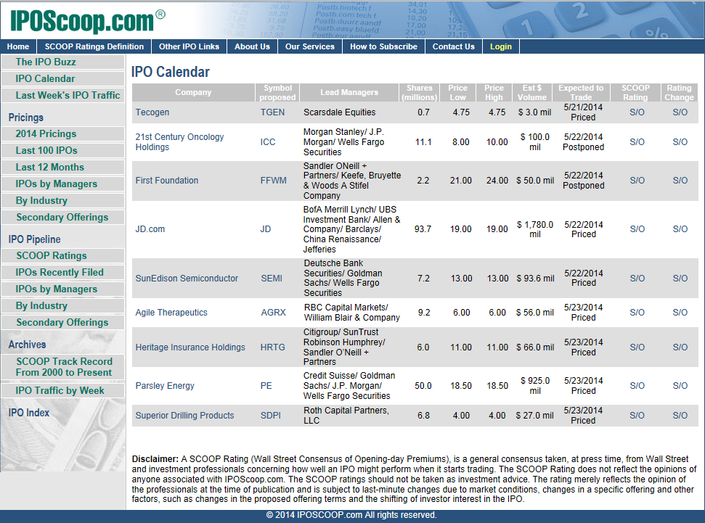
Initial Public Offering
www.IPOScoop.com

Slide 19
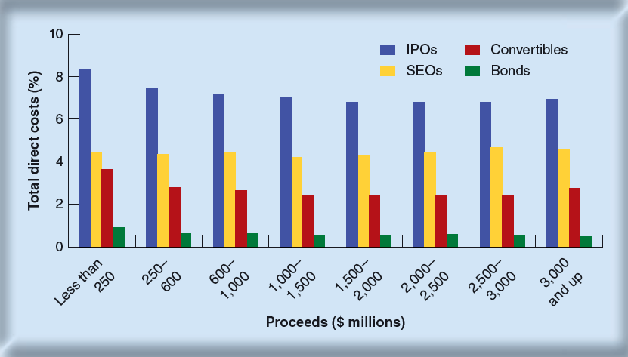
Initial Public Offering
Expenses
Notes:
8

Slide 20
The Underwriters
 | Value of Issues ($ billions) | Number of Issues
JP Morgan Chase | $389 | 1,464
Deutsche Bank | 375 | 1,499
Barclay’s Capital | 369 | 1,171
Bank of America Merrill Lynch | 327 | 1,304
Citi | 309 | 1,138
Morgan Stanley | 277 | 1,186
Goldman Sachs | 270 | 815
Credit Suisse | 235 | 980
UBS | 225 | 1,008
BNP Paribas | 214 | 803
Top Underwriters in 2011
Notes:
9

Slide 21
General Cash Offers
Seasoned Offering - Sale of securities by a firm that is already publicly traded
General Cash Offer - Sale of securities open to all investors by an already public company
Shelf Registration - A procedure that allows firms to file one registration statement for several issues of the same security
Private Placement - Sale of securities to a limited number of investors without a public offering
Notes:
11

Slide 22
Rights Issue
Rights Issue - Issue of securities offered only to current stockholders
Example
Barclays Bank currently has 12.68 billion shares outstanding. The market price is £2.85/sh. Barclays decides to raise additional funds via a 1 for 4 rights offer at £1.85/sh. If we assume 100% subscription, what is the value of each right?
Notes:
13

Slide 23
Rights Issue
Example
Barclays Bank currently has 12.68 billion shares outstanding. The market price is £2.85/sh. Barclays decides to raise additional funds via a 1 for 4 rights offer at £1.85/sh. If we assume 100% subscription, what is the value of each right?
Current market value = 12.68 bil × £2.85/sh = £36.14 bil
Total shares = 12.68 bil + 3.17 bil = 15.85 bil
Amount of new funds = 3.17 bil × £1.85/sh = £5.86 bil
New share price = (36.14 + 5.86)/15.85 = £2.65/sh
Notes:
14

Slide 24
Rights Issue
Example
Barclays Bank currently has 12.68 billion shares outstanding. The market price is £2.85/sh. Barclays decides to raise additional funds via a 1 for 4 rights offer at £1.85/sh. If we assume 100% subscription, what is the value of each right?
$$Value of a right=\frac{preprice−issue price}{\frac{held shares}{new shares}+1}$$
$$Value of a right=\frac{2.85−1.85}{\frac{4}{1}+1}=0.20$$
Notes:
14

