Slide 1
Conservation of Biodiversity
Genetic resources and conservation
BS Biotechnology (6th Semester)
University of Sargodha

Slide 2
Biodiversity
The term biodiversity was coined by E.O. Wilson in 1985.
Biodiversity is the occurrence of different types of ecosystems, different species of organisms with the whole range of their variants and genes adapted to different climates, environments along with their interactions and processes.

Slide 3
Distribution of biodiversity
Biodiversity is not uniform throughout the world but shows uneven distribution.
Biodiversity is affected by two factors
1. Latitudinal Gradient
2. Species- area relationship
The large tropical Amazonian rain forest in South America has the greatest biodiversity on earth

Slide 4
Latitudinal Gradient
In general, species diversity decreases as we move away from the equator (tropics) towards the poles
Why tropics have more diversity?
Temperate regions have undergone frequent glaciations in the past. It killed most the species.
Tropical environments are less seasonal which promote niche specialization (the process by which a species becomes better adapted, by natural selection, to the specific characteristics of a particular habitat) and lead to a greater species diversity
More solar energy is available in the tropics which contributes to higher productivity and in turn might contribute

Slide 5
Specie-area relationship
Alexander von Humboldt was a German naturalist and explorer.
He observed that within a region species richness increased with increasing explored area, but only up to a limit.

Slide 6
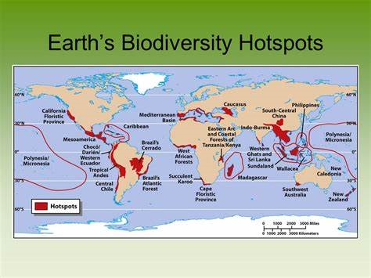
Hotspots of biodiversity
Biodiversity hotspot are those places on Earth that are
Biologically rich
Highly threatened
Norman had identified 10 such places.
Now there are approximately 34 hotspots
of biodiversity

Slide 7
Criteria for biodiversity hotspot
The region must contain 1500 species of vascular plants as endemics
The region must 70% of natural habitat/ natural vegetation

Slide 8
Importance of biodiversity
In 2018, Julie Shaw mentioned in article that >1 million species are at risk of extinction.

Slide 9
1-Biodiversity maintain healthy ecosystem
We depend on ecosystem for
Materials like food, fiber and fuels
Regulation of climate, waste cycle
Supporting processes such as water purification and nutrient cycle
Opportunities of Enjoyment of beautiful outdoor
Ecosystems weakened by the loss of biodiversity are less likely to deliver those services, especially given the ever-growing human population

Slide 10
2-Biodiversity as a solution to climate change
Nature can provide more than 30 % of the solution to climate change by holding global warming below 2 degrees Celsius
The destruction of forest ecosystems is responsible for 11 percent of all global greenhouse gas emissions caused by humans
Mangroves ecosystems are good at storing carbon and keeping it out of the atmosphere
Forests and wetland ecosystems provide crucial buffers to extreme storms and flooding related to climate change
Amazon rainforest is known as “lungs of the world” because It provides about 20% of the world’s supply of oxygen and absorbs large amounts of carbon dioxide.

Slide 11
3-Biodiversity is good for the economy
At least 40 percent of the world’s economy and 80 percent of the needs of the poor are derived from biological resources.
Millions of people also depend on nature and species for their day-to-day livelihoods. This is particularly true for struggling communities in developing countries
Nature-related tourism is also a significant income generator for many people as well

Slide 12
4-Biodiversity is an integral part of culture and identity
Species are frequently integral to religious, cultural and national identities
231 species are formally used as national symbols in 142 countries
Ecosystems such as parks and other
protected areas also provide recreation
and a knowledge resource for visitors
Biodiversity is a frequent source of
inspiration for artists and designers.

Slide 13
Threats to biodiversity
A threat by definition refers to any process or event whether natural or human induced that is likely to cause adverse effects upon the status or sustainable use of any component of biological diversity
Biodiversity is declining rapidly due to factors such as
habitat alteration and destruction by the land use change, over exploitation of biological resources
climate change
Pollution
invasive species.

Slide 14
Habitat alteration and destruction
Habitat destruction renders entire habitats functionally unable to support the species present in the habitat
Biodiversity reduced in this process when existing organisms in the habitat are displaced or destroyed
Natural habitats are often destroyed through human activity for the purpose of harvesting natural resources for industry production and urbanization.
A five-year estimate of global forest cover loss for the years 2000–2005 was 3.1 %.
In the humid tropics 2.4% of the forest is lost due to timber extraction
In the tropics, these losses also represent the extinction of species because of high levels of endemism.

Slide 15
Habitat alteration and destruction
Some other reasons of loss in biodiversity are
Loss to genetic diversity
species reduction and increased ecosystem changes
random population changes
disease outcrop
habitat fragmentation

Slide 16
Habitat fragmentation
Habitat fragmentation describes the emergence of fragmentation in an organism's preferred habitat causing population fragmentation and ecosystem decay
OR
Habitat fragmentation is a process by which large and contiguous habitats get divided into smaller, isolated patches of habitats

Slide 17
Causes of Habitat fragmentation
Natural causes
Fire
Volcano
Climate change
Human causes
Agriculture
Urbanization
Roads development
Endogenous processes
Endogenous is a process that develops as a part of species biology so they typically include changes in biology, behavior, and interactions within or between species. Endogenous threats can result in changes to breeding patterns or migration patterns
Exogenous processes
Habitat subdivision or isolation can lead to changes in dispersal or movement of species including changes to seasonal migration. These changes can lead to a decrease in a density of species, increased competition or even increased predation

Slide 18
Over-exploitation of biological resources
It results when individuals of a particular species are taken at a higher rate than can be sustained by the natural reproductive capacity of the population being harvested.
Main reasons of Over-exploitation of biological resources
Hunting
Fishing
Trade
food gathering

Slide 19
Pollution
inorganic and organic pollutants
Thermal pollution
Species in habitats are increasingly being harmed by industrial activities and pollution from excessive use of agrochemicals/pesticides
The dramatic decreases in house sparrow population in India is experienced in recent past. It is linked with pollution caused by electromagnetic radiation from mobile phones.

Slide 20
Species invasions
Introduced species are organisms arising in areas/ habitats in which they were previously not native. Such introduced species are usually referred to as biological pollutants
Some of the ecological impacts of the invasion include hybridization, out competition, disruption of original ecosystem, plant pathogenic influences, disease transmission, disruption of foodwebs, and to some situations extinction.
Species may be introduced intentionally for ornamental concerns, agriculture, hunting and spotting activities etc.

Slide 21
Climatic changes
This is of great concern especially when global CO2 increases in the atmosphere resulting to global warming
Recent changes in climate, such as warmer temperatures in certain regions, have already had significant impacts on biodiversity and ecosystem
It is estimated that changes in climate by 2050 could lead to the extinction of many species living in certain limited geographical regions.
It is also estimated that the end of this century, climate change and its impacts may become the main direct driver of overall biodiversity loss

Slide 22
Conservation
What is conservation?
prevention of wasteful use of a resource
preservation, protection, restoration and sustainable use of the natural environment and genetic resources
Conservation goals include protecting species from extinction, maintaining and restoring habitats, enhancing ecosystem services and protecting biological diversity.
Notes:
Preservation is an aspect of conservation meaning to keep something without altering or changing it.
Sustainable development is another intricate aspect of biodiversity conservation. This refers to development that meets the needs of the current generation without compromising the ability of future generations to meet their needs

Slide 23
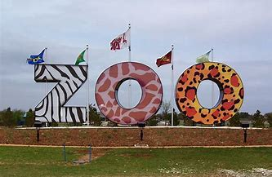
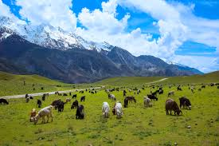
Methods of conservation
1-Ex-Situ conservation
It refers to conservation of components of biodiversity outside their natural habitat
2-In-Situ conservation
It refers to conservation of ecosystems and natural habitats including maintenance and recovery of viable populations of species in their natural habitats

Slide 24
Ex-Situ conservation
Zoo
Gene bank
Seed bank
Botanical gardens

Slide 25
Zoo
Over 7,000 vertebrate species are kept in zoos worldwide
Zoos are relatively good places for maintaining species in captivity and for captive breeding programs
Captive breeding is the breeding of wild animals in places such as zoos, especially animals which have become rare in the wild
Many techniques are used in captive breeding which are often species-specific.

Slide 26
Zoo
Bahawalpur Zoo
Lahore Zoo
Clifton Fish Aquarium
Hyderabad Zoo
Islamabad Zoo

Slide 27
Botanical gardens
A botanical garden or botanic garden is a garden dedicated to the collection, cultivation, preservation and display of a wide range of plants labelled with their botanical names
Worldwide about 80,000 plant species are grown in botanical gardens

Slide 28
Botanical gardens in Pakistan
Pakistan Botanic Gardens Network Secretariat was established in 2006 at Botanic Garden, GC University, Lahore. The Secretariat provides a forum for the mutual linkages among the existing Botanic Gardens and also encourages the establishment of new Botanic Gardens
Forman Christian College Botanic Garden, Lahore
Bagh-e-Jinnah, Lahore
Karachi University Botanic Garden, Karachi, Karachi
Pakistan Forest Institute Botanical Garden, Peshawar
National Herbarium, Islamabad

Slide 29
Gene bank
Gene banks are a type of biorepository which preserve genetic material. For plants, this is done by in vitro storage, freezing cuttings from the plant, or stocking the seeds (e.g. in a seedbank).
For animals, this is done by the freezing of sperms, eggs or animal cells until further need.

Slide 30
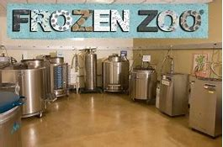
Cryopreservation
Cryo-preservation or cryo-conservation is a process where organelles, cells, tissues, extracellular matrix, organs or any other biological constructs susceptible to damage caused by unregulated chemical kinetics are preserved by cooling to very low temperatures in deep freezers (-80°C) in vapour phase nitrogen (-150°C) or in liquid nitrogen (-196°C)
Generally cryopreservation is done at -196 degree celcius in liquid nitrogen, in the presence of cryoprotectants [dimethyl sulfoxide (DMSO) is more commonly used]
Trehalose (also used as cryoprotectants) stabilizes cell membranes, and it is particularly useful for the preservation of sperm, stem cells, and blood cells.

Slide 31
Seed bank
Places where the seeds (and sometimes also pollen, tissue cultures, etc.) can be stored over the long term
In seed banks, the seeds are kept in cold, dark conditions, which slows down metabolism and prevents the seeds from germinating
For a long time seed banks have existed, but primarily as a repository for storing seeds of commercially important species.
Now seed banks are also maintained for endangered species

Slide 32
How to store seeds in Seed bank
Dry the seeds completely before packaging them.
The drier seeds are, the longer they will store
Storing seeds that are less than 8% moisture provides the optimum long term seed storage

Slide 33
The Millennium Seed Bank Project (MSBP) is located at the Royal Botanical Gardens, Kew, United Kingdom. Its goal is to eventually store and protect more than 24,000 global species of plants. It currently stores samples of the country's entire native plant population, including several hundred endangered species
The Vavilov Institute of Plant Industry was established in 1894 in St. Petersburg, Russia, and is the oldest seed bank in the world
International Rice Research Institute (Los Banos, Philippines): It maintains seed bank of Rice.

Slide 34
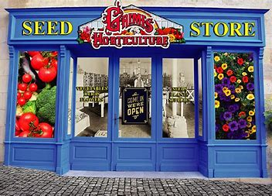
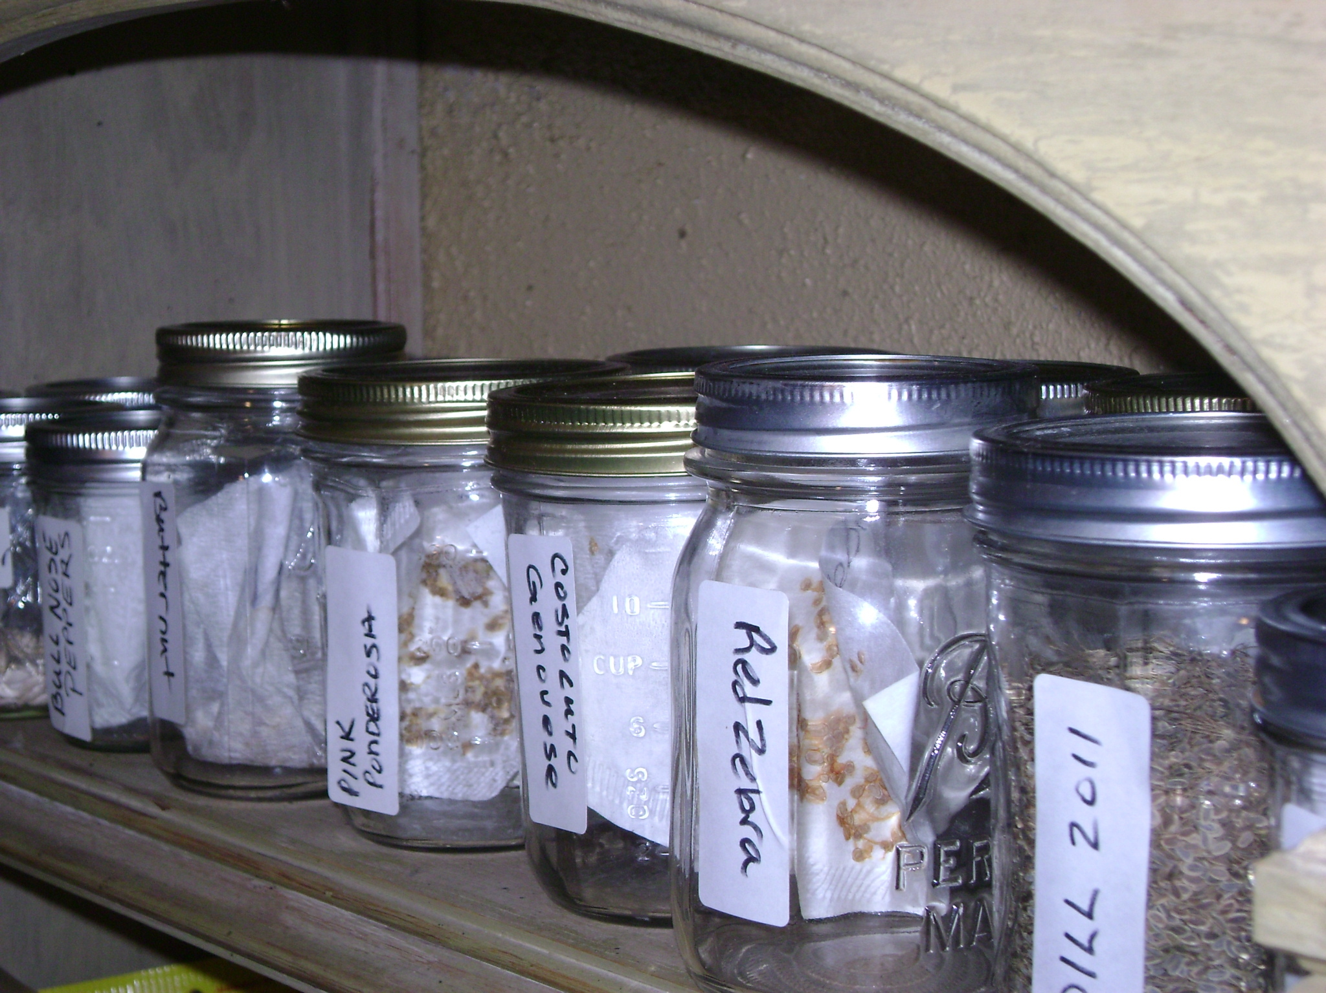
Benefits of seed bank
Protection from Climate Change
Protection from Natural Disasters
Prevention from disease
Provide seed material for research.

Slide 35
Disadvantages of seed bank
On the other hand, seeds do not last forever and so, periodically, seeds
have to be germinated to form plants that can produce new seeds
Seed banks are also vulnerable to breaks in the power supply that keep
the refrigerators running
Another disadvantage is that there are some seeds that simply do not produce
plants that can be stored in this way
Just as with zoos, seed banks will not work as a repository for all species

Slide 36
In-Situ conservation
National parks
Wildlife Sanctuaries
Biosphere reserve
Sacred groves

Slide 37
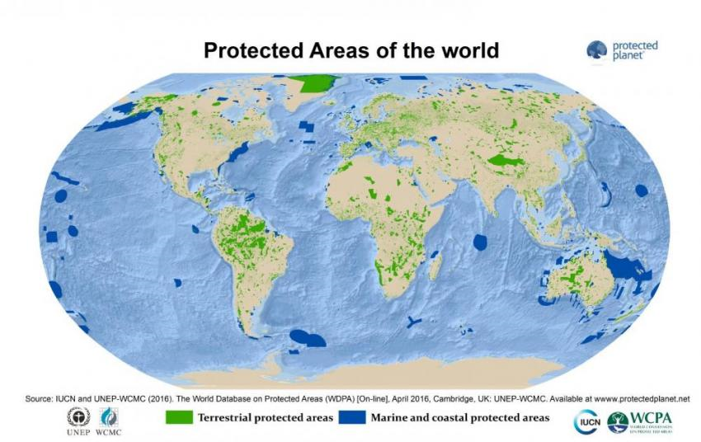
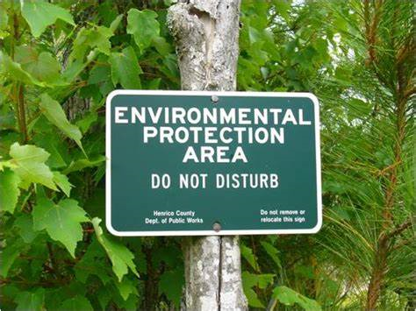
Protected areas
The IUCN definition of a protected area is “A clearly defined geographical space, recognised, dedicated and managed, through legal or other effective means, to achieve the long-term conservation of nature with associated ecosystem services and cultural values”.
According to the World Database on Protected Areas (WDPA) there are over 210,000 protected areas around the world.

Slide 38
Categories of protected area

Slide 39
National Park
A national park is an area dedicated for the conservation of wildlife along with its environment. It has clearly marked boundaries and human activities are strictly prohibited
In Pakistan a National Park is an area of outstanding scenic merit and natural beauty where the landscape, flora and fauna are protected and preserved in a natural state.
Hunting of wild animals or interfering with animals and plants is prohibited
Clearing land for cultivation, mining or allowing polluted water to flow in National Parks is also prohibited.

Slide 40
National Park
It protects the entire ecosystem of the land plants, animals, landscapes, historic objects etc.
It is a highly restricted area, human activities are not allowed.
It is an IUCN category II protected area.

Slide 41
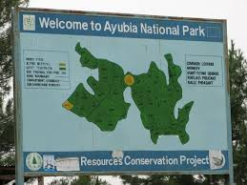
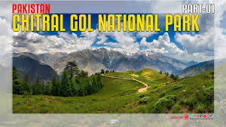
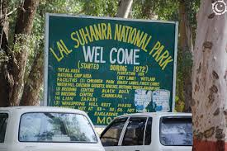
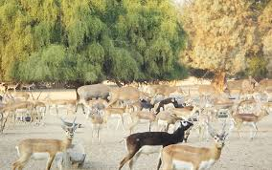
National Park
Some of the major National parks of Pakistan
Hingol National Park
Hazarganji Chiltan National Park
Kirthar National Park
Lal Suhanra National Park
Margalla Hills National Park
Ayubia National Park
Deosai National Park
Chitral Gol National Park
Khunjerab National Park

Slide 42
Wildlife Sanctuary
It is also known as wildlife refuge or Nature reserve.
It is a natural protected habitat which provides protection and favourable living conditions to wildlife including the rare or endangered species of plants, animals, insects etc.
It mainly provides protection to birds, animals, insects, reptiles and other organisms.
It is not a highly restricted area, limited human activities are allowed.
It does not have visible or marked boundaries.
It is an IUCN category IV protected area.

Slide 43
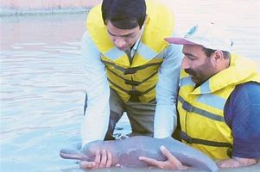
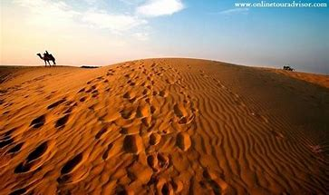
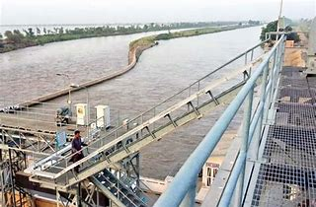
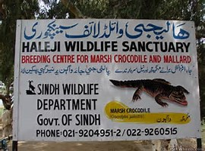
Few wildlife sanctuaries in Pakistan
Cholistan Wildlife Sanctuary
Chashma and Taunsa Barrage Dolphin Sanctuary
Islamabad Wildlife Sanctuary
Haleji Wildlife Sanctuary

Slide 44
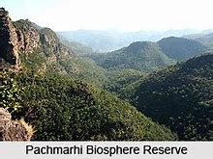
Biosphere reserve
Notified areas which cover a larger area of land
Areas are meant for conservation of biodiversity of a specific area.
It mainly focus the whole biotic community of an ecosystem.
Boundaries are marked
Tourism is generally not permitted
Lal Suhanra Biosphere Reserve and
Ziarat Juniper Forest are the only
two biosphere reserve in Pakistan

Slide 45
Sacred groves
Sacred groves are forest fragments, size varying between 0.5 -500 hectare,(some groves are more than 500 hectare in size) which are protected by religious communities, and have a significant religious connotation for the protecting community.
Sacred groves are mostly associated with temples/ shrines or with cremation grounds
Sacred Groves are also culturally important; various cultural and religious festivals are often arranged by local people within these patches.
Sacred groves contain various ecosystems, various food chains and food webs are present in Sacred Groves.
Notes:
Cremation is a method of final disposition of a dead body through burning.

Slide 46
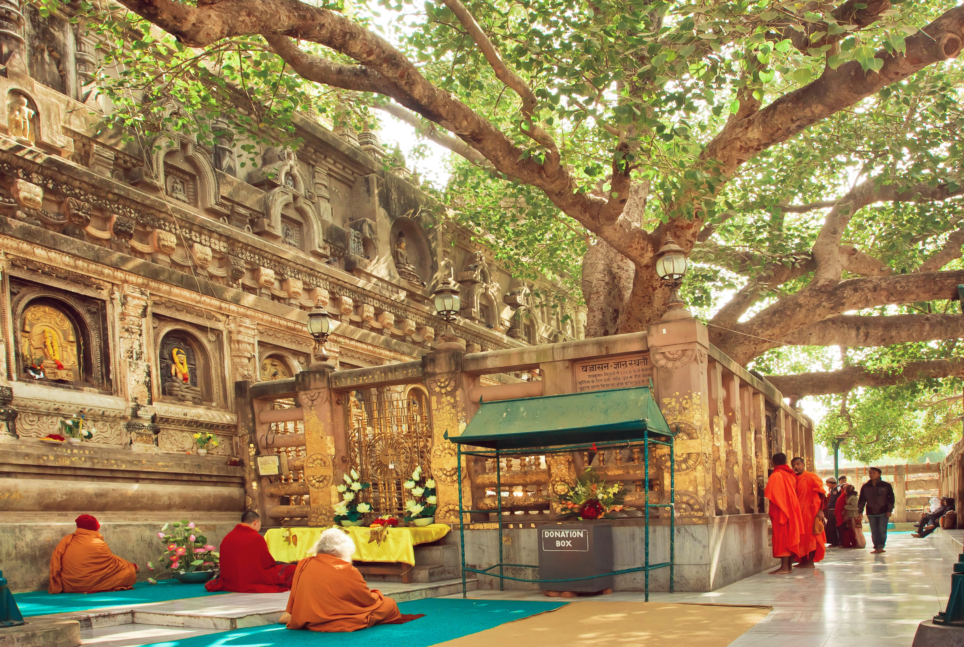
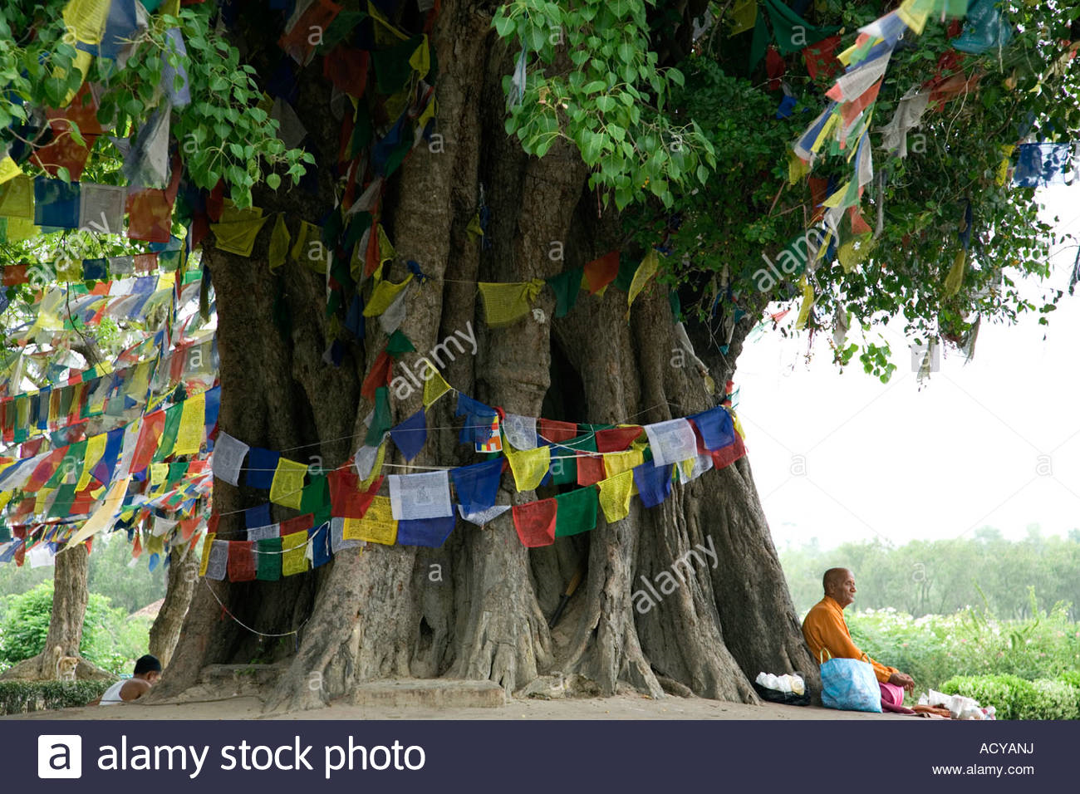
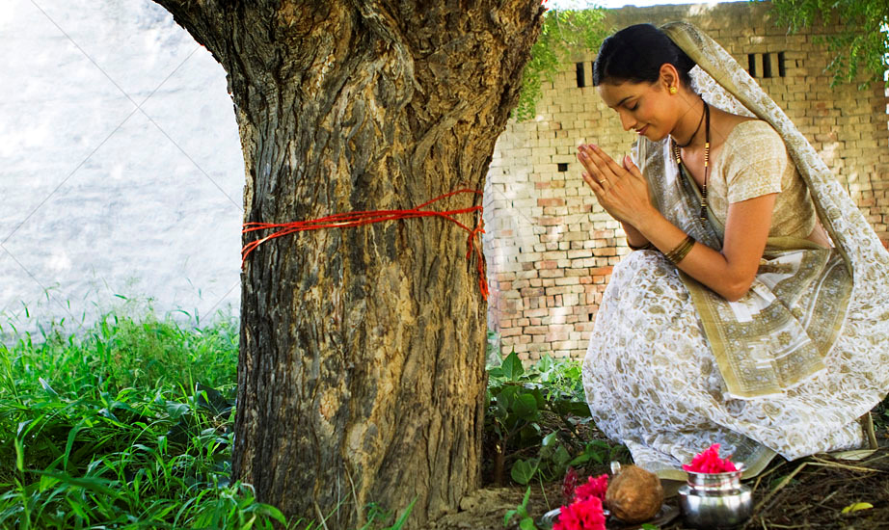
Sacred groves
Around 15000 sacred groves have been reported from different parts of India

