Slide 1
Environmental Management System (ISO 14000 series):
ISO 14001 is the international standard that specifies requirements for an effective environmental management system (EMS).
It provides a framework that an organization can follow.
An Environmental Management System (EMS) is a set of processes and practices that enable an organization to reduce its environmental impacts and increase its operating efficiency.
The current version of ISO 14001 is ISO 14001:2015, which was published in September 2015

Slide 2
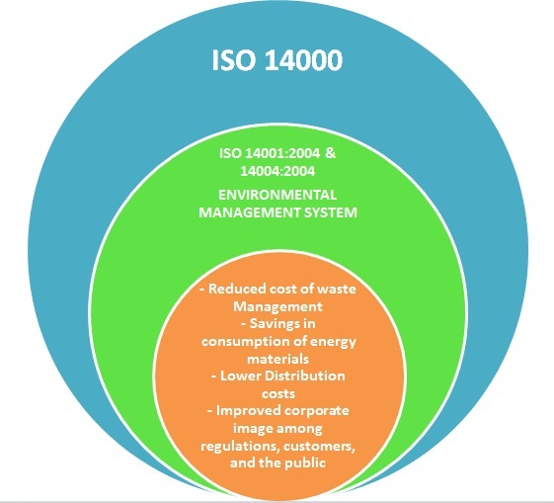

Slide 5
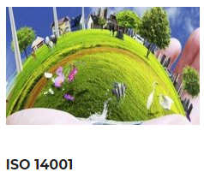
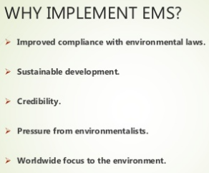

Slide 6
ISO 14000 series of standards
ISO 14000 series of standards provides
specifications and guidelines for various
environmental management disciplines, including
Environmental management system (EMS),
Environmental performance,
Environmental auditing,
Environmental labeling and life cycle assessments.
The most popular of the ISO 14000 series of standards is ISO 14001: Environmental Management Systems - Specification with Guidance for Use.

Slide 7
ISO 14000EMS- General Guidelines on Principles, Systems and Supporting Techniques
ISO 14001EMS- Specification with Guidance for Use
ISO 14004EMS - General Guidelines on Systems, Principles and Supporting Techniques
ISO 14010EA- General Principles of Environmental Auditing
ISO 14011EA- Auditing of Environmental Management Systems
ISO 14012EA- Qualification Criteria for Environmental Auditors
ISO 14013Management of Environmental Audit Programs
ISO 14014Initial Reviews etc

Slide 8
Introduction to ISO 14000
There is now a considerable amount of public concern about the health of the environment in almost all developed countries of the world.
As a consequence, the adoption by companies of procedures (SOP) that minimize damage to the environment is becoming an important part in their success, and is almost as important as the quality of the goods and services that they provide.

Slide 9
Introduction to ISO 14000
ISO has developed standards that help organizations to take a practical approach to managing environmental issues (Air Pollution, water Pollution and Waste etc)
The ISO 14000 family of environmental management standards which can be implemented in any type of organization in either public or private .
An EMS encourages an organization to continuously improve its environmental performance.

Slide 12
Significance of EMS ISO 14000
Environmental management ISO 14001 standards is similar importance to quality management to ISO 9001 standards in today’s businesses.
Apart from the need to satisfy the strict environmental control legislation that exists in most developed countries, the image of a company is damaged if pollution incidents occur, particularly if these are identified by environmental pressure groups, and this can have a severe impact on the marketability of products and services provided by the company

Slide 13
Significance of EMS ISO 14000
ISO 14000’ is a global term for a set of standards that have been written in response to this need for environmental protection systems, in the same way that ISO 9000 standards were written to satisfy the need for quality assurance systems to control the goods produced and services supplied by companies.
Are you trying to improve your environmental performance (e.g., compliance with regulations or prevent pollution)

Slide 14
ISO 14000 framework
ISO 14000 is a series of environmental management standards developed and published by the International Organization for Standardization ( ISO ) for organizations.
The ISO 14000 standards provide a guideline or framework for organizations that need to systematize and improve their environmental management efforts.

Slide 15
ISO 14000 framework
The ISO 14001 standard is the most important standard within the ISO 14000 series.
ISO 14001 specifies the requirements of an environmental management system (EMS) for small to large organizations.
An EMS is a systemic approach to handling environmental issues within an organization.
The ISO 14001 standard is based on the Plan-Check-Do-Review-Improve cycle.

Slide 16
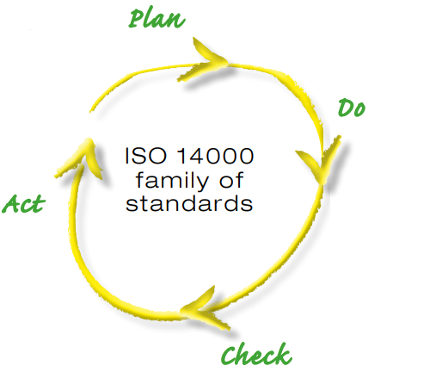

Slide 17
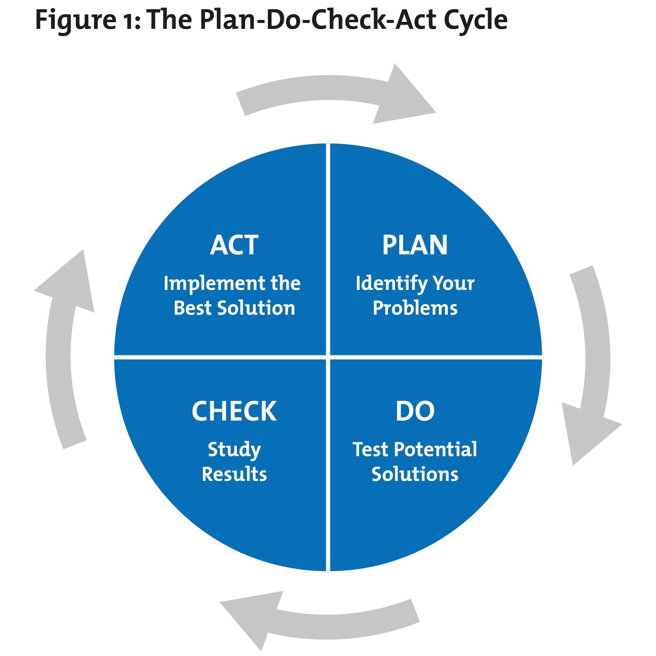

Slide 18
The Plan cycle deals with the beginning stages of an organization becoming ISO 14001 meeting the requirements (identify the problem).
The Do cycle is the implementation and operation of the ISO 14001 standard within an organization (Test Solutions)
The Check cycle deals with checking and correcting errors (Study the results).
The Act cycle is implementation the best solution by the organization.
And the Improve cycle is a cycle that never ends as an organization continually finds ways to improve their EMS.

Slide 19
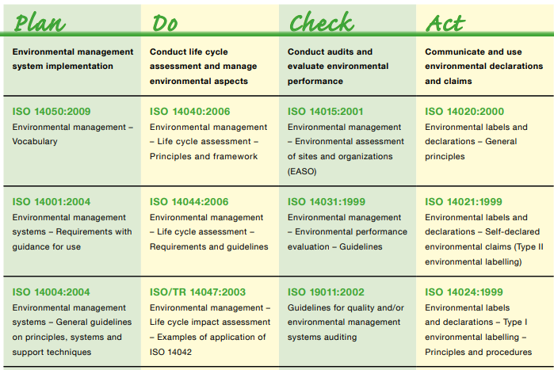

Slide 20
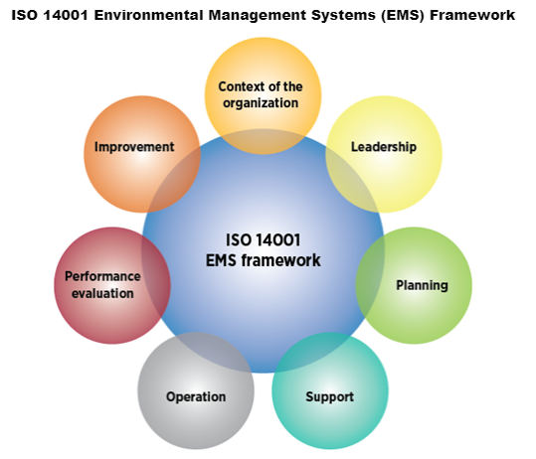

Slide 21
5 main stages of ISO 14001 / EMS under ISO 14001
The most commonly used framework for an EMS is the one developed by the ISO for ISO 1400.
The framework is the official international standard for an EMS which is based on the Plan-Do-Check-Act methodology. The five main stages of an EMS, as defined by the ISO 14001 standard, are described below:

Slide 22
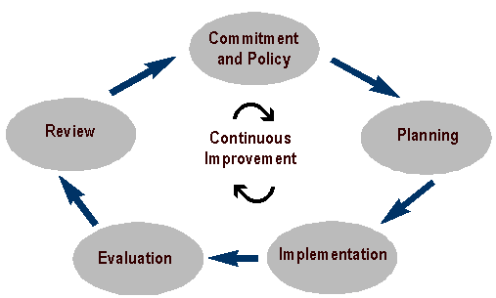
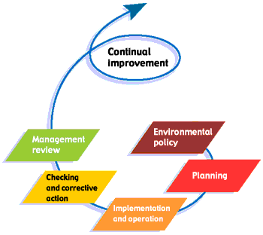
EMS under ISO 14001

Slide 23
1. Commitment and Policy ( Environmental Policy)
Top management commits to environmental improvement and establishes the organization's environmental policy (i.e environmental SOP ).
The policy is the foundation of the Environmental Management System.

Slide 24
2. Planning
An organization first identifies environmental aspects of its operations.
Environmental aspects / portion are those items, such as air pollutants or hazardous waste, that can have negative impacts on people and/or the environment.
An organization then determines which aspects are significant by choosing criteria considered most important by the organization.
For example, an organization may choose worker health and safety, environmental compliance, and cost as its criteria.
The final part of the planning stage is develop an action plan for meeting the targets. This includes designating responsibilities, establishing a schedule, and outlining clearly defined steps to meet the targets.

Slide 25
3. Implementation
A organization follows through with the action plan using the necessary resources (human, financial, etc.).
An important component is employee training and awareness for all employees.
Other steps in the implementation stage include documentation, following standard operating procedures (SOP) , and setting up internal and external communication lines.

Slide 26
4. Evaluation & 5. Review
A company monitors / check its operations to evaluate / assess whether targets are being met.
If not, the company takes corrective action.
Top management reviews the results of the evaluation to see if the EMS is working.
Management determines whether the original environmental policy is consistent with the organization's values.
The plan is then revised to optimize the effectiveness of the EMS.
The review stage creates a loop of continuous improvement for a company.

Slide 27
Benefits / Advantages of ISO 14001:2015 Certification
Process improvement
Environmental cost reduction
Better relationships with regulators
Better relationships with insurers, investors, and financial markets
Product improvement
Marketing advantages
Better control of liabilities
Reduced regulatory burden
Protection of company image and name
Demonstration of responsible management.

Slide 28
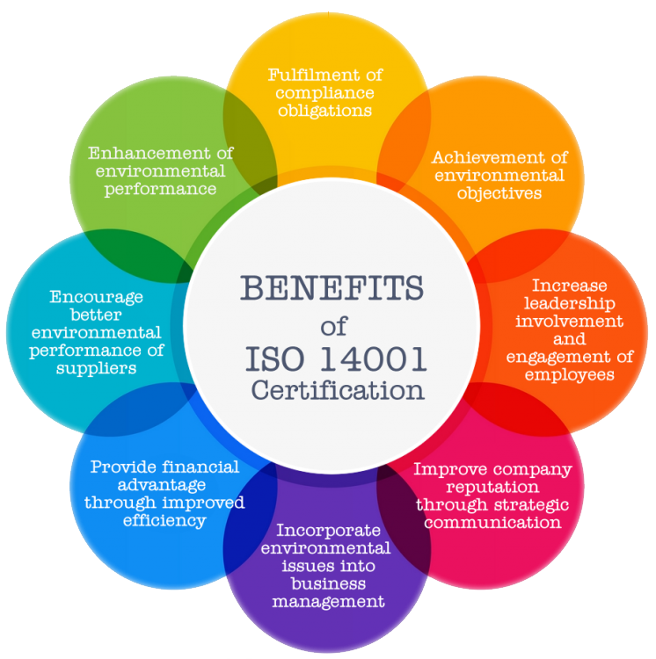

Slide 29
Requirements of ISO 14001
The fundamental requirements of the EMS implemented are that it should: – Identify and assess the environmental impact of all of a company’s operations, and repeat this on a regular basis. –
Consider all of the company’s operations and activities that are identified as having a potential or actual environmental impact, and set environmental protection targets that are appropriate to the scale and impact of the operations, but within the restriction of what is technically possible and economically affordable.
Irrespective of cost, ensure that the company at least complies with all relevant environmental legislation (Law) that its operations may be subject to in respect of their environmental impact.

Slide 30
Requirements of ISO 14001
Be continually reviewed and improved wherever possible. Have all aspects of the policy written down in documentation that is available to the public
Everyone in a company must be fully committed to the EMS being operated.
Appropriate communication paths must be established to ensure that the EMS operates efficiently.
Responsibility for the implementation, operation and review of the EMS must be assigned to one designated person.
The key characteristics of all operations that can have a significant effect on the environment must be regularly monitored and measured, and results must be documented.
All instruments and equipment used to measure performance of the EMS must be used properly and calibrated regularly.

Slide 31
Requirements of ISO 14001
Abnormal situations that might cause environmental damage must be documented with corrective measures.
The training needs of anyone in the company whose activities may impact on the environment must be identified and appropriate training provided.
Regular audits must be carried out to ensure that the EMS is operating satisfactorily and meeting its target of protecting the environment in the way that is expected of it.
The fundamental responsibility for implementation and successful operation of the EMS lies with the executive management of the company implementing it.
The executive management must ensure that enough resources are provided to support the EMS. These resources must include employees with the necessary skills as well as the financial resources necessary to buy whatever equipment is needed.

Slide 32
Design and Implementation of ISO 14001 Environmental Management Systems (EMS)
The ISO 14001 standard prescribes / set down a number of procedures, which, if applied correctly, successfully achieve these environmental protection goals.
The EMS designed must be implemented such that the environmental targets set are met.

Slide 33
Design and Implementation of ISO 14001 Environmental Management Systems (EMS)
The key components in implementing an EMS that satisfies ISO 14001 (see Figure on next slide) are: commitment of company executives, cooperation of all company personnel, effective management, establishment of effective communication systems, appropriate training, design and implementation of supporting equipment, planning of emergency procedures, collection of data to monitor performance, regular system reviews and maintaining full documentation of the system.

Slide 34
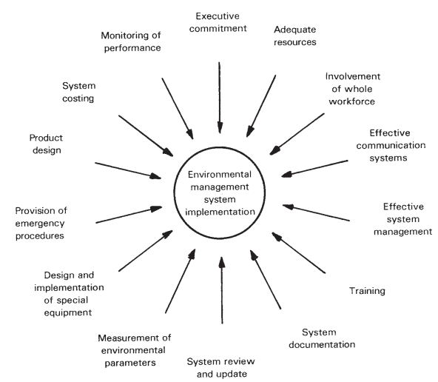

Slide 35
General requirements in implementing an ISO 14001-approved EMS
The general, non-engineering requirements specified by ISO 14001 to ensure that the EMS is implemented and maintained in an efficient and effective manner, include: executive commitment, total involvement of all company employees, effective communication systems, managerial responsibility, adequate training, system documentation, and system review and update.

Slide 36
Executive commitment
Full commitment by the executive management of a company is an essential requirement for successful implementation and operation of an EMS.
They must fully support it by providing all financial resources necessary, and they must be the driving force behind the EMS.
This commitment of the company executives to the EMS must also be highly visible, because any apparent lack of commitment on their part will spread like a disease through the rest of the company.

Slide 37
Total involvement
ISO 14001 requires that the responsibility for successfully operating the company’s EMS should be shared by everyone in the company.
Everyone has a contribution to make, even if it is just turning taps off to avoid wasting water and turning lights off to reduce energy consumption when they are not needed.
Executive management are ultimately responsible for ensuring that this motivation towards environmental protection is generated in their employees.

Slide 38
Communication
On top of this communication upward and downward in a company, sideways communication between different departments is also essential.
It is not sufficient for each department to operate its own environmental protection scheme; the EMS must operate as a consistent / organized whole across the whole company.
This can only be achieved by complete cooperation and constant conversation between the different parts of a company

Slide 39
Management of EMS
The responsibility for implementation, operation and review of an EMS must be assigned to one designated person.
This person may subcontract responsibility for particular aspects of environmental policy in certain areas to other designated staff, but a clear chain of persons with designated responsibility must exist, and the one named person with overall responsibility must be at the head of the chain.
The existence of one named person in-charge of the EMS is crucial.
It is entirely insufficient to just assign responsibility to a department or group of people in an organization, as this leads to people blaming each other when things go wrong

Slide 40
Training
To satisfy ISO 14001, the documentation provided with the EMS must specify the training needs of everyone in the company whose activities may impact on the environment.
The amount of training necessary will depend on the extent to which a person’s activities can affect the environment.
Clearly, workers who are involved in designing, implementing, operating or maintaining an EMS will require in-depth training about particular feature of the EMS, whereas other people will require much less training

Slide 41
Necessary procedures for an effective training plan.

Slide 42
Documentation
Full documentation of all aspects of an EMS is essential.
This should take the form of a manual, which can be in either electronic or paper form, in which every EMS procedure is carefully set out and the whole philosophy and purpose of the system is described.
The environment targets and their justification in terms of balancing the cost/benefit equation.

Slide 43
EMS costs over benefits

Slide 44
Documentation
Documentation should identify clearly the organizational structure and mode of operation of the EMS, including a description of the associated training procedures.
Assignment of responsibility for each elemental part of the system is particularly important, and care should be taken to see that activities on the boundaries between functions are managed sufficiently.

Slide 45
Documentation
Modifications and additions have to be made to the manual from time to time following periodic reviews of EMS operation, and it is essential that efficient, documented procedures exist for effecting such changes.
To draw attention to the changes made, it is beneficial to highlight them in some way in the documentation.
This can be achieved in various ways. One way would be to put a box around revised procedures, prefaced by the words, ‘Revised procedure’ in bold type.

Slide 46
System review and update
One factor complicating the design and operation of an EMS is that the environmental targets change continually under the influence of technological developments, market forces and new/revised rule and regulations.
This requires the EMS to be updated at various points in time in order to meet the changed requirements.
Modifications to the system also become necessary if the monitoring exercise about costs and performance shows a difference from the target cost and performance goals.
A regular review of the EMS is therefore required to determine whether changes to the system are necessary.
Such reviews should be additional to, and not instead of, the regular system audits specified by ISO 14001.

Slide 47
EMS Audits
If an EMS is to be operated with the intention of assuring customers of a company and also the general public about the environmental performance of the company and its products, then the company has to win full confidence in the effectiveness of the environmental protection procedures in operation
Properly qualified internal company employees can carry out the internal audit.
However, periodically, an external audit must be carried out by an independent third party if the EMS is to be certified to give it full credibility.

Slide 48
Internal audits
Internal audits are necessary for two reasons.
Firstly, the external auditors will expect to see documentary evidence but internal audits of the EMS have been carried out at regular intervals.
Secondly, it is a necessary step towards ensuring that the system ‘passes’ when subjected to the external audit.

Slide 49
Internal audits
The internal auditing procedure consists of systematically going through all the questions that the external auditors will ask.
This seems simple enough, but a problem can arise in that the person responsible for EMS operation in a company may be too close to it and may fail to mark deficiencies.
It is much better if two or more companies can get together and swap their EMS managers for the purpose of carrying out internal quality audits.

Slide 50
External audits
The requirements for external audits will be presented first, because these also give essential guidance about what a company should be doing when conducting an internal audit.
External audits by a third party are necessary to confirm that the EMS implemented conforms (obey the rules) to the requirements of ISO 14001, has been properly implemented, is properly maintained, is achieving the targets set, is reviewed at regular intervals and is accompanied by a full set of up-to-date documentation.

Slide 51
External audits
Such audits must be repeated regularly, and they are mandatory before ISO 14001 certification can be achieved for an EMS.
External audits must necessarily be systematic, although if the same audit procedures have been followed previously by internal reviews (as they should be) then there will be no difficulty in ‘passing’ the audit and gaining certification or recertification of the EMS operated.
The auditors will have a checklist on which they mark down the conformance or otherwise of the EMS to each of the clauses in the ISO 14001 standard.

Slide 52
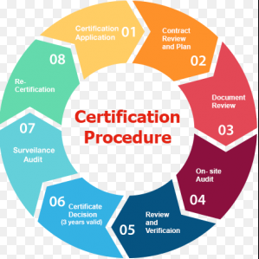
Certification Process

Slide 55
Expected Problems
Nervous Employees
Dissatisfied / Unhappy Employees
Poor Communication
Outside distraction
Lack of Resources etc
Toxics Chemical handling ( water pollution) etc
Improper documentation / record keeping

