Slide 2
Grading
Definition:
Using engineering techniques or vegetative practices, or a combination of both, to provide surface drainage and control erosion and sedimentation while reshaping and stabilizing the ground surface.
Notes:
Land grading involves reshaping the ground surface to planned grades as determined by an engineering survey, evaluation, and layout. Land grading provides more suitable topography for buildings, facilities, and other land uses and helps to control surface runoff, soil erosion, and sedimentation during and after construction.

Slide 3
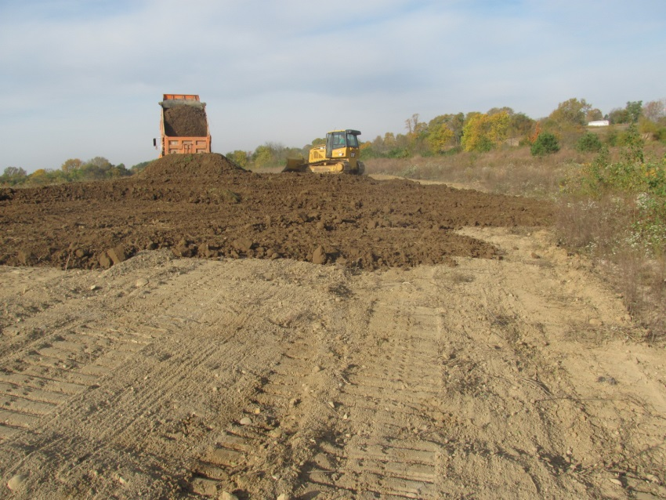

Slide 4
IMPORTANCE
Efficient application of irrigation water without excessive erosion.
Provides for adequate surface drainage.
A plane surface is easiest to manage and maintain.

Slide 5
Design criteria
Soils should be deep enough so that, after the needed grading work is done, an adequate, usable root zone remains over most of the field that will permit satisfactory crop production with proper conservation measures.
Notes:
All grading work for drainage or irrigation should be planned as an integral part of an overall farm system to conserve soil and water resources. Boundaries, elevations and direction of slope of individual field grading jobs should be such that the requirements of all adjacent areas in the farm unit can be met. Designs for the area being graded should include plans for removing excess irrigation and storm runoff water from the fields.

Slide 6
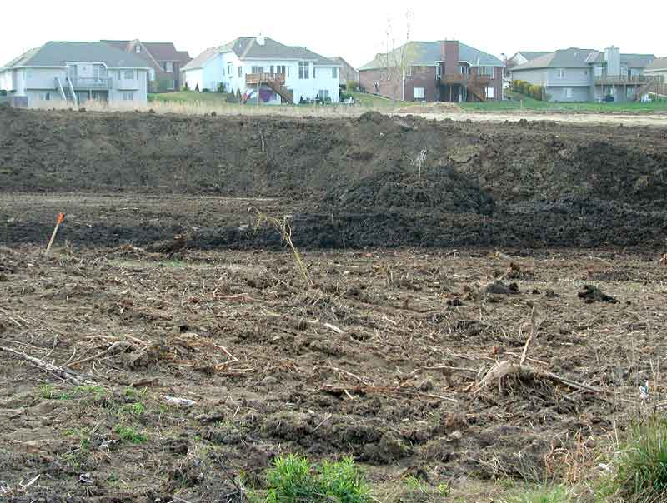

Slide 7
Grading specification
Land to be graded should be cleared of brush and excessive crop residue, trash or vegetative material.
Grading should not be attempted when soil moisture exceeds that permitting normal tillage or plowing.
Land grading is applicable to sites with uneven or steep topography or easily erodible soils.
Notes:
Grading of land means to cut dirt from a high spot and fill in a low spot, when grading and leveling, dirt is removed from high points and placed in low places making a level area, this type grading is known by excavating contractors as a ” cut and fill ” type grading.
Grading of land is also known as land leveling in some areas, land leveling is done by grading large fields for farm use or to allow water for irrigation of large fields planted for crop lands.

Slide 8
Limitations
Improper grading practices that disrupt natural stormwater patterns might lead to poor drainage, high-runoff velocities.
Clearing and grading the entire site without vegetated buffers promotes offsite transport of sediments and other pollutants.

Slide 9
Check all graded areas especially after heavy rainfalls. Remove all sediment from diversions or other stormwater conveyances, and if washouts or breaks occur, repair them immediately. To prevent small-scale eroded areas from becoming significant gullies, maintain them promptly.
Maintenance Consideration

Slide 10
Effectiveness
Land grading is effective when properly implemented with
stormwater management and
erosion and sediment control practices.

Slide 11
WAT BANDI
Definition:
Wat bandi is a practice of conservation in which we make boundaries around the field to control flow of water.

Slide 12
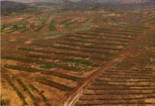

Slide 13
IMPORTANCE
This prevent water loss and soil erosion.
Top soil or fertile soil layer is not loss due to flow of water.
The bunds capture and retain runoff for several days so Important in Water conservation.
Notes:
The bunds capture and retain runoff for several days. Infiltration of the water into the soil increases, and there is a gradual build-up of sediment behind the bunds, creating favourable conditions for the establishment of vegetation.

Slide 14
Contour bunds
A contour bund is a rectangular structure consisting with bunds built with earth or stone or combination of both, which can be permeable or impermeable.
Notes:
These are built in staggered rows along the natural countour of the land with the open and facing hill.
Down slope of the structure,a water collection ditch 0.50m wide and 0.30m deep is dug.
The earth excavated from the ditch is piled up and compacted to construct the main bund.
Contour bunds for crops increase the area of land that can be farmed and its productivity thanks to their capacity to retain runoff and the shelter provided by trees planted along the bottom bund, which protects the crops.

Slide 15
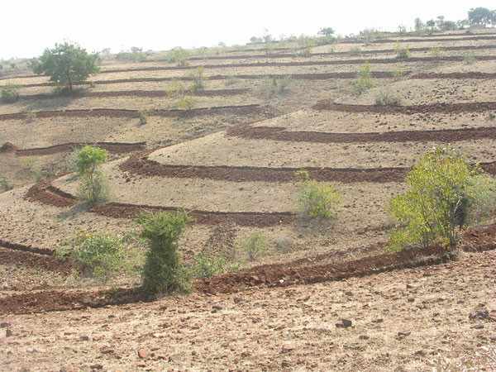

Slide 16
POTENTIAL
It increases the amount of water available to crops and vegetation in rain fed areas.
It has socio economic effects.
Good vegetation cover established along the bunds.
Notes:
Socio economics effects
The construction of contour bunds helps to restore vegetation cover on vast areas of denuded land from the first year after they are established. The catchments capture large quantities of water, promoting plant growth and replenishing the water table.
Good vegetation
Good vegetation cover established along the bunds contributes to lowering soil temperature and providing protection from wind erosion along the entire length of the patch.

Slide 17
THANK YOU!

