Slide 1
Organizational Culture and Environment: The Constraints

Slide 3
Good managers anticipate change, exploit opportunities, correct poor performance, and lead their organizations toward their objectives, which even may be changed if necessary.
In the omnipotent view, when organizations perform poorly, someone has to be held accountable regardless of the reasons why, and in our society, that "someone" is the manager. Of course, when things go well, we need someone to praise. So managers also get the credit—even if they had little to do with achieving positive outcomes.

Slide 5
According to the symbolic view, managers have a limited effect on organizational outcomes.
A manager's roles are seen as creating meaning out of randomness, confusion, and ambiguity or trying to innovate and adapt.
Managers symbolize control and influence by developing plans, making decisions, and engaging in other managerial activities. They do so for the benefit of stockholders, customers, employees, and the public.
However, according to this view, the actual part that managers play in organizational success or failure is minimal.

Slide 6
Reality Suggests a Synthesis
In reality, managers are neither helpless nor all-powerful.
Internal constraints that restrict a manager's decision options exist within every organization. These internal constraints arise from the organization's culture. In addition, external constraints come from the organization's environment.
Exhibit 3.1 shows managers as operating within the constraints imposed by the organization's culture and environment. Yet, despite these constraints, managers are not powerless. They can still influence an organization's performance.
These constraints don't mean that a manager's hands are tied. Managers may be able to change and influence their culture and environment and, thus, expand their area of discretion as they plan, organize, lead, and control.

Slide 9
Individuals perceive the organizational culture on the basis of what they see, hear, or experience within the organization.
Second, even though individuals may have different backgrounds or work at different organizational levels, they tend to describe the organization's culture in similar terms. That is the shared aspect of culture.
Organizational culture is a descriptive term. It's concerned with how members perceive the organization, not with whether they like it. It describes rather than evaluates.

Slide 10
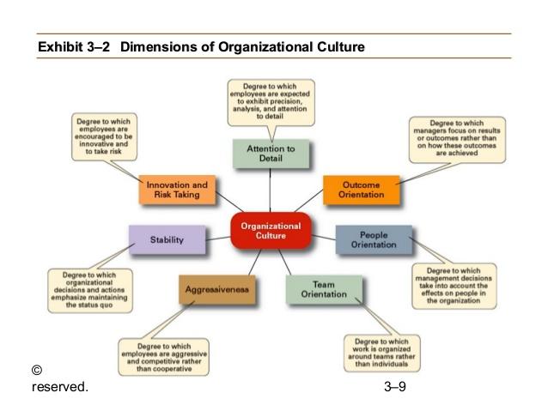

Slide 11
7 dimensions of Organizational Culture
Appraising an organization on these seven dimensions gives a composite picture of the organization's culture.
In many organizations, one of these cultural dimensions often rises above the others and essentially shapes the organization's personality and the way organizational members do their work.

Slide 18
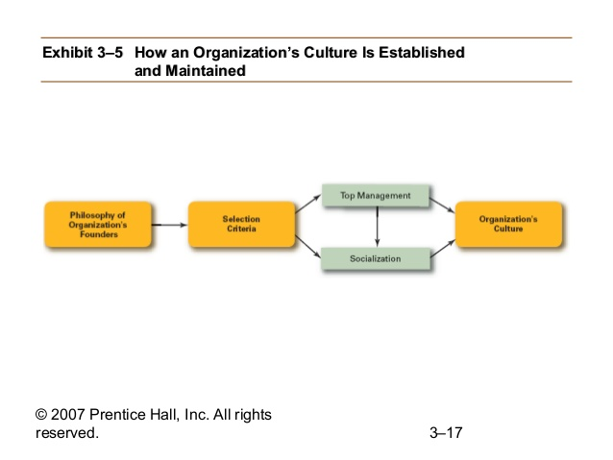

Slide 19
