Slide 1
HORT 308
MEDICINAL AND AROMATIC PLANTS

Slide 2
Corn

Slide 3
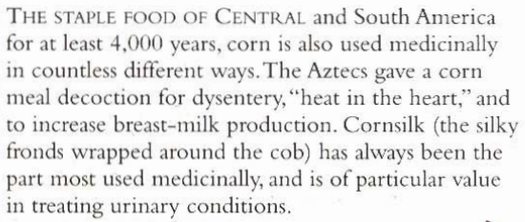
B.N Zea mays Family: Gramineae

Slide 4
Habitat & Cultivation
Native to Andes & Cantral America, Peru
Cultivated throughout the world as food

Slide 5
Key Constituents
Flavonoids
Alkaloids
Allantoin
Saponins
Volatile Oil
Mucilage
Vitamins C & K
Potassium

Slide 6
Key Actions
Urinary demulcent
Diuretic
Mildly stimulates bile secretion
Gently lowers blood pressure

Slide 7
Research
Bile production
Corn silk lowers B.P
Reduces blood clotting time

Slide 8
Tradition & Current Uses
Poultice
Bruises, swellings, sores and boils
Itchy skin
Urinary Remedy: Due to potassium corn silk is used as diuretic, relive irritation & improve urine flow, prostate disorder
Kidney Stone
Fluid retention & jaundice

Slide 9
Parts Used
Corn silk
Meal

Slide 10
Key Preparations
Infusion
Decoction
Capsules
Tinctures

Slide 11
Ispagula

Slide 12
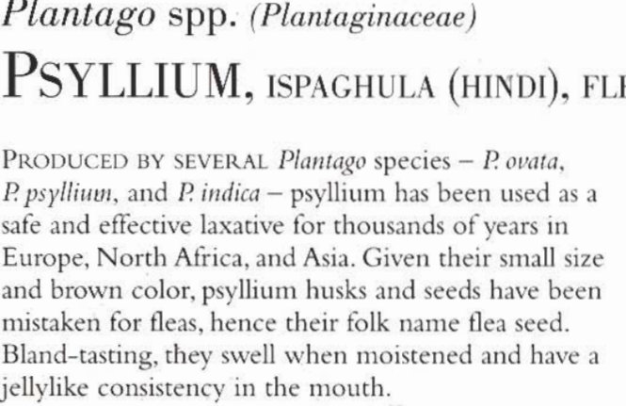

Slide 13
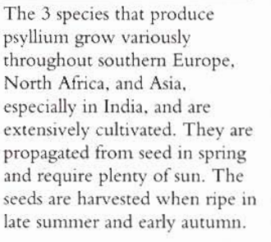
Habitat and cultivation

Slide 14
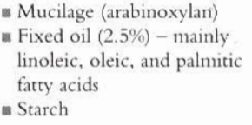
Key Constituents

Slide 15
Key Actions

Slide 16
Traditional and current uses
Laxative(Constipation)Husk and seed having high fibre
Bowl problems (Diarrhea, Irritation, Dysentery)
Hemorrhoid relieve(softening of bowl)
Detoxifying
Digestion ailments
Urinary infections

Slide 17
Research
Regulate bowel functions Proved in clinical trails in Germany and U S A

Slide 18
Parts used
Husk
Seeds

Slide 19
Key preparations
Cold macerration (soak 20 grams of seed in 200 ml of water for 10 hours and take as a single dose for constipation)
Capsules
Precaution
Always take with plenty of water, never never dose

