Slide 1
Background and History of Medical Genetics

Slide 2
What is Medical Genetics?
Medical genetics involves any application of genetics to medical practice. It thus Includes:
studies of the inheritance of diseases in families
mapping of disease genes to specific locations on chromosomes
the diagnosis & treatment of genetic disease
It also includes genetic counseling, in which information regarding risks, prognoses, and treatments is communicated to patients and their families.

Slide 3
WHY IS A KNOWLEDGE OF MEDICAL GENETICS IMPORTANT FOR TODAY’S HEALTH-CARE PRACTITIONER?
Genetic diseases make up a large percentage of the total disease burden
Modern medicine is placing increasing emphasis on prevention
Prevention and effective treatment are among the highest goals of medicine

Slide 4
A BRIEF HISTORY OF MEDICAL GENETICS
Mendel advanced the field significantly by performing a series of cleverly designed experiments on living organisms (garden peas)
Charles Darwin formulated his theories of evolution
Francis Galton, performed an extensive series of family studies
Mendel’s principles were independently rediscovered in 1900 by three different scientists working in three different countries
This was also the year in which Landsteiner discovered the ABO blood group system
In 1902, Archibald Garrod described alkaptonuria as the fist “inborn error of metabolism.”
In 1909, Johannsen coined the term gene to denote the basic unit of heredity
H. J. Muller demonstrated the genetic consequences of ionizing radiation in the fruit fly
In 1944, Oswald Avery showed that genes are composed of DNA
Physical structure of DNA by James Watson and Francis Crick in 1953 formed the basis of what is known as Molecular Genetics

Slide 5
TYPES OF GENETIC DISEASES
Chromosome disorders: in which entire chromosomes (or large segments of them) are missing, duplicated, or otherwise altered. These disorders include diseases such as Down syndrome and Turner syndrome.
Disorders in which single genes are altered; these are often termed mendelian conditions, or single-gene disorders. Well-known examples include cystic fibrosis, sickle cell disease, and hemophilia.
Multifactorial disorders, which result from a combination of multiple genetic and environmental causes. Many birth defects, such as cleft lip and cleft palate, as well as many adult disorders, including heart disease and diabetes, belong in this category.
Mitochondrial disorders, a relatively small number of diseases caused by alterations in the small cytoplasmic mitochondrial chromosome. Examples are Mitochondrial encephalopathy, lactic acidosis, and stroke-like episodes (MELAS)

Slide 6
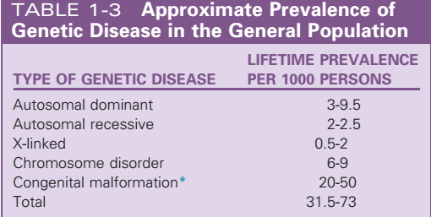

Slide 7
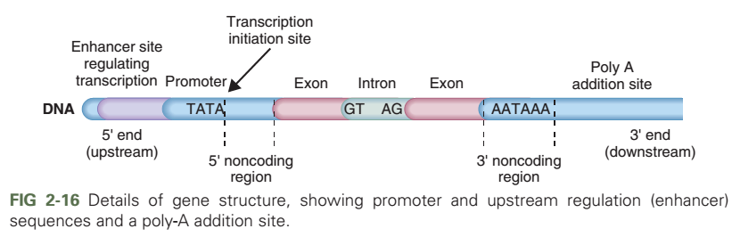

Slide 8
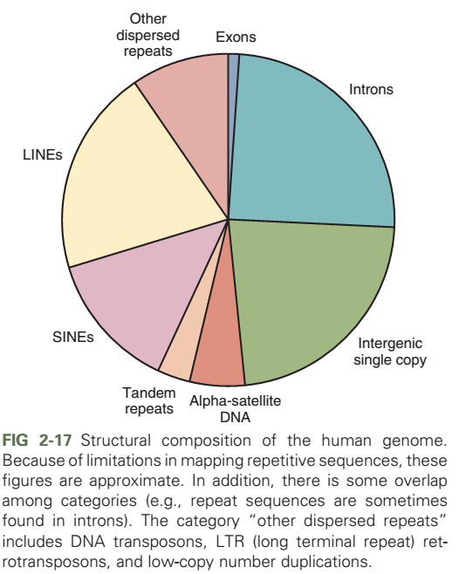

Slide 9
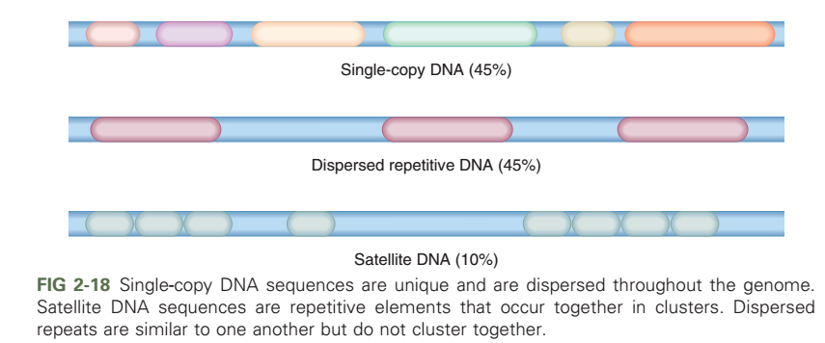

Slide 10
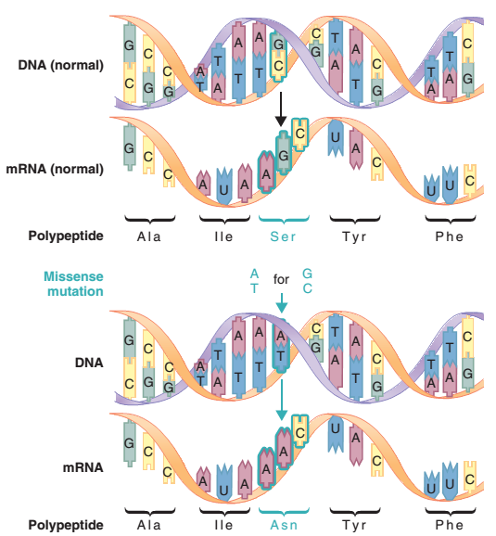

Slide 11
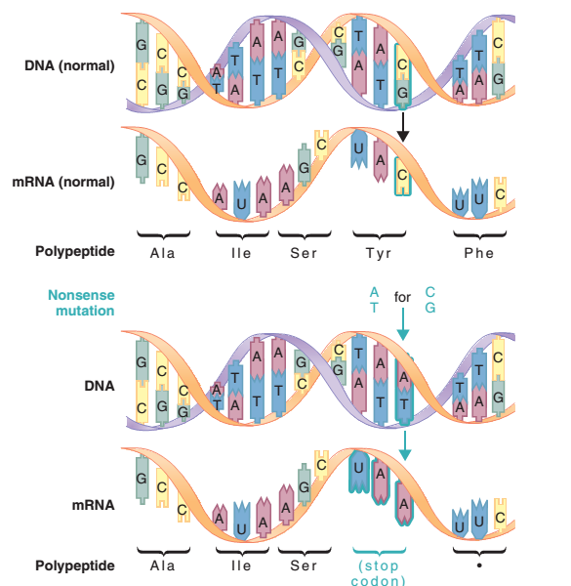

Slide 12
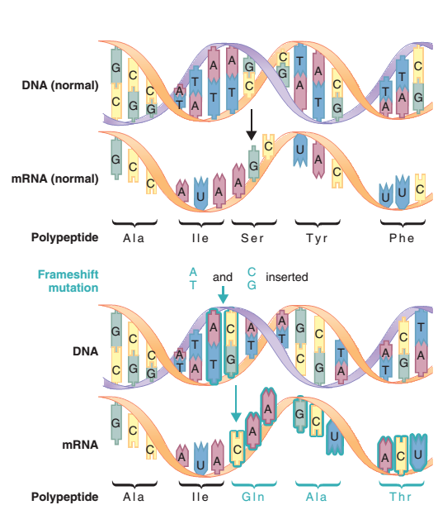

Slide 13
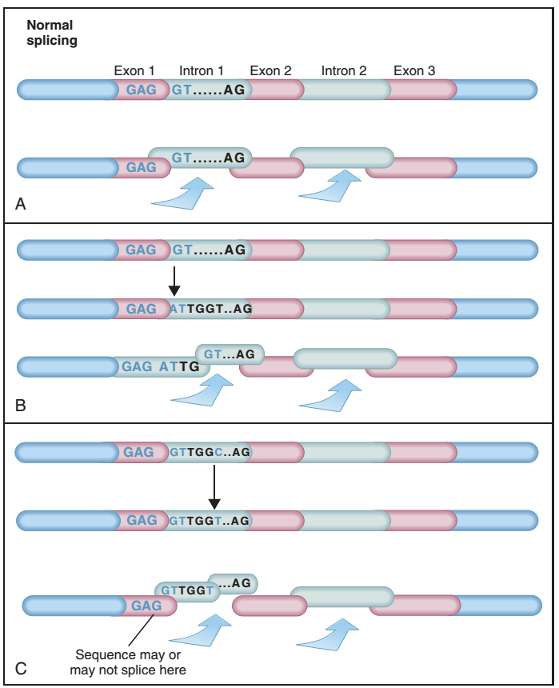

Slide 14
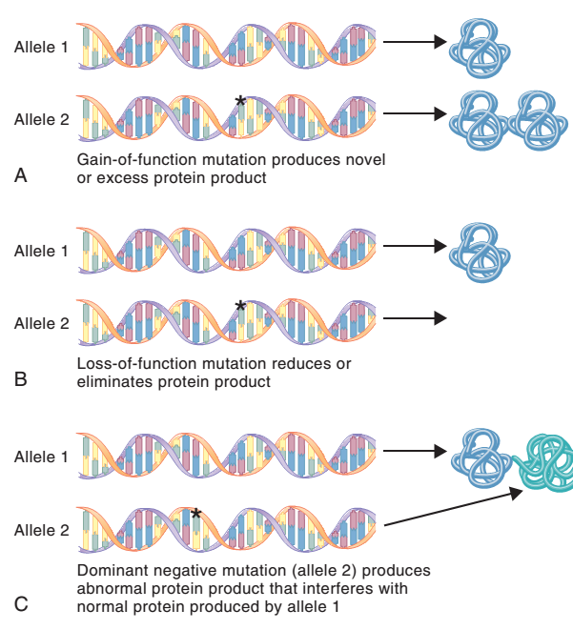

Slide 15
Clinical Consequences of Mutation: The Hemoglobin Disorders
Genetic disorders of human hemoglobin are the most common group of single-gene diseases
An estimated 7% of the world’s population carries one or more mutations of the genes involved in hemoglobin synthesis
Ordinarily, tight regulation of these genes ensures that roughly equal numbers of α and β chains are produced
Can be classified into two broad categories: structural abnormalities and thalassemia's
Another condition, hereditary persistence of fetal hemoglobin (HPFH) also exist

Slide 16
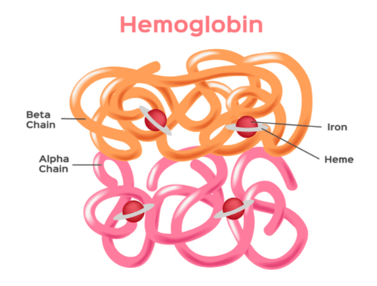

Slide 17
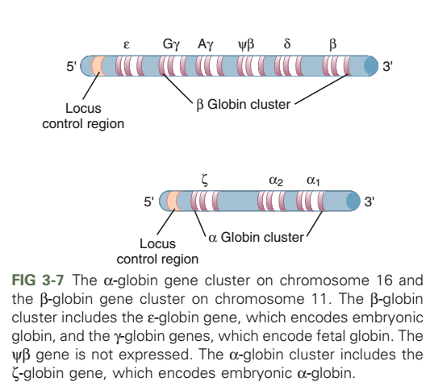

Slide 19
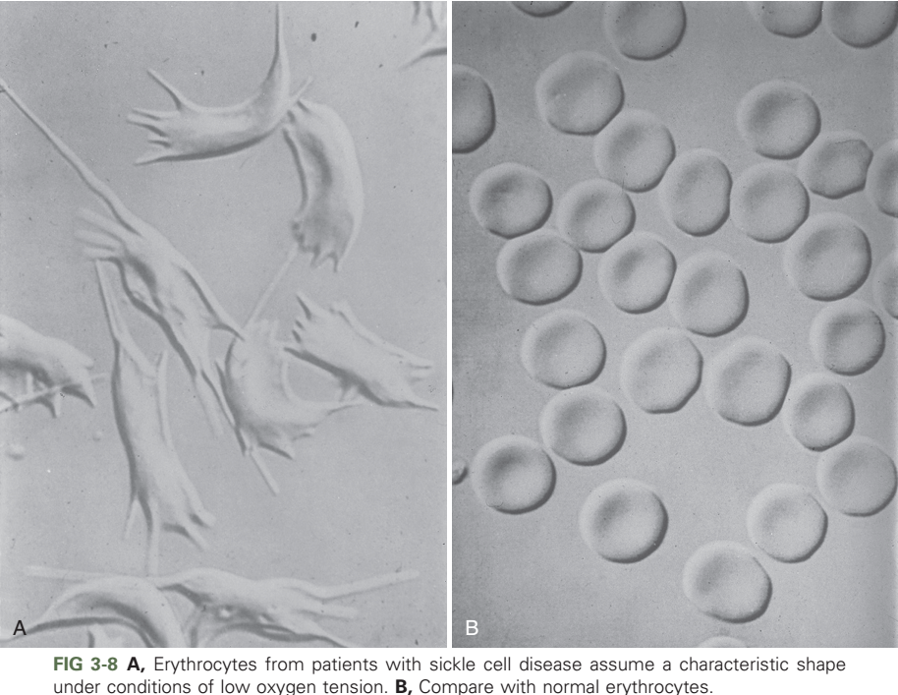

Slide 20
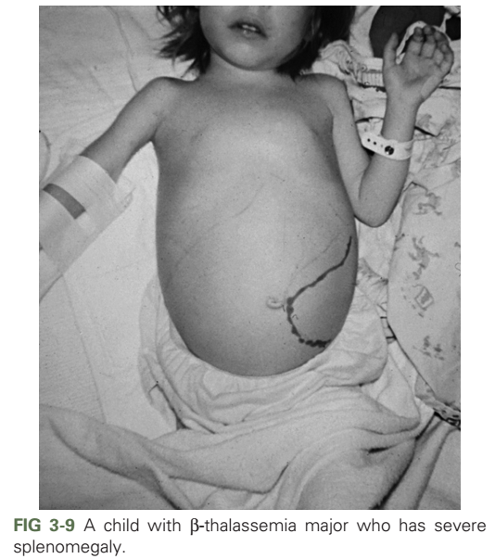

Slide 21
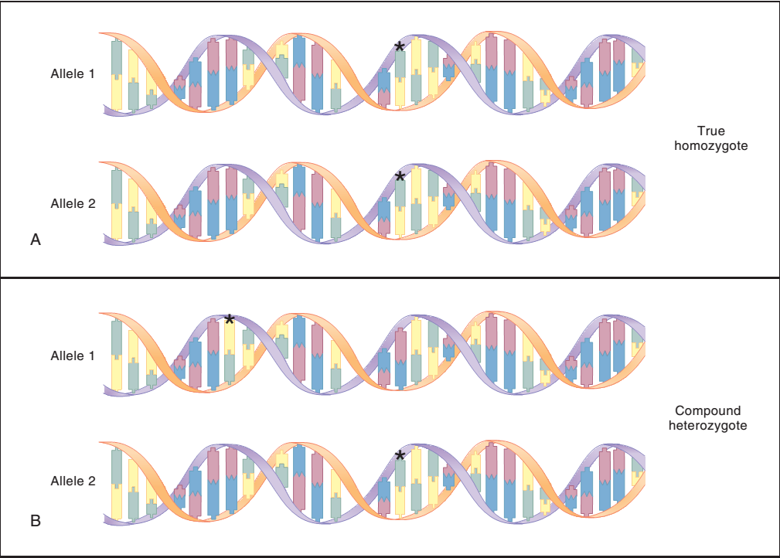

Slide 22
Causes of Mutation
A large number of agents are known to cause induced mutations. These mutations, which are attributed to known environmental causes, can be contrasted with spontaneous mutations, which arise naturally in cells, for example during DNA replication. Agents that cause induced mutations are known collectively as mutagens. Animal studies have shown that radiation is an important class of mutagen

Slide 23
Causes of Mutation
Many substances in the environment are known to be mutagenic, including ionizing and nonionizing radiation and hundreds of different chemicals. These mutagens are capable of causing base substitutions, deletions, and frameshifts. Ionizing radiation can induce double stranded DNA breaks. Some mutagens occur naturally, and others are generated by humans.

Slide 24
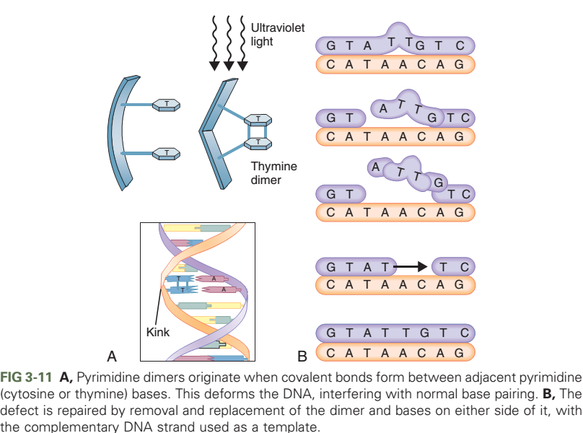

Slide 25
DNA Repair
DNA repair helps to ensure the accuracy of the
DNA sequence by correcting replication errors
(mismatches), repairing double-stranded DNA
breaks, and excising damaged nucleotides.

Slide 27
Mutation Rates
Large genes, because of their size, are generally more likely to experience mutations than are small genes. Mutation hot spots, particularly methylated CG dinucleotides, experience elevated mutation rates. For many single-gene disorders, there is a substantial increase in mutation risk with advanced paternal age.

Slide 28
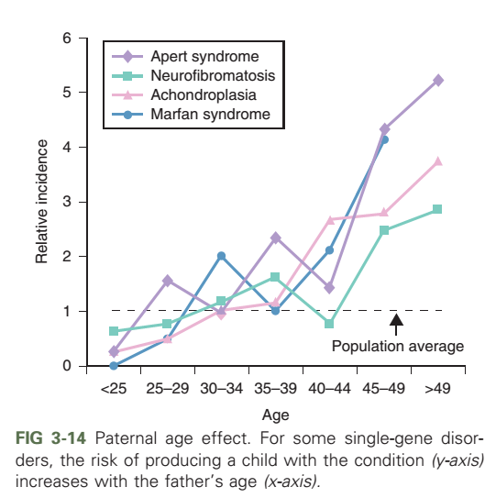

Slide 29
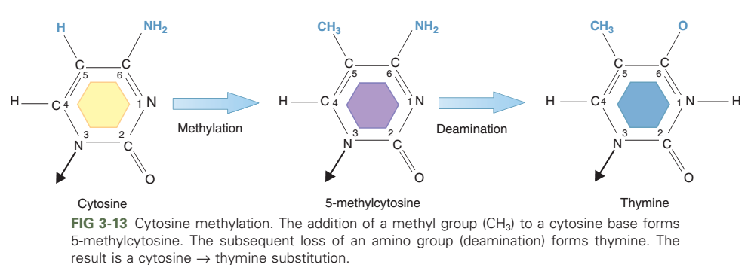

Slide 30
DETECTION AND MEASUREMENT OF GENETIC VARIATION
Blood Groups The blood groups, of which the ABO and Rh systems are examples, have provided an important means of studying human genetic variation. Blood group variation is the result of antigens that occur on the surface of erythrocytes

Slide 31
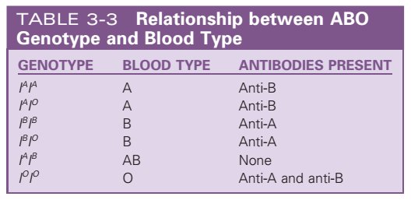

Slide 32
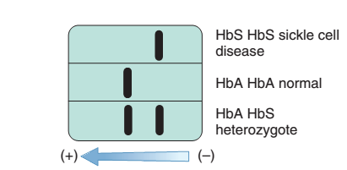
Protein Electrophoresis
Protein electrophoresis detects variations in genes that encode certain serum proteins. These variations are observable because proteins with slight differences in their amino acid sequence migrate at different rates through electrically charged gels

Slide 33
Southern Blotting and Restriction Fragment Analysis
Restriction enzymes can cut DNA into fragments, which are sorted according to their length by electrophoresis, transferred to a solid membrane (Southern blotting), and visualized through the use of labeled probes. This process can detect deletions or duplications of DNA, as well as RFLPs.

Slide 35
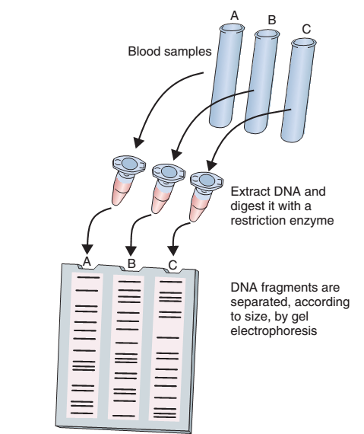

Slide 36
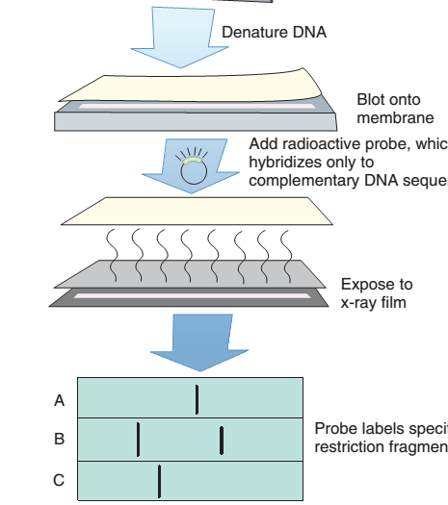

Slide 37
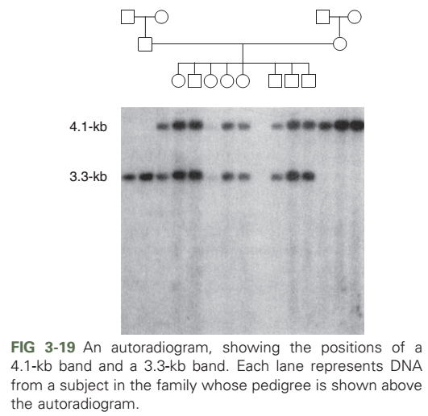

Slide 38
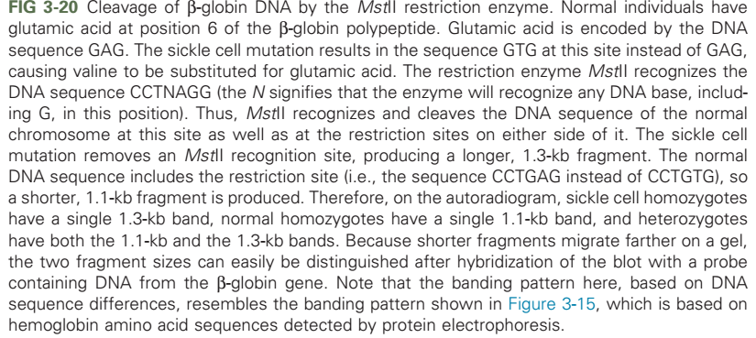

Slide 39
Tandem Repeat Polymorphisms
VNTRs are a type of polymorphism that results
from varying numbers of minisatellite repeats
in a specifi DNA region. STRs are a similar type of polymorphism that results from varying numbers of smaller, microsatellite repeats.
Because VNTRs and STRs can have many different alleles in a population, they are especially useful in medical genetics and forensics.

Slide 41
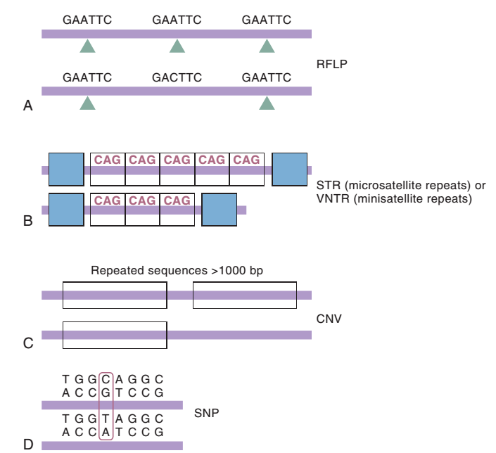

Slide 42
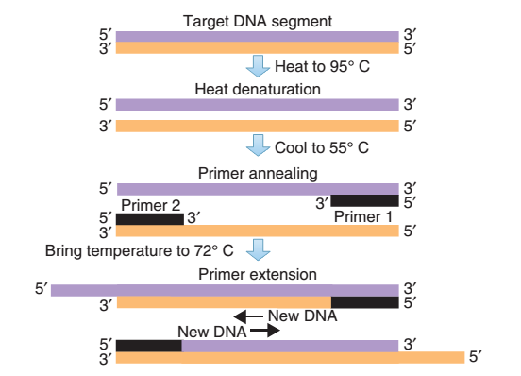

Slide 43
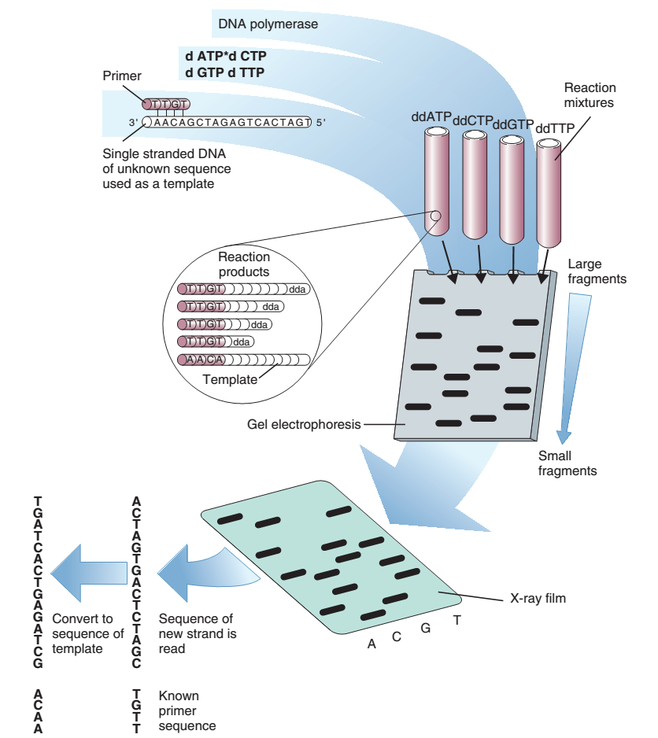

Slide 44
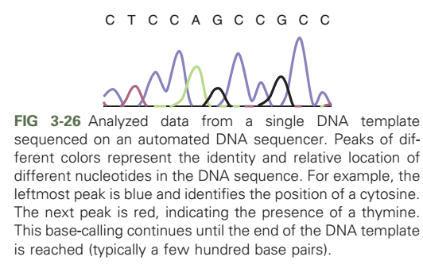

Slide 45
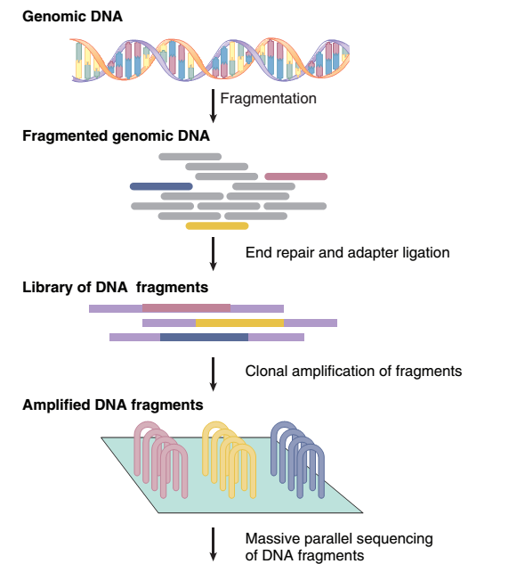

Slide 46
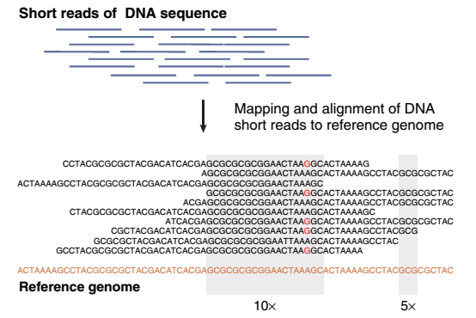

Slide 47
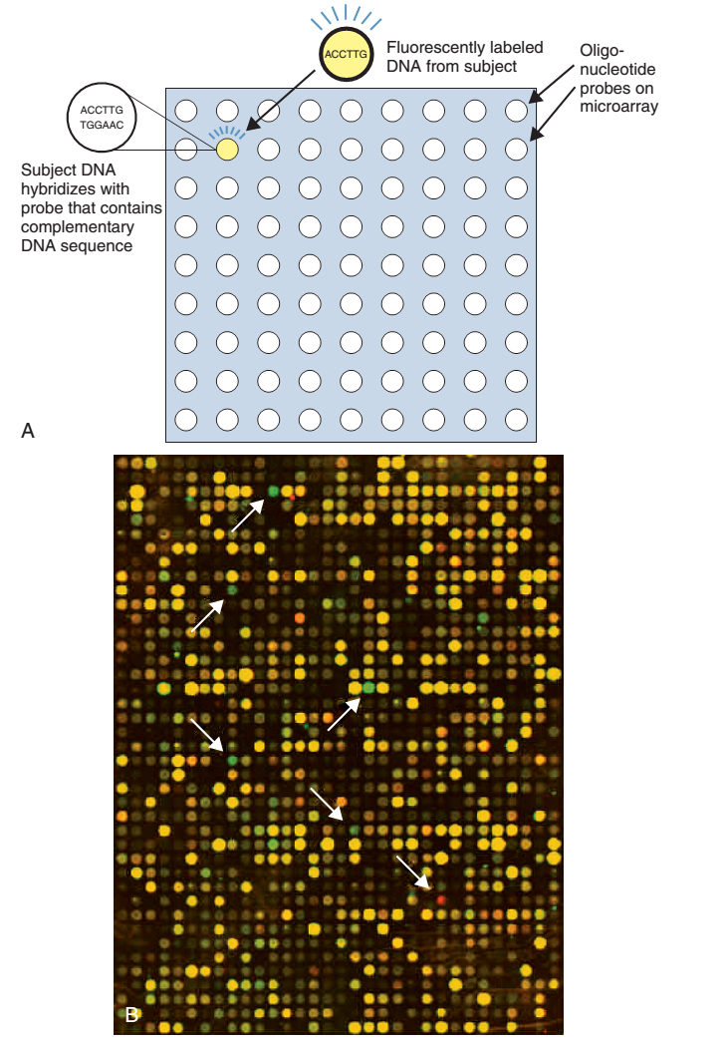

Slide 48
Basic Concepts of Probability
A probability is defined as the proportion of times that a specific outcome occurs in a series of events.
Because probabilities are proportions, they lie between 0 and 1, inclusive.
During meiosis, one member of a chromosome pair is transmitted to each sperm or egg cell. This is directly analogous to coin tossing, in which the probabilities of obtaining heads or tails are each 1/2, we will use coin tossing as our illustrative example.
Notes:
Basic probability enables us to understand and estimate genetic risks and to understand genetic variation among populations. The multiplication rule is used to estimate the probability that two events will occur together. The addition rule is used to estimate the probability that one event or another will occur.

Slide 49
The multiplication rule states that if two trials are independent, then the probability of obtaining a given outcome in both trials is the product of the probabilities of each outcome.
The addition rule states that if we want to know the probability of either one outcome or another, we can simply add the respective probabilities together

Slide 50
Gene and Genotype Frequencies
Gene and genotype frequencies specify the
proportions of each allele and each genotype,
respectively, in a population. Under simple
conditions these frequencies can be estimated
by direct counting

Slide 51
The Hardy–Weinberg Principle
Under panmixia, the Hardy–Weinberg principle specifis the relationship between gene frequencies and genotype frequencies. It is useful in estimating gene frequencies from disease prevalence data and in estimating the incidence of heterozygous carriers of recessive disease genes.

Slide 52
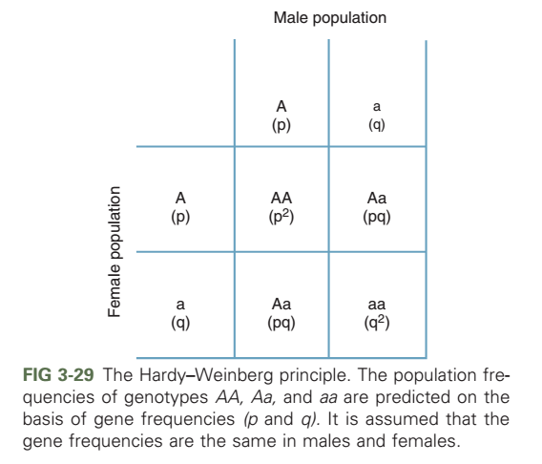

Slide 53
Causes of Genetic Variation
Natural selection is the evolutionary process in which alleles that confer survival or reproductive advantages in a specific environment are selected positively to increase in frequency, and alleles that confer lower survival or reproductive disadvantages are selected negatively so that they decrease in frequency

Slide 54
Genetic drift is a random evolutionary process that produces larger changes in gene frequencies in smaller populations. Founder effect, in which small founder populations can experience large changes in gene frequency because of their small size, is a special case of genetic drift.

Slide 55
Gene Flow
Mutation–selection balance predicts a relatively constant gene frequency when new mutations introduce harmful alleles, whereas natural selection removes them. This process predicts that the gene frequencies should be lower for dominant diseases, in which most alleles are exposed to natural selection, than in recessive diseases, where most alleles are found in heterozygotes and are thus protected from natural selection.

