Slide 1
Writing Long Reports

Slide 2
In this lecture you will learn to
Describe how organizations produce formal reports and proposals
Prepare all necessary parts of a formal report
Select and prepare the visual aids to support the text of your report
Assemble all the parts of a formal report in the proper order and use an appropriate format
Prepare and assemble all the parts of a formal proposal
Critique formal reports prepared by someone else

Slide 3
Report Production
Planning formal reports and proposals, conducting the necessary research, organizing the ideas, developing visual aids, and drafting the text are demanding and time consuming tasks.
After careful editing and rewriting, you still need to produce a polished version.
How to produce your report also depends on the equipment you have available.
Personal reports automatically handle many of the mechanical aspects of report preparation.
Be sure to schedule enough time to turn out a document that looks professional.

Slide 4
Composing a formal Report
A professional report conveys the impression that the subject is important.
The three basic divisions of a formal report:
Prefatory parts
Text
Supplementary parts

Slide 5
Prefatory Parts
Prefatory parts may be written after the text has been completed.
Many of these parts such as table of contents, list of illustrations, and synopsis are easier to prepare after the text has been written.
Other parts can be completed any time.

Slide 6
Cover
Many companies have standard covers for reports, made of heavy paper and imprinted with company’s name and logo.
Put the title on the cover that is informative but not too long.
You don’t want to intimidate you audience with a title that is too long, awkward and unwieldy.
Notes:
intimidate = Frighten

Slide 7
Title fly and Title Page
The title fly is a plane sheet with only the title of the report on it.
The title report includes four blocks of information
The title of the report
The name, title and address of the person that authorized the report
The name, title and address of the person that prepared the report
The date on which the report was submitted

Slide 8
Letter of Authorization and Letter of Acceptance
If you received a written letter of authorization to prepare the report or proposal, you may want to include that in your report.
A letter of authorization usually follows the direct-request plan.

Slide 9
Letter of Transmittal
The letter of transmittal conveys your report to your audience.
Use a less formal style for the letter of transmittal than for the report itself.
Generally the letter of transmittal appears right before the table of contents.

Slide 10
Table of Contents
The table of contents indicates in outline form the coverage, sequence, and relative importance of the information in the report.
The table of contents is prepared after other parts of the report have been typed, so that the beginning page numbers of each heading can be shown.

Slide 11
List of Illustrations
For simplicity sake, some report refer to all the visual aids as illustrations or exhibits.
Put the list of illustrations on a separate page, if it won’t all fit on one page with the table of contents; start the list of figures and list of tables on a separate page if they won’t both fit on one page.

Slide 12
Synopsis or Executive Summary
A synopsis is a quick overview of the report’s important points, designed to give readers a quick preview of the contents.
Because it is a concise representation of the whole report it may be distributed separately to a wide audience.
The phrasing of a synopsis can be either informative or descriptive, depending on whether the report is in direct or indirect order.
An informative synopsis summarizes the main ideas; a descriptive synopsis describes what the report is about.

Slide 13
Informative synopsis
Sales of Walls ice-cream make up 11 % of the total ice- cream market.
Descriptive synopsis
This report contain information about Walls ice-cream and its share of the market.
Use a descriptive synopsis for a unconvinced or hostile audience, an informative synopsis for most other situations.
An executive summary is a fully-developed ‘mini’ version of the report itself, intended for readers who lack time or motivation to read the complete text.
Put enough information in a executive summary so that an executive can make decisions without reading the complete text.

Slide 14
Text of the Report
Visual aids are also useful tools for calling attention to key points and helping readers grasp the flow of ideas.
Eye-catching graphics dramatize the high points of the message, and informative captions explain their meaning.
It is also useful to preview summary points at the beginning of each major section or chapter and to sum them up at the end.
Tell them what you are going to tell them
Tell them
Tell them what you told them

Slide 15
Introduction
The introduction to a report serves a number of important function:
Putting the report in a broader context by tying it to a problem or an assignment
Telling the readers the report’s purpose
Previewing the report’s contents and organization
Establishing the tone of the report and the writer’s relationship with the audience

Slide 16
Authorization
When, how and by whom was the report authorized; who wrote it; and when it was submitted.
Problem/purpose
The reason for report’s existence what is to be accomplished as a result of the report being written.
Scope
What is and what isn’t going to be covered in the report. The scope indicates the report’s size and complexity.
Background
The historic events and conditions that have led up to the report.

Slide 17
Sources and methods
The secondary sources of information used and the primary sources such as interviews, surveys, experiments and observations.
Definitions
A brief introductory statement leading into a column of terms used in the report and their definitions.
Limitations
Factors indicating the quality if the report, such as the budget too small to do all the work that should have been done, time constraints and other events beyond your control.
Report organization
An organization of the report, along with the rationale for following this plan.

Slide 18
Body
The body of the report follows the introduction.
It consists of major sections or chapters that analyze, present and interpret the material gathered as a result of your investigation.
One of the decisions to make when writing the body of your report is how much detail to include.
In general provide only enough information in the body to support your conclusions and recommendations.
Another decision to make is whether to put the conclusions in the body, in a separate section for it or in both.

Slide 19
Summary, Conclusions and Recommendations
The final section in the text report tells readers ‘what you have told them’.
Summary
The key findings of your report, paraphrased from the body and stated or listed in the key order in which they appear in the body.
Conclusions
The writer’s analysis of what the findings mean. These are the answers to the questions that lead to the report.
Recommendations
Opinions, based on reason and logic, about the course of action that should be taken.

Slide 20
If the report is organized in the direct order, the summary, conclusions and recommendations are presented before the body, and are reviewed only briefly at the end.
In action-oriented reports put all the recommendations in a separate section and spell out precisely what they mean.

Slide 21
Notes
When you are writing the text of your report, you decide to acknowledge your sources.
Give credit where credit is due.
Plagiarism occurs when one person misappropriate without permission, any ideas, facts or words that were originated by others

Slide 22
In general you have flirted with plagiarism when your business documents fail to alert your audience that you have
Repeated someone else’s information word for word
Paraphrased another’s material too closely
Lifted a series of phrases and put them together with your own words
Borrowed a unique term that originated elsewhere

Slide 23
Plagiarism
Although your company may have more specific guidelines, here are a few general tips on how to handle situation that commonly arise
Repeating information from another company document
If you reuse information appearing another report, your audience may believe that you have independently verified material and eliminated any errors in the original report.
Using same sources as another Document
Consulting someone else's sources for further information is perfectly acceptable.
Plagiarism deals with the way information is reported, not with whether you access the sources used by someone else.

Slide 24
Repeating information protected by Copyright
If you repeat information from books, published articles and other copyright materials, be sure to avoid infringing on the originators’ legal rights.
To be safe talk to your company’s management before you repeat information protected by copyrights.
Notes:
Infringing = violating

Slide 25
Example
One approach, especially for internal reports, is simply to mention a source in the text:
– Accordi ng to Dr. Aftab of Ganga Ram Hospital, hi p replacement operations account for 7% of all surgery performed on women aged 65 and above.
– If your report is to be distributed to outsiders, you should include extra information on where you obtained the data.

Slide 26
Visual Aids
When illustrating the text of any report you face the problem of choosing any specific form that best suits your message.
Moreover, good business ethics demand you chose a form of visual aid that will not mislead your audience.
Tables
When you have to present detailed, specific information, choose a table, a systematic arrangement of data in rows and columns.
Use tables to help you audience understand detailed information.

Slide 27
Line and Surface Charts
A line chart illustrates the trend over time and plots the interaction of two variables.
Use line charts to
Indicate change over time
Plot the interaction of two variables
A surface chart is a kind of line chart with a cumulative effect; all the lines add up to the top line, which represents the total.
This form of chart is useful when you want to illustrate the changes in the composition of something over time.

Slide 28
Example of a Line Chart

Slide 29
Bar Charts
A bar chart is a chart in which amounts are visually portrayed by the height or length of rectangular bars.
They are valuable when you want to
Compare the size of several item at once
Show changes in one item over time
Indicate composition of several items over time
Show relevant size of a component of a whole

Slide 30
Bar Charts

Slide 31
Pie Charts
In a pie chart numbers are represented as slices of a complete circle, or pie.
Although they are less versatile, but are nevertheless valuable in your inventory of visual aids.
When composing a pie chart, try to limit the number of slices in a pie to no more than seven.

Slide 33
Organization Charts and Flow Charts
Use organization charts to depict the interrelationships among the parts of an organization
Use flow charts to
Show a series of steps from beginning to end
Board of Trusties
Show relationship

Slide 35
Conclude the text of proposals and reports with a summary, and if appropriate a conclusion and recommendation
In a summary, recap the findings and explanations already presented.
Place conclusions and recommendations in their order of logic or importance, preferably in list format.
To induce action, explain in recommendations section who should do what, where, when and how.
If appropriate point up the benefits if action, to leave readers with the motivation to follow recommendations.

Slide 36
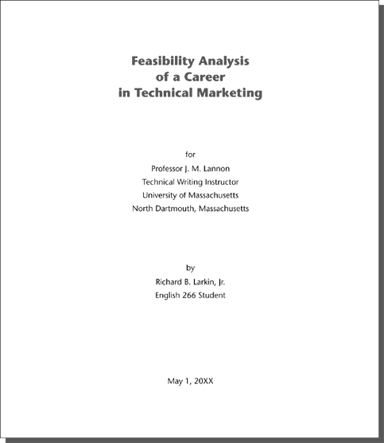
Title Page

Slide 37
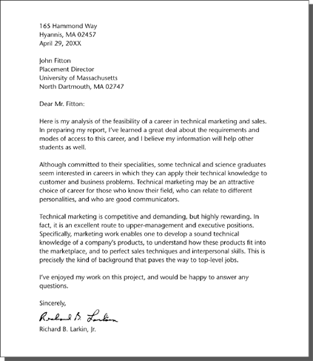
Letter of Transmittal

Slide 38
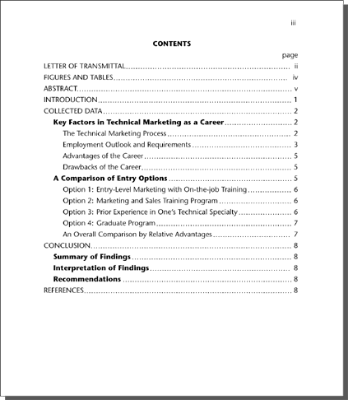
Table of Contents

Slide 39
A List of Tables and Figures

Slide 40
An Informative Abstract

Slide 41
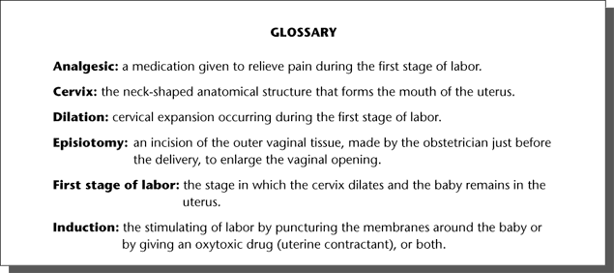
A PARTIAL GLOSSARY

