Slide 1
Advanced Analysis of Algorithms
Dr. Qaiser Abbas
Department of Computer Science & IT,
University of Sargodha, Sargodha, 40100, Pakistan
qaiser.abbas@uos.edu.pk

Slide 2
Edit Distance
DNA Sequence Comparison: First Success Story
Finding sequence similarities with genes of known function is a common approach to infer a newly sequenced gene’s function
In 1984 Russell Doolittle and colleagues found similarities between cancer-causing gene and normal growth factor (PDGF) gene.

Slide 3
Edit Distance

Slide 4
Edit Distance
Problem: Given two strings of size m, n and set of operations substitution (S), insert (I) and delete (D) all at equal cost. Find minimum number of edits (operations) required to convert one string into another.

Slide 5
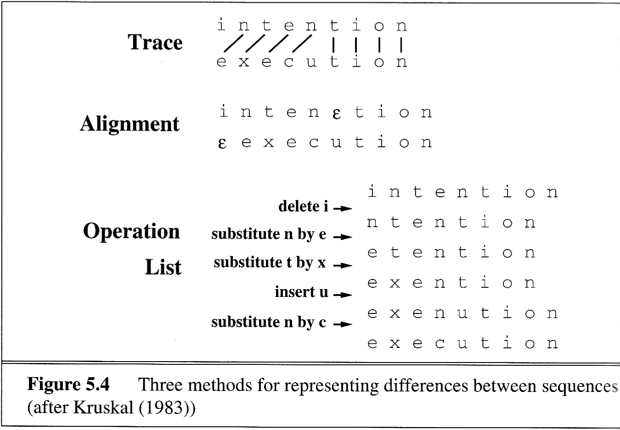
Minimum Edit Distance
The minimum edit distance between two strings is the minimum number of edit operations (insert, delete, substitution) needed to transform one string into another.
For example the gap between “intention” and “execution” is 5 operations, which can be represented in three ways as follows:

Slide 6
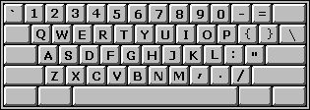
Minimum Edit Distance
Applications
could be used for multi-typo correction
used in Machine Translation Evaluation (MTEval)
Cost and Weight models
Levenshtein (Cost)
insertion, deletion and substitution all have unit cost
Levenshtein (alternate) (Cost)
insertion, deletion have unit cost
substitution is twice as expensive
substitution = one insert followed by one delete
Typewriter (Weight)
insertion, deletion and substitution all have unit cost
modified by key proximity

Slide 7
Minimum Edit Distance
Dynamic Programming
divide-and-conquer
to solve a problem we divide it into sub-problems
sub-problems may be repeated
don’t want to re-solve a sub-problem the 2nd time around
idea: put solutions to sub-problems in a table
and just look up the solution 2nd time around, thereby saving time
memoization

Slide 8
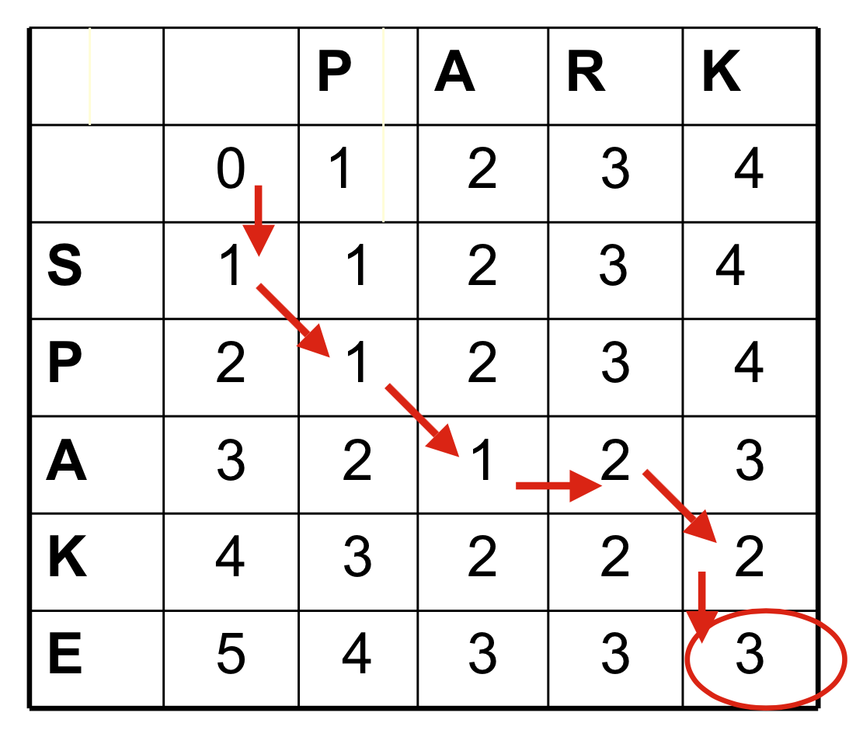
Minimum Edit Distance
j
Levenshtein (1st Version)
D(i,j) = score of best alignment from s₁..s_{i} to t₁..t_{j}
Min=
i
D(i-1,j-1)+d(si,tj) //substitute
D(i-1,j)+1 //insert
D(i,j-1)+1//delete

Slide 9
Minimum Edit Distance

Slide 10
Minimum Edit Distance
O(1) each
O(n)+O(m)
O(nm)

Slide 11
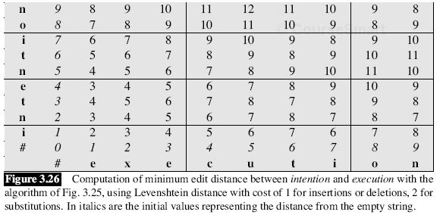
Minimum Edit Distance
Levenshtein (2nd Version)

Slide 12
Knapsack Problem

Slide 13
Knapsack Problem
Given some items(boxes), pack the knapsack to get the maximum total value (dollars). Each item has some weight (kg) and some value (dollars). Total weight that we can carry is no more than some fixed number W (15kg). So we must consider weights of items as well as their values.
3 Yellow, 3 Grey

Slide 14
Knapsack Problem
Two versions of the problem:
0-1 knapsack problem
Items are indivisible; you either take an item or not. (Dynamic Approach)
Fractional knapsack problem
Items are divisible: you can take any fraction of an item. (Greedy Approach)

Slide 15
0-1 Knapsack Problem
Given a knapsack with maximum capacity W, and a set S consisting of n items
Each item i has some weight w_{i} and benefit value b_{i} (all w_{i} and W are integer values)
Problem: How to pack the knapsack to achieve maximum total value of packed items?
The problem is called a “0-1” problem, because each item must be entirely accepted or rejected.

Slide 16
0-1 Knapsack Problem
Brute-force approach:
For n items, there are 2^{n} possible combinations.
Go through all combinations and find the one with maximum value and with total weight ≤ W
Running time will be O(2^{n})
Dynamic programming approach:
Can do better using dynamic programming by identifying the sub-problems.

Slide 17
0-1 Knapsack Problem
The sub-problem will be to compute V[k,w], i.e., to find an optimal solution for S_{k} = {items labeled 1, 2, .. k} in a knapsack of size w

Slide 18
0-1 Knapsack Problem
The best subset of S_{k} that has the total weight ≤ w, either contains item k or not.
First case: w_{k}>w. Item k can’t be the part of the solution, since if it was, the total weight would be > w, which is unacceptable.
Second case: w_{k} ≤ w. Then the item k can be in the solution, and we choose the case with greater value.

Slide 19
0-1 Knapsack Problem
0-1 Knapsack(b,w,n,W)
for w = 0 to W
V[0,w] = 0
for i = 1 to n
V[i,0] = 0
for i = 1 to n
for w = 0 to W
if w_{i} ≤ w // item i can be part of the solution
V[i,w] = max{V[i-1,w], b_{i}+V[i-1,w-w_{i}]}
else
V[i,w] = V[i-1,w] // w_{i} > w
Return V[n,W]
Running Time is O(nW), while the brute force O(2^{n})

Slide 20
0-1 Knapsack Problem
Example:
# of elements n=4, Max weight W = 5
Elements (w_{i}, b_{i}): (2,3), (3,4), (4,5), (5,6)

Slide 21
0-1 Knapsack Problem
i\W
0
1
2
3
4
5
0
0
0
0
0
0
0
1
2
3
4
for w = 0 to W
V[0,w] = 0

Slide 22
0-1 Knapsack Problem
i\W
0
1
2
3
4
5
0
0
0
0
0
0
0
1
0
2
0
3
0
4
0
for i = 1 to n
V[i,0] = 0
(This loop can be exempted)

Slide 23
0-1 Knapsack Problem
Items:
1: (2,3)
2: (3,4)
3: (4,5)
4: (5,6)
i\W
0
1
2
3
4
5
i=4
b_{i}=6
w_{i}=5
w= 5
w- w_{i}=0
0
0
0
0
0
0
0
1
0
0
3
3
3
3
2
0
0
3
4
4
7
3
0
0
3
4
5
7
4
0
0
3
4
5
7
if w_{i} ≤ w // item i can be part of the solution
V[i,w] = max{V[i-1,w], b_{i}+V[i-1,w-w_{i}]}
else
V[i,w] = V[i-1,w] // w_{i} > w

Slide 24
0-1 Knapsack Problem
This algorithm only finds the maximum possible value that can be carried in the knapsack
i.e., the value in V[n,W]
To know the items that make this maximum value, an addition to this algorithm is necessary

Slide 25
0-1 Knapsack Problem
Question: How do we use the values keep{i,w} to determine the subset T of items having the maximum computing time?
If keep[n,W] is 1, then n belongs to T. We can now repeat this argument for keep[n-1,W-w_{n}].
If keep[n,W] is 0, then n does not belong to T and we can repeat the argument for keep[n-1,W].
Now, the final algorithm becomes as follows:

Slide 26
0-1 Knapsack Problem

Slide 27
Fractional Knapsack Problem
We have n objects and a knapsack. The i^{th} object has positive weight w_{i} and positive unit value v_{i}. The knapsack capacity is C.
We wish to select a set of proportions of objects to put in the knapsack so that the total values is maximum and without breaking the knapsack.

Slide 28
Fractional Knapsack Problem
Greedy-fractional-knapsack (w, v, W)
FOR i =1 to n do x[i] =0 weight = 0 while weight < W do i = best remaining item IF weight + w[i] ≤ W then x[i] = 1 weight = weight + w[i] else x[i] = (W - weight) / w[i] weight = W return x

Slide 29
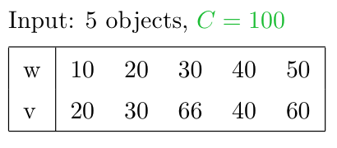
Fractional Knapsack Problem
Example:
Select always the most valuable object
Total selected weight 100 and total value 146.
Select always the lighter object
Total selected weight 100 and total value 156.

Slide 30
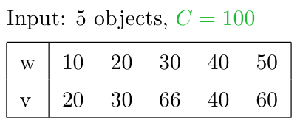
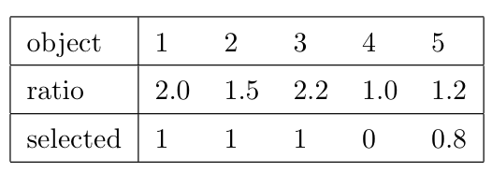
Fractional Knapsack Problem
Select always the object with highest ratio value/weight
Total selected weight 100 and total value 164.

Slide 31
Fractional Knapsack Problem
The greedy algorithm that always selects the most valuable object does not always find an optimal solution to the Fractional Knapsack problem.
The greedy algorithm that always selects the lighter object does not always find an optimal solution to the Fractional Knapsack problem.
The greedy algorithm that always selects the object with better ratio value/weight always finds an optimal solution to the Fractional Knapsack problem.

