Slide 1
MITOCHONDRIA AND NUCLEUS

Slide 2
MITOCHONDRIA
What is mitochondria?
A spherical or rod-shaped organelle with its own genome, and is responsible for the generation of most of the cell’s supply of adenosine triphosphate through the process of respiration.
It is commonly known as power house of cell.

Slide 3
mitochondria

Slide 4
History
In 1857, Albert von Kölliker described & called granules in the cells of muscles.
The discovery of mitochondria in general came in 1886 when Richard Altman, a cytologist, identified the organelles using a dye technique, called bioblasts.
He coined the term "mitochondrion" for them, from the Greek words "mitos," meaning "thread" and "chondros," meaning "granule," with the plural being "mitochondria."

Slide 5
ORIGIN an evolution
There are two hypotheses about the origin of mitochondria:
Endosymbiotic
Autogenous
Endosymbiotic
The endosymbiotic hypothesis suggests that mitochondria were originally prokaryotic cells, capable of implementing oxidative mechanisms that were not possible for eukaryotic cells; they became endosymbionts living inside the eukaryote.
The endosymbiotic hypothesis for the origin of mitochondria suggests that mitochondria are descended from specialized bacteria that somehow survived endocytosis by another species of prokaryote or some other cell type, and became incorporated into the cytoplasm.

Slide 6
Autogenous
In the autogenously hypothesis, mitochondria were born by splitting off a portion of DNA from the nucleus of the eukaryotic cell at the time of divergence with the prokaryotes;
this DNA portion would have been enclosed by membranes, which could not be crossed by proteins.
Since mitochondria have many features in common with bacteria,
the endosymbiotic hypothesis is more widely accepted.

Slide 7
Distribution and localization
The mitochondria move autonomously in the cytoplasm, so they generally have uniform distribution in the cytoplasm, but in many cells their distribution is very restricted. The distribution and number of mitochondria are often correlated with type of function the cell performs. Typically mitochondria with many cristae are associated with mechanical and osmotic work situations, where there are sustained demands for ATP and where space is at a premium, e.G. Myocardial muscle cells have numerous large mitochondria called sarcosomes that reflect the great amount of work done by these cells. In flight muscles of insects number of mitochondria is very large approximately five lack.

Slide 8
Orientation
The mitochondria have definite orientation. For example, in cylindrical cells the mitochondria usually remain orientated in basal apical direction and lie parallel to the main axis.
In leucocytes, the mitochondria remain arranged radially with respect to the centrioles.
As they move about in the mitochondria form long moving filaments or chains, while in others they remain fixed in one position where they provide ATP directly to a site of high ATP utilization,
e.G., They are packed between adjacent myofibrils in a cardiac muscle cell or wrapped tightly around the flagellum of sperm.

Slide 9
Morphology
Number
The number of mitochondria in a cell depends on the type and functional state of the cell.
It varies from cell to cell and from species to species. Certain cells contain exceptionally large number of the mitochondria,
e.G., The amoeba, chaos chaos contain 50,000; eggs of sea urchin contain 140,000 to 150,000 and oocytes of amphibians contain 300,000 mitochondria. Certain cells, viz., Liver cells of rat contain only 500 to 1600 mitochondria.
The cells of green plants contain less number of mitochondria in comparison to animal cells because in plant cells the function of mitochondria is taken over by the chloroplasts.
Some algal cells may contain only one mitochondrion

Slide 10
Size
Normally mitochondria vary in size from 0.5µm to 2.0 µm and, therefore, are not distinctly visible under the light microscope.
Sometimes their length may reach up to 7 µm

Slide 11
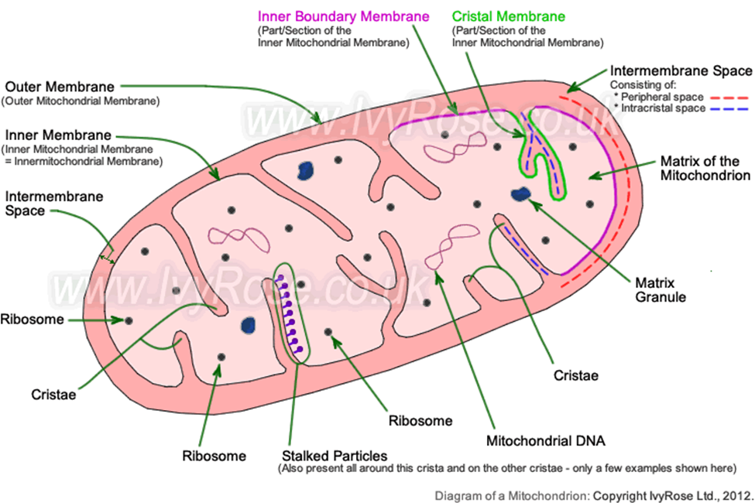
STRUCTURE
Outer membrane
Inner membrane
Intermembrane space
Matrix
Cristae
The mitochondrion is a double-membrane, rod-shaped structure found in both plant and animal cell.
Its size ranges from 0.5 to 1.0 micrometer in diameter.
The structure comprises an outer membrane, an inner membrane, and a gel-like material called the matrix.
The outer membrane and the inner membrane are made of proteins and phospholipid layers separated by the intermembrane space.
The outer membrane covers the surface of the mitochondrion and has a large number of special proteins known as porins.
It is freely permeable to ions, nutrient molecules, energy molecules like the ADP and ATP molecules.
Mitochondria stripped of their outer membrane are called mitoplasts.

Slide 12
Mitochondria and Chloroplast as Transducing agent
In cells, energy transformation takes place through the agency of two main transducing systems.
Systems that produce energy transformation) represented by mitochondria and chloroplasts.
These two organelles of eukaryotic cells in some respects operate in opposite directions.
For example, chloroplasts are present only in plant cells and especially adapted to capture light energy and to transduce it into chemical energy, which is stored in covalent bonds between atoms in the different nutrients or fuel molecules.
In contrast, the mitochondria are the “power plants” or “power houses” that by oxidation, release the energy contained in the fuel molecules and make other forms of chemical energy.
The main function of chloroplasts is photosynthesis, while that of mitochondria is oxidative phosphorylation.
Finally, photosynthesis is an endergonic reaction, which means that it captures energy; oxidative phosphorylation is an exergonic reaction, meaning that it releases energy.

Slide 13
FUNCTION OF MITOCHONDRIA
The mitochondria perform most important functions such as oxidation, dehydrogenation, oxidative phosphorylation and respiratory chain of the cell.
Their structure and enzymatic system are fully adapted for their different functions.
They are the actual respiratory organs of the cells
The main job of mitochondria is to perform cellular respiration.
This means it takes in nutrients from the cell, breaks it down, and turns it into energy. This energy is then in turn used by the cell to carry out various functions.
Each cell contains a different number of mitochondria.
The number present is dependent upon how much energy the cell requires.
The more energy a cell needs the more mitochondria that will be present.
Cells have the ability to produce more mitochondria as needed.
They also can combine mitochondria to make larger ones.

Slide 14
Common function of mitochondria
Production of atp(power house of cell)
Cell death
Calcium homeostasis
Mitochondria play a central role in many other metabolic tasks, such as:
Signaling through mitochondrial reactive oxygen species
Regulation of the membrane potential
Apoptosis-programmed cell death
Regulation of cellular metabolism

Slide 15
nucleus
The nucleus is a membrane-bound organelle that contains genetic material (DNA) of eukaryotic organisms. As such, it serves to maintain the integrity of the cell by facilitating transcription and replication processes.

Slide 16
history
Nuclei were first discovered and named by Robert brown in 1833 in the plant cells and animal cells.
Nucleoli were described by M.J. Schleiden in 1838, although first noted by Fontana (1781).
The term nucleolus was coined by bowman in 1840.
In 1879, W. Flemming coined the term chromatin for chromosomal meshwork.
Strasburger (1882) introduced the terms cytoplasm and nucleoplasm.
In 1950, Callan and Tomlin, first observed the nucleopores in the nuclei of amphibian oocytes.

Slide 17
Occurrence and position
The nucleus is found in all the eukaryotic cells of the plants and animals.
However, certain eukaryotic cells such as the mature sieve tubes of higher plants and mammalian erythrocytes contain no nucleus. In such cells nuclei are present during the early stages of development.
Since mature mammalian red blood cells are without any nuclei, they are called red blood “corpuscles” rather than cells.
The prokaryotic cells of the bacteria do not have true nucleus,
i.e., The single, circular and large DNA molecule remains in direct contact with the cytoplasm.
The position or location of the nucleus in a cell is usually the characteristic of the cell type and it is often variable.
Usually the nucleus remains located in the center.
But its position may change from time to time according to the metabolic states of the cell.
For example, in the embryonic cells the nucleus generally occupies the geometric center of the cell but as the cells start to differentiate and the rate of the metabolic activities increases, the displacement in the position of the nucleus takes place.
In certain cells such as the glandular cells the nucleus remains located in the basal portion of the cell.

Slide 18
number
Usually the cells contain single nucleus but the number of the nucleus may vary from cell to cell.
According to the number of the nuclei following types of cells have been recognised :
Mononucleate.
Most plant and animal cells contain single nucleus, such cells are known as mononucleate cells
Binucleate cells.
The cells which contain two nuclei are known as binucleate cells. Such cells occur in certain protozoans such as paramecium and cells of cartilage and liver.

Slide 19
Polynucleate cells.
The cells which contain many (from 3 to 100) nuclei are known as polynucleate cells.
The polynucleate cells of the animals are termed as syncytial cells,
Example of the syncytial cells
are the osteoblast (polykaryocytes of the bone morrow) which contain about 100 nuclei per cell and striated muscle fibers each of which contains many hundred nuclei.
The polynucleate cells of the plants are known as coenocytes
Example of coenocytes plant cells
The siphonal algae vaucheria contains hundreds of nuclei and certain fungi.

Slide 20
shape
The shape of the nucleus normally remains related with the shape of the cell, but certain nuclei are almost irregular in shape.
The spheroid, cuboid or polyhedral cells (isodiametrical cells) contain the spheroid nuclei.
The nuclei of the cylindrical, prismatic or fusiform cells are ellipsoid in shape.
The cells of the squamous epithelium contain the discoidal nuclei.
The leukocytes, certain infusoria, glandular cells of some insects and spermatozoa contain the irregular shaped nuclei.

Slide 21
size
Generally nucleus occupies about 10 per cent of the total cell volume.
Nuclei vary in size from about 3 µm to 25 µm in diameter.
The size of the nucleus is directly proportional to that of the cytoplasm.
R. Hertwig has given the following formula for the deduction of the size of the nucleus of a particular cell
Np=vn/(vc-vn)
Where NP is the nucleoprotein index,
vn is the volume of the nucleus and
vc is the volume of the cell.

Slide 22
Structure of nucleus
➢ Nuclear envelope
➢ Nucleoplasm
➢ Chromatin fiber
➢ Nucleolus

Slide 23
Nuclear Envelope
Outer Membrane
Inner Membrane
Peri Nuclear Space (10 To 50 Nm Wide)
Nuclear Lamina
Nuclear Pores
Nucleoplasm ( space between the nuclear envelope and the nucleolus is filled by a transparent, semi-solid, granular substance)
Chromatin fibers
Heterochromatin
Euchromatin

Slide 24
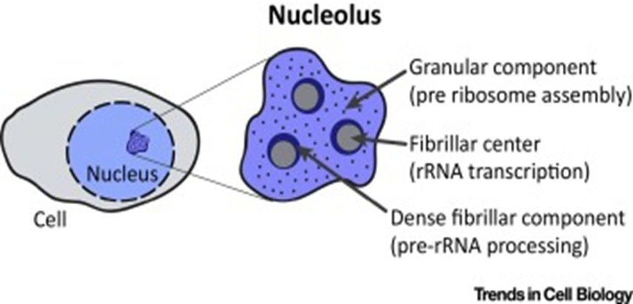
Nucleolus
Difference between Nucleus and Nucleolus
Nucleus
It is large in size and bounded by a double membrane called nuclear envelope. It contains chromosomes which is rich in DNA and genetic material.
Nucleolus
It is very small in size and has no limitng membrane. It does not hold any chromosomes but rich in RNA.

Slide 25
Functions of Nucleus
It controls the heredity characteristics of an organism.
It main cellular metabolism through controlling synthesis of particular enzymes.
It is responsible for protein synthesis, cell division, growth and differentiation.
Stores heredity material in the form of deoxy-ribonucleic acid (DNA) strands. Also stores proteins and ribonucleic acid (RNA) in the nucleolus.
It is a site for transcription process in which messenger RNA (mrna) are produced for protein synthesis.
It helps in exchange of DNA and RNA (heredity materials) between the nucleus and the rest of the cell.
Nucleolus produces ribosomes and are known as protein factories.
It also regulates the integrity of genes and gene expression.

