Slide 1
Chapter 11
Usability

Slide 2
Usability
Usability is concerned with how easy it is for the user to accomplish a desired task and the kind of user support the system provides.

Slide 3
Usability
Usability comprises the following areas:
Learning system features. If the user is unfamiliar with a particular system or a particular aspect of it, what can the system do to make the task of learning easier? This might include providing help features.
Using a system efficiently: what can system do to make the user more efficient in its operation? This might include the ability for the user to redirect the system after issuing a command.

Slide 4
Usability
Minimizing the impact of errors: What can the system do so that a user error has minimal impact? For example, the user may wish to cancel a command issued incorrectly.
Adapting the system to user needs: How can the user (or the system itself) adopt to make the user’s task easier? For example, the system may automatically fill the URLs based on the user’s past entries.

Slide 5
Usability
Increasing confidence and satisfaction: What does the system do to give the user confidence that the correct action is being taken? For example, providing feedback that indicates that the system is performing a long-running task and the extent to which the task is completed will increase the user’s confidence in the system.

Slide 6
Usability General Scenario
The portions of the usability general scenarios are these:
Source of stimulus. The end user (who may be in a specialized role, such as a system or network administrator) is always the source of the stimulus for usability.
Stimulus. The stimulus is that the end user wishes to use a system efficiently, learn to use the system, minimize the impact of errors, adapt the system, or configure the system.
Environment. The user actions with which usability is concerned always occur at runtime or at system configuration time.
Artifact. The artifact is the system or the specific portion of the system with which the user is interacting.
Response. The system should either provide the user with the features needed or anticipate the user’s needs.
Response measure. The response is measured by task time, number of errors, number of tasks accomplished, user satisfaction, gain of user knowledge, ratio of successful operations to total operations, or amount of time or data lost when an error occurs.

Slide 7
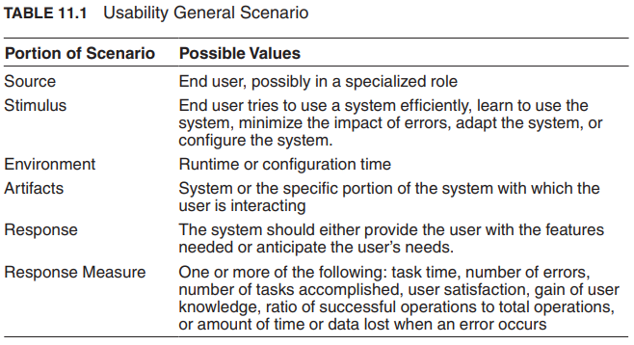
Usability General Scenario
Table 11.1: The user downloads a new application and is using it productively after two minutes of experimentation.

Slide 8
Tactics for usability
Researchers in human-computer interaction have used the terms user initiative, system initiative, and mixed initiative to describe which of the human-computer pair takes the initiative in performing certain actions and how the interaction proceeds.
Usability scenarios can combine initiatives from both perspectives. For example, when canceling a command, the user issues a cancel—user initiative— and the system responds.
During the cancel, however, the system may put up a progress indicator—system initiative.
Thus, cancel may demonstrate mixed initiative. We use this distinction between user and system initiative to discuss the tactics that the architect uses to achieve the various scenarios.

Slide 9
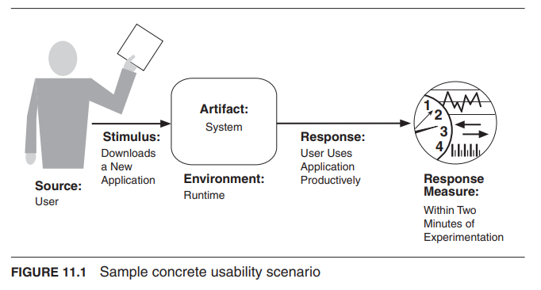
Concrete usability scenario
Figure 11.2 shows the goal of the set of runtime usability tactics.

Slide 10
Usability Tactics

Slide 11
Usability Tactics

Slide 12
Support User Initiative
Cancel: the system must listen for the cancel request; the command being canceled must be terminated; resources used must be freed; and collaborating components must be informed.
Pause/Resume: temporarily free resources so that they may be re-allocated to other tasks.
Undo: maintain a sufficient amount of information about system state so that an earlier state may be restored, at the user’s request.
Aggregate: When a user is performing repetitive operations, or operations that affect a large number of objects in the same way, it is useful to provide the ability to aggregate lower-level objects into a group, so that a user operation may be applied to the group, freeing the user from the drudgery.

Slide 13
Support System Initiative
Maintain Task Model: determines context so the system can have some idea of what the user is attempting and provide assistance.
Maintain User Model: explicitly represents the user's knowledge of the system, the user's behavior in terms of expected response time, etc. A special case of this tactic is commonly found in user interface customization, wherein a user can explicitly modify the system’s user model.
Maintain System Model: system maintains an explicit model of itself. This is used to determine expected system behavior so that appropriate feedback can be given to the user. A common manifestation of a system model is a progress bar that predicts the time needed to complete the current activity

Slide 14
A Design Checklist for Usability

Slide 15
A Design Checklist for Usability

Slide 16
A Design Checklist for Usability

