Slide 1
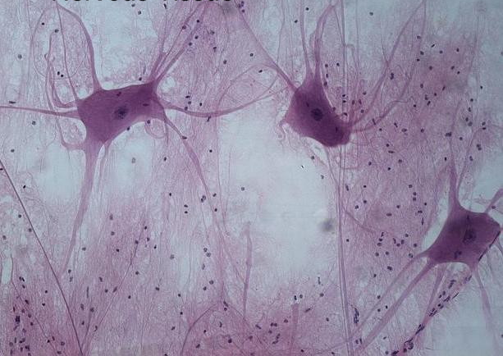
Neuron Structure and Function

Slide 2
Receptor:
Sensory cells or
organs that
detect stimuli
Nerve impulses transmitted by
peripheral nerves to CNS
(brain and spinal cord)
CNS:
brain interprets
nerve impulses and
decides action to
be taken
Brain initiates nerve
impulses; transmitted
to effectors
Effectors
Muscles or glands that
carry out
actions

Slide 3
Nerve
Sensory nerve fibre: conduct nerve impulses from sense organs
Motor nerve fibre: conduct nerve impulses to effectors
Mixed fibre: contains both sensory and motor nerve fibres (eg spinal nerve)

Slide 4
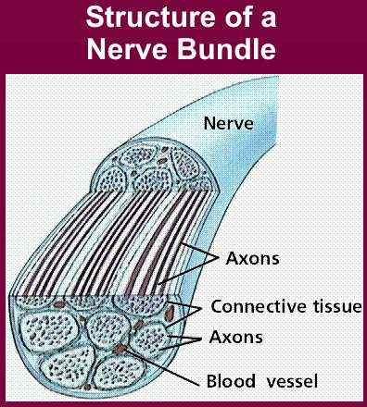
Nerve:
bundle of axons enclosed in a sheath of connective tissue
Cranial nerve: Nerve that emerge from brain
Spinal nerve: Nerve that emerge from spinal cord

Slide 5
Nervous Tissue
Nervous system
made up of
Nervous tissue
consists of
Nerve cells (neurones)
Sensory neurons
Interneurons
Motor neurons

Slide 6
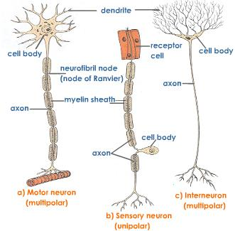

Slide 7
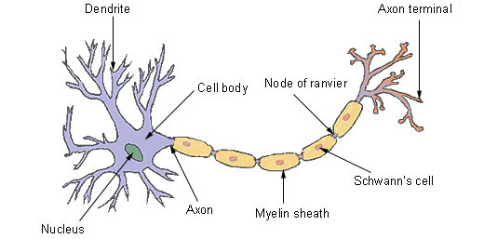
Anatomy of a Motor Neuron

Slide 8
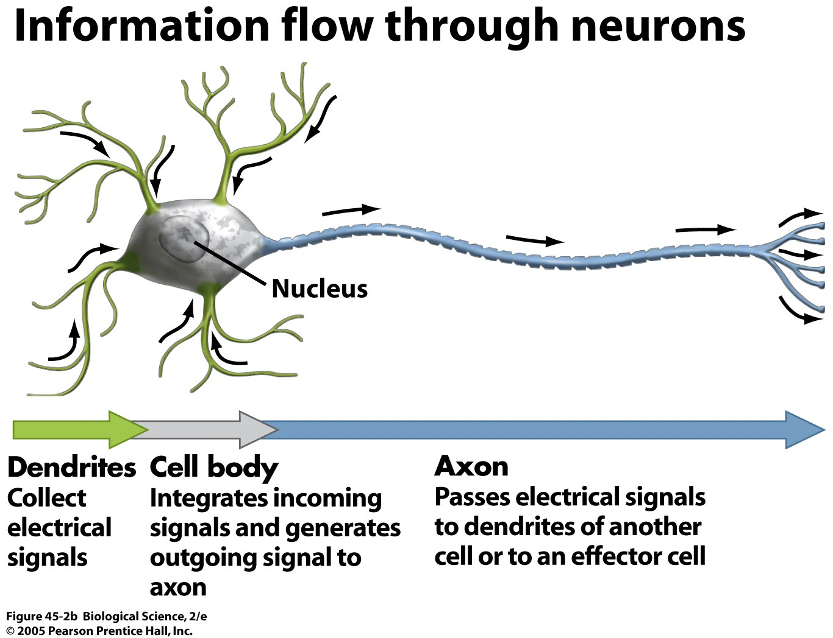

Slide 9
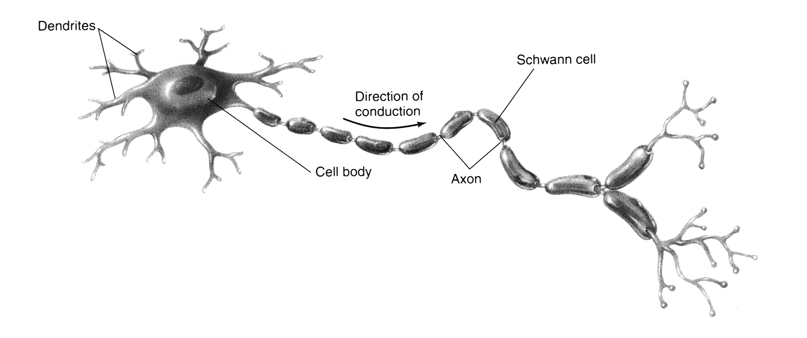
myelin sheath
Parts of neuron:
node of Ranvier
Dendron and Dendrites: Nerve fibres that transmit nerve impulse towards cell body. End branches of dendrons are dendrites. Dendrites receive nerve impulses from other neurons.
Cell body: cell body of motor neuron is irregular in shape. It contains the nucleus and controls cell activities
Axon: nerve fiber that transmit nerve impulses away from cell body. Axons are usually long.
Myelin sheath: layer of fatty substances enclosing nerve fibers. Insulates axon like a rubber sheath.
Nodes of Ranvier: regions where myelin sheath is absent. Allows nerve impulses to jump, speeding up transmission of impulses
Axon terminal/synaptic terminal: release chemicals which transfer the message to the next neuron.

Slide 10
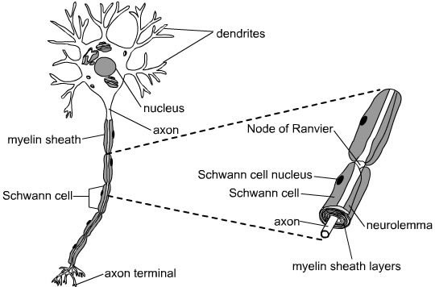
dendron

Slide 11
A closer look at the sensory neurone..
dendron
dendrite
How is it different from motor neurone?
circular cell body
1 long dendron and 1 short axon

Slide 12
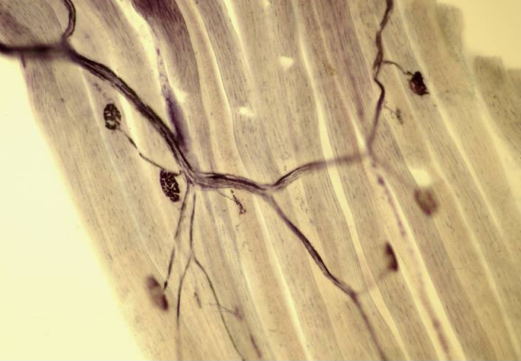
Motor neurone – motor end plate
Nerve impulses are transmitted across motor end plate by chemicals that stimulate the muscle.
Motor end plate: junction between dendrite and muscle fibre

Slide 13
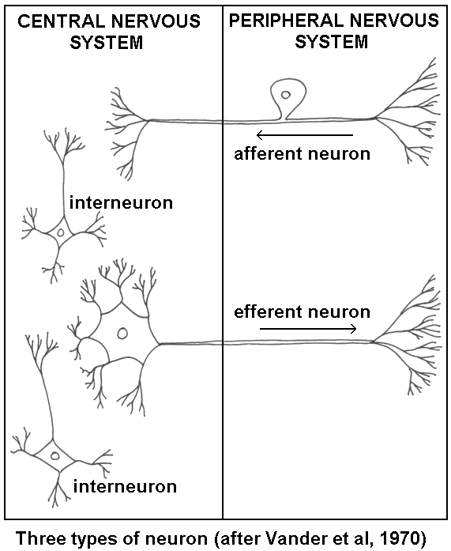
receptor
sensory neurone
sensory neuron
interneuron
motor neuron
effector
(eg muscle)

Slide 14
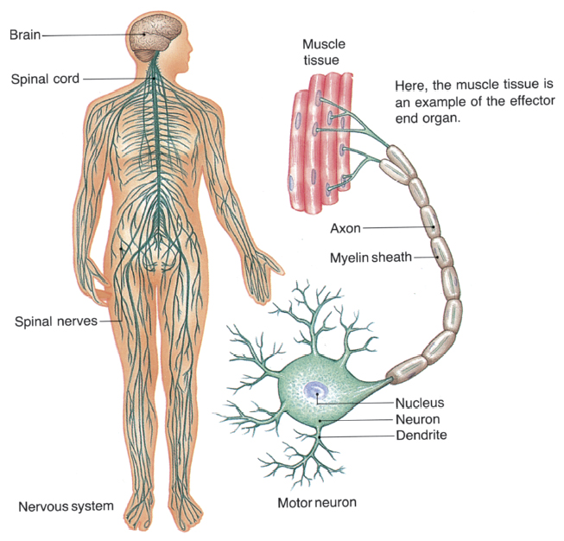
A closer look at the motor neuron.
Direction of nerve impulse

Slide 15
