Slide 1
Cityscape/Landscape
by Andleeb Rana

Slide 2
Landscape painting
Landscape painting, also known as landscape art, is the depiction of natural scenery such as mountains, valleys, trees, rivers, and forests, especially where the main subject is a wide view—with its elements arranged into a coherent composition. In other works, landscape backgrounds for figures can still form an important part of the work. Sky is almost always included in the view, and weather is often an element of the composition. Detailed landscapes as a distinct subject are not found in all artistic traditions, and develop when there is already a sophisticated tradition of representing other subjects.
Two main traditions spring from Western painting and Chinese art, going back well over a thousand years in both cases. The recognition of a spiritual element in landscape art is present from its beginnings in East Asian art, drawing on Daoism and other philosophical traditions, but in the West only becomes explicit with Romanticism.

Slide 3
Subject matter
Landscape views in art may be entirely imaginary, or copied from reality with varying degrees of accuracy. If the primary purpose of a picture is to depict an actual, specific place, especially including buildings prominently, it is called a topographical view.
The earliest forms of art around the world depict little that could really be called landscape, although ground-lines and sometimes indications of mountains, trees or other natural features are included. The earliest "pure landscapes" with no human figures are frescos from Minoan Greece of around 1500 BCE.
Hunting scenes, especially those set in the enclosed vista of the reed beds of the Nile Delta from Ancient Egypt, can give a strong sense of place, but the emphasis is on individual plant forms and human and animal figures rather than the overall landscape setting. The frescos from the Tomb of Nebamun, now in the British Museum (c. 1350 BC), are a famous example.

Slide 4
Perspective
For a coherent depiction of a whole landscape, some rough system of perspective, or scaling for distance, is needed, and this seems from literary evidence to have first been developed in Ancient Greece in the Hellenistic period, although no large-scale examples survive.
The Chinese ink painting tradition of shan shui ("mountain-water"), or "pure" landscape, in which the only sign of human life is usually a sage, or a glimpse of his hut, uses sophisticated landscape backgrounds to figure subjects, and landscape art of this period retains a classic and much-imitated status within the Chinese tradition.
Both the Roman and Chinese traditions typically show grand panoramas of imaginary landscapes, generally backed with a range of spectacular mountains – in China often with waterfalls and in Rome often including sea, lakes or rivers. These were frequently used, as in the example illustrated, to bridge the gap between a foreground scene with figures and a distant panoramic vista, a persistent problem for landscape artists. The Chinese style generally showed only a distant view, or used dead ground or mist to avoid that difficulty.

Slide 5
Renaissance
Landscape backgrounds for various types of painting became increasingly prominent and skillful during the 15th century. The period around the end of the 15th century saw pure landscape drawings and watercolours from Leonardo da Vinci, Albrecht Dürer, Fra Bartolomeo and others. At the same time Joachim Patinir in the Netherlands developed the "world landscape" a style of panoramic landscape with small figures and using a high aerial viewpoint, that remained influential for a century, being used and perfected by Pieter Brueghel the Elder. The Italian development of a thorough system of graphical perspective was now known all over Europe, which allowed large and complex views to be painted very effectively.
By abandoning the panoramic viewpoint of the world landscape and focusing on the humble, rural and even topographical, the Small Landscapes set the stage for Netherlandish landscape painting in the 17th century. After the publication of the Small Landscapes, landscape artists in the Low Countries either continued with the world landscape or followed the new mode presented by the Small Landscapes.

Slide 6
17th and 18th centuries
Dutch Golden Age painting of the 17th century saw the dramatic growth of landscape painting, in which many artists specialized, and the development of extremely subtle realist techniques for depicting light and weather. Most Dutch landscapes were relatively small, but landscapes in Flemish Baroque painting, still usually peopled, were often very large, above all in the series of works that Peter Paul Rubens painted for his own
By the beginning of the 19th century the English artists with the highest modern reputations were mostly dedicated landscape painters, showing the wide range of Romantic interpretations of the English landscape found in the works of John Constable, J.M.W. Turner and Samuel Palmer.

Slide 7
19th and 20th centuries
French painters were slower to develop landscape painting, but from about the 1830s Jean-Baptiste-Camille Corot and other painters in the Barbizon School established a French landscape tradition that would become the most influential in Europe for a century, with the Impressionists and Post-Impressionists for the first time making landscape painting the main source of general stylistic innovation across all types of painting.
In the United States, the Hudson River School, prominent in the middle to late 19th century, is probably the best-known native development in landscape art. These painters created works of mammoth scale that attempted to capture the epic scope of the landscapes that inspired them. The work of Thomas Cole, the school's generally acknowledged founder, has much in common with the philosophical ideals of European landscape paintings — a kind of secular faith in the spiritual benefits to be gained from the contemplation of natural beauty. Although certainly less dominant in the period after World War I, many significant artists still painted landscapes in the wide variety of styles exemplified by Edvard Munch, Georgia O'Keeffe, Charles E. Burchfield, Neil Welliver, Alex Katz, Milton Avery, Peter Doig, Andrew Wyeth, David Hockney and Sidney Nolan.

Slide 8
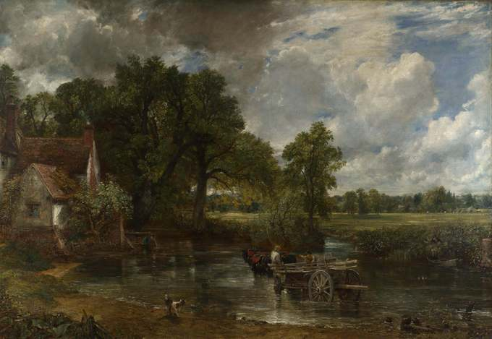
Western Cityscapes
The Hay Wain by John Constable 1821

Slide 9
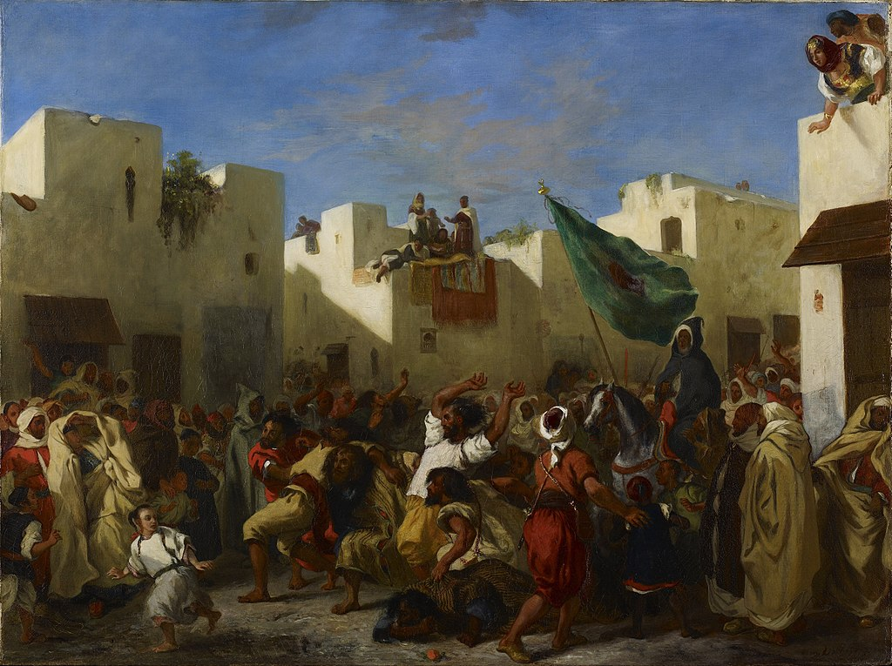
Eugène_Delacroix_-_The_Fanatics_of_Tangier 1838

Slide 10
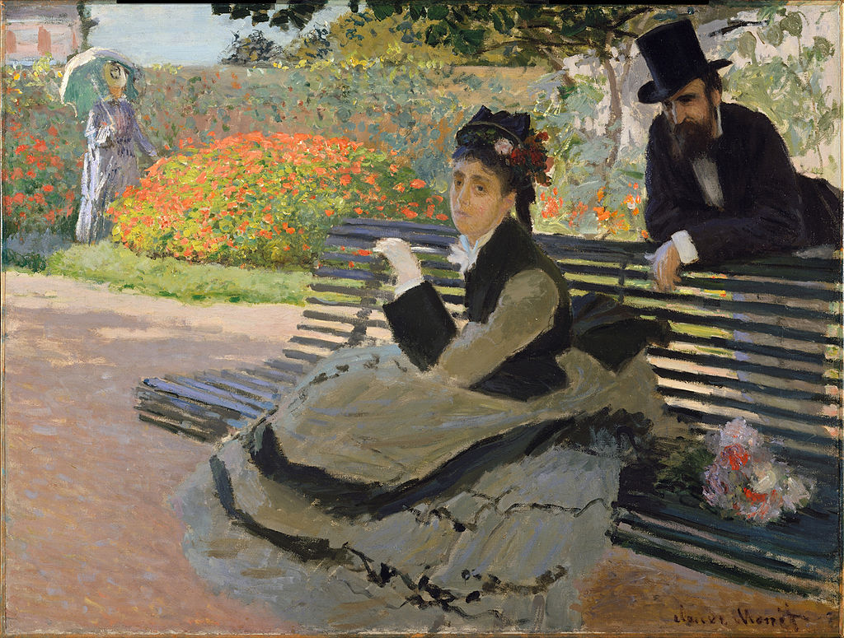
Claude Monet,1873, Camille Monet on a Bench, oil on canvas, 60.6 x 80.3 cm

Slide 11
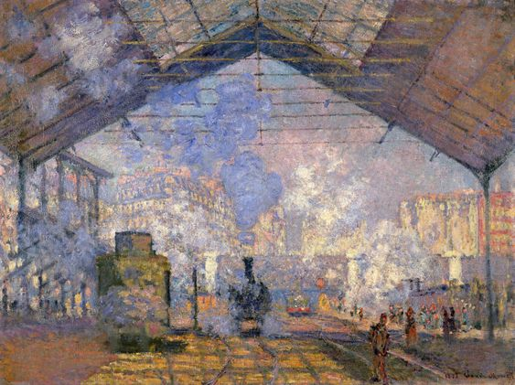
Arrival of the Normandy Train, Gare Saint-Lazare, 1877, Claude_Monet

Slide 12
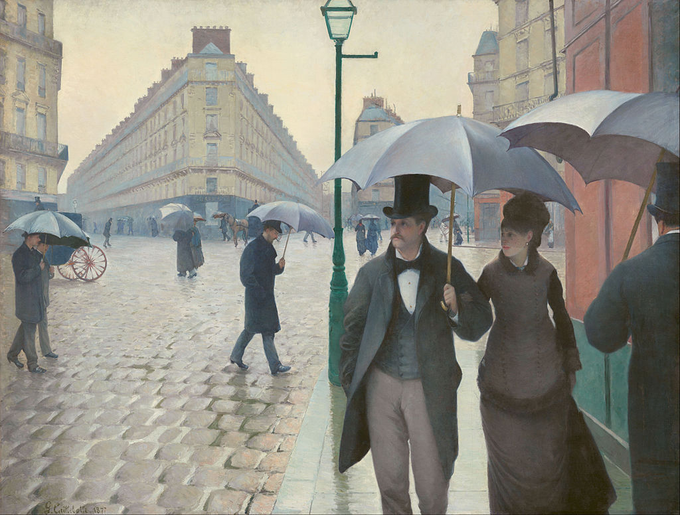
Gustave Caillebotte, Paris Street; Rainy Day, 1877

Slide 13
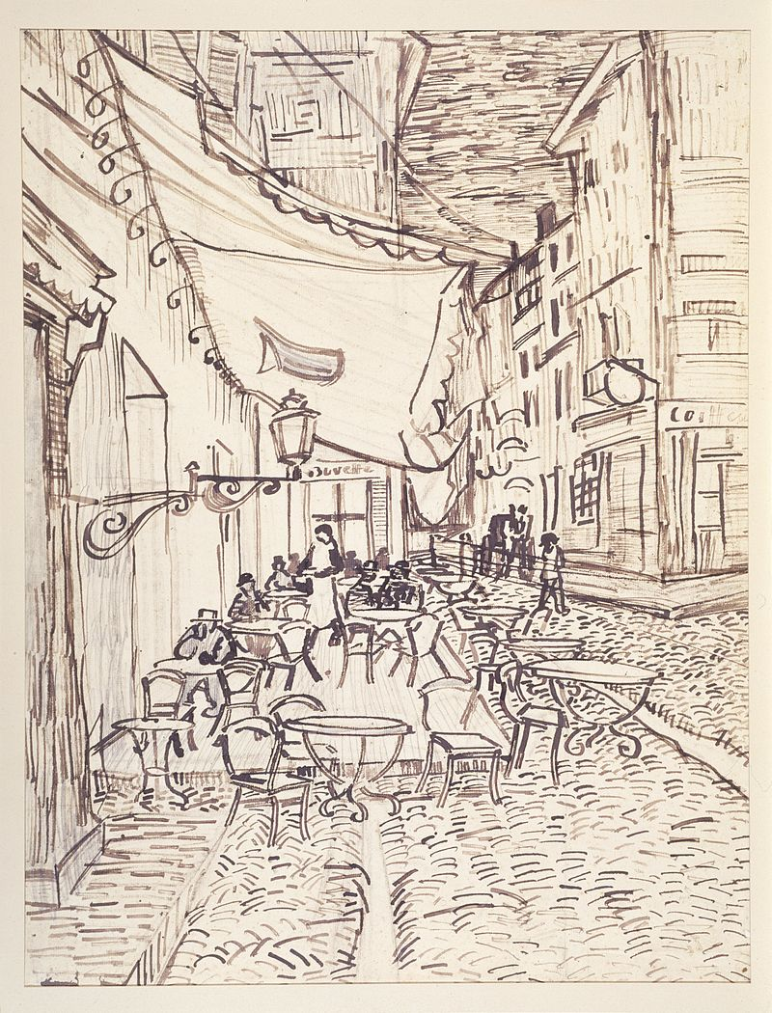
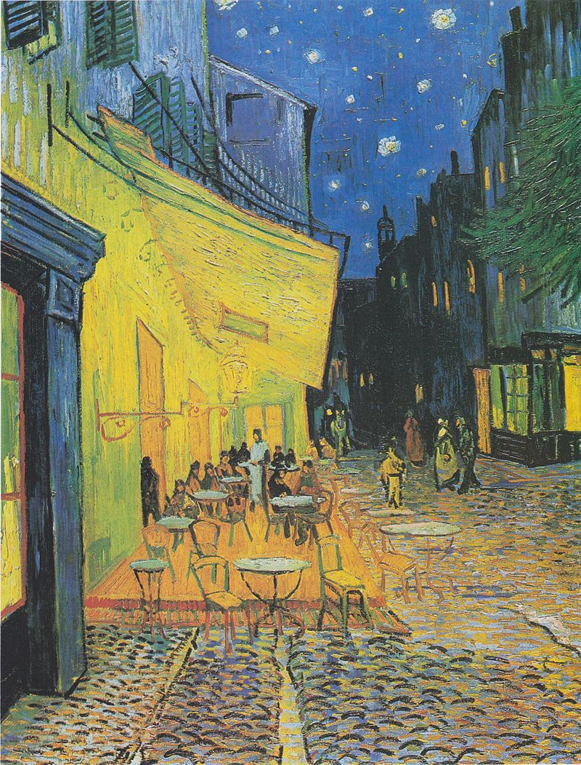
Vincent van Gogh Café Terrace at Night (1888)

Slide 14
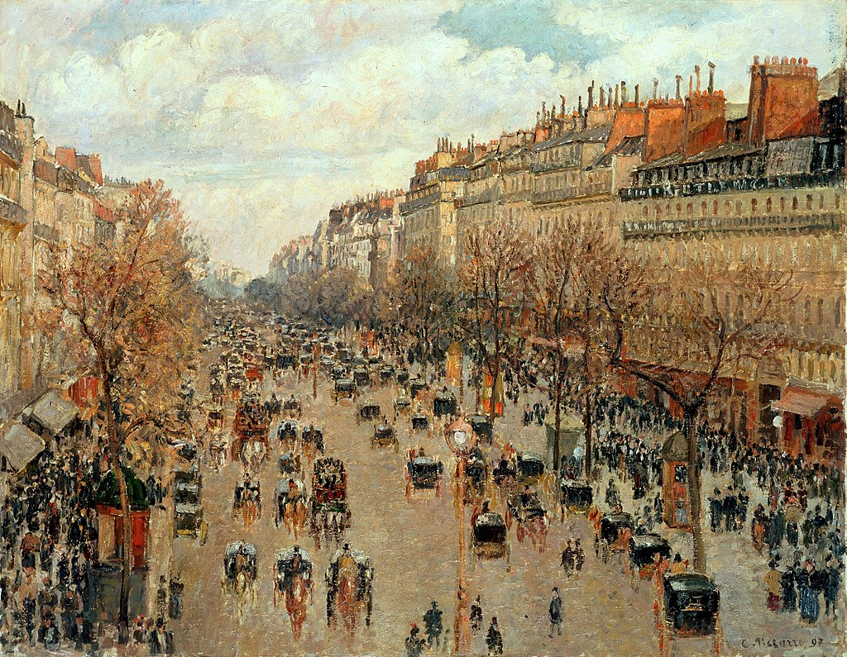
Camille Pissarro Boulevard Montmartre Heremitage Saint Petersburg 1897

Slide 15
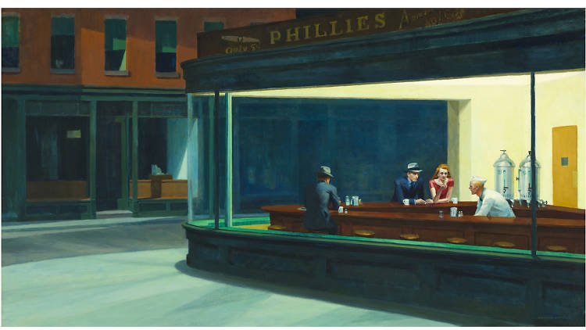
Edward Hopper, Nighthawks, 1942

Slide 16
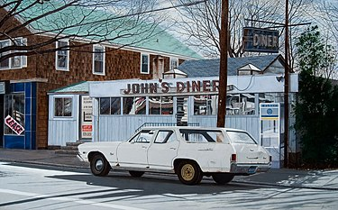
John's Diner with John's Chevelle 2007 John Baeder Oil on canvas 30 x 48 inches

Slide 17
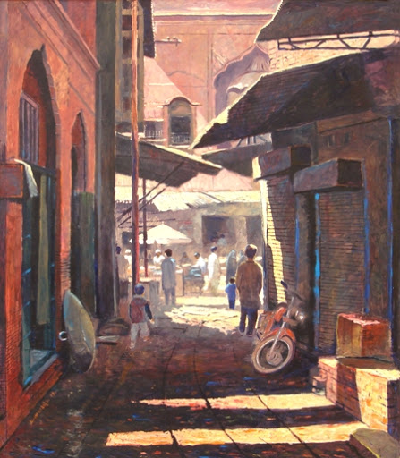
Cityscape in Pakistan’s Art
Gulam Mustapha

Slide 18
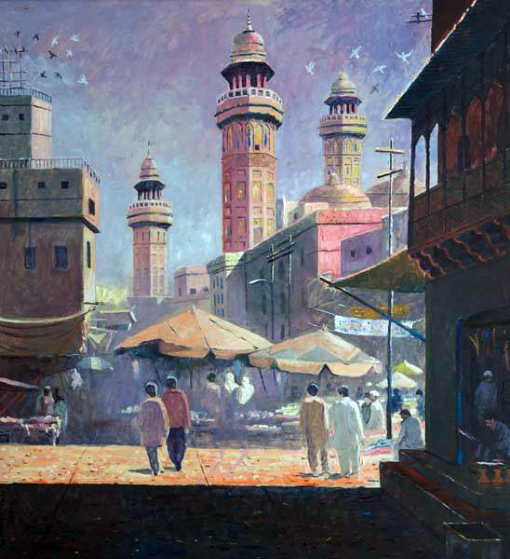
Ghulam Mustapha

Slide 19
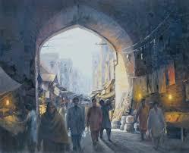
Zulfiqar Zulfi

Slide 20
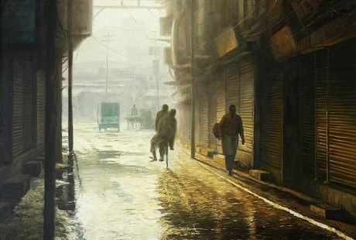
Zulfiqar Zulfi

Slide 21
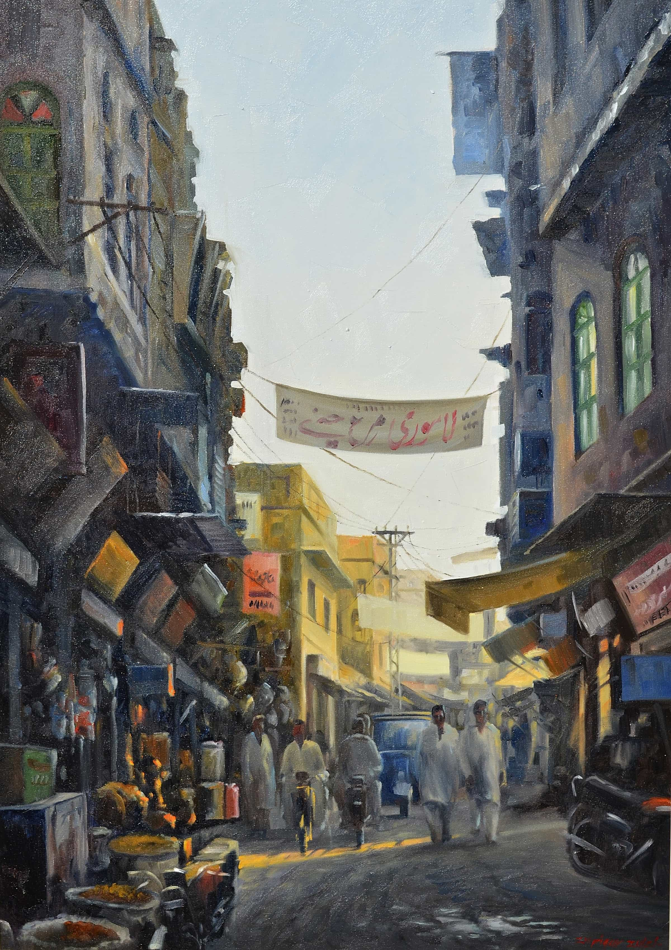
Zulfiqar Zulfi

Slide 22
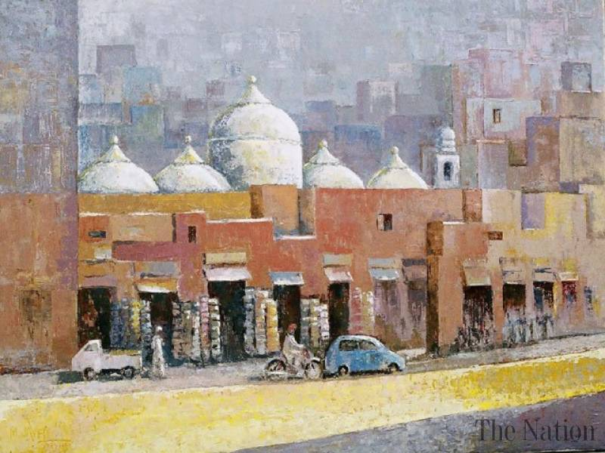
Muhammad Javed

Slide 23
Thank You

