Slide 2
GUAR

Slide 3
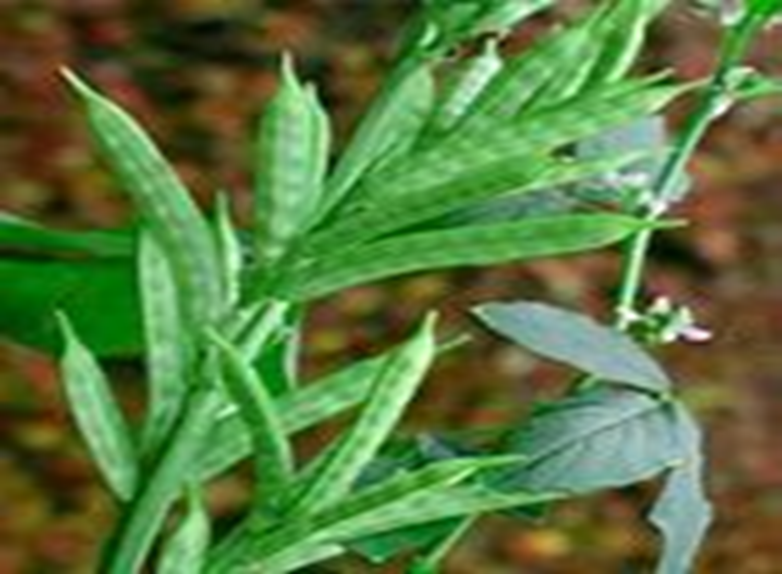

Slide 4
Introduction:
The guar or Lond bean, with the herbal name Cyamopsis tetragonoloba, is a yearly vegetable and the wellspring of guar gum. It is otherwise called gavar, gawar, or guar bean. The inception of Cyamopsis tetragonoloba is obscure, since it has never been found in the wild. It is expected to have created from the African species Cyamopsis senegalensis. It was additionally trained in South Asia, where it has been developed for centuries. Guar develops well in semiarid regions, yet visit precipitation is vital. This vegetable is a significant plant in a yield pivot cycle, as it lives in beneficial interaction with nitrogen-fixing bacteria. Agriculturists in semi-dry areas of Rajasthan follow crop-revolution and use guar to renew the dirt with fundamental composts and nitrogen obsession, before the following harvest. Guar has numerous capacities for human and creature nourishment, yet the gelling operator in its seeds (guar gum) are the most significant use. Demand is ascending because of the utilization of guar gum in water powered cracking (oil shale gas). About 80% of world creation happens in India, yet because of solid interest, the plant is being presented somewhere else.

Slide 5
History:
Guar or cluster bean, (Cyamopsis tetragonoloba (L.) Taub) is a dry season open minded yearly vegetable that was brought into the United States from India in 1903. Business creation of guar in the United States started in the mid-1950s and has been moved in northern Texas and southwestern Oklahoma. The significant world providers are India, Pakistan and the United States, with littler acreages in Australia and Africa. In the mid-1980s, Texas cultivators were planting around 100,000 sections of land yearly. They gathered about portion of the planted grounds and furrowed the rest under as green fertilizer. In contrast to the seeds of different vegetables, the guar bean has an enormous endosperm. This circular molded endosperm contains huge measures of galactomannan gum (19 to 43% of the entire seed), which shapes a gooey gel in chilly water. Guar gum is the essential attractive result of the plant. India and Pakistan send out quite a bit of their guar yield to the United States and different nations as incompletely handled endosperm material. World interest for guar has expanded as of late, prompting crop presentations in a few nations.

Slide 6
The beginning of Cyamopsis tetragonoloba is obscure, since it has never been found in the wild. It is accepted to have created from the African species Cyamopsis senegalensis. It was additionally tamed in South Asia, where it has been developed for centuries. Guar develops well in semiarid territories, yet visit precipitation is fundamental. This vegetable is an important plant in a harvest turn cycle, as it lives in beneficial interaction with nitrogen-fixing bacteria. Agriculturists in semi-bone-dry areas of Rajasthan follow crop-pivot and use guar to renew the dirt with basic composts and nitrogen obsession, before the following yield. Guar has numerous capacities for human and creature sustenance, yet the gelling specialist in its seeds (guar gum) are the most significant use. Demand is ascending because of the utilization of guar gum in pressure driven breaking (oil shale gas). About 80% of world creation happens in India, however because of solid interest, the plant is being presented somewhere else.

Slide 7
CYTOGENETICS:
Gene activity of significant qualities Character Mode of legacy Reported image Growth propensity Indeterminate: prevailing De Determinate: passive de Pubescent: predominant G Glabrous: passive g Hairy; prevailing H Non furry: latent h Male sterility Male Fertile; dominant MS Male clean; passive mms Seed shape Flat: dominant R Round: passive r Leaf shading Green; predominant Y Yellow: passive y Ray and Stafford (1985) .

Slide 8
Botany and Morphology of Guar
Cyamopsis tetragonoloba develops upstanding, arriving at a most extreme stature of up to 2–3 m. It has a fundamental single stem with either basal stretching or fine expanding along the stem. Guar taproots can get to soil dampness in low soil depths. This vegetable creates root knobs with nitrogen-fixing soil microscopic organism’s rhizobia in the surface piece of its establishing framework. Its leaves and stems are for the most part shaggy, contingent upon the cultivar. Its fine leaves have a prolonged oval shape (5 to 10 cm length) and of interchange position. Bunches of roses develop in the plant axil and are white to somewhat blue in shading. The creating cases are somewhat level and thin containing 5 to 12 little oval seeds of 5 mm length (TGW = 25-40 g). Normally develop seeds are white or dim, yet with overabundance dampness they can turn dark and lose germination limit.
The chromosome number of guar seeds is 2n=14. The seeds of guar beans have an exceptional trademark. Its part comprises of a protein-rich germ (43-46%) and a moderately enormous endosperm (34-40%), containing a lot of the galactomannan. This is a polysaccharide containing polymers of mannose and galactose in a proportion of 2:1 with numerous branches. Thus, it displays an incredible hydrogen holding action having a viscosifying impact in fluids.

Slide 9
Uses
Guar plant:
Agribusiness
Rummage: Guar plants can be utilized as steers feed, yet due to hydrocyanic corrosive in its beans, just develop beans can be used.
Green compost: Guar plantings increment the yield of ensuing harvests as this vegetable preserves soil supplement content.
Local use
Vegetable: Guar leaves can be utilized like spinach, and the cases are readied like plate of mixed greens or vegetables. Its beans are nutritious, yet guar protein isn't usable by people except if toasted to crush the trypsin inhibitor.
Guar gum:
The seeds of the guar bean contain an enormous endosperm. This endosperm comprises of an enormous polysaccharide of galactose and mannose. This polymer is water-solvent and shows a viscosifying impact in water. Guar gum has a large number of various applications in nourishment items, modern items, and extractive industry.

Slide 10
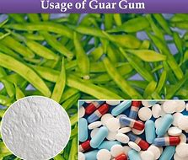

Slide 11
Food
In a few nourishment and drinks guar gum is utilized as added substance to change its thickness or as fiber source.
Partially hydrolyzed Guar gum:
In partially hydrolyzed guar gum (PHGG) is delivered by the halfway enzymatic hydrolysis of guaran, the galactomannan of the endosperm of guar seeds (guar gum). It is an impartial polysaccharide comprising of a mannose spine chain with single galactose side units happening on very nearly two out of each three mannose units. The normal sub-atomic weight is around 25,000 Daltons. This gives a PHGG that despite everything measures and capacities as a solvent dietary fiber.
PHGG was sold financially is totally solvent, corrosive and warmth steady, unaffected by particles, and won't gel at high fixations. Business PHGG is roughly 75% dietary fiber and has insignificant impact on taste and surface in nourishment and refreshment things. PHGG is completely fermentable in the enormous gut, with a high pace of unpredictable unsaturated fat development. The pH of the defecation is brought down alongside an expansion in fecal mass that mostly comprises of bacterial cell mass and water. Clinical examinations have shown a prebiotic impact of PHGG. Studies have indicated that PHGG can be utilized to look after normality. PHGG is utilized in nourishments for particulate suspension, emulsification, antistaling, ice gem control, and diminished fat prepared products .

Slide 12
OBJECTIVES
Higher yield and efficiency
Development of assortment appropriate for summer season
Resistance to maladies
Early development

Slide 13
BREEDING METHODS
Pedigree strategy
Bulk Pedigree technique
Back cross
Single plant choice
Mutation rearing
Polyploidy rearing
Interspecific hybridization
Biotechnological devices

Slide 14
Reproducing for quality characteristics:
Gum and protein substance in guar seed are of prime significance from mechanical view point Positive connection was seen between seed yield and rate gum content yet there was a negative relationship between's seed weight and gum rate which may hamper rearing for strong seededness. Genetic investigation uncovered that both added substance and non-added substance quality impacts were working in the declaration of this modern segment Breeding for infection obstruction Bacterial scourge (Xanthomonoas oxonopodis), Alternaria leaf spot and fine mold are the genuine ailments Inheritance of bacterial curse and Alternaria leaf spot isn't completely comprehended Singh et al(1995) and Saharan et al(1999) saw that opposition for bacterial curse was a predominant attribute though Alternaria leaf spot is acquired by passive characteristic Additive , prevailing and epistemic quality communication assumed noteworthy job towards contributing obstruction in guar Phenol and peroxidase chemical assumed a huge job in giving the obstruction towards primary sicknesses.

Slide 15
Mutation BREEDING:
Perfect apparatus to improve variety in crop like guar where exploitable and helpful hereditary changeability is merging. Creation of variety through hybridization is troublesome Physical mutagens. Occurrence of proportional translocation in 20kR lighted populace 200KR illumination end up being deadly prompting total disappointment in seed germination. Early blossoming and determinate freaks created by gamma radiation Chemical mutagens. Chlorophyll lacking freaks saw in seed treated with EMS in M1[Gohal et al., 1970]. Hydroxyl amine treatment brought about spellbound and normal unit bearing freak. EMS and hydroxyl hydrate treatment came about in pleiotropic impact prompts broad blooming and late blossoming.
PHYSICAL AND CHEMICAL MUTAGENS:
Induction of high yielding freaks in cultivars PLG 143 and Suvidha seeds presented to 80 to 100 Kr gamma beams and treated with EMS 0.1to 0.3 percent prompts long units expanded number of cases and early development Effect of hybridization and illumination on acceptance of fluctuation Comparison of nature and greatness of inconstancy among the unirradiated F1S and F2S,and lighted F1M1S and F2M2S ages uncovered that light reason earliness in blossoming and development just as expanded 100

Slide 16
INTESPECIFIC HYBRIDIZATION:
The hybridization however a traditional technique could be a finished disappointment. Cyamopsis tetragonoloba x c.serreta (Sandhu, 1988) BIOTECHNOLOGICAL APPROACHES Major issue is the absence of cloned DNA speaking to qualities for characters of monetary significance for utilization of guar raisers. Utilization of RFLPs for quality mapping could give helpful choice instrument. Agrobacterium interceded quality exchange and direct quality exchange in to protoplast are the strategies which have yielded transgenic plants.
POLYPLOIDY BREEDING:
Cluster bean is a diploid with 2n=14 Autotetraploids have been portrayed by similarly moderate development during beginning times of improvement, thickened leaves less stomata and ale dust grains, Reduced dust and seed ripeness and Mixoploid plant came about because of fluid colchicine treatment indicated 2n=26 and 2n=28 chromosomes in PMC of same plant.

Slide 17
Anthesis:
Flower opening at morning from 6-10 am. Dehiscence of anther before sprouting i.e.; 10 pm-1 am
SELFING:
Cluster bean is being a self-pollinated crop it doesn't require any counterfeit selfing strategies however for the improvement we by and large go for sacking of the develop bloom bud.
EMASCULATION AND POLLINATION:
Intersection Emasculation completed in develops bloom bud in going before night.
Pollination is done all the while or in next morning from newly opened blossoms.

Slide 18
PROCESSING OF GUAR CROP
Guar gum preparing differs from plant to plant. The general layout of the assembling procedure of guar gum is appeared in Fig. 1. At the point when guar seeds are expelled from their pods these are circular fit as a fiddle, earthy in shading, littler than pea seeds in size.

Slide 19
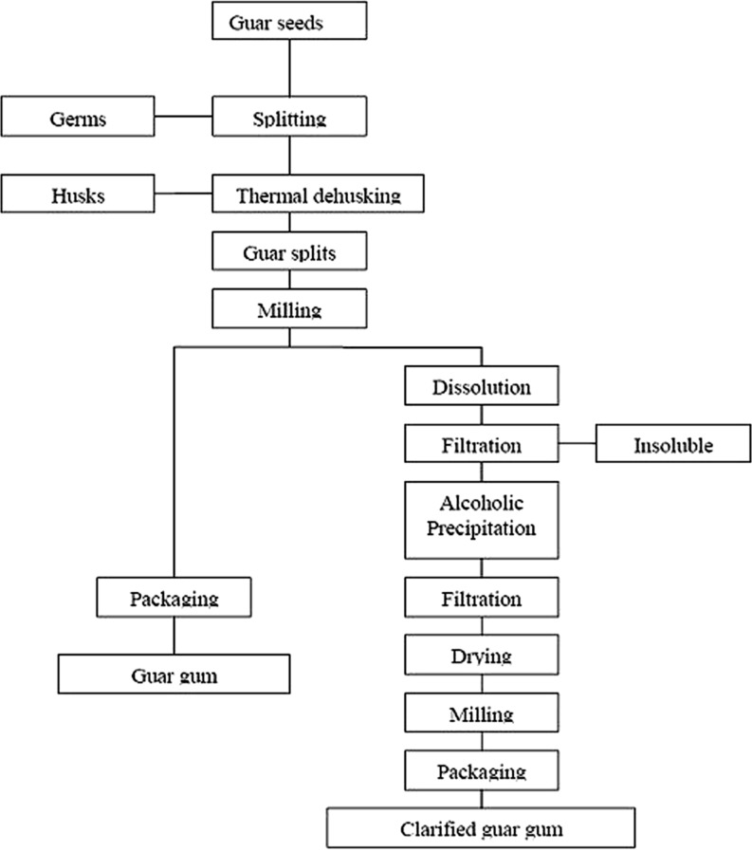

Slide 20
The gum is monetarily separated from seeds basically by a mechanical procedure of simmering, differential whittling down, sieving and cleaning. The seeds are broken and the germ is isolated from the endosperm. Two parts of the endosperm are acquired from each seed and are known as undehusked guar split. At the point when the fine layer of sinewy material, which frames the husk, is expelled and isolated from the endosperm parts by cleaning, refined guar parts are gotten. The structure (husk) and germ bit of guar seed are named as guar dinner which is a significant result of guar gum powder handling and is used as steers feed. The refined guar parts are then treated and completed into powders (known as guar gum) by an assortment of courses and preparing strategies relying on the final result wanted. The pre hydrated guar parts are squashed in flacker plant and afterward consistently moved to ultra-fine processor, which pounds the parts without creating an excessive amount of warmth. The pounded material is dried and gone through screens for evaluating of the material as per the molecule size. Different evaluations are accessible relying on shading, work size, thickness potential and pace of hydration (Chudzikowski 1971). In mechanical preparing of guar gum expulsion is additionally included before hydration and chipping. After these means granulating and drying are finished. Incorporation of expulsion gives guar gum powder with improved hydration rate (Chowdhury 2002). The results of guar gum industry are Churi and Korma which are used for dairy cattle feed.

Slide 21
Value addition of Guar Crop
Request of guar gum has expanded during most recent couple of decades because of the advancement of various subsidiaries of guar gum like anionic and cationic subordinates. Present business significance of guar gum is a result of its utilization in oil and gas well incitement explicitly water driven breaking in which high weight is utilized to split stone. Guar gum makes the cracking liquid thicker with the goal that it can convey sand into broke stone. This break stays open because of quality of sand which makes a way for gas or oil to stream to all around bore. Guar subordinates for use in breaking liquids are hydroxypropyl guar (HPG) and carboxymethyl hydroxypropyl guar (CMHPG). In material and floor covering printing, guar gum thickens the color arrangements which permit all the more strongly printed examples to be created. . Guar gum has been utilized in explosives for more than 25 years as an added substance to explosive for water blocking. Lately, it has become the essential gelling specialist in water based slurry explosives. Water blocking, expanding and gelling property of guar gum make it empower to use as an added substance in hazardous industry. Dangerous property is kept up by blending of ammonium nitrate, nitroglycerine and oil explosives with guar gum even in wet conditions. The creation of paper is improved by an expansion of modest quantities of guar gum to the mash. It fills in as a fiber deflocculent and dry-quality added substance. It gives denser surface to the paper utilized in printing.

Slide 22
Food Applications:
In nourishment industry, guar gum is utilized as novel nourishment added substance in different nourishment items for nourishment adjustment and as fiber source (Morris 2010). It is enjoyed by both maker and shopper since it is prudent just as characteristic added substance. It is utilized in assortment of nourishments as an added substance since it changes the conduct of water present as a typical part in different food sources. Allowable use levels and confinements in different items are secured under Title 21 CFR 184.1339, certifying guars "for the most part perceived as protected" (GRAS) status
Beverages:
Guar gum is utilized in beverages for thickening and thickness control in view of its few inborn properties. The significant property of guar gum is its protection from breakdown under low pH conditions present in drinks. Guar gum is solvent in cool water which makes it simple to use in drink preparing plants. It improves the time span of usability of refreshments.

Slide 23
Processed cheeses:
In cheddar item, syneresis or sobbing is an issue of genuine concern. Guar gum forestalls syneresis or sobbing by water stage the board and hence improves the surface and body of the item (Klis 1966). In cheddar items it is permitted upto 3% of the all-out weight. Guar gum in the delicate cheeses upgrades the yield of curd solids and gives a gentler bend with isolated whey. Low-fat cheddar can be created with expansion of guar gum (at fixation 0.0025–0.01% w/v) without changing the rheology and surface contrasted and full-fat cheddar.
Dairy items:
Primary motivation behind utilizing guar gum in solidified items is adjustment. Guar gum has significant job in frozen yogurt adjustment on account of its water restricting properties. Its utilization in high temperature brief timeframe (HTST) forms is truly good in light of the fact that such procedures require hydrocolloids that can completely hydrate in a short preparing time. As indicated by McKiernan (1957) insect bean gum has all the properties of a perfect gum however it hydrates gradually which isn't great in HTST process. Julien (1953) got palatable outcomes with guar as stabilizer in ceaseless frozen yogurt preparing. Guar gum ought to be utilized in frozen yogurt blend at a fixation level of 0.3% (Goldstein and Alter 1959a, b). It was likewise utilized in mix with carrageenan in a blended guar-carrageenan framework created for HTST process. Like grasshopper bean gum its exhibition can be improved when utilized in mix with different stabilizers (Weinstein 1958).

Slide 24
Processed meat items:
Guar gum has solid water holding limit in both hot and cold water. Henceforth, it is successfully utilized as a cover and ointment in the assembling of hotdog items and stuffed meat items. It performs explicit capacities in handled meat items like syneresis control, anticipation of fat movement during capacity, thickness control of fluid stage during preparing and cooling and control of aggregation of the water in the can during capacity. Guar gum likewise improves the creaming strength and control rheology of emulsion arranged by egg yolk (Ercelebi and Ibanoglu 2010) .
Pastry kitchen items:
Expansion of guar gum in cake and scone mixture improves the machinability of the batter that is handily expelled from the form and can be effectively cut without disintegrating. At 1% expansion of in hitter of doughnuts, it gives alluring authoritative and film-framing properties that diminishes the infiltration of fats and oils. Guar gum in mix with starch is seen as viable in anticipation of lack of hydration, contracting and splitting of solidified pie fillings (Werbin 1950). In wheat bread batter, expansion of guar gum brings about noteworthy increment in portion volume on heating (Cawley 1964). Guar gum alongside thickener hinder staling in sans gluten rice cakes by diminishing the weight reduction and retrogradation enthalpy (Sumnu et al. 2010). Additionally, guar gum likewise impedes staling in chapati at room temperature just as refrigerated temperature by controlling retrogradation of starch (Shaikh et al. 2008).

Slide 26
Medical advantages
Different investigations have been led on creatures to test for both unsafe and gainful impact of guar gum. Guar is totally corrupted in the digestive organ by Clostridium butyricum (Harte mink et al. 1999). Destructive impacts are watched just when the guar gum is given to the creatures at a high grouping of around 10–15% on weight premise. This high fixation will lessen development of creature because of diminished feed admission and impeded absorption. It is viewed as that the high consistency of the intestinal tract substance, coming about because of admission of guar gum at higher fixation, is the significant reason for the negative impacts. Consequently, guar gum must be utilized for its valuable impacts at lower grouping of about 0.5–1.0%. Over this focus it will show negative impacts of higher thickness, diminished protein viability and lipid usage.
High thickness of guar gum when utilized at a higher fixation, above 1.0% won't just meddle with wholesome properties of the nourishment yet additionally with the physicochemical and tactile properties of the nourishment item which isn't acknowledged by the purchaser. Halfway hydrolysis of guar gum (PHGG) decreases the chain length and sub-atomic load of the polymer and eventually the lower consistency makes it a novel dissolvable fiber that looks like in fundamental synthetic structure with local guar gum and has different applications in clinical sustenance related with ingestion of dietary fiber.

Slide 27
In vitro investigation shows that nearness of guar gum essentially diminishes the assimilation of starch. It goes about as a hindrance among starch and starch hydrolyzing proteins (Dartois et al. 2010).
Guar gum shows cholesterol and glucose bringing down impacts due to its gel shaping properties. It likewise helps in weight reduction and heftiness avoidance. Because of gel shaping limit of guar gum solvent fiber, an expanded satiation is accomplished in view of moderate gastric purging. Diet enhanced with guar gum diminished the craving, yearning and want for eating (Butt et al. 2007). System behind cholesterol bringing down by guar gum is because of increment in discharge of bile acids in faecus and decline in enterohepatic bile corrosive which may improves the creation of bile acids from cholesterol and consequently hepatic free cholesterol fixation is decreased (Rideout et al. 2008).
Harmfulness concentrate on incompletely hydrolyzed guar gum has uncovered that it isn't mutagenic upto portion level of 2500 mg/day (Takahashi et al., 1994). Satisfactory admission of guar gum as dietary fiber helps in the upkeep of gut consistency, critical decreases altogether and LDL-cholesterol, control of diabetes, upgrade of mineral ingestion and anticipation of stomach related issues like stoppage (Yoon et al. 2008).

Slide 28
References:
Hypotriacylglycerolaemic impacts are because of decline in retention of dietary lipids and diminished movement of unsaturated fat synthase in liver (Yamamoto 2001).
Anderson E. Endosperm adhesives of vegetables: event and creation. Ind Eng Chem. 1949; 41:2887–2890. doi: 10.1021/ie50480a056. [CrossRef] [Google Scholar]
Andres S, Zaritzky N, Califano A. The impact of whey protein focuses and hydrocolloids on the surface and shading attributes of chicken hotdogs. Int J Food Sci Technol. 2006; 41:954–961. doi: 10.1111/j.1365-2621.2005.01152.x. [CrossRef] [Google Scholar]
APEDA (2011) APEDA yearly fare report. http://agriexchange.apeda.gov.in/list/product_description_32head.aspx?gcode=0502. Gotten to June 2011. Barth HG, Smith DA. Elite size-prohibition chromatography of guar gum. J Chromatogr. 1981;206:410–415. doi: 10.1016/S0021-9673(00)82558-3. [CrossRef] [Google Scholar]
BeMiller JN. One hundred years of business nourishment starches in the United States. J Agric Food Chem. 2009;57:8125–8129. doi: 10.1021/jf8039236. [PubMed] [CrossRef] [Google Scholar]

Slide 29
Thanks!!!

