Slide 1
Municipal Solid waste (msw)
Aka: Garbage

Slide 2
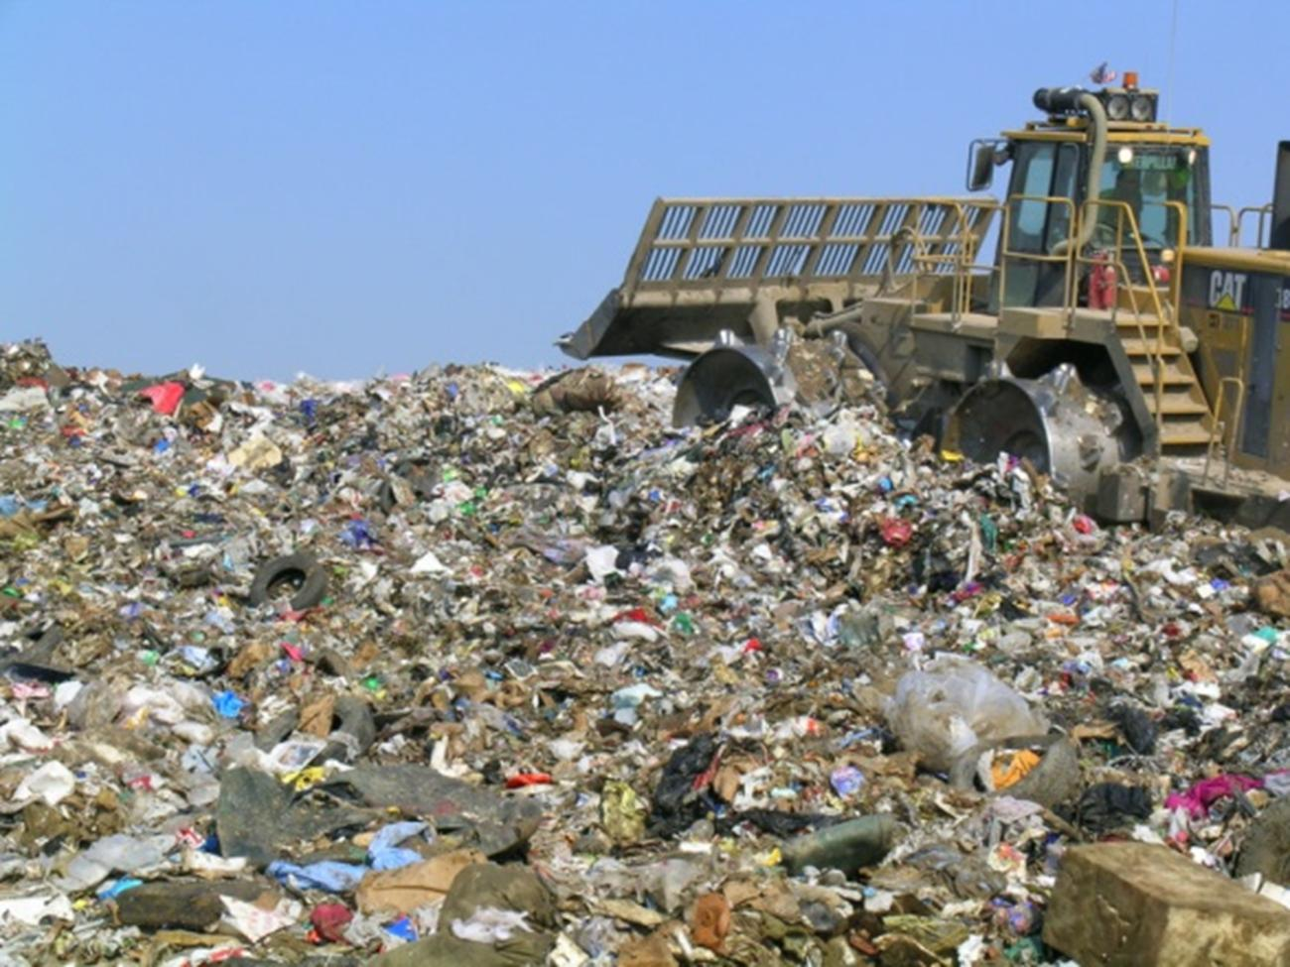
Municipal Solid Waste
Aka “trash” or “garbage”
Consists of common household waste, as well as office and retail waste.
Excludes industrial, hazardous and construction waste.

Slide 3
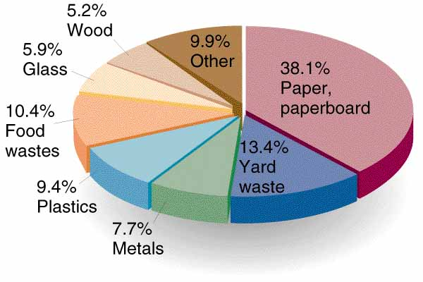
US MSW Composition
Paper is the greatest component (by weight) of MSW in the US.
* % for plastics has increased over the last several years.*

Slide 4
US Annual MSW Generation
Compared to other developed countries, Americans produce about twice as much garbage on a per capita basis.

Slide 5
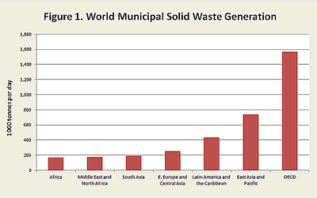

Slide 6
Plastics
From 1980 to 2005, there has been approximately a 300% increase in the use of plastics.
The environmental costs associated with the trend in the amount of plastic recovery compared to the amount of plastic generated include
Large amounts of non-biodegradable waste
Toxic compounds associated with petrochemicals

Slide 7
Why More Plastic?
Desirable properties of plastic include
Reusable
Durable
Light weight
Unbreakable

Slide 8
Waste Management Practices
The primary method of waste disposal in the US is landfilling.

Slide 9
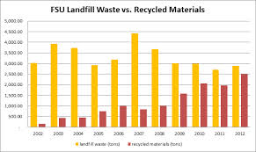

Slide 10
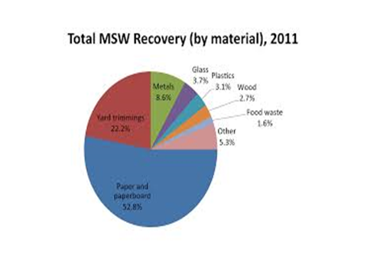
What Amount is Recycled?

Slide 11
Recycling and Composting
Reduce in all of the following:
volume of material ending up in landfill
Amount of methane generated in landfills
Amount of energy needed to transport material to a landfill
Generation of rich organic matter (composting)

Slide 12
Trends for Last 5 Decades

Slide 13
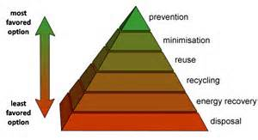
Optimal Situation

Slide 14
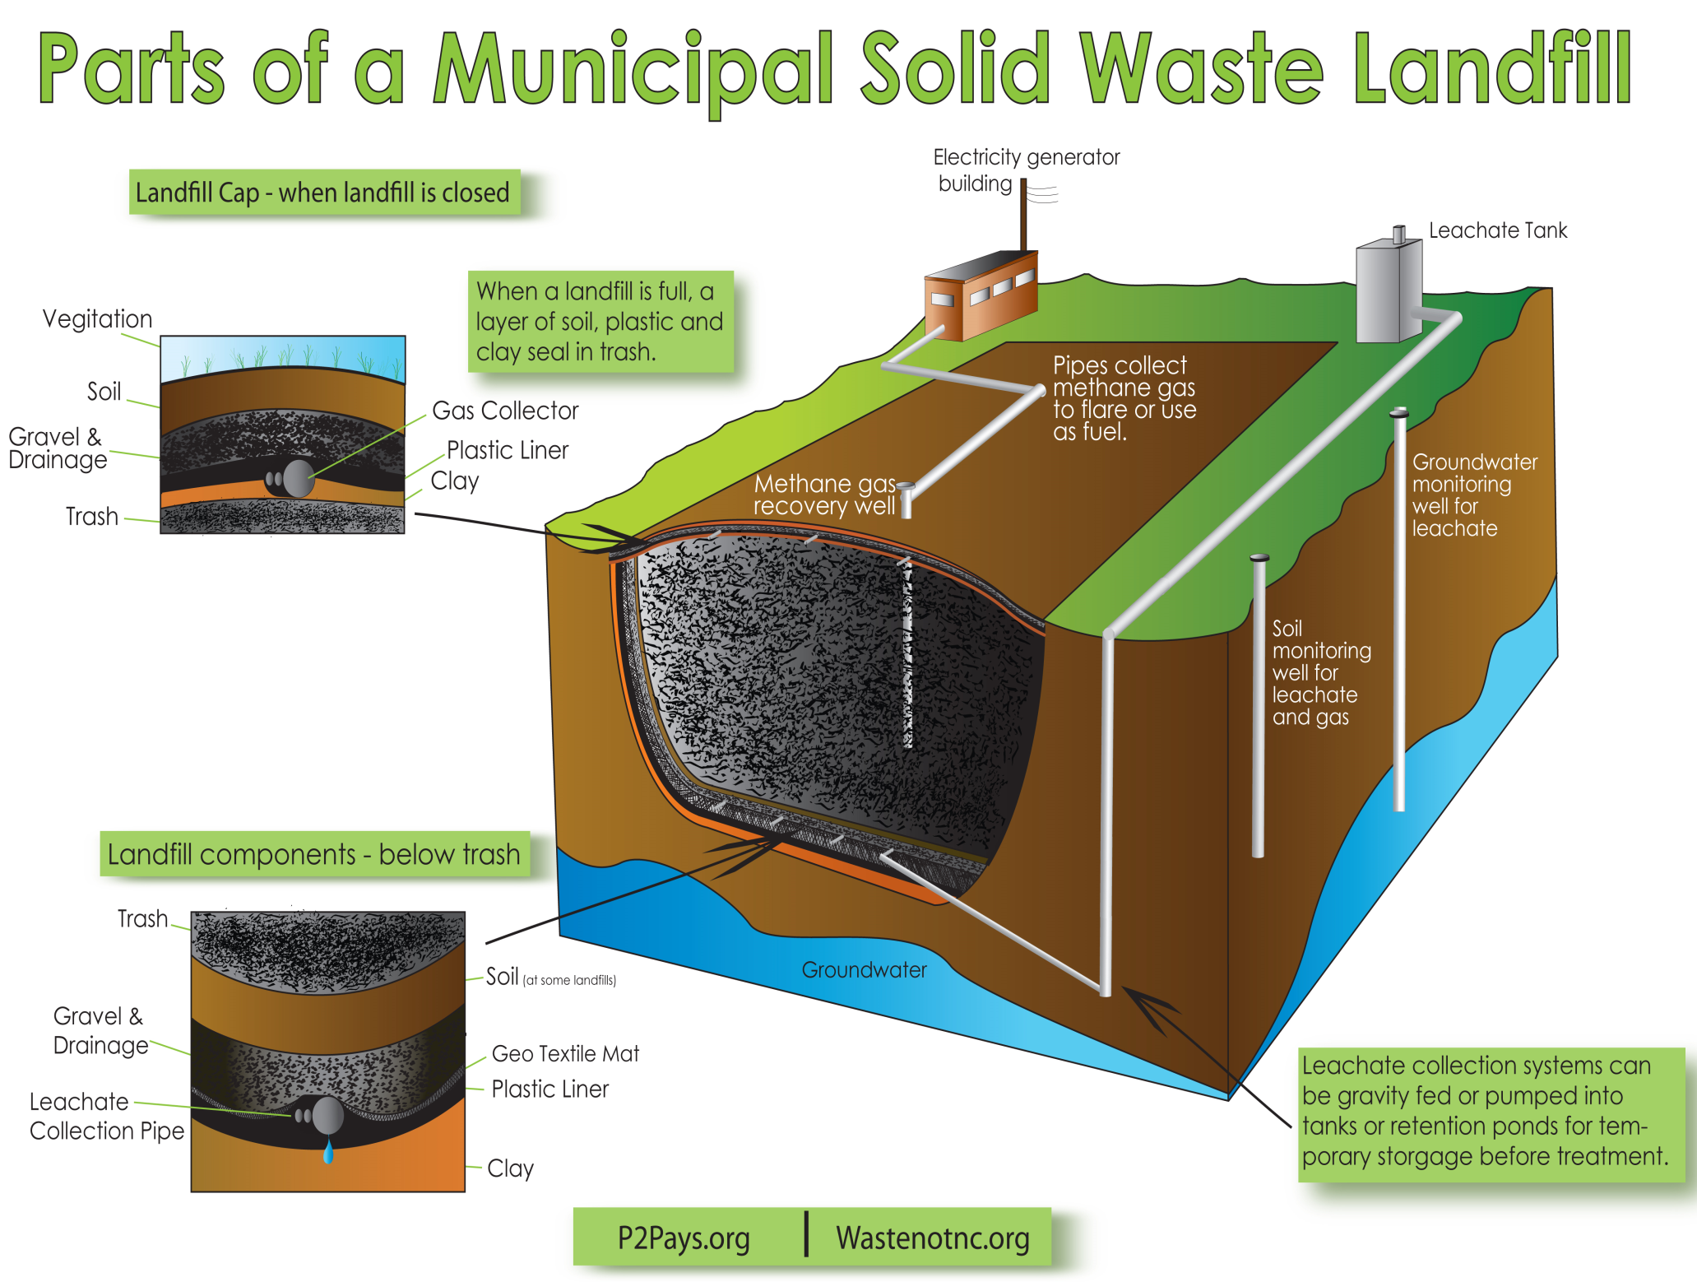
Notes:
The clay liner impedes water flow and can trap metal ions. Methane is extracted and either used as fuel or burned off. The leachate is extracted and transported to a wastewater treatment facility.

Slide 15
Leachate
Garbage soup
Rain filtering through landfills leaches toxic materials.
More contaminants are leached when solid waste is crushed into small particles and put in contact with water because of increased surface area per unit volume than larger particles.
Contaminated leachate can seep from the bottom of landfills.
Older, unlined landfills may have water pollution problems.

Slide 16
Properties of a Good Landfill
Located away from surface water, water table and drinking water sources.
Not near people.
Deep enough to hold a high volume of garbage.
Monitoring wells for methane and leachate
Piping system for leachate
The best soil in which to engineer a landfill is high in clay with sand or gravel above it.

Slide 17
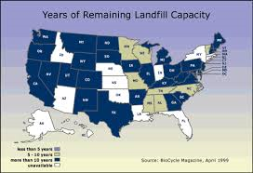
Available Space
Decomposition in a landfill undergoes anaerobic decay - very slow.
Where does all the garbage go?

Slide 19
Comparison of Waste Generation

Slide 20
Used Tires
Classified as hazardous waste
Burn extremely hot and for long period of time.
Release numerous toxins into the air when burned.
Serve as breeding ground for mosquitoes.

