Slide 1
ROLE OF THERAPY IN BEHAVIOURAL DISORDERS
Date:23rd Nov,2020

Slide 2
Contents:
Introduction
Attention-Deficit Hyperactivity Disorder (ADHD)
Obsessive-Compulsive disorder (OCD)
Autism Spectrum Disorders
References

Slide 3
Behavioural Disorders
The American Psychiatric Association (APA) defined a disorder as:
An impairment or dysfunction of the individual that causes distress to the
person or increased risk of death, pain, disability or loss of freedom.
(Remschmidt H. Et al 2006)

Slide 4
Behavioural Disorders
The Tenth Revision of the International Classification of Diseases and Related
Health Problems (ICD – 10, 2002) published by the World Health Organization,
defines:
“Disorder as the presence of hallucinations, delusions or a limited number of severe
abnormalities of behavior such as gross excitement and overactivity, marked
psychomotor retardation and catatonic behavior.”
(Remschmidt H. Et al 2006)

Slide 5
Common Behavioural disorders
Attention-Deficit Hyperactivity Disorder (ADHD)
Obsessive-Compulsive disorder (OCD)
Autism Spectrum Disorders
Conduct disorder
Anxiety and fear-related disorders
Panic disorder
Post-traumatic stress disorder
Dissociative disorders

Slide 6
Attention-Deficit Hyperactivity Disorder (ADHD)
ADHD is characterized by behavioral disturbances, including inattention,
hyperactivity and reduced memory.
ADHD is also associated with severe sleep problems, such as insomnia,
long sleep-onset latency, sleepiness and increased awakenings.
Sleep alterations play an important role in the appearance and severity of
the behavioral disturbances found in ADHD.
(T sai, M.H. et al, 2016)

Slide 7
Role of therapy in ADHD
Melatonin is a Hormone primarily released by the pineal gland that regulates the Sleep–wake cycle
Melatonin act as a:
Sleep promoter
Circadian rhythm regulator
Several clinical trials have focused on its possible use as a therapy in the treatment of sleep alterations in children with ADHD
(Mediavilla, M.D et al,2010)

Slide 8
Mechanism of Melatonin
Melatonin acts through different molecular pathways.
Melatonin leads to the activation of two types of membrane specific receptors:
High affinity ML1
Low affinity ML2
ML1 receptor promotes the onset of sleep
ML2 receptor shifts the timing of circadian rhythm
Jockers, R. et al,2016

Slide 9
Clinical Study on Melatonin:
A larger sample of children participated in a trial having ADHD
TO
Sleep parameters:
Sleep-onset
latency
Total sleep time
wake-up
Time sleep
efficiency
Treat
In this study:
Administration of Melatonin in children with
Chronic sleep onset insomnia and ADHD diagnoses was
evaluated

Slide 10
Secondary outcomes, such as:
Emotional and Behavioral problems
Measured using the:
Child Behavior
Teachers Report Form
Melatonin
administration reduced sleep-onset by 30 min and
increased total time asleep and sleep efficiency.
Banach, M.et al,2011

Slide 11
Clinical studies on Melatonin in Patients diagnosed with ADHD:
Subject | Melatonin Dosage & Treatment Duration | Controlled Variables | Results
24 children (age not indicated) Diagnosed with ADHD Insomnia | 3 mg Short-term (1-4 weeks) long-term (3 months) | Sleep evaluation by: Clinical interview | Short-term improved the time of falling asleep. Long-term treatment induced the same effects as short-term treatment.
Weiss, M.D et al 2006

Slide 12
Clinical studies on Melatonin in Patients diagnosed with ADHD:
Subject | Melatonin dosage & Treatment duration | Controlled variables | Results
22 children with ADHD Aged from 6 to 14 years not respond to sleep hygiene therapy | 5 mg (20 min before bed time) in combination with sleep hygiene therapy 30 days duration | Parental questionnaires about drug effects on: Sleep Problems Mood Behavior | Melatonin in combination with sleep hygiene therapy improved sleep-onset latency

Slide 13
Stimulant Therapy
Methylphenidate Class Short acting (last 3-6 h) Intermediate acting (last 6-8 h) | Can be used for younger (under 6 year) children requiring stimulant Treatment Potential for abuse and dependence | Adverse effects: Psychosis Increase blood pressure Loss of appetite Headache Anxiety Weight loss Worsening of bipolar disorder symptoms
Amphetamine Class | Can be used for younger children requiring stimulant treatment if Methylphenidate fails | Potential for abuse and dependence Agitation/irritability

Slide 14
Non stimulant Therapy
Selective norepinephrine reuptake inhibitor | Good alternative for those who cannot tolerate stimulants Most useful for inattentive symptoms of ADHD,Less so for hyperactive impulsive symptoms | Upset stomach if taken without food Possible activation of suicidal thoughts Increase in pulse & blood pressure
Alpha 2 adrenergic agonists | Works well for hyperactive symptoms of ADHD less so for inattentive symptoms May be useful for comorbid anxiety and ADHD symptoms Can help with agitation | Sedation Lethargy Dizziness

Slide 15
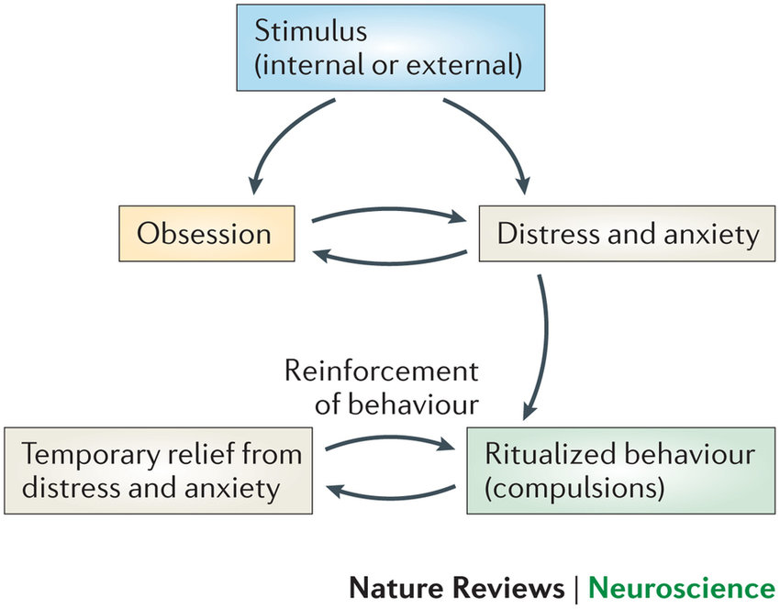
Obsessive-Compulsive disorder (OCD)
Obsessive-compulsive disorder (OCD) is a neuropsychiatric behavioural disorder characterized by:
Obsessions (recurrent or persistent unwanted thoughts, images or impulses)
Compulsions (repetitive behaviors or mental acts often performed to relieve anxiety or distress)

Slide 16
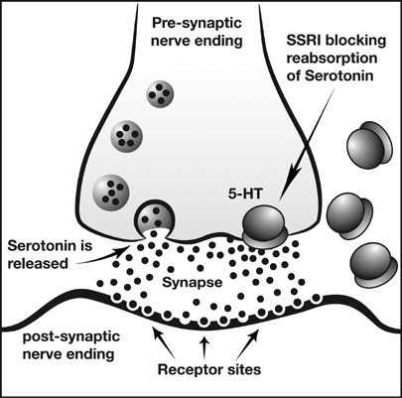
Drug Therapy in OCD:
Serotonin reuptake inhibitors are considered the most effective and well-established
pharmacotherapy for the treatment of OCD.
The introduction of SRIs and behavioral therapy techniques have certainly improved clinical
outcome in many patients.
Citalopram
Fluoxetine
Paroxetine
Sertraline
JF Leckman et al 2006

Slide 17
OCD Prevalance:
OCD is now estimated to affect between 2 and 3% of the general population and
is the 4TH most common psychiatric illness (after specific phobias, substance
abuse and major depression)
However, 40–60% of OCD patients do not respond adequately to SRI therapy
and an even greater proportion of patients fail to experience complete remission
of OCD symptoms.
Bystritsky et al.

Slide 18
Antipsychotic Augmentation Therapy in OCD
Two additional pharmacological augmentation strategies have been implemented to
aid patients non-responding to SRI monotherapy.
The 1st category of augmentation strategies involves:
The use of serotonin-enhancing agents:
(such as lithium, clonazepam and buspirone)
To maximize treatment response

Slide 19
The second category of augmentation strategies has involved
Block dopamine receptors in brain(limbic system,basal ganglia)
Areas associated with the emotions, Cognitive function and motor function
Dopamine level in the CNS
Result : Tranquilizing effect in OCD patient
The addition of low-dose dopamine
antagonists to
SRI medications

Slide 20
Study selection:
The primary study population in which patients with psychiatric diagnosis of OCD
had not responded to at least 2 months of treatment with traditional SRI
therapy.
The study compared Antipsychotic and Placebo augmentation in addition to SRI
mono therapy.
Study used OCD severity before and following adequate augmentation with an antipsychotic augmentation agent.

Slide 21
Results:
Proportion of treatment responders in Antipsychotic versus Placebo augmentation
143 receiving antipsychotic augmentation
135 receiving placebo augmentation included in these analyses
A treatment response was significantly more likely in the antipsychotic augmentation than in the
placebo augmentation group
A forest plot depicting the differences in individual augmentation studies

Slide 22
Reiter, R. J. (2017).

Slide 23
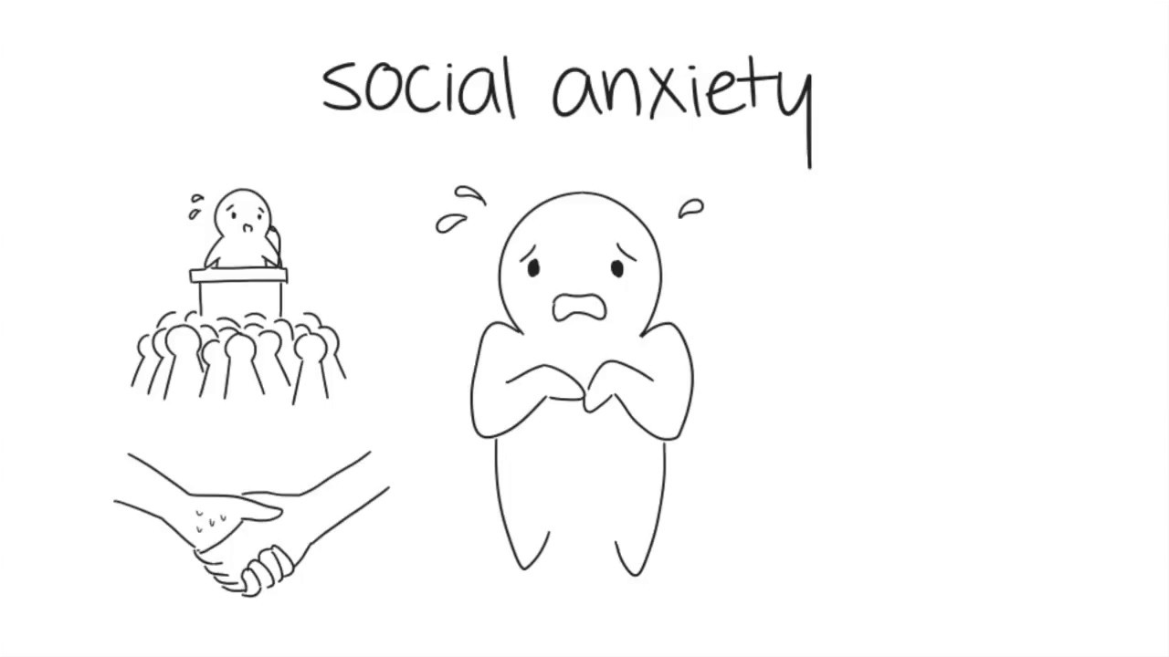
Autism Spectrum Disorders
ASD is a neurodevelopmental behavioural disorder characterized by symptoms such as:
Social and communication difficulties
Language delays
Restricted & repetitive behaviors
Strict adherence to routine

Slide 24
Autism Spectrum Disorders
The Diagnostic and Statistical Manual of Mental Disorders, 5th edition (DSM 5) describes two major symptom categories of ASD,
The first being deficits in social communication and interaction
The second as:
restricted, repetitive patterns of behavior, interests or activities

Slide 25
The Autism Treatment Evaluation Checklist (ATEC)
The ATEC was developed by Rimland and Edelson (1999) at the Autism Research
Institute (ARI), located in the United States
The Autism Treatment Evaluation Checklist (ATEC) help researchers assess the
effectiveness of treatments offered to children and adults with ASD.
It also help parents identify whether their children could benefit from specific treatments or
interventions through questioniers designed by experts.
Teachers and parents can use the ATEC to monitor and follow a child’s development over
time, even in absence of a specific treatment

Slide 26
The Autism Treatment Evaluation Checklist (ATEC)
The ATEC is simple to use and is available on the Internet.
The ATEC is a caregiver-administered questionnaire designed to measure changes in severity of ASD in response to treatment
Results obtained from the ATEC can also indicate whether the individual with ASD
is lagging behind peers or having a medical or behavioral problem that is not
otherwise apparent.

Slide 27
The Autism Treatment Evaluation Checklist (ATEC)
It is not only a diagnostic checklist, but also a useful tool to evaluate interventions and treatments.
The scores of its subscales and its total score are used to compare the effectiveness of
treatments and interventions for ASD as well as to assess progress following
treatment.
ATEC has 77 items distributed across four subscales:
Al-khadher, M. M. A. (2020).

Slide 28
The Autism Treatment Evaluation Checklist (ATEC) Scoring:
Parameters | No. of Items | Scale
Speech/language/communication | 14 items | 0 - 28
Sociability | 20 items | 0 - 40
Sensory/cognitive awareness | 18 items | 0 - 36
Health/physical/behavior | 25 items | 0 - 179
Mahapatra, S.,2018

Slide 29
The Autism Treatment Evaluation Checklist (ATEC) Scoring:
The scores from each subscale are combined in order to calculate a Total Score, which ranges 0–179 points.
A lower score indicates less severe symptoms of ASD and a higher score
correlates with more severe symptoms of ASD.
The lower the scores, the better
Mahapatra, S.,2018

Slide 31
References:
Sánchez-Barceló, E.J.; Mediavilla, M.D.; Tan, D.X.; Reiter,R.J. Clinical uses of melatonin: evaluation of human trials.Curr. Med. Chem., 2010
Arendt, J. Melatonin and human rhythms. Chronobiol Int.,2006
Olakowska, E.; Marcol, W.; Kotulska, K.; Lewin-Kowalik,J. The role of melatonin in the neurodegenerative diseases.Bratisl. Lek. Listy, 2005
Banach, M.; Gurdziel, E.; Jędrych, M.; Borowicz, K.K.Melatonin in experimental seizures and epilepsy. Pharmacol.Rep., 2011
Jockers, R.; Delagrange, P.; Dubocovich, M.L.; Markus,R.P.; Renault, N.; Tosini, G.; Cecon, E.; Zlotos, D.P. Updateon melatonin receptors: IUPHAR Review 20. Br. J.Pharmacol., 2016

Slide 32
Weiss, M.D.; Wasdell, M.B.; Bomben, M.M.; Rea, K.J.;Freeman, R.D. Sleep hygiene and melatonin treatment for children and adolescents with ADHD and initial insomnia.J. Am. Acad. Child Adolesc. Psychiatry, 2006
Kessler RC, McGonagle KA, Zhao S, Hughes M, Swartz M, Blazer DG. Lifetime and 12-month prevalence of DSM-III-R psychiatric disorders in the United States. Arch Gen Psychiatry 1994
A systematic review: antipsychotic augmentation with treatment refractory obsessive-compulsive disorder MH Bloch, A Landeros-Weisenberger, B Kelmendi, V Coric, MB Bracken and JF Leckman
Abaoud, A. A., Almalki, N. S., Bakhiet, S. F., & Al-khadher, M. M. A. (2020). Psychometric properties of the Autism Treatment Evaluation Checklist in Saudi Arabia. Research in Autism Spectrum Disorders
Sanchez-Barcelo, E. J., Rueda, N., Mediavilla, M. D., Martinez-Cue, C., & Reiter, R. J. (2017). Clinical uses of melatonin in neurological diseases and mental and behavioural disorders. Current medicinal chemistry
Mahapatra, S., Vyshedsky, D., Martinez, S., Kannel, B., Braverman, J., Edelson, S. M., & Vyshedskiy, A. (2018). Autism Treatment Evaluation Checklist (ATEC) norms: A “growth chart” for ATEC score changes as a function of age. Children
Rimland, B., & Edelson, S. (1999). Autism Research Institute. Autism Treatment Evaluation Checklist (ATEC).

