Slide 1
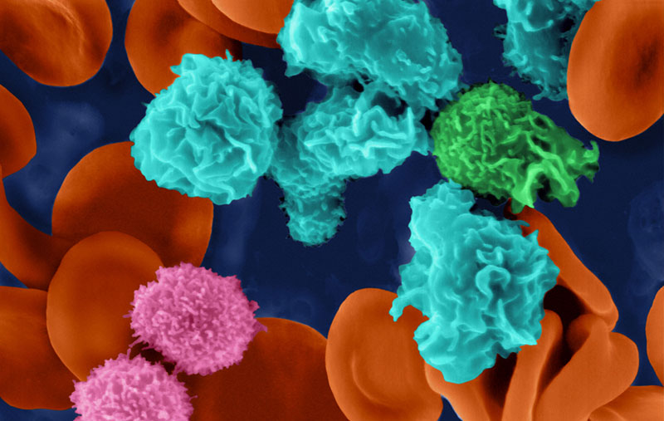
Body Defenses

Slide 2
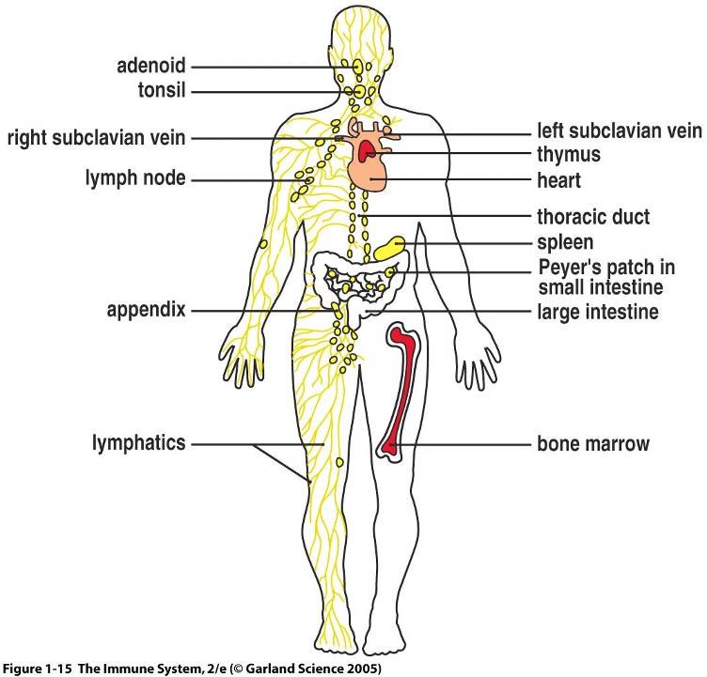

Slide 3
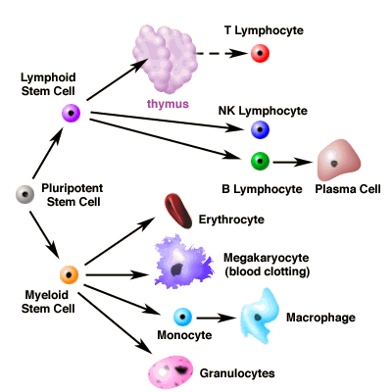

Slide 4
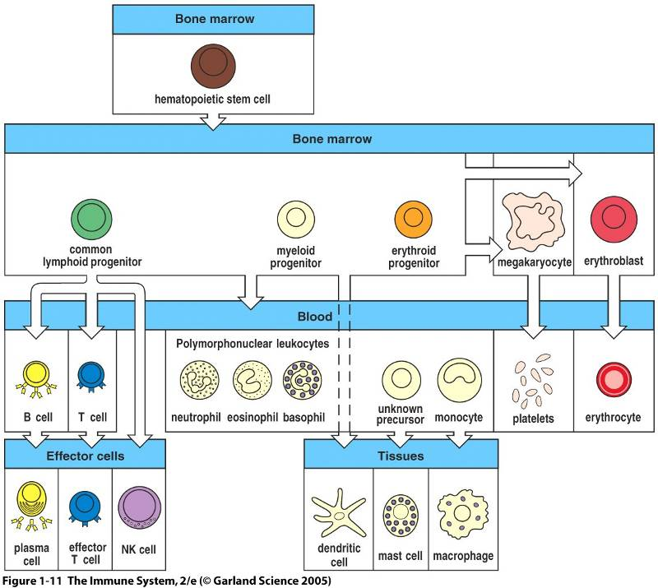

Slide 5
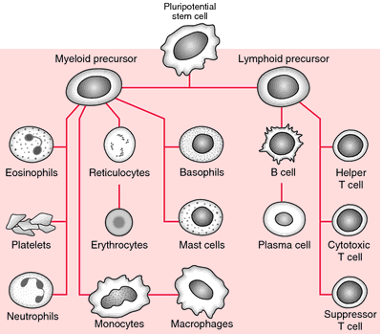

Slide 6
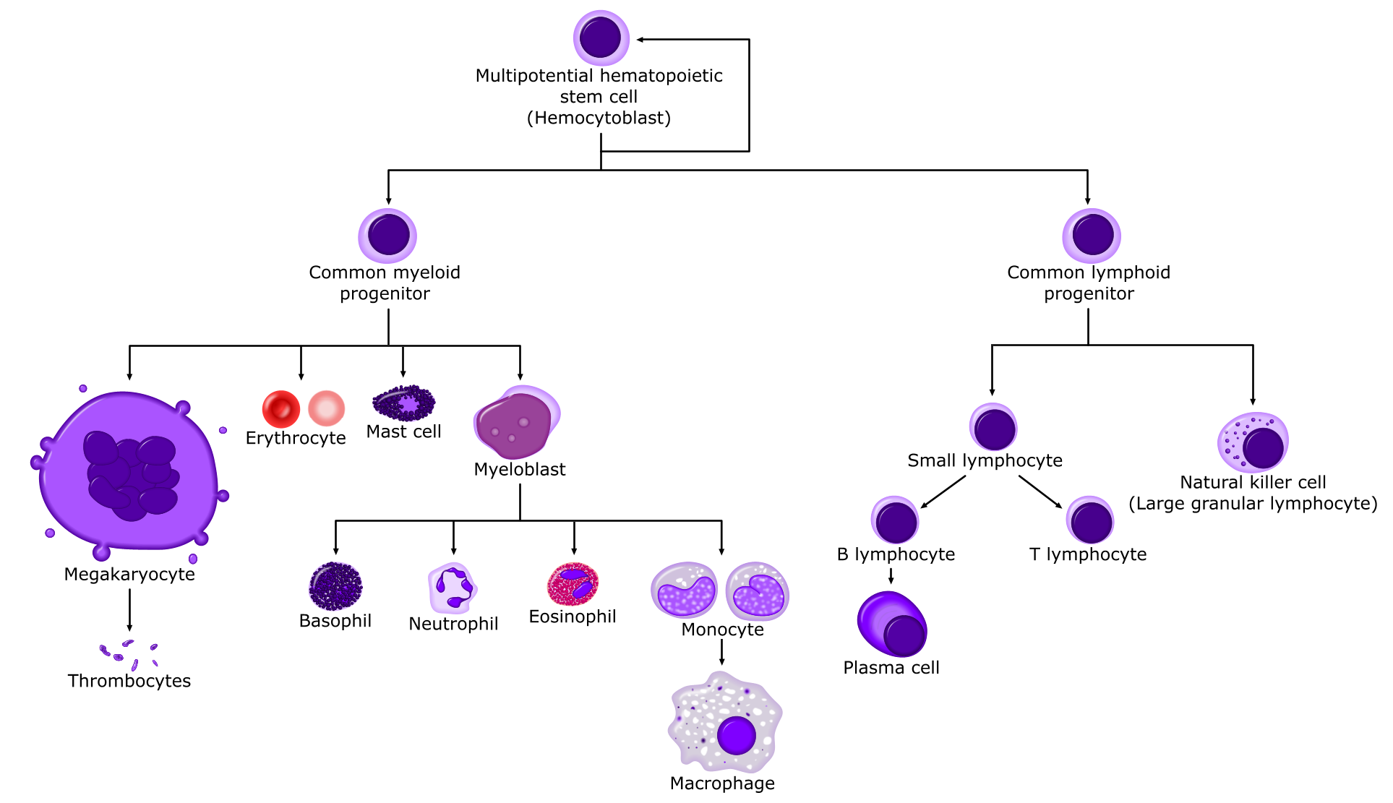

Slide 7
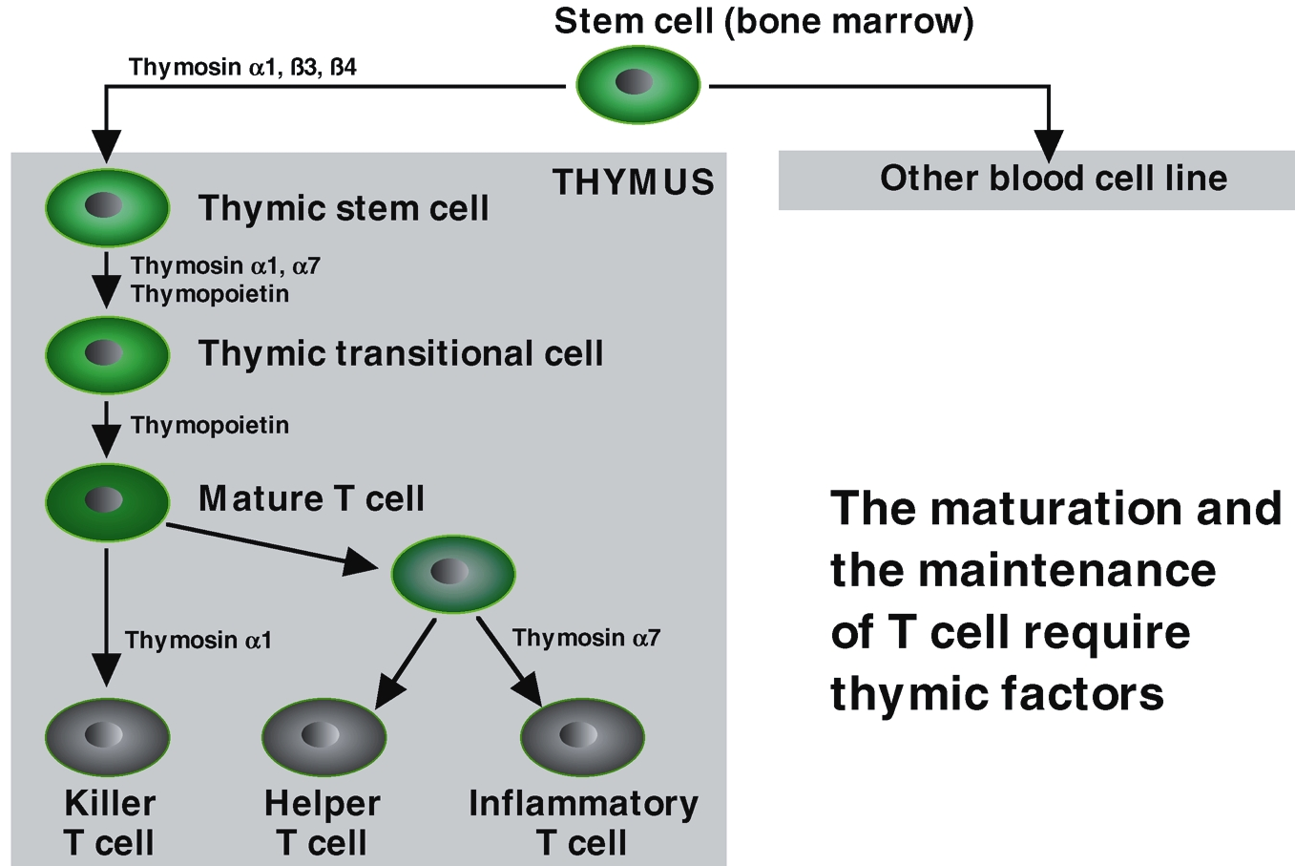

Slide 9
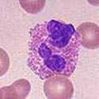
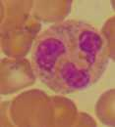
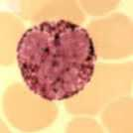
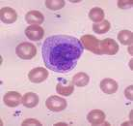
NK Cell
Eosinophils
Basophils & Mast cells
Monocyte Macrophage
Neutrophil

Slide 10
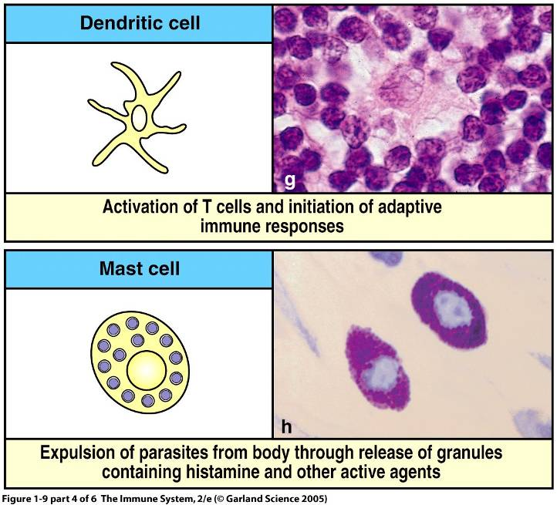

Slide 11
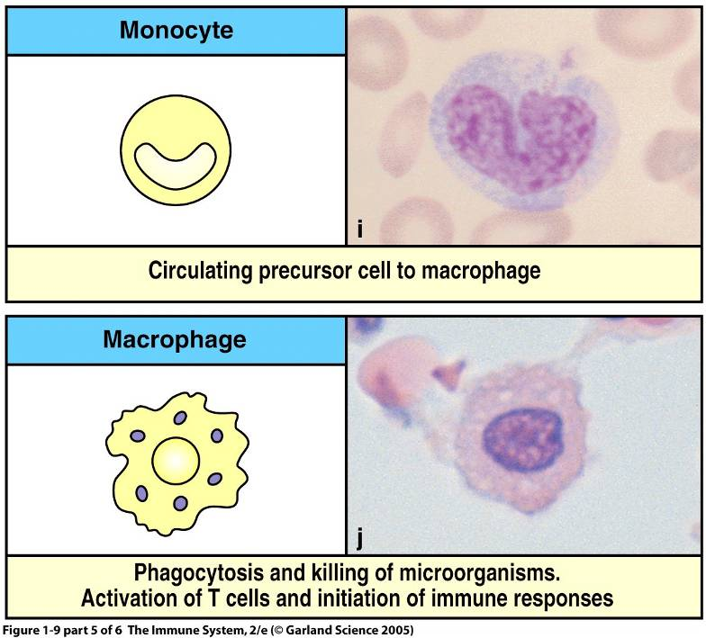

Slide 12
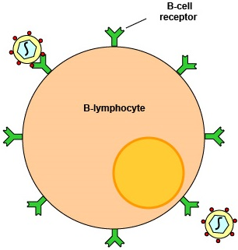
1.5-3x10⁵
Somatic hypermaturation
Class switching

Slide 13
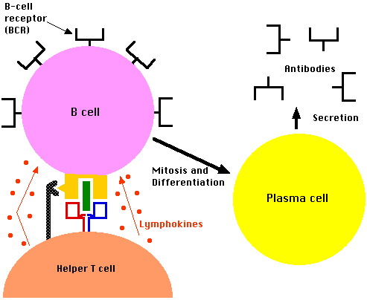
Highly specialized for Ab secretion: more that 1000 Abs/second

Slide 14
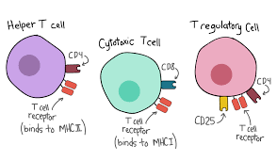
Recognize the processed antigen by MHC. Ratio of CD4 to CD8:2:1
T_{REG} to inhibit immune response

Slide 15
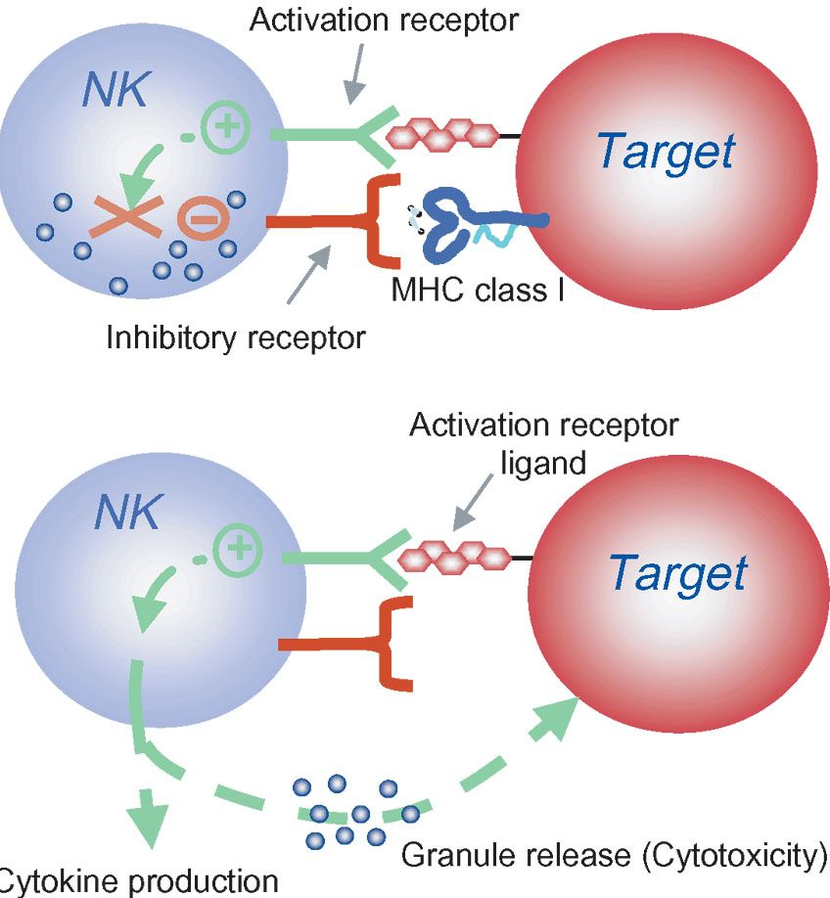

Slide 16
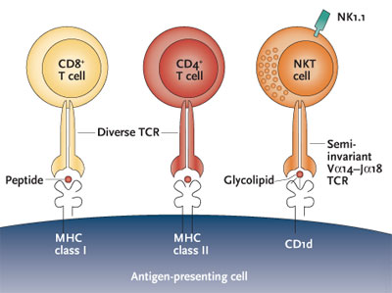

Slide 17
Primary Lymphoid organs (where immune cell develops)
Bone marrow
Thymus
:Stem cell niches: specialized anatomical microenvironments
: Stromal cells: soluble and membrane bounded proteins------ regulate
Survival, proliferation, differentiation, trafficking

Slide 20
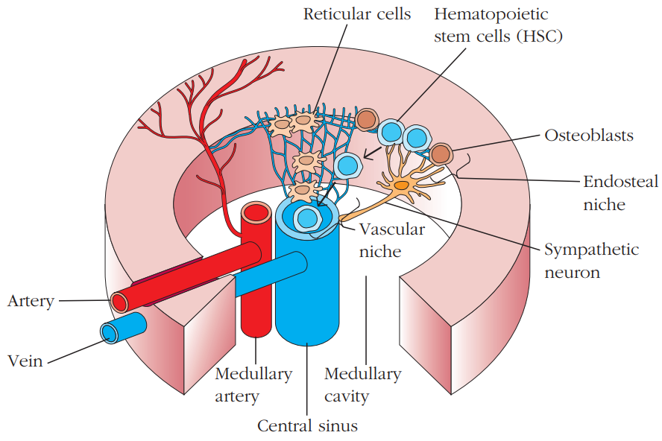

Slide 22
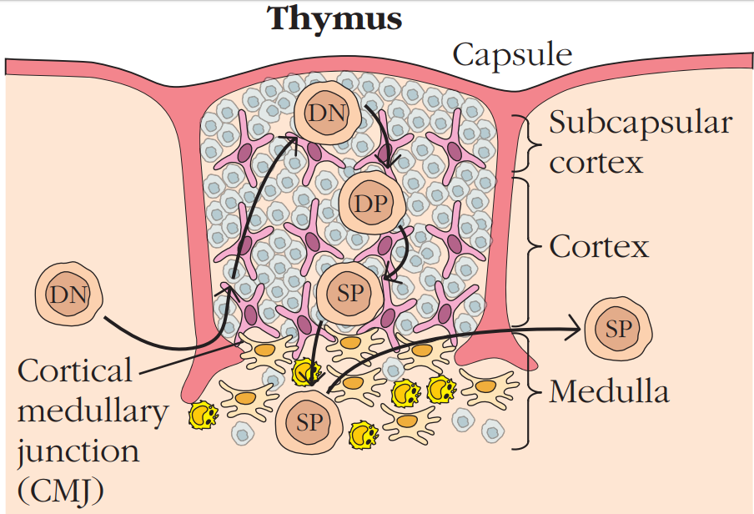

Slide 23
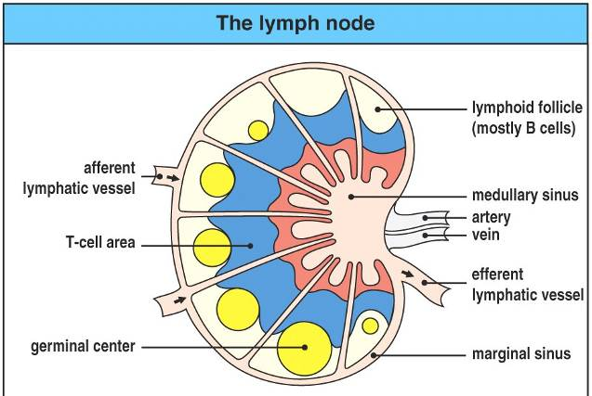

Slide 24
Secondary Lymphoid organs (where immune response is initiated)
Lymph nodes
Spleen
:MALT: Mucosa-associated lymphoid tissue (digestive, respiratory, urogenital, skin)
Tonsils, appendix, lymphoid follicles

Slide 26
Memory T and B cells
Central memory cells
Effectors memory T cells

Slide 27
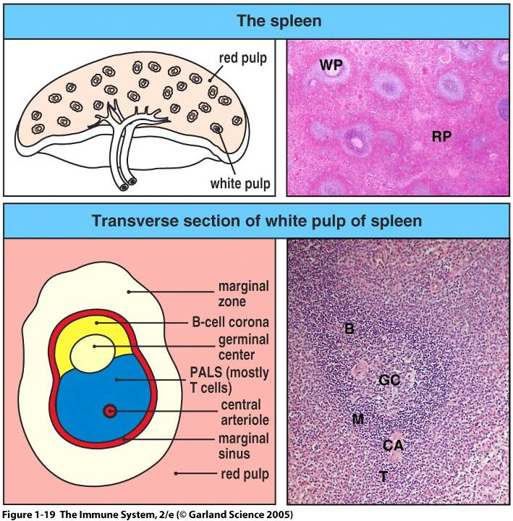

Slide 28
OPSI (overwhelming post-splenectomy infection)

Slide 29
Secondary Lymphoid organs (where immune response is initiated)
Lymph nodes
Spleen
:MALT: Mucosa-associated lymphoid tissue (digestive, respiratory, urogenital, skin)
Tonsils, appendix, lymphoid follicles
BALT, NALT, GALT

Slide 33
Tertiary Lymphoid organs (site of infections)
Liver, brain, lungs etc

Slide 35
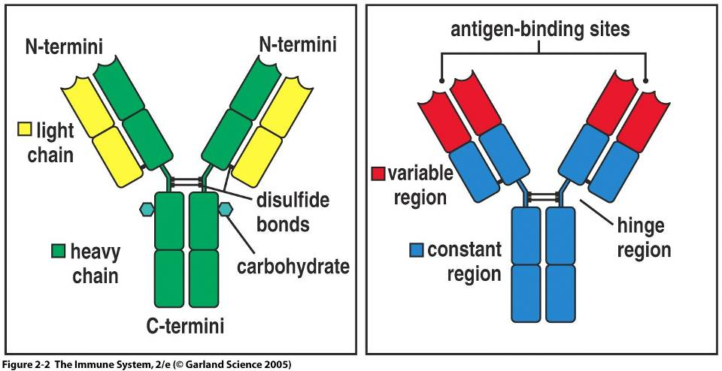

Slide 36
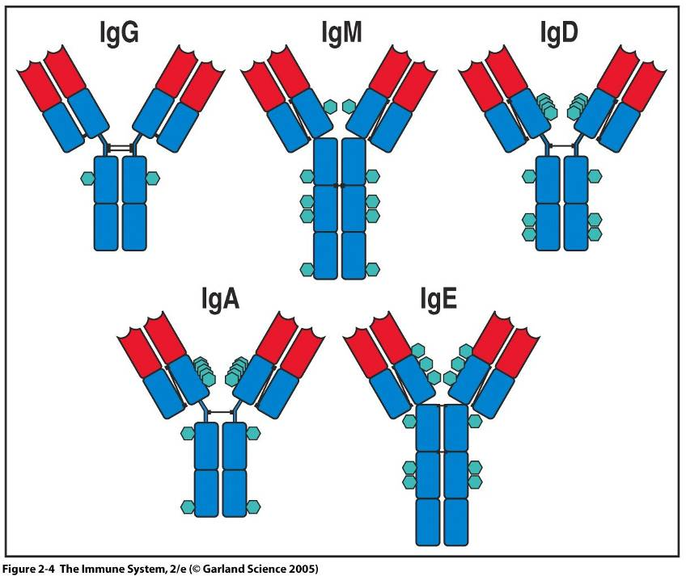

Slide 37
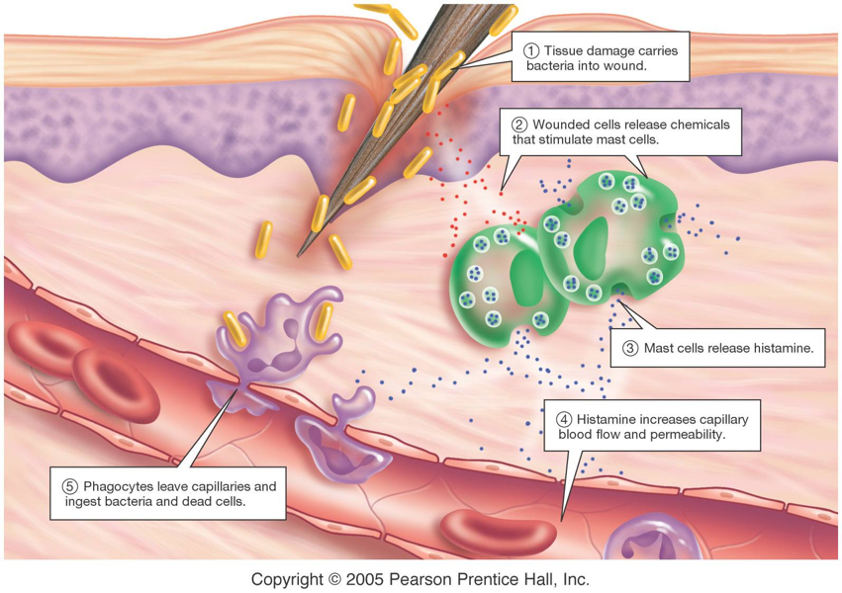

Slide 39
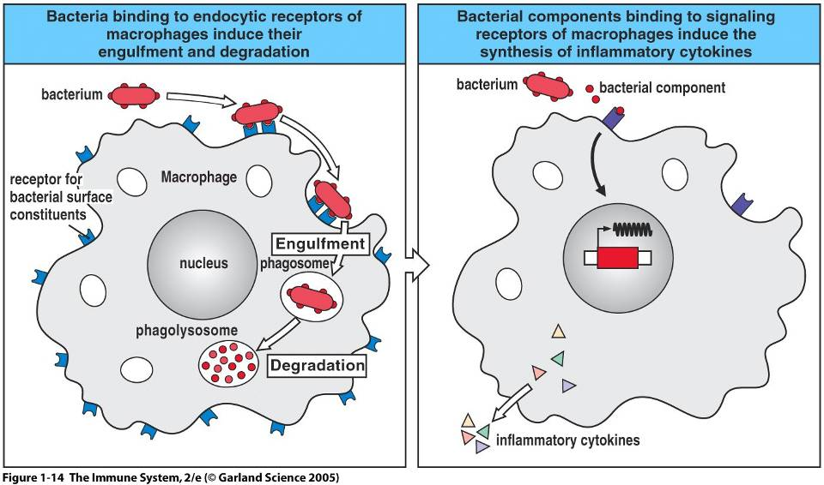

Slide 40
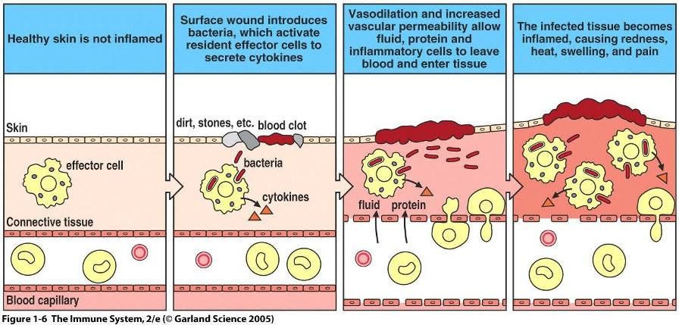

Slide 41
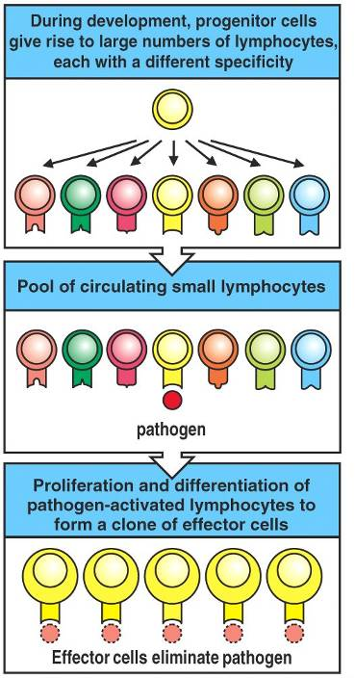

Slide 42
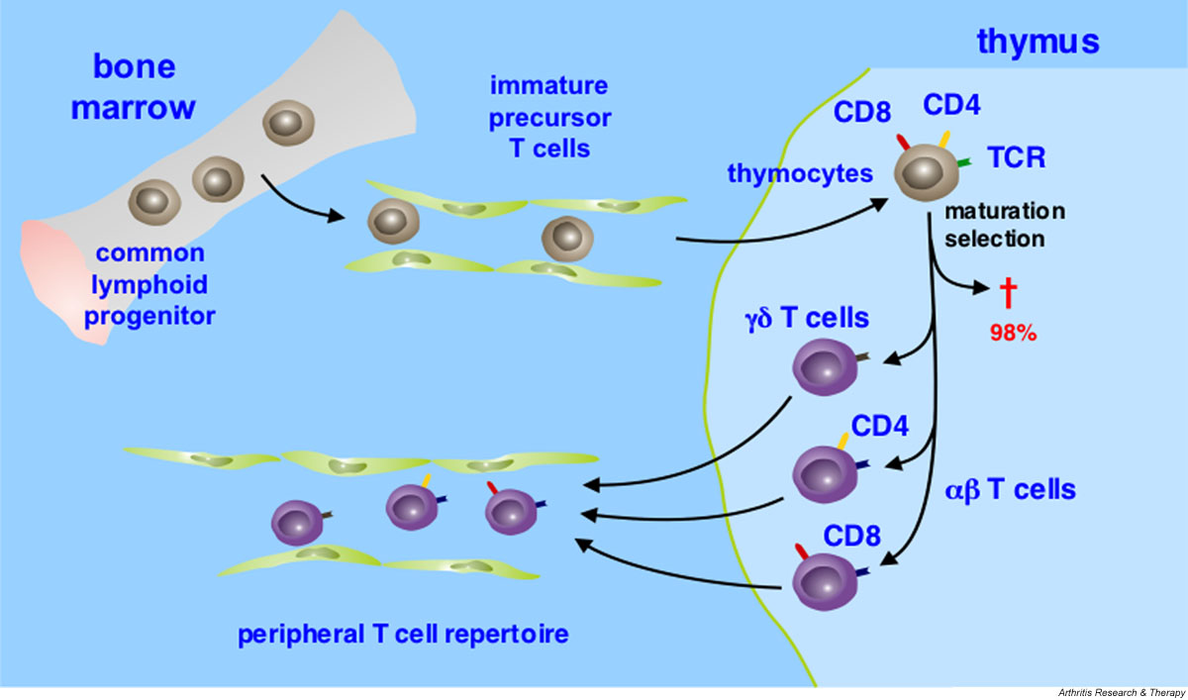

Slide 43
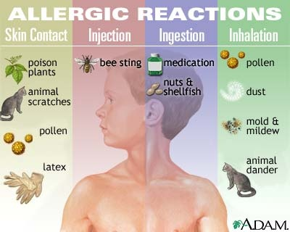

Slide 44
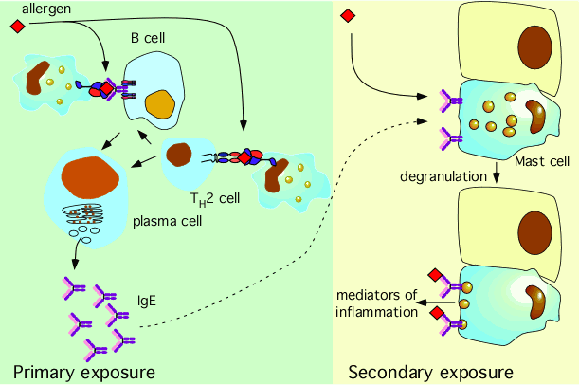

Slide 45
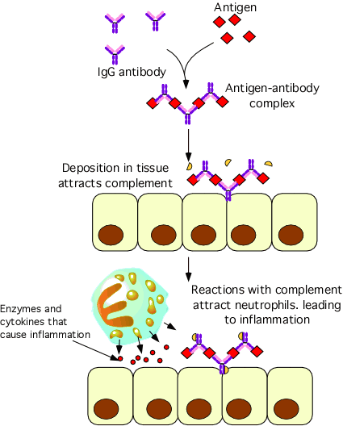

Slide 46
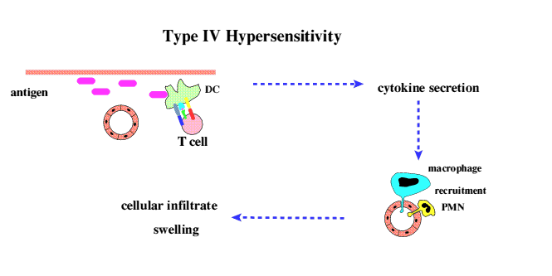

Slide 47
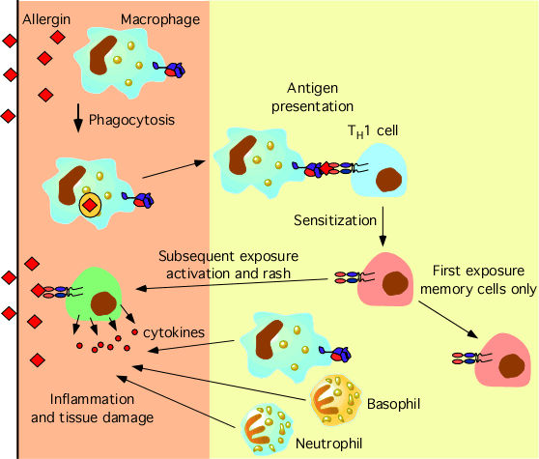

Slide 48
