Slide 1
Week 8

Slide 2
Lecture Contents
Basic Concepts
Scheduling Criteria
Scheduling Algorithms
Thread Scheduling
Multi-Processor Scheduling

Slide 3
Lecture Objectives
Describe various CPU scheduling algorithms
Assess CPU scheduling algorithms based on scheduling criteria
Explain the issues related to multiprocessor and multicore scheduling
Apply modeling and simulations to evaluate CPU scheduling algorithms

Slide 4
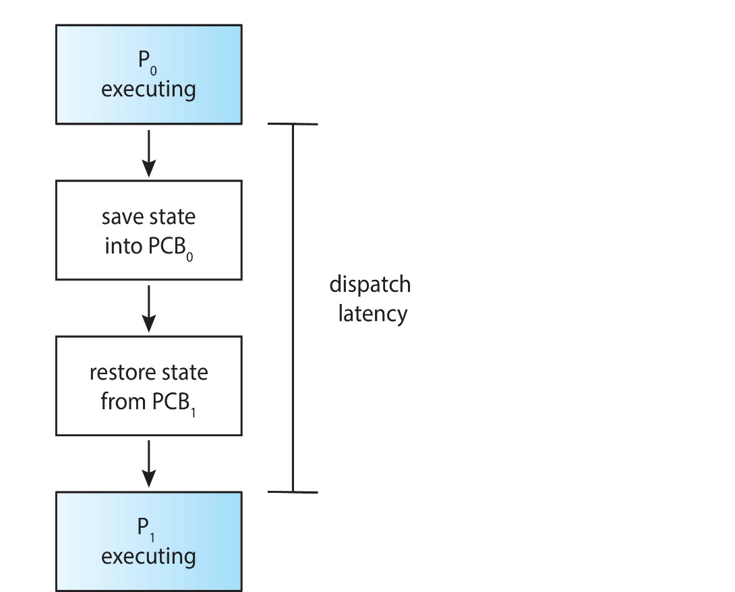
Dispatcher
Dispatcher module gives control of the CPU to the process selected by the CPU scheduler; this involves:
Switching context
Switching to user mode
Jumping to the proper location in the user program to restart that program
Dispatch latency – time it takes for the dispatcher to stop one process and start another running

Slide 5
Scheduling Criteria
CPU utilization – keep the CPU as busy as possible
Throughput – # of processes that complete their execution per time unit
Turnaround time – amount of time to execute a particular process
Waiting time – amount of time a process has been waiting in the ready queue
Response time – amount of time it takes from when a request was submitted until the first response is produced.

Slide 6
Uniprocessor Scheduling Algorithms
• First Come First Serve
• SJF
SRTF
Priority Scheduling
Round Robin Scheduling Algorithm
Multi-Level Queues
Multi-Level Feedback Queues

Slide 7
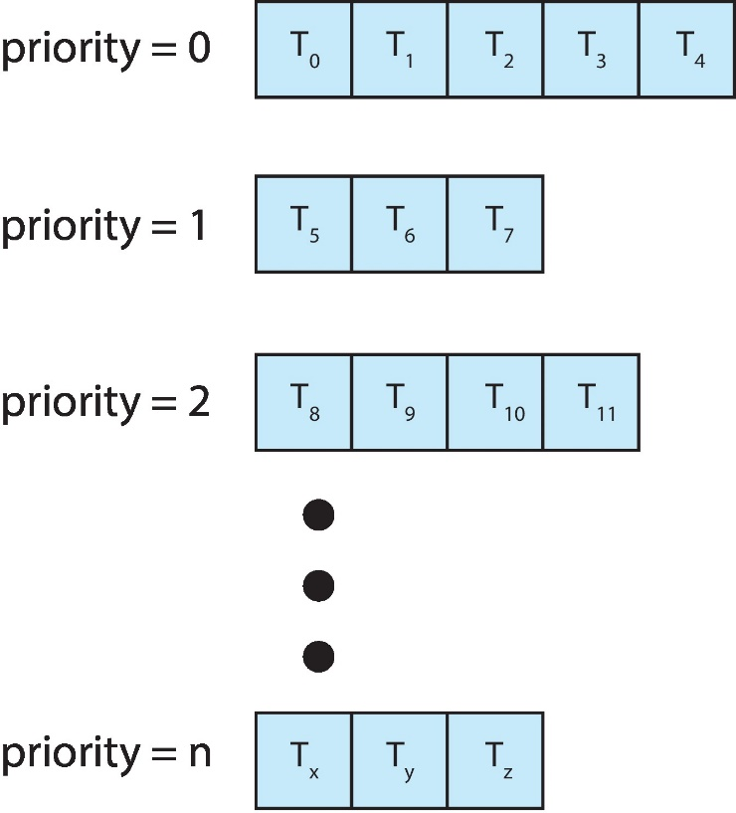
Multilevel Queue
With priority scheduling, have separate queues for each priority.
Schedule the process in the highest-priority queue!

Slide 8
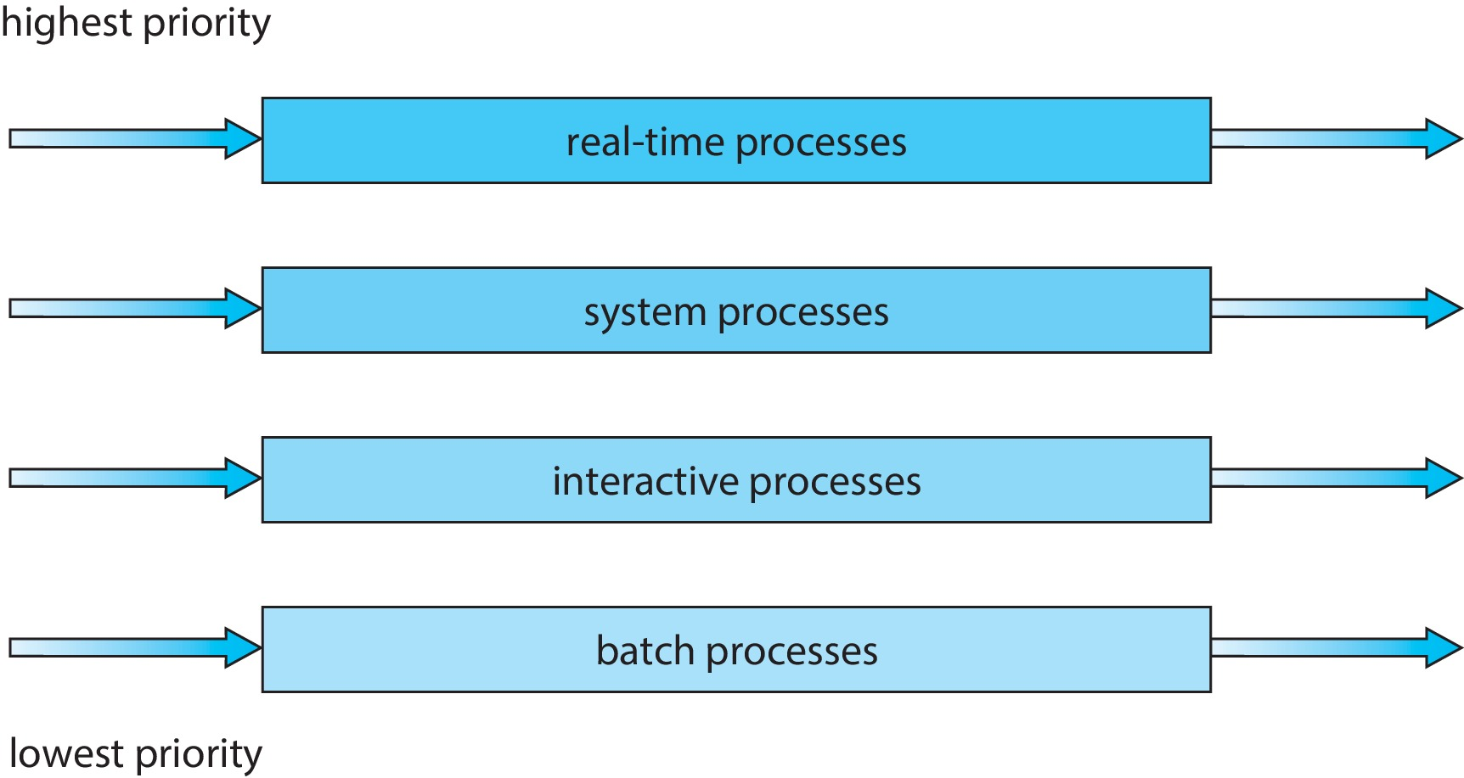
Multilevel Queue
Prioritization based upon process type

Slide 9
Multilevel Feedback Queue
A process can move between the various queues.
Multilevel-feedback-queue scheduler defined by the following parameters:
Number of queues
Scheduling algorithms for each queue
Method used to determine when to upgrade a process
Method used to determine when to demote a process
Method used to determine which queue a process will enter when that process needs service
Aging can be implemented using multilevel feedback queue

Slide 10
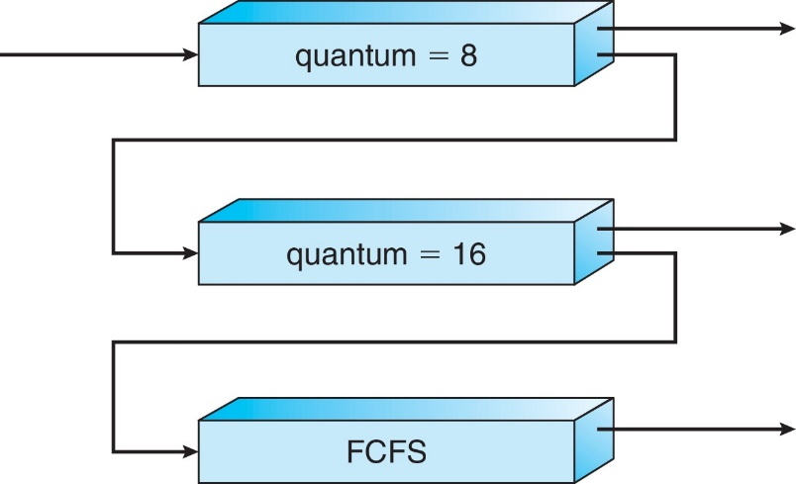
Example of Multilevel Feedback Queue
Three queues:
Q₀ – RR with time quantum 8 milliseconds
Q₁ – RR time quantum 16 milliseconds
Q₂ – FCFS

Slide 11
Thread Scheduling
Process-contention scope (PCS)
System-contention scope (SCS) – competition among all threads in system

Slide 12
Multicore Processors
Recent trend to place multiple processor cores on same physical chip
Faster and consumes less power
Multiple threads per core also growing
Takes advantage of memory stall to make progress on another thread while memory retrieve happens
Figure

Slide 13
Multithreaded Multicore System
Each core has > 1 hardware threads.
If one thread has a memory stall, switch to another thread!
Figure

Slide 14
Processor Affinity
Soft Affinity
Hard Affinity

Slide 15
Algorithm Evaluation
Deterministic Evaluation
Simulations
Queuing Theory

Slide 16
Lecture Material
Slides of chapter 5 can be found from the given link
https://codex.cs.yale.edu/avi/os-book/OS10/slide-dir/index.html

