Slide 1
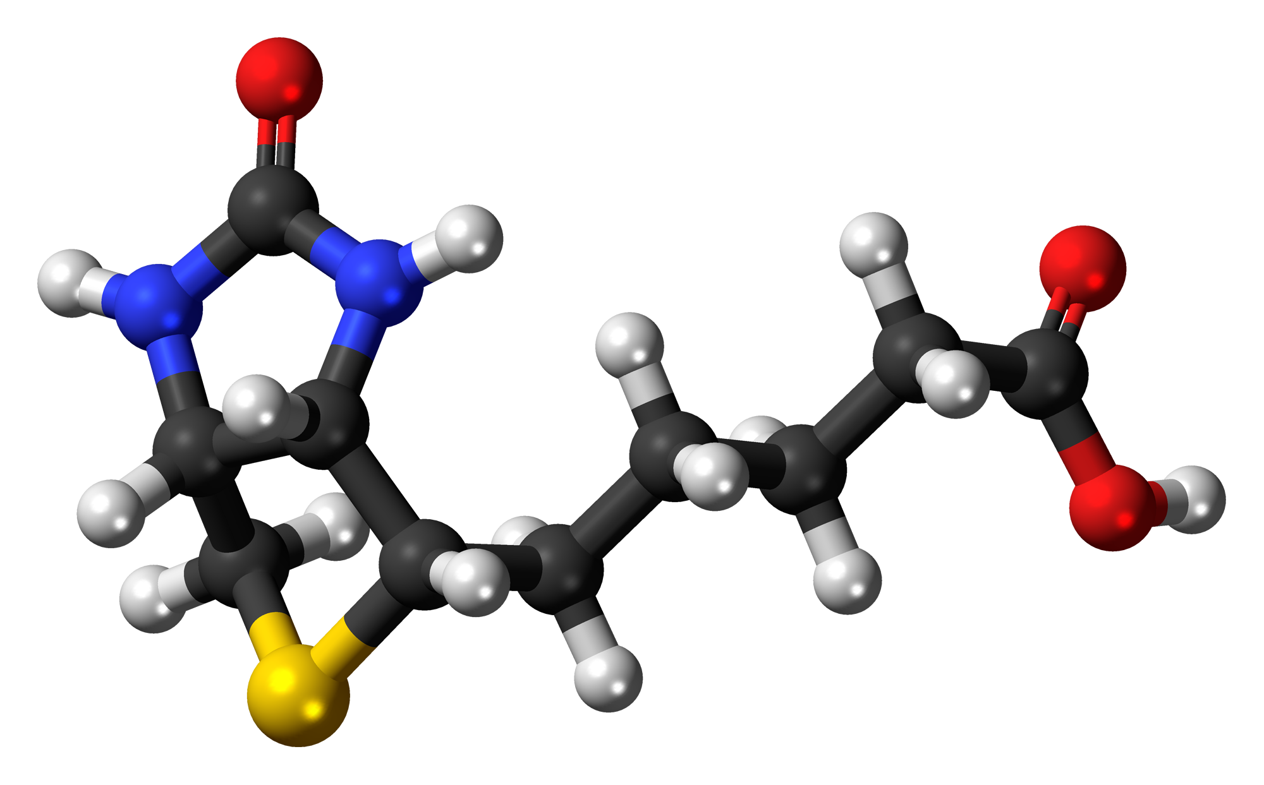
BIOTIN

Slide 2
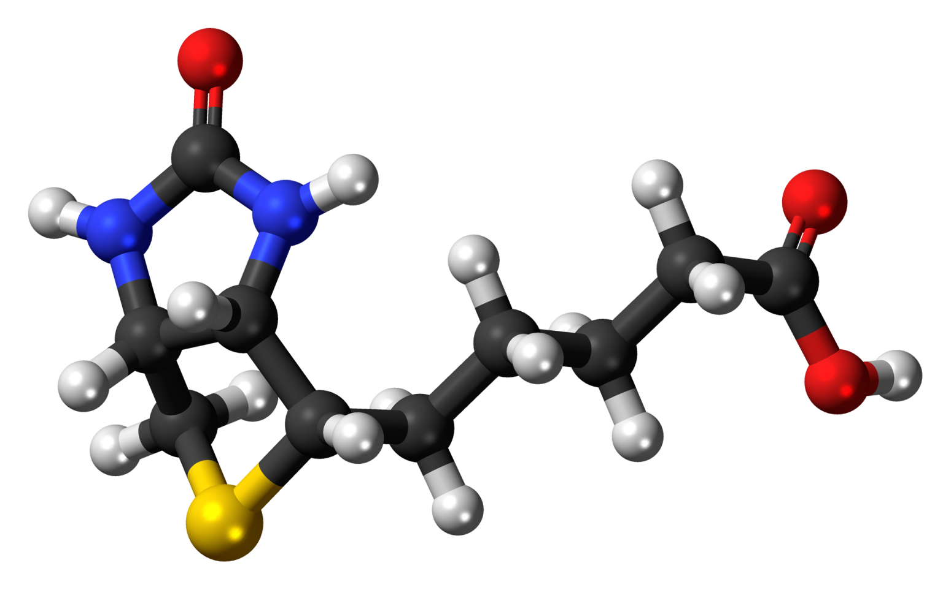
CONTENTS
INTRODUCTION
HISTORY
CHEMICAL STRUCTURE, PROPERTIES, AND ANTAGONISTS
ANALYTICAL PROCEDURES
METABOLISM
FUNCTIONS
REQUIREMENTS
NATURAL SOURCES
DEFICIENCY
SUPPLEMENTATION
TOXICITY

Slide 3
INTRODUCTION
Biotin is a water-soluble B vitamin
Also called vitamin B7 and formerly known as vitamin H
Biotin is an important component of enzymes involved in metabolizing fats and carbohydrates,
Influencing cell growth, and affecting amino acids involved in protein synthesis
Discovered by Vincent du Vigneaud and his colleagues in 1942

Slide 4
PROPERTIES
Chemical formula C10H16N2O3S
Molar mass 244.31 g·mol−1
Appearance White crystalline needles
Melting point 232 to 233 °C (450 to 451 °F; 505 to 506 K)
Solubility in water 22 mg/100 mL

Slide 5
HISTORY
Biotin was the name given to a substance isolated from egg yolk by Kögl and Tönnis in 1936 that was necessary for yeast growth.
This substance was discovered to be identical to a growth factor named coenzyme R that was required by legume nodule bacteria.
The toxic properties of feeding raw egg white to animals were first observed by Bateman in 1916.
Clinical signs of dermatitis and hair loss due to egg-white injury were prevented by several researchers by feeding certain foods, notably liver and kidney.
György studied the chemistry of this protective factor in certain foods, which he named factor H in 1937.

Slide 6
HISTORY
The term vitamin H was chosen by György because the factor protected the haut, the German word for skin.
In 1940 György and associates found that biotin, vitamin H, and coenzyme R were the same substance. Other names given to this factor were protective factor X, egg-white injury protection factor, factor S, and factor W (or vitamin Bw).
Egg-white injury resulted from its inactivating dietary biotin because of a specific constituent, avidin.
Heat was found to destroy avidin, therefore revealing that this biotin antagonistic factor was heat labile.

Slide 7
HISTORY
Avidin is a protein that is a secretory product of the mucosa of the oviduct and therefore is found in the albuminous part of eggs.
The structure and properties of biotin were established by U.S. and European investigators between 1940 and 1943.
The first chemical synthesis was completed by Harris and associates of the Merck Company in 1943.
In 1949 Goldberg and Sternbach developed a technique for industrial production of biotin.

Slide 8
CHEMICAL STRUCTURE, PROPERTIES, AND ANTAGONISTS
The chemical structure of biotin in metabolism includes a sulfur atom in its ring (like thiamin) and a transverse bond across the ring.
The empirical formula for biotin is C11H18O3N2S.
Biotin is a fusion of an imidazolidone ring with a tetrahydrothiophene ring bearing a valeric acid side chain.
It is a monocarboxylic acid with sulfur as a thioether linkage.
Biotin, with its rather unique structure, contains three asymmetric carbonations, and therefore eight different isomers are possible.
Of these isomers only one contains vitamin activity, d-biotin.
The stereoisomer l-biotin is inactive.

Slide 9
CHEMICAL STRUCTURE, PROPERTIES, AND ANTAGONISTS
Biotin crystallizes from water solution as long, white needles.
Its melting point is 232 to 233oC.
Free biotin is soluble in dilute alkali and hot water and practically insoluble in fats and organic solvents.
Biotin is quite stable under ordinary conditions.
It is destroyed by :
Nitrous acid,
Other strong acids,
Strong bases,
Formaldehyde and is inactivated by rancid fats and choline (Scott et al., 1982).
It is gradually destroyed by ultraviolet radiation.

Slide 10
CHEMICAL STRUCTURE OF BIOTIN

Slide 11
ANALYTICAL PROCEDURES
A number of methods are available for estimating biotin content of feeds and supplements.
An enzyme-linked immunosorbent assay has been used to determine biotin in blood and other fluids (Wellenberg and Banks, 1993).
This assay utilizes the strong binding property of streptavidin.
Bioassay procedures with animals (rats and chicks) and microorganisms are employed because of the difficulty of establishing chemical or physical methods suitable for natural materials.
However, Achuta Murthy and Mistry (1977) reported progress in the use of
Colorimetric,
Gas chromatographic, and
Polarographic methods of analyses.

Slide 12
ANALYTICAL PROCEDURES
Isotope dilution and radiotracers have been used for biotin analysis and are sensitive, yielding results comparable to the Lactobacillus plantarum assay (Bonjour, 1991).
In the biological estimation, rats and chicks are made biotin deficient by the use of special diets.
Rats are made deficient by resorting to the use of;
Sulfonamides,
Preventing coprophagy,
Feeding egg white (avidin),
Or combinations of these techniques.
An additional test to evaluate feeds is based on the
Pyruvate carboxylase activity in poultry or rat blood,
Either directly or by assaying the in vitro activity before and after addition of biotin (Whitehead et al., 1982; Bonjour, 1991).

Slide 13
ANALYTICAL PROCEDURES
Lactobacillus plantarum is often employed with other suitable organisms, including;
L. casei and
Saccharomyces cerevisiae.
The procedure with microorganisms includes heating with H2SO4 to liberate bound forms and removing unsaturated fatty acids that interfere with the assay.
A simple, rapid, and economic method for assessing biotin availability of feedstuffs was developed using egg yolk and plasma biotin concentrations after hens were fed specific feeds (Buenrostro and Kratzer, 1984).

Slide 14
METABOLISM
Biotin exists in natural materials in both bound and free forms.
Much of the bound biotin apparently not available to animal species.
For poultry:
Often less than one-half of the microbiologically determined biotin in a feedstuff is biologically available (Scott, 1981).
Naturally occurring biotin is found partly in the free state ;
Fruit,
Milk,
Vegetables)
Partly in a form bound to protein in;
Animal tissues,
Plant seeds,
Yeast.
Those linkages involve the formation of covalent bonds between the carboxyl group of the biotin side-chain with the amino acid lysine or to protein.

Slide 15
METABOLISM
Biotinidase, present in pancreatic juice and intestinal mucosa, releases biotin from biocytin during the luminal phase of proteolysis.
Physiological concentrations of biotin are absorbed from the intestinal tract by a sodium-dependent active transport process, which is inhibited by desthiobiotin and biocytin (Said and Derweesh, 1991).
Absorption of biotin by a Na+-dependent process was noted to be higher in the duodenum than the jejunum, which was in turn higher than that in the ileum,
It was concluded that the proximal part of the human small intestine was the site of maximum transport of biotin (Said et al., 1988).

Slide 16
METABOLISM
Biotin is absorbed as the intact molecule in the first third to half of the small intestine (Bonjour, 1991).
There is also absorption of biotin from the hind gut of the pig,
with disappearance of between 50 and 61% of infused biotin between the cecum and feces that was accompanied by more than a fourfold increase of plasma biotin concentration and more than a six fold increase of urinary biotin excretion (Barth et al., 1986).
Postileal absorption was 10 to 15% of that from the small intestine after oral ingestion.
Eighty percent of a labeled biotin dose infused into the cecum of mini pigs appeared in portal blood (Drouchner and Volker, 1984) with the largest proportion appearing in feces.
Scholtissek et al. (1990) suggested that under basal conditions, 1.7 to 17% of the requirement for biotin is provided by colonic bacteria.

Slide 17
METABOLISM
Biotin appears to circulate in the bloodstream both free and bound to a serum glycoprotein, which also has biotinidase activity, catalyzing the hydrolysis of biocytin.
In humans, 81% of biotin in plasma was free and the remainder bound (Mock and Malik, 1992).
Information is very limited on;
Biotin transport,
Tissue deposition,
Storage in animals and humans.
Said et al. (1992) reported that biotin is transported into human liver via a specialized carrier-mediated transport system.
This system is Na+-gradient dependent and transports biotin via an electro neutral process.

Slide 18
METABOLISM
Disappearance of an intravenous dose of radioactive biotin from blood of biotin-deficient rats was more rapid than for controls (Petrelli et al., 1979).
All cells contain some biotin, with larger quantities in the liver and kidneys.
Intracellular distribution of biotin corresponds to known localization of biotin-dependent enzymes (carboxylases).
Investigations into biotin metabolism in animals and humans are difficult to interpret, as biotin-producing microorganisms exist in the intestinal tract distal to the cecum.
In rats and pigs, biliary excretion of biotin and metabolites was negligible (Zempleni et al., 1997).
The brush border of the kidney cortex has a sodium-biotin transport system similar to that in the intestinal mucosa, thus providing for resorption of free biotin filtered into the urine.

Slide 19
FUNCTIONS
Necessary for cell growth
Metabolism of fats and amino acids
Biotin assists in various metabolic reactions involving the transfer of carbon dioxide
It may also be helpful in maintaining a steady blood sugar level
Biotin is often recommended as a dietary supplement for strengthening hair and nails, though scientific data supporting these outcomes are weak
biotin is found in many cosmetics and health products for the hair and skin
It helps to convert nutrients into energy

Slide 20
FUNCTIONS
Specific biotin-dependent reactions in carbohydrate metabolism are…
Carboxylation of pyruvic acid to oxaloacetic acid.
Conversion of malic acid to pyruvic acid.
Interconversion of succinic acid and propionic acid.
Conversion of oxalosuccinic acid to α-ketoglutaric acid.

Slide 21
FUNCTIONS
In protein metabolism, biotin enzymes are important in:
Protein synthesis,
Amino acid deamination,
Purine synthesis, and
Nucleic acid metabolism.
Deficiency of the vitamin in mammals hinders the normal conversion of the deaminated chain of leucine to acetyl-CoA.
Depletion of hepatic biotin results in reduction of hepatic activity of methylcrotonyl-CoA carboxylase, which is needed for leucine degradation (Mock and Mock, 1992).
Ability of liver homogenates to incorporate labeled CO2 was directly related to biotin level of the animal (Terroine, 1960).

Slide 22
FUNCTIONS
Acetyl-CoA carboxylase catalyzes addition of CO2 to acetyl-CoA to form malonyl-CoA.
A cytosolic multienzyme complex, fatty acid synthetase, then accomplishes synthesis of palmitate from malonyl-CoA.
Biotin is required for normal long-chain unsaturated fatty acid synthesis and is important for essential fatty acid metabolism (Kramer et al., 1984).
Ability to synthesize citrulline from ornithine was reduced in liver homogenates from biotin-deficient rats.
The urea cycle enzyme ornithine transcarbamylase was significantly lower in livers of biotin deficient rats (Maeda et al., 1996).

Slide 23
REQUIREMENTS
Biotin requirements are difficult to establish because of variability in feed content and bioavailability.
It is difficult to obtain a quantitative requirement for biotin because the vitamin is synthesized by many different microorganisms and certain fungi.
These microorganisms are found in the lower part of the intestinal tract, a region in which absorption of nutrients is generally reduced.
It is believed that intestinal microflora make a significant contribution to the body pool of available biotin.
Combined urinary and fecal excretion of biotin exceeds the dietary intake.

Slide 24
REQUIREMENTS

Slide 25
REQUIREMENTS
Microorganisms contribute to animal and human requirements because the use of some sulfa drugs, such as Sulfathalidine.
Microorganisms that provide significant quantities of biotin to most species apparently supply a variable and undependable amount of biotin for poultry (Scott, 1981).
Verification that humans require biotin was documented in two situations:
Prolonged consumption of raw egg white and parenteral nutrition without biotin supplementation in patients with short-gut syndrome and other causes of mal absorption (Mock, 1990).
For human
Biotin requirements vary from 10 to 100 μg/day;
Uncertainty of requirements is due to lack of information on the nutritional significance of biotin synthesis and utilization of biotin by enteric bacteria (RDA, 1989).

Slide 26
NATURAL SOURCES

Slide 27
NATURAL SOURCES
richest sources of biotin are:
Poor sources of biotin are:
Royal jelly
Liver
Kidney
Yeast
Blackstrap molasses
Peanuts
Eggs.
Corn
Wheat
Other cereals
Meat
Fish.

Slide 28
NATURAL SOURCES
Most fresh vegetables and some fruits are fairly good sources.
In comparison to cereal grains, oilseed meals are better sources of total biotin.
Soybean meal, for instance, contains a mean biotin content of 270 ppb, with a range of 200 to 387 ppb (Frigg and Volker, 1994).
Animal proteins, on the other hand, are rather unreliable sources of biotin.
For instance, highly variable levels are found in fish meals (135 ppb on average, ranging from 11 to 421 ppb) and meat meals (88 ppb on average, ranging from 17 to 322 ppb).

Slide 29
NATURAL SOURCES
All appear to play a part in determining biotin content and may also affect the availability.
Harvest conditions,
Origin of sample,
Year of collection,
Postharvest treatment,
Storage conditions
For example,
65 samples of corn analyzed for biotin varied between 0.012 and 0.072 ppm, and 20 samples of meat meal varied between 0.008 and 0.20 ppm (Brooks, 1982).

Slide 30
NATURAL SOURCES
Biotin is unstable to oxidizing conditions and
therefore is destroyed by heat, especially under
conditions that support simultaneous lipid peroxidation.
These losses can be reduced by the use of an
antioxidant (e.g., vitamin C, vitamin E).
After baby foods were stored for 6 months, an
approximate 15% reduction in biotin content was found
(Karlin and Foisy, 1972).

Slide 32
NATURAL SOURCES
Biotin in feedstuffs may be destroyed by:
Heat curing,
Solvent extraction, and
Improper storage conditions,
While pelleting has little effect on biotin content of feed (McGinnis, 1986a,b).
Milling reduced biotin concentrations of;
wheat or corn and
canning of corn,
carrots,
spinach, or tomatoes (Bonjour, 1991).

Slide 33
DEFICIENCY

Slide 34
Effects of Deficiency
Biotin is important for normal function of the thyroid and adrenal glands, the reproductive tract, and the nervous system.
However, the effect of biotin deficiency on the cutaneous system is most dramatic since a severe dermatitis is the major obvious clinical sign of deficiency in livestock and poultry.

Slide 35
Ruminants
Biotin deficiency…
Hindquarter paralysis,
Decreased urinary excretion of biotin,
Correction of the problem with biotin injections was reported in calves (Wiese et al., 1946).
Flipse et al. (1948) reported a potassium-biotin interrelationship in calves, with the result that calves fed purified diets low in potassium and biotin developed progressive paralysis of the hind legs that spread to the
Forelegs,
Neck,
Respiratory system.
Death may result within 12 to 24 hours of the first signs;
However, the condition can be cured by injections of potassium salts or biotin.

Slide 36
Ruminants
In biotin-deficient dairy cows,
The hoof horn is of poor quality,
Soft, and crumbling,
With no distinct separation of keratinizing and cornified cells.
This results in the omission of the granular layer at the epidermis of the bulb of the heel.
Dairy cows supplemented with 20 mg of biotin per cow over an 11-month period expressed a steepened angle of the dorsal border and height of the heel;
Length of the diagonal
Size of the ground surface increased (Distl and Schmid, 1994).
Greenough et al. (1999) reported that biotin supplementation (20 mg/day) to dairy cows not only reduced hoof lesions, but significantly increased milk production.

Slide 37
Ruminants
Beef cattle suffer from a common hoof defect known as sandcracks, which are vertical fissures in the hoof.
These tend to be more prevalent in older, heavier cows and often result in chronic lameness problems in beef cattle.
Feeding dairy and beef cows 20 mg/day of supplemental biotin resulted in reduced incidence of hoof lesions and increased milk production (Seymour, 1999).

Slide 38
Swine
Biotin deficiency was produced in 1946 in swine by feeding a purified diet containing Sulfathalidine or raw egg white (Cunha et al., 1946; Lindley and Cunha, 1946).
Clinical signs of deficiency were observed by:
Feed company personnel
Scientists under field conditions.
However, it wasn’t until the 1970s that a greater awareness of the problem of biotin field deficiency became apparent (Cunha, 1984).
Biotin deficiency results in reduced growth rate and impaired feed conversion as well as a wide variety of clinical signs.
Alopecia (hair loss)
Dermatitis characterized by dryness
Roughness
A brownish exudate
Ulceration of the skin
Inflammation of the mouth mucosa
Hind-leg spasticity
Transverse cracking of the soles and tops of hooves (Cunha, 1977).

Slide 39
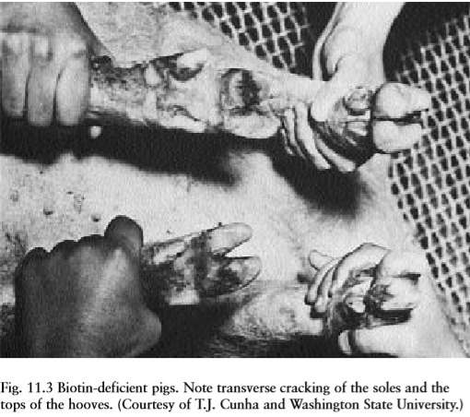
Swine

Slide 40
Poultry
The principal effects in both species are
Reduced growth rate and feed efficiency,
Disturbed and broken feathering,
Dermatitis
Leg and beak deformities.
First signs of deficiency are usually:
Growth depression and
Loose feathering;
Signs of dermatitis then appear and, finally,
Disorders of the leg (perosis)
Beak become apparent.
With dermal lesions, bottoms of feet become rough and calloused and contain deep fissures that show some hemorrhaging.

Slide 41
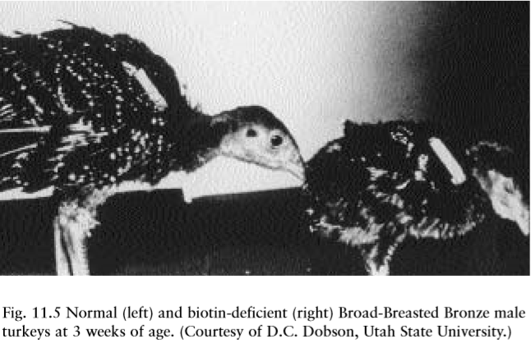
Poultry

Slide 42
Poultry
Lesions appear in the corner of the mouth and slowly spread to the whole area around the beak.
Eyelids eventually swell and stick together.

Slide 43
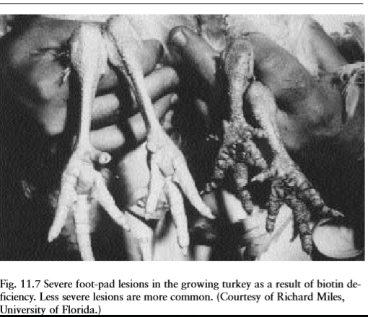
Poultry
Feet problems are usually exacerbated by bacterial invasion of lesions.
Toes may become necrotic and slough off.
Bain et al. (1988) report that “twisted leg” is the most common limb disorder in broiler chickens and that biotin deficiency adversely affected tibiotarsal bone growth.
Tibiotarsal bones are frequently longitudinally distorted
in biotin-deficient poultry.

Slide 44
Horses
Biotin is synthesized in the lower digestive tract of the horse, but information on dietary requirement is lacking (NRC, 1989b).
Such cases were characterized by Hoof condition of a 7-year-old 18hands heavyweight show hunter resulting from biotin supplementation.
The horse had a history of tender feet.
(A) The walls of the hooves were very weak, crumbling at the lower edges, with large areas breaking out and detaching when shoes were nailed.
(B) Five months after supplementation with 15 mg of biotin per day, the walls of the hooves were thicker and harder, so nailing was achieved.
horn that tended to crumble at the lower edges of the hoof walls and that was generally prone to poor conformation and damage to the walls, soles, and the white line junction (Comben et al., 1984).

Slide 45
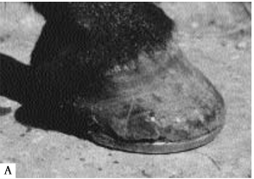

Slide 46
Other Animal Species

Slide 47
DOGS AND CATS
Biotin-responsive disease conditions in dogs include…
Dull coat,
brittle hair,
loss of hair,
scaly skin pruritis, and
dermatitis
(NRC, 1985a; Frigg et al., 1989).
Small animal practitioners, 60% of clinical signs in dogs were cured, and another 31% improved (119 cases) in dogs with hair and skin conditions (Frigg et al., 1989).

Slide 48
In cats
Biotin deficiency may be marked by…
Bloody diarrhea,
Anorexia, and
Emaciation.
Most cats with the deficiency develop signs of alopecia;
Dried secretion around the
Eyes,
Nose,
mouth, and
feet;
Focal dermatitis of the lips near the eyeteeth
A brownish appearance of the skin (Pastoor et al., 1991).

Slide 49
FISH
Biotin deficiency in trout and salmon include…
Anorexia,
Slow growth,
Increased mortality, and
Poor feed conversion.
The “blue slime” disease of trout can be prevented with dietary biotin.
Biotin-deficient catfish develop light skin pigmentation and anemia.
Japanese eels fed a biotin-deficient diet exhibited
Reduced growth,
Abnormal swimming behavior,
Dark coloration.
Common carp and channel catfish required from 8 to 12 weeks, and rainbow trout from 4 to 8 weeks, to show growth depression when fed biotin-deficient diets (NRC, 1993).

Slide 50
FOXES AND MINK
Biotin deficiencies have been produced by feeding purified diets or diets containing egg products to growing mink.
Apparently, the short intestinal tract of the mink and rapid feed passage make it impossible for the animal to obtain adequate biotin from that synthesized by its intestinal flora.
Stout et al. (1966) reported biotin deficiency in mink when diets contained 40% or more offal from breeder hen turkeys.
In both mink and foxes, biotin deficiency resulted in graying or discoloration of hair and, in extreme cases, hair loss (NRC, 1982a).

Slide 51
RABBITS
Deficiency of biotin, characterized by…
Loss of hair
Dermatitis,
Occurred in rabbits that were fed raw egg white over a period of time (Lease et al., 1937).

Slide 52
Humans
Adult volunteers fed 200 g of dehydrated egg white daily for 5 weeks displayed symptoms of
Mild depression,
Lassitude,
Somnolence,
Hallucination,
Anxiety with muscle pain, and
Hyperesthesia
Sudden infant death syndrome (SIDS) may be related to low biotin intakes of bottle-fed infants (Bonjour, 1991).

Slide 53
SUPPLEMENTATION

Slide 54
SUPPLEMENTATION
Biotin is one of the expensive vitamins.
Costs less than other vitamins, such as choline and vitamin E, in monogastric diets.
Biotin deficiency is now more prevalent because of limited bioavailability of biotin found in some grains (e.g., wheat, barley, sorghum)
Some animal protein sources (e.g., meat meal, poultry by-product meal)
Biotin antagonists including molds, feed rancidity, and improved genetic characteristics for greater production.
Foot lesions in adult sows healed in a matter of weeks.
Biotin supplementation resulted in a 28% reduction in lesions after 6 months.
Where foot lesions already existed, dietary supplements of 2,000 to 3,000 μg of biotin per kilogram of diet were beneficial.
A 2% spray-dried biotin product is also available for use in either feed or drinking water.

Slide 55
SUPPLEMENTATION
Less need for biotin supplementation for swine fed a high-quality corn-soybean diet that has no mold (short-term storage)
For swine raised under favorable environmental and nutritional conditions.
Supplementation as increased hoof horn strength may be anticipated within 3 to 5 months.
Milk replacers for calves are recommended to contain 0.1 mg/kg of biotin (NRC, 1989a).
In acute cases of biotin deficiency in calves, single injections of 100 μg of biotin subcutaneously or 1 mg of biotin intravenously reversed the deficiency (Wiese et al., 1946).
For human
Eggs are a good source of biotin .
Biotin supplements in the form of injections of 150 to 300 μg/day can clear up symptoms of deficiency in a matter of a few days.

Slide 56
Losses of biotin during storage can be considerable
Biotin is readily destroyed by feed rancidity
Preparing fresh feeds, storing them for only short periods, and keeping them dry and in a well-ventilated storage area will minimize rancidity problems.
Over-drying
Poor storage conditions
Presence of mold may reduce the availability of biotin in corn.
Biotin is generally stable in feeds, but losses of the vitamin during processing do occur. Processing losses of biotin in extruded pet food have been reported at about 15%

Slide 57
TOXICITY

Slide 58
TOXICITY
For both humans and animals, biotin is apparently not toxic even in large doses.
An acute dose of biotin (5 mg/100 g of body weight) caused irregularities of the estrus cycle, with heavy infiltration of leukocytes in the vagina of the rat up to 14 days after treatment.
Dose of biotin at least 5,000 or 10,000 times the daily requirement had no deleterious effects
Poultry and swine indicate a safety tolerance of 4 to 10 times their requirement
Maximum tolerable level probably much higher
Humans, no adverse effects have resulted from oral or intravenous administration of high doses over prolonged periods.

Slide 59
Summary

Slide 60
Summary
It was believed that supplemental biotin was not required in swine and poultry diets because of its wide distribution in feedstuffs and because of known biotin synthesis by the intestinal microflora. Biotin is a fusion of an imidazolidone ring with a tetrahydrothiophene ring bearing a valeric acid side chain. It is a monocarboxylic acid with sulfur as a thioether linkage. Biotin, with its rather unique structure, contains three asymmetric carbonations, and therefore eight different isomers are possible. A number of methods are available for estimating biotin content of feeds and supplements. An enzyme-linked immunosorbent assay has been used to determine biotin in blood and other fluids. Biotin functions as a carboxyl carrier in four carboxylase enzymes: pyruvate carboxylase, acetyl CoA carboxylase, propionyl CoA carboxylase, and 3-methylcrotonyl CoA carboxylase. Biotin requirements are difficult to establish because of variability in feed content and bioavailability. It is difficult to obtain a quantitative requirement for biotin because the vitamin is synthesized by many different microorganisms and certain fungi. biotin deficiency on the cutaneous system is most dramatic since a severe dermatitis is the major obvious clinical sign of deficiency in livestock and poultry. For both humans and animals, biotin is apparently not toxic even in large doses.

