Slide 1
Introduction to Earthquake Engineering Lec#1
Engr. Muhammad Mubashir Ajmal
Department of Civil Engineering, University of Sargodha, Sargodha

Slide 2
List of Content
Department of Civil Engineering, University of Sargodha, Sargodha

Slide 3
Causes of Earthquake
Earth and Its Interior
Long time ago, a large collection of material masses joined and formed the Earth.
Large amount of heat was generated by this fusion, and slowly as the Earth cooled, the heavier and denser materials sank to the center and the lighter ones rose to the top.
The differentiated Earth consists of the Inner Core (radius ~1290km), the Outer Core (thickness ~2200km), the Mantle (thickness ~2900km) and the Crust (thickness ~5 to 40km).
The Inner Core is solid and consists of heavy metals (e.g., nickel and iron), while the Crust consists of light materials (e.g., basalts and granites). Mantle has the ability to flow.
At the Core, the temperature is estimated to be ~2500°C, the pressure ~4 million atmospheres and density ~13.5 gm/cc; this is in contrast to ~25°C, 1 atmosphere and 1.5 gm/cc on the surface of the Earth.
Department of Civil Engineering, University of Sargodha, Sargodha

Slide 4
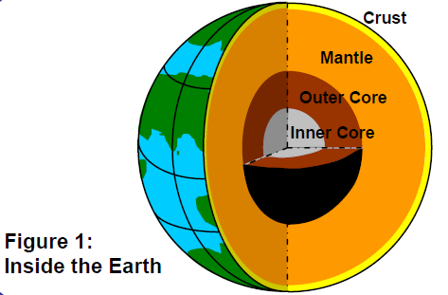
Causes of Earthquake
Department of Civil Engineering, University of Sargodha, Sargodha

Slide 5
Causes of Earthquake
The Circulations:
Convection currents develop in the viscous Mantle, because of prevailing high temperature and pressure gradients between the Crust and the Core
The energy for the above circulations is derived from the heat produced from the never-ending decay of radioactive elements in the rocks throughout the Earth’s interior.
These convection currents result in a circulation of the earth’s mass; hot molten lava comes out and the cold rock mass goes into the Earth.
Department of Civil Engineering, University of Sargodha, Sargodha

Slide 6
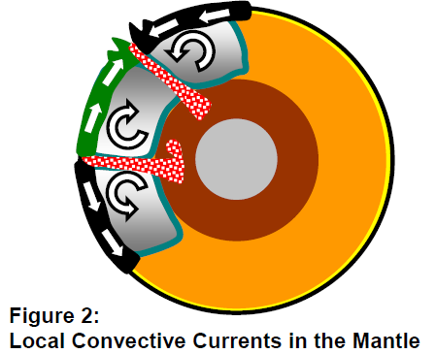
Causes of Earthquake
Department of Civil Engineering, University of Sargodha, Sargodha

Slide 7
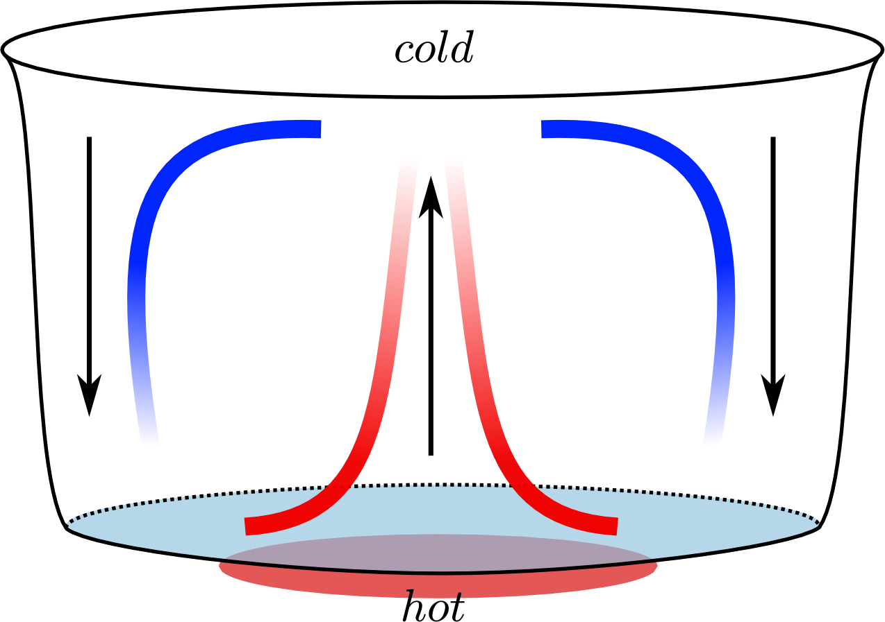
Causes of Earthquake
Department of Civil Engineering, University of Sargodha, Sargodha

Slide 8
Causes of Earthquake
Plate Tectonics:
The convective flows of Mantle material cause the Crust and some portion of the Mantle, to slide on the hot molten outer core. This sliding of Earth’s mass takes place in pieces called Tectonic Plates.
The surface of the Earth consists of seven major tectonic plates and many smaller ones (Figure 3).
These plates move in different directions and at different speeds from those of the neighboring ones.
Types of INTER-PLATE Interactions:
Convergent: Two plates collides head to head (and mountains are formed).
Divergent: Two plates move away from one another (and rifts are created).
Transform: Two plates move side-by-side, along the same direction or in opposite directions.
The convergent boundary has a peculiarity (like at the Himalayas) that sometimes neither of the colliding plates wants to sink.
The relative movement of these plate boundaries varies across the Earth; on an average, it is of the order of a couple to tens of centimeters per year.
Department of Civil Engineering, University of Sargodha, Sargodha

Slide 9
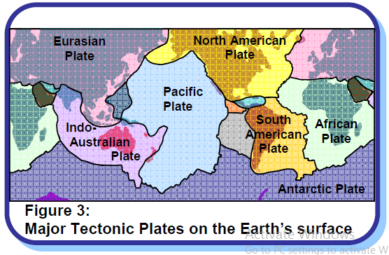
Causes of Earthquake
Department of Civil Engineering, University of Sargodha, Sargodha

Slide 10
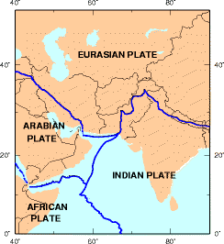
Causes of Earthquake
Department of Civil Engineering, University of Sargodha, Sargodha

Slide 11
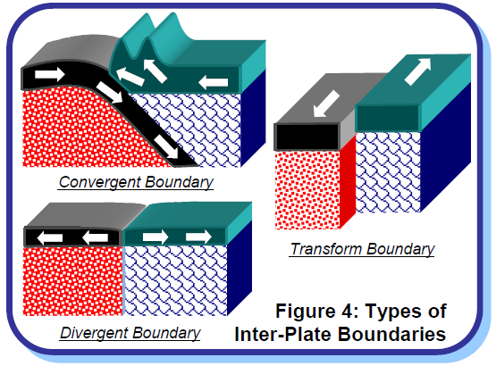
Causes of Earthquake
Department of Civil Engineering, University of Sargodha, Sargodha

Slide 12
Causes of Earthquake
The Earthquake:
Tectonic plates are made of elastic but brittle rocky material. And so, elastic strain energy is stored in them during the relative deformations that occur due to the gigantic tectonic plate actions taking place in the Earth.
But, when the rocky material along the interface of the plates in the Earth’s Crust reaches its strength, it fractures and a sudden movement takes place there (Figure 5); the interface between the plates where the movement has taken place (called the fault) suddenly slips and releases the large elastic strain energy stored in the rocks at the interface.
For example, the energy released during the 2001 Bhuj (India) earthquake is about 400 times (or more) that released by the 1945 Atom Bomb dropped on Hiroshima!!
The sudden slip at the fault causes the earthquake…
Department of Civil Engineering, University of Sargodha, Sargodha

Slide 13
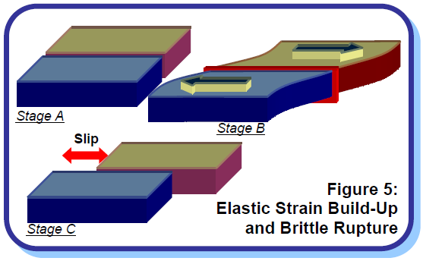
Causes of Earthquake
Department of Civil Engineering, University of Sargodha, Sargodha

Slide 14
Causes of Earthquake
A violent shaking of the Earth during which large elastic strain energy released spreads out in the form of seismic waves that travel through the body and along the surface of the Earth.
After the earthquake is over, the process of strain build-up at this modified interface between the tectonic plates starts all over again (Figure 6).
Earth scientists know this as the Elastic Rebound Theory.
The collection of material points at the fault over which slip occurs usually constitutes an oblong three-dimensional volume, with its long dimension often running into tens of kilometers in case of significant earthquakes.
Department of Civil Engineering, University of Sargodha, Sargodha

Slide 15
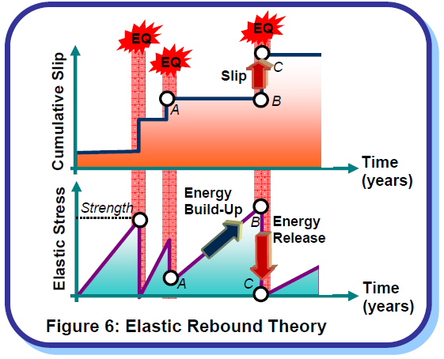
Causes of Earthquake
Department of Civil Engineering, University of Sargodha, Sargodha

Slide 16
Causes of Earthquake
Types of Earthquake and Faults:
Most earthquakes in the world occur along the boundaries of the tectonic plates as described above and are called Inter-plate Earthquakes (e.g., 1897 Assam (India) earthquake).
A number of earthquakes also occur within the plate itself but away from the plate boundaries (e.g., 1993 Latur (India) earthquake); these are called Intra-plate Earthquakes.
Here, a tectonic plate breaks in between. In both types of earthquakes, the slip generated at the fault during earthquakes is along both vertical and horizontal directions (called Dip Slip) and lateral directions (called Strike Slip) (Figure 7), with one of them dominating sometimes.
Department of Civil Engineering, University of Sargodha, Sargodha

Slide 17
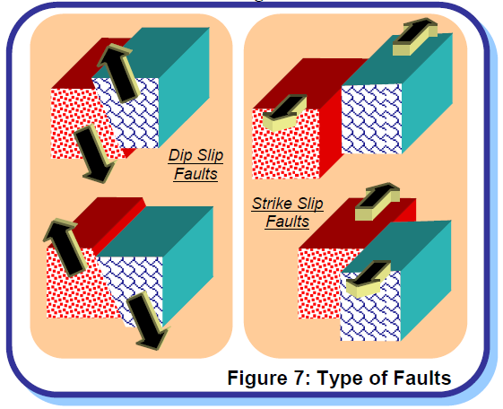
Causes of Earthquake
Department of Civil Engineering, University of Sargodha, Sargodha

Slide 18
Department of Civil Engineering, University of Sargodha, Sargodha

