Slide 1
Software Testing & Quality Engineering
Chapter 4
Leadership Skills
Linda Westfall Quality Press
Notes:
Leadership: - unity of purpose – anyone who has managerial role - in a position to lead
Communicate + Motivate + Accountability + Proactive (Think of future) – Self-awareness (knowledgeable) – Lead from front.
Is a manager a leader ?
Management due to technical knowledge – Leader is Born.
Manager is working on specific task ,
Different –
Manager may or may not be a good leader – Leader he will have managerial skills as well. (Manage people) Leading. Task at hand

Slide 2
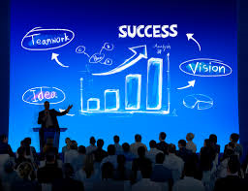
Objectives
Leadership Skills:
Organizational Leadership
Facilitation Skills
Communication Skills
Notes:
Describe and apply various principles and techniques for developing and organizing teams and leading quality initiatives.

Slide 3
Leadership
Leadership is an essential part of any quality initiative. The leader’s role is to establish and communicate a vision and to provide the tools, knowledge, and motivation necessary for those individuals or teams who will collaborate to bring the vision to life. This can apply to an entire organization as well as each specific department or work group. For example, the leader of the quality engineering function is responsible for helping shape the policies for the quality technologies that will be deployed throughout the organization and for ensuring that department personnel are sufficiently qualified to support the use of the technologies.
Notes:
Change process

Slide 4
Leadership - Defined
Leadership is the ability to positively influence people and systems to have a meaningful impact and achieve results.
Leadership is the art of motivating a group of people to act toward achieving a common goal. In a business setting, this can mean directing workers and colleagues with a strategy to meet the company's needs.
Leading People
Influencing People
Commanding People
Guiding People
Leadership is about helping others realize their potential and inspiring them to work with you to achieve a shared vision for the future.
Leadership is ensuring that people have everything they need to achieve the missions of an organization.
Notes:
Motivate the people :
Intrinsic : Appreciate : Certificate of appreciation
Extrinsic: Bonus + Salary
Does need has relation with motivation: Need based motivational appraoach it will bring loyalty.
Need : Socialize : club membership

Slide 5
Characteristics of a Leader
It is difficult to agree on a list of common characteristics of good leaders, however, it is safe to say that they seem to have a greater need for power and achievement and have a more self control and more self confidence then others.
A leader may or may not hold an officially designated position. Often someone in a work group will emerge as a leader because of their knowledge, skills, experience, and/or abilities. Further, teams often include facilitators, another leadership role. The facilitator’s purpose is to provide support to the team’s effort, while at the same time allowing the team to maintain ownership of its decisions.
A good leader always tries to understand where the other person is coming from, what makes them act the way they do—in other words, what motivates them. Good leaders recognize and apply Maslow’s hierarchy of needs. This is the assertion that people are driven by their needs and wants and that all human needs can be roughly placed in a hierarchy. Higher-level needs are not really relevant until lower-level needs are satisfied, but once a need is met, it no longer motivates behavior.
Notes:
Organization - Over confident : Lack of motivation -

Slide 6
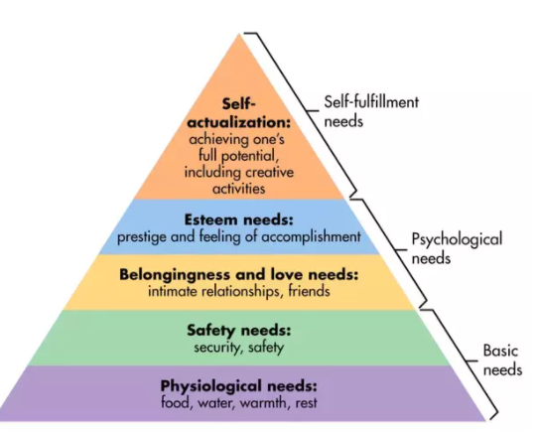
Maslow’s hierarchy of needs
Notes:
Leader : - CEO
Labor unions: 5 Lack home, insurance – Picture Hall of fame

Slide 7
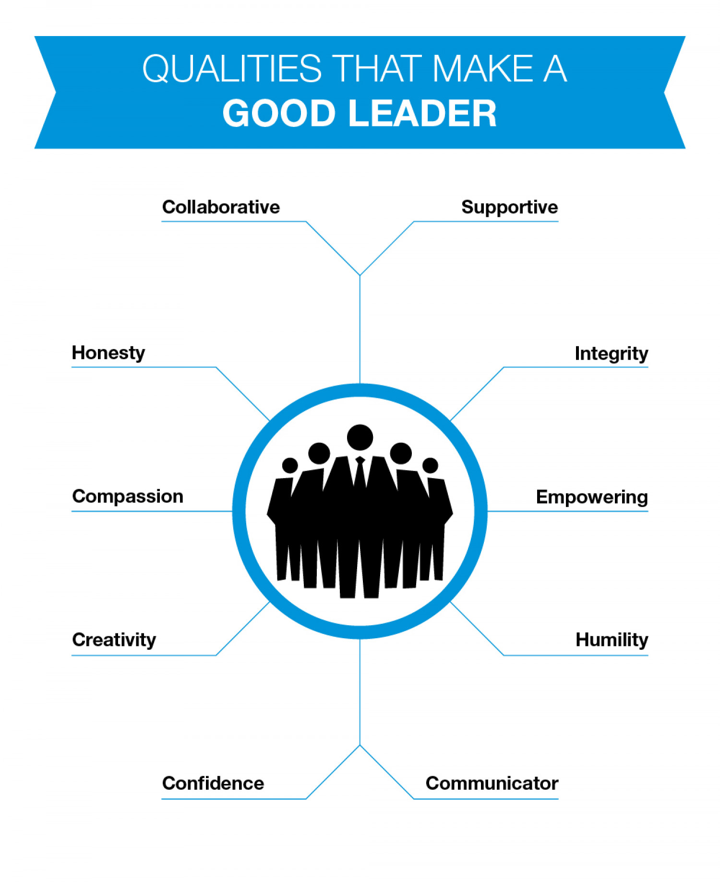
Characteristics of a Leader
Honesty and integrity
Confidence
Inspire Others
Commitment and Passion
Good Communicator
Decision Making Capabilities
Accountability
Delegation and Empowerment
Creativity and Innovation
Empathy
Resilience
Emotional Intelligence
Humility
Transparency
Vision and Purpose
Notes:
Power - Leadership
Relevant : Power cause people to follow.
Power : Punish/Reward – Knowledge is type of power – Investment + leadership skills.
Personality charisma:

Slide 8
Derived powers of a leader.
Position Power: Power may come from person’s position i.e. authority that arise due to a position one holds. Position power can further be analyzed into:
Coercive power: The ability to force someone to do something by threatening and punishment.
Connection Power: It is based on having access to those who have power.
Legitimate power: It is based on a person’s title conferring a special status. Rewards Power: Where the holder can give rewards to those who carry out tasks to his/her satisfaction.
Personal Power: Power that come from person’s individual qualities i.e. knowledge, skills, charisma etc. Personal power can further be analyzed into:
Expert power: which comes from being a person who is able to do specialized tasks.
Information Power: where the holder has exclusive access to information. Journalism
Referent power: which based on the personal attractiveness of the leader.
Notes:
Organization structure : TL, Team member (Connections).
Vaccume : Super mans, spider mans . Real character, associate as a Muslim, Practically Justice.

Slide 9
Leadership styles
Authoritarian:
Directive behaviors
Decides alone
Focuses on tasks
Laissez-Faire:
Permissive
Abstain from leading
Power with staff
Democratic:
Open communication
Team Leader
Focusses on people
Bureaucratic:
Insecure
Knows the rules
Impersonal
Notes:
HRM – Employees . HR manager listens to people needs – policies
Power authority – Personality charisma, he advocates for employees
Political Elite – Bureaucracy (Governmental machinery)

Slide 10
Leadership Styles
As a manager one might be concerned, initially, about establishing personal authority. Balanced against this is the need to involve the staff in decision making in order to make best use of expertise and to gain commitment. Lets take two scenarios.
Ali might decide to be very democratic when formulating plans, but once plans have been agreed, to insist on a very disciplined execution of plans.
Alia on the other hand might feel that she alone has the technical expertise to make some decisions, but, once she has briefed staff, they expect to be left alone to get on with the job as they see fit.
Notes:
Ali and Alia will need to judge when they must be authoritative and insist on things and when they must be more flexible and tolerant.
Authority – people around

Slide 11
Facilitation Skills
A facilitator’s primary mission is to ensure that a team is successful, but this must be done in a way that ensures that the team, not the facilitator, is responsible for the outcome. He may or may not be from the same team.
Different roles of facilitator
Meeting Manager:- The facilitator is actually guiding the team through the agenda and flip charting discussions that occur.
Observer: Where the facilitator sits quietly to the side and simply comments when it seems necessary or useful to further team progress. The observer role also provides the opportunity to gain information that can be used to coach the team leader in team process skills.
Note:
The facilitators do not discuss content issues, only process issues. (Refer to Example in Notes)
However, if the team leader is assuming the role of a facilitator then he might contribute to the content because of his technical knowledge.
Notes:
1-Concurrent with the development of teams was the emergence of the facilitator as a key organizational player. Teams and facilitators go together like love and marriage, horse and carriage.
In an ideal world there would be no need for facilitators. Everyone would have the skills necessary for their roles and would work effectively with everyone else. However, it is not an ideal world, since all of us are continually learning. The role of facilitator is therefore a valuable one since it allows special additional skills to be readily available to the team.
2- For example, if a team were trying to reduce the amount of time patients spend in the waiting room of a healthcare clinic, the facilitator would not interject comments such as, “Should we change the patient scheduling process?” since it is relative to technical content of the subject matter. However, at the appropriate time the facilitator might ask, “What are some additional ways that the time could be reduced?” since it only involves ensuring that the team has taken a broad view of potential opportunities.

Slide 12
Skills required for a facilitator
Meeting Management skills
Meetings are like mini projects
Mission (Purpose of meeting)
Technical Process (Meeting agenda)
Boundaries (Meeting duration)
Time management
Communicate properly
People Skills
Understanding of psychology
Dealing with background, skills, and priorities
Technical Process Analysis Skills
It is difficult to understand others if you do not understand yourself, because you may make interpretations using filters of which you are unaware. Therefore make use of QC tools, Management Tools, statistical process control etc., at appropriate times.
Conflict Management
Notes:
QC Tools : Flow Charts – Pareto Charts – Check sheets – Histograms
Management Tools : Affinity Diagram – Prioritization Matrix – Benchmarking – Process Maps
Statistical Tools:- Six sigma

Slide 13
Communication
To create understanding and commitment, leaders employ skills such as clear formulation of a concept, emphasis of key points, repetition, and summarization. Multiple channels are absolutely vital to convey our message in the complex information world we inhabit. Every listener/reader is bombarded with communication from numerous sources.
Notes:
Leadership : Different type of people, you have different initiatives . Listener should be engaged.

Slide 14
Communication
Need for communication
Every communication interaction is unique in terms of purpose, context, mode of communication, and people involved.
Only the rarest job does not require excellent communication skills.
Relevance with Leadership & Quality
A good leaders understand and employ efficient and effective communication in order to achieve shared vision/goal.
In the quality field, effective communication is essential in order for everyone to understand and have a sense of ownership of the common vision. Every employee must be aware of objectives and necessary actions that are required for successful quality initiatives within the organization. Common goals are a unifying factor in virtually all successful teams.
Notes:
Terms audience, reader, listener, and customer are used interchangeably as are the terms speaker and writer.

Slide 15
Modes of Communicating
Written Communication
Queries – Directives – Memos – Minutes of Meeting – Letters – emails – Invitations
Use of hard copies is still sometimes required for legal and archiving purposes.
Constructive feedback is important
Oral Communication
Interview – Formal speeches – Conversation – Debate – Directives - Announcements
A successful quality engineer will master both discussion skills and presentation skills.
The ability to analyze and organize information and to present this information orally will consistently reap rewards.

Slide 16
Importance! Of communication
Individuals speak at 100 to 175 words per minute but they can listen intelligently at 600 to 800 words per minute. Since it is possible to receive so much faster than the message can be produced orally there often is a tendency to allow our thoughts to drift to other things. This is why it takes effort and focus to hold attention on the message being sent. Active listening means to listen with purpose and concentration. The receiver decides to listen closely to gain information, obtain direction, understand others, solve problems, share interests, see how another feels, show support, and so on. It requires as much energy to listen actively as it does to construct and send the message.
Notes:
Software developers are not preferred . Software quality (Developers).
Exp

Slide 17
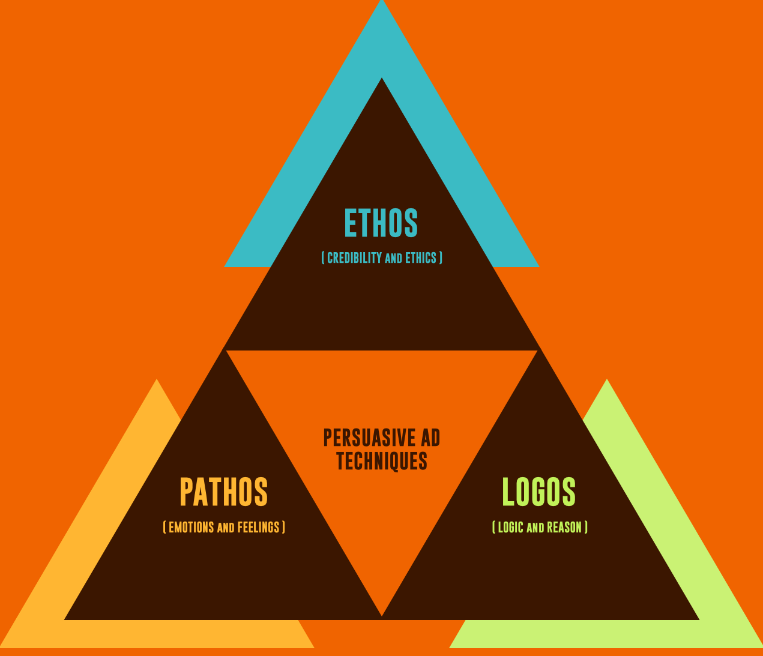
Communication : Feedback
Ethos. Often defined as credibility but has a much fuller meaning. The dimensions of credibility are competence, character, goodness, decency and trustworthiness, composure, sociability, dynamic extroversion, and a sense of purpose. (Effective communication is deep, subtle, and complex!)
Logos. Logic, evidence, sequence of thought, building up of the case in a pleasing manner that enhances comprehension. It means giving an idea order and form.
Pathos. The appeal to emotions. It implies a reaching out to our common bond of feelings and our innate sense of being human. It comprises our compassion, our values, and feelings about ourselves and others. The use of pathos has the ability to create in us a deeply felt response.
As a quality engineer you rely heavily on the discovery and organization of data, facts, and evidence—systematically collecting, analyzing, and organizing the material (logos). In addition, your authority, expertise, character, and reputation enhance the believability of your message (ethos). When this message is then framed to appeal to the emotional state of your receiver (pathos), you have a compelling triad.
Notes:
Aristotle coined the terms Ethos, Logos, Pathos

