Slide 1
Material
Paints, Papers & Brushes for Islamic Illumination
Paper
Use a heavy weight watercolour paper (hot press) that starts from 240 gsm and above. Use this heavy weight because layer of paintings with a lot of paint, so if you are not doing a lot of layers then you can use lighter weights.
Also avoid cold press/rough paper because it has a lot of texture that can impact the fine outlining that do with ink. The Cass Art Hot Press 300 gsm paper.

Slide 2
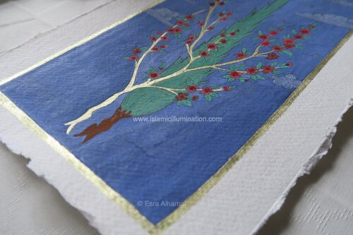
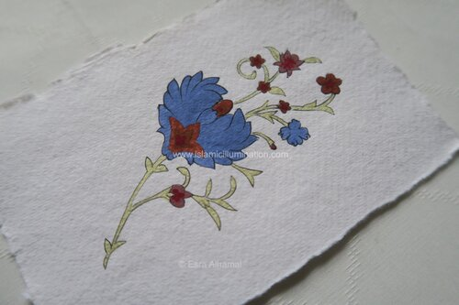
Budget Hot Press Paper
BOCKINGFORD : GLUED PAD : 9X12IN : 300GSM : 12 SHEETS : HOT PRESSED
DALER ROWNEY : AQUAFINE WATERCOLOUR PAD : LANDSCAPE : 300G : A4 : SMOOTH
Mid Range Hot Press Paper
ARCHES : AQUARELLE : GUMMED WATERCOLOUR PAD : HOT PRESSED
SAUNDERS WATERFORD : WATERCOLOUR PAPER SPIRAL FAT PADS
High Budget Press Paper
FABRIANO, Hot press, 300 gsm
SAUNDERS WATERFORD, Hot press, 425 gsm
Cotton paper from the Khadi brand

Slide 3
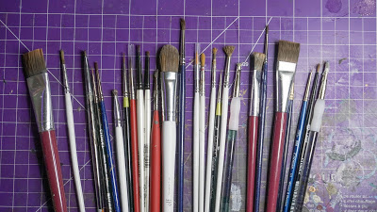
Brushes
Does your brush size matter? Best Illumination Brushes
No.2 Round for base coating and layering, can also use this on for shading/washing.
00 Fine Detail for those tight places.
Small ELF Blush brush for dry brushing.
Junk Brushes, one for texture paints because that stuff never comes out of a brush, and the other for transferring paints from a pot to a palate.
Brushes suitable for the art of Islamic illumination
Rosemary and Co is absolute favourite and that is local in the UK. They have SO many types and use their Series 33, pure Kolinsky Sable brushes.
Windsor & Newton is another reliable brand for brushes and can be found in most places. They have a few sizes and types as well. I use their standard series 7.
Da Vinci brush is popular amongst illumination artists. I have a few and they are okay, but I prefer the other two brands.

Slide 4
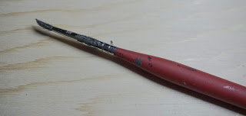
Citadel Layer Medium , Citadel Fine Detail
This brush has become a staple for me when it comes to fine details like eyes or wiring on a backpack.
The "Junk Brush" - A long dead brush that still comes in handy for transferring to a palate or mixing.
The Army Painter - War Painter- Regiment- This is the new brush .Made from Natural Sable it is a No. 2 size, the brush has a fairly large belly considering how sharp the tip is and the triangular shape is comfy to hold and doesn't slip. I look forward to painting with this and you can expect a review baked into a future post.
E.L.F Consealer Brush & E.L.F Foundation Brush
Yes, consider these makeup brushes a must have in brush rack, with a very high bristle count made from a soft material, and their rounded tips, they make amazing dry brushes.

Slide 5
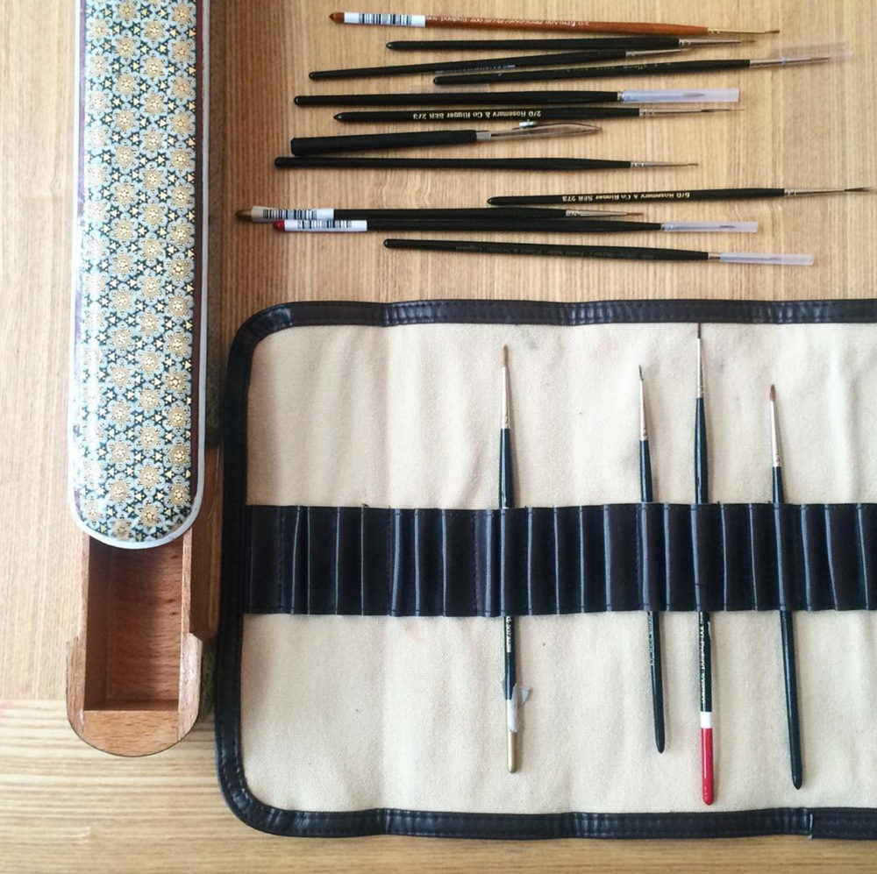
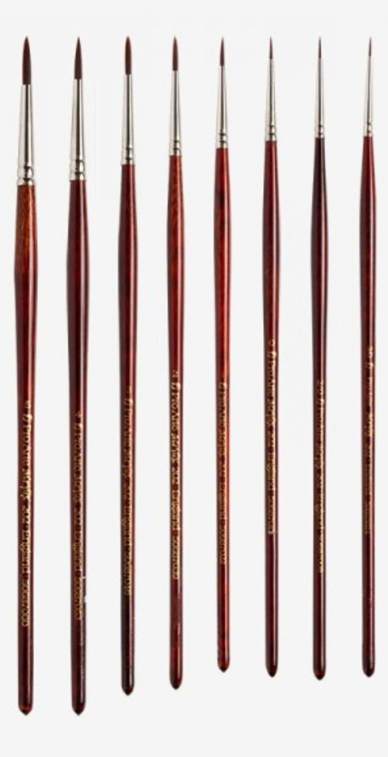
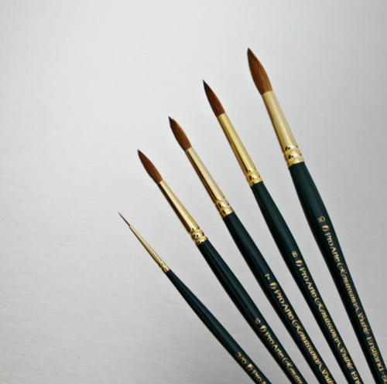
Brushes
Generally use a range of brushes that start with size 1 as the largest and it gets smaller up to 0/10, but that depends on the scale of you work.
Budget Brushes
Pro Arte Series 101: KOLINSKY SABLE
Pro Arte Series 202: SYNTHETIC

Slide 6
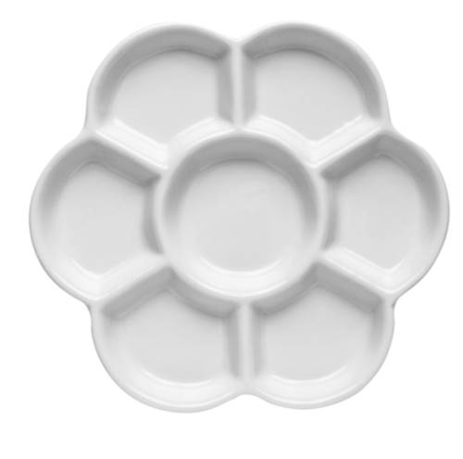
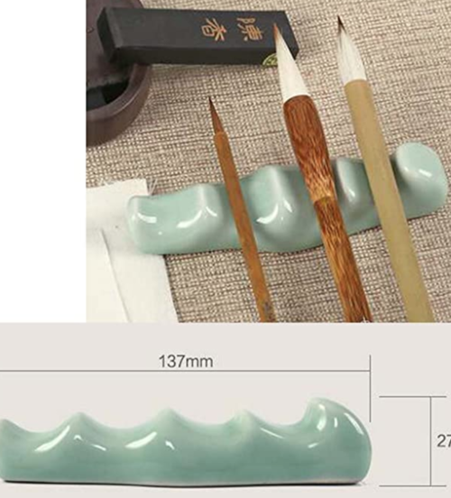
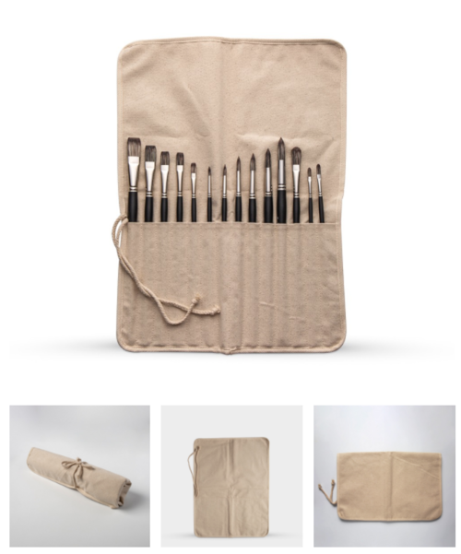
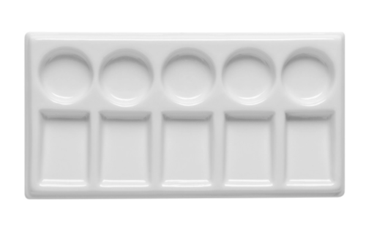
Mid Range Brushes
Winsor and Newton Series 7: KOLINSKY SABLE
Higher Range Brushes
Rosemary and Co Brushes series 33: PURE KOLINSKY POINTED
Rosemary and Co Brushes series 99: POINTED PURE SABLE
Cloud and Rock Brushes from artist Vaishali
Some other tools related to brush like the paint palette, brush holder, brush rest and of course a brush box or a brush fabric case.

Slide 7
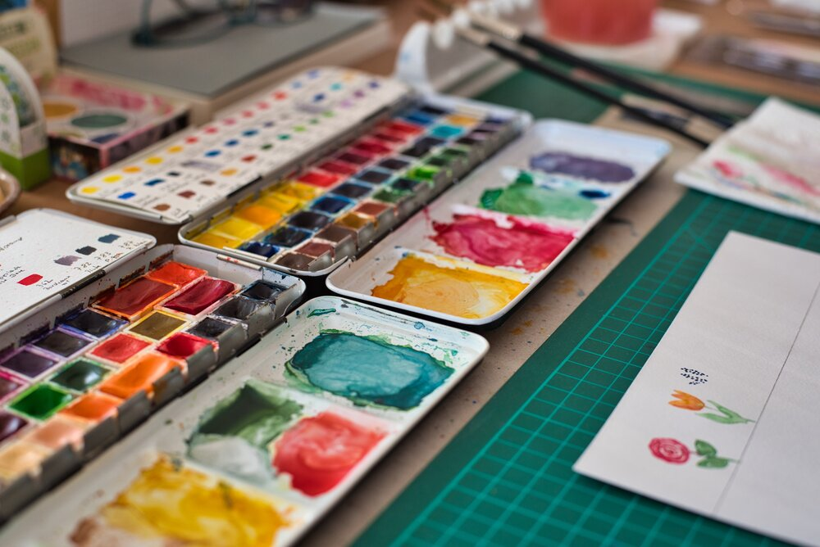
Colours
The main type of colours use is gouache with genuine pigments. If you are not familiar with gouache then this post will help you: Gouache Paint Explained.

Slide 8
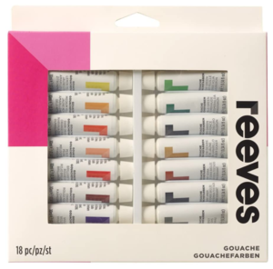
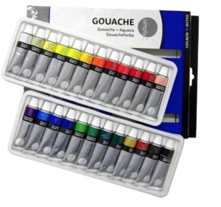
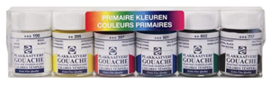
Budget Gouache
Reeves Gouache Paint (UK link)
Amazon US link for Reeves Gouache Paint
Daler Rowney 12ml Simply Gouache Set UK Link |US Link
Talens - Extra Fine Gouache Paint - 6x16ml Jars of Assorted Primary Colours UK Link

Slide 9
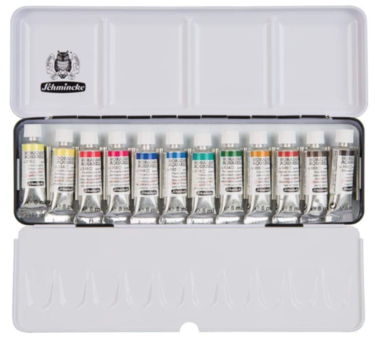
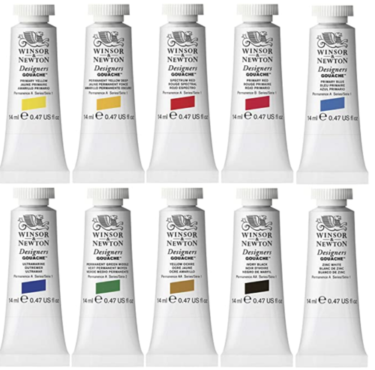
Mid-High Range Gouache
Winsor Newton gouache (Uk Link) are my absolute favourite brand and they are my go-to brand for professional work. They are not cheap, but they will last you for YEARS if you close them properly and store them correctly so they don’t dry up. You can start with primary colours and mix up the hues or just buy the colours secretly every few months. | Amazon US link for Winsor Newton gouache

Slide 10
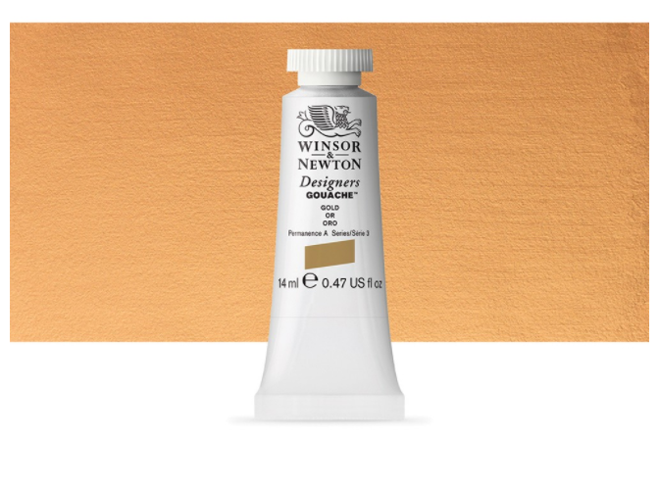
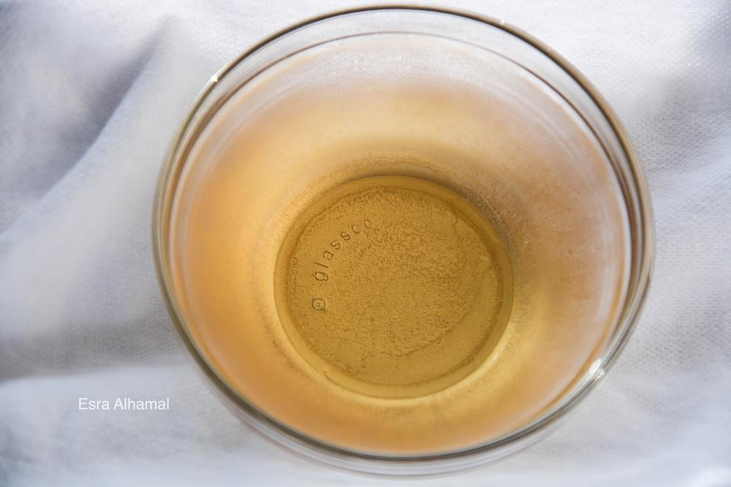
Gold
The only budget solution for gold is to use imitation gold such as the gouache paints and my favourite is the Winsor Newton Gouache Gold. Using real shell gold then you can buy the shell gold leaves that come as a little booklet of 24 loose leave and there are a few
people who sell it such as Cornelissen or Wrights of Lymm. The prices range from £20-40 depending on the quality of gold and the trading price.

