Slide 1
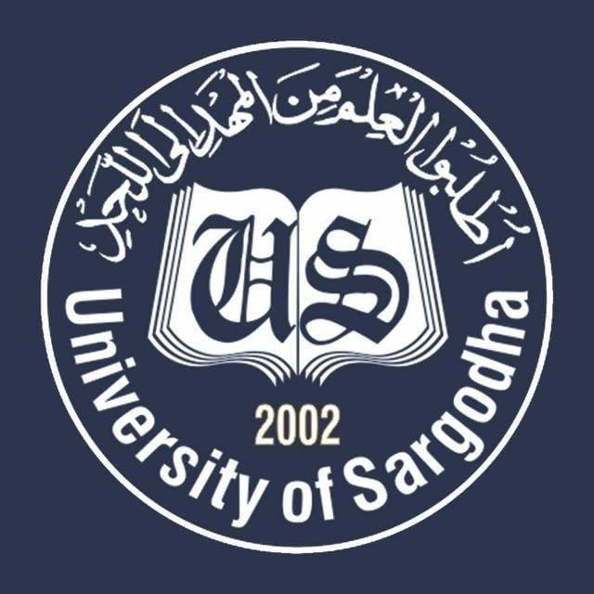
Muslim Philosophical Perspective on Education BS Education-III Philosophy of Education (EDU-203)
Department of Education University of Sargodha

Slide 2
Presented by
Group#7
Afifa Sehar BEDF19E027
Maira Kanwal BEDF19E035
Rimsha Rehman BEDF19E041
Tehreem Fatima BEDF19E053
BS Education
Semester 3
Self-support
Assignment of philosophy of Education
Notes:
Assignment of philosophy of Education

Slide 3
Topic of presentation
Muslim Philosophical Perspectiveon Education
Imam Ghazali
Ibne-Khaldun
Shah waliullah
Sir Syed Ahmed Khan
Allama Iqbal

Slide 4
Introduction
Imam Ghazali
The impact of Al-Ghazali Philosophy
Ibne-Khaldun
View of Education
Contribution in Education:
Shah waliullah
Sources of knowledge
Shah waliullah ‘s work
Shah waliullah ‘s book
Sir shed Ahmad khan
The alighar Movement
Allama Iqbal
Philosophy Of Islamic education

Slide 5
Introduction
The philosophy of Islamic education is looking at the principles and concepts underlying education in Islam, it isanalyzing and criticizing, deconstructing and disintegrating of the existing educational infrastructure and strives to produce new concepts continuously or displays what should be the concepts. In this sense it is philosophy that beyond what is existing constantly toward absolute values, and is working in the space of Islamic knowledge and who is humane and moral essence. The Islamic Education is seeking to achieve the distinct role of the human being which is reform and construction of human life. This Islamic concept of life based on the fundamental concepts as individual, society and the world, and education works to find a balanced relationship and equitable between the parties to this equation which are based on a relationship characterized by a mutual and integration, so one party cannot survive without the other parties.
This relationship is based on ethical authority, who is the religion or the Holy Quran which represents the source of Islamic education that derive their universal values from it, so the task of education to link every human activity or behavior with ideal moral value. Therefore, Islamic education is interested in all activities of the individual at the physical, mental, psychological, spiritual, and try to find a balance between these forces that comprise the human being. For example education on independent thinking and creativity takes a great interest in Islamic culture; we find that the Koran, as well as many Muslim scholars, Ibn al-Haytham and al Ghazali stress the importance of critical thinking and independent.

Slide 6
Muslim Philosophical Perspectiveon Education
Imam Ghazali
Abu Hamid Muhammad bin Muhammad surnamed al-Ghazali was a great scholar, mystic, Sufi, thinker, jurist, philosopher
and educationist. He has left an indelible mark on the cultural, religious and educational history of the world. As an educationist, we can rank him with his two great non-Muslim predecessors, Confucius and Plato. He gave much importance to education and wrote as many as one hundred books, out of which seventy eight works are still available.
His greatest work is Ahya-ul-Uloom-ud-din, which reflects his main philosophical and psychological thoughts. His philosophy of education represents the high point of Islamic thinking on education.Al-Ghazali, the purpose of society is to apply Sharia and therefore the aim of education is to cultivate men so that they abide by the teachings of religion and is hence assured of salvation and happiness in the eternal life of the hereafter.
CLASSIFICATION OF KNOWLEDGE:
CLASSIFICATION OF KNOWLEDGE:
STAGES OF EDUCATION

Slide 7
The impact of Al-Ghazali Philosophy
Al-Ghazali died at the age of 55, after a life that was not as Long as it was productive, wide-ranging and influential. He is rightly considered to be one of the most important and profound Islamic thinkers, who were aptly called, the “renovator of the fifth century A.H. his influence may be witnessed by a number of factors such
a. The profundity, power and comprehensiveness of his thought contained in some fifty different works, which are still studied today.
b. The fact that his view were well suited to his age and milieu and were more a reflection of that age than a response to its needs and requirements they constituted more an element of continuity and conservation that a factor renewal and change.
c. After Al-Ghazali, Islamic society and thought entered into a long period of stagnation and decline producing few great minds.
Al-Ghazali thus remained alive and influential. l-Ghazali’s writings on education constitute the high point of thinking on the subject in the Islamic world. The theory of education he elaborated is the most complete edifice relating to the field. It clearly defies the aims, lays out the path and means whereby the objectives can be achieved. From 12-19th century (A.D), Islamic educational philosophy was heavily influenced by him. Indeed, theoretical and practical educationists, with few exceptions, hardly did anything other than borrow from Al-Ghazali and summarize his ideas and books.

Slide 8
Education is not limited to training the mind and filling it with information but involves all aspects i.e. intellectual, religious, moral and physical of the personality of the learner; it’s not enough to impart theoretical learning, that learning must be put into practice. True learning is that which affects behavior and where by the learner makes practical use of his knowledge.
Ibne-Khaldun
Ibn-e- Khaldun was one of the most talented and versatile person and thinker the world ever saw. Besides being the top Muslim philosopher, he was also a practicing politician and expert historian.In a nut shell he was a person gifted with a great intelligence. His philosophical approach towards the understanding of history gave him a place among the pioneers of philosophy of history.(Ahmad, 1984).
View of Education
Ibn-e-Khaldun conveys that the education consists of the moral as well as the intellectual training and teaching of humans which brings out the potential within a man that helps develop the character and builds up the personality (Khalid, 2012). According to Khaldun, the knowledge can be divided into two parts of streams, one of the subjects pertaining to philosophy depending upon one’s mental potentialities and thinking faculties, the other dealing with the religious subject. In the view of Ibn-e-Khaldun both types of knowledge are crucial for mankind as both play a role in the development and progress of any nation (Shahid, 2000).

Slide 9
Contribution in Education:
Ibn-e-Khaldun was a famous historian, a great philosopher, and also an incredible educationist. His views on education and the deep psychological insight in the educational process and development of human mind and body tagged him as a great educator too. His contribution in education is considered to be worthwhile and valuable across the world in the field of education because he emphasized on the social efficiency as an aim of education and also promoted professional and vocational subjects along with academic subjects in education. The modern education literally advocates the methods provided by Khaldun in teaching.
The mastermind of Ibn-e-Khaldun was assorted and adaptable: he was an accomplished philosopher, a seasoned politician, a reputed historian, and a learned geographer. He was the founder of philosophy of History, a originator of the “Philosophy of Sociology” and a pioneer of Demography. Khaldun had great command over imaginative and creative teaching potentials. He was not only a teacher but an educator who could lay hands on any subject and lecture over it with reference to his academic skills. He is the original thinker and philosopher whose range and depth of wisdom in the field of education is just exclusive.

Slide 10
Shah walliullah
Shah Walliullah was a great Muslim reformist of 18th century in India. He was a brilliant thinker and scholar with critical insight of political scenario of that time. He worked for the betterment and true education of Muslims on right Islamic norms. At that time in the Muslims after ruing India magnificently were going to lose power. The decline of Muslim rule in India had already begun and Muslims were being exploited at every facet of life. In order to bring Muslims of India on right path and help them Shah Walliullah worked really hard. He was born on 21st February 1703 in Delhi and he died in 1762. His father was a famous religious personality at that time his name was Abdur Rahim he was a famous educationist who was running a Madrasah called Madrasah –i-Rahimiyah. Shah Walliullah got his early education under his well educated father who taught him well and he was also enrolled in Naqshbandiyya Sufi order to enrich his spiritual insight. Soon he got permission to teach at father’s Madrasah, where he continued teaching for next 12 years.
Sources of Thought
The central point on which revolves the philosophical thought of Shah Waliullahis religion. According to him religion is the source of strength and power for Muslims.Their decline was the direct result of their apathy towards it. His chief concern thereforewas to call Muslims back to the teachings of Islam. He had a strong faith in the force andstrength of Islamic ideology in which, he believed, if accepted fully and applied honestly,lay the hope for peaceful and prosperous development of the human race. Shah Waliullahconsequently spent all his energies towards purifying Islamic ideals of all unhealthyinfluences and providing them a fresh intellectual ground to meet the challenges of thetime.

Slide 11
Shah waliullah’s Books
Hujjathullahi-l-baligha
Izalatul-khaifa
The vilul Ahadih
Faizul-kabir
Budur-al-bazighah
Notes:
Shah waliullah’s Books
Hujjathullahi-l-baligha
Izalatul-khaifa
The vilul Ahadih
Faizul-kabir
Budur-al-bazighah

Slide 12
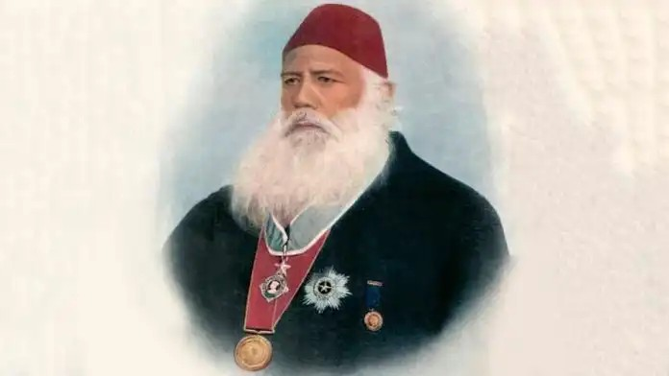
Sir syed Ahmad khan
Born on 17 October 1817 to a wealthy family that was close to the Mughal court, Sir Syed Ahmad Khan wore many hats: Civil servant, journalist, historian. However, he is, first and foremost, known for his pioneering role in transforming the educational opportunities for Muslims. He recognised that education is the most important tool through which Muslims could emerge from a position of disadvantage and compete with Hindus, especially Bengali Hindus who were at the pinnacle of the political scene at the time.
He pushed for educational and social reforms and was a champion of democratic ideals and freedom of speech. In one of his essays he wrote, “Freedom of expression is the right of everyone… Suppression of opinions, be it for any religious fear, or the fear of community and tribe or the fear of being defamed, or the fear of the government – is very bad”
The Aligarh Movement
Khan’s most notable contribution to the field of education is establishing the Madarsatul Uloom in Aligarh in 1875, now known as the Aligarh Muslim University, a premier educational institution of the country.

Slide 13
He attempted to model the college on universities such as Oxford and Cambridge. His work on Muslim education was not limited to this alone — he wanted to create a network of educational institutions managed by Muslims and founded the All India Muslim Educational Conference.
In 1886, he set up the Mohammedan Anglo-Oriental Education Congress, later renamed the Mohammedan Anglo-Oriental Educational Conference, to bring together education and culture. He emphasised the need for an autonomous Muslim institution free of any government funding.
On this issue he said, “As long as we depend on Government for wants which are essentially of a domestic nature as education necessarily is, we really expect to get what is simply impossible to obtain. The best educational institutions in Europe are either entirely or next to entirely free from any control of the government.”
Allama Iqbal
Allama Muhammad Iqbal (1873-1938) has valuable contribution in that he denes the resolution education can provide. In his scientic work entitled: “The Reconstruction of Religious thought in Islam”, Iqbal (1998) laid the theory of education, according to Saiyidain, cannot be profoundly elucidated without consciously postulating some conception of the nature of the individual to be educated, his relationship to the community and, what may be called, his ultimate destiny (Saiyidain, 1992). The essence of the educative process, reduced To its most elementary .

Slide 14
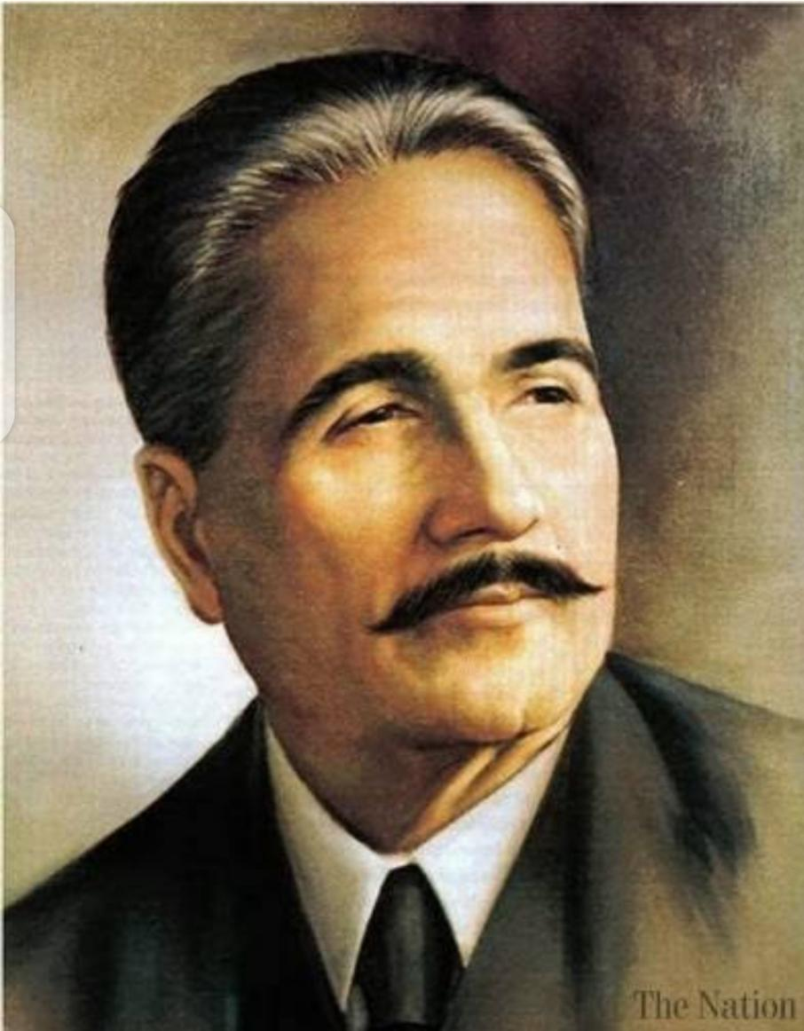
Philosophy of Islamic Education
To the mind of the researcher, the relationship of an individual with his environment like what
has been discussed in this introduction vividly could be made as the basis of developing the
nature, meaning and philosophy of education in general. It is important then to elaborate
the philosophy of education from the sight of Islam (Al-Attas, 1980). In elaborating the
philosophy of Islamic education, the view of Rosnani Hashim (2008) infers from her book
entitled Education Dualism in Malaysia. To her, it is a well-known principle that education
is one of the means through which a particular society transmits and renews its culture and values
According to William K. Franken, education is the transmission or acquisition of the excellence
(desirable abilities, habits, states and traits) by the use of techniques like instruction, training,
studying, practice, guidance and discipline (Franken, 1965). Consequently, it is natural that
educational principles.

Slide 15
Reference
https://www.researchgate.net/publication/333389341_Shah_Waliullah_on_The_Art_of_Being_Knowledgable_Fann_Daneshmandi
https://www.researchgate.net/publication/267370644_Iqbal's_Philosophy_on_Islamic_Education_A_Historical_Perspective
https://www.researchgate.net/publication/267370644_Iqbal's_Philosophy_on_Islamic_Education_A_Historical_Perspective
https://theprint.in/theprint-profile/sir-syed-ahmad-khan-for-whom-educational-reform-way-of-life/306520/
Notes:
Reference

Slide 17
Presented by
Group#7
Afifa Sehar BEDF19E027
Maira Kanwal BEDF19E035
Rimsha Rehman BEDF19E041
Tehreem Fatima BEDF19E053
BS Education
Semester 3
Self-support
Assignment of philosophy of Education

