Slide 1
Social Interaction

Slide 2
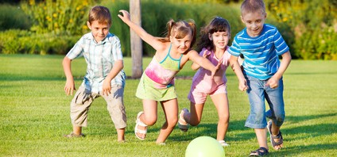
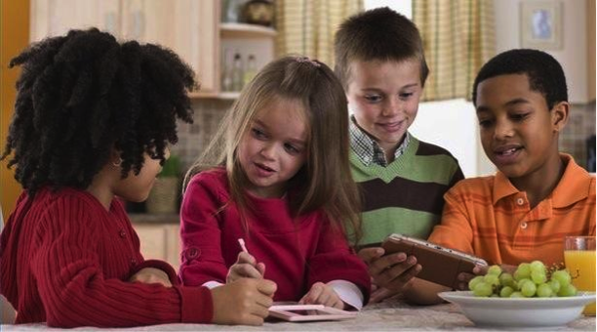
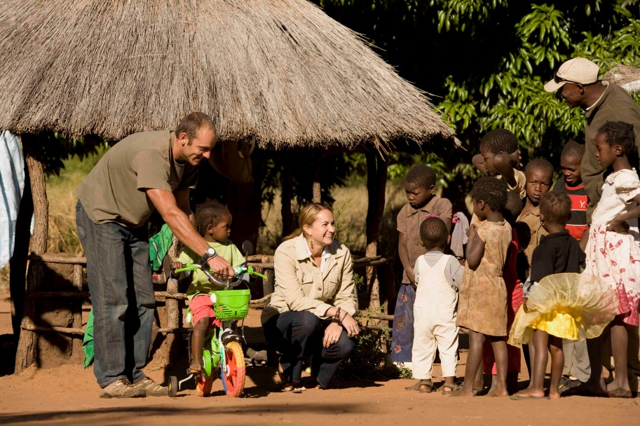
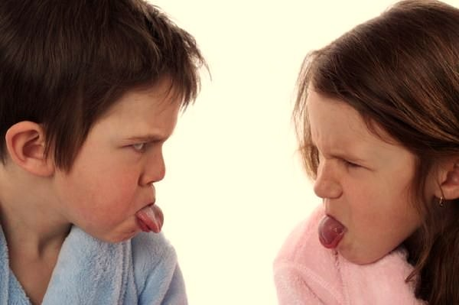

Slide 3
Definition
When an individual, group or party influence the behavior of other individual, group or party is called social interaction.

Slide 4
According to Persal:-
“Social interaction refers to the ways people behavior in relation to one another using language, gestures and symbols”.
According to Ian Robertson:-
“Social interaction is the process by which people toward or responded to other people.”

Slide 5
Forms of social interaction

Slide 6
Individual to individual
It is the basic form of social interaction, in which two individuals interact with one another. For example, interaction of mother with her child, customer and shopkeeper.

Slide 7
Individual to group:-
It is also a common form of social interaction in
In which one individual interact with a group of people. For example, the lecture of a professor to his class, the speech of a political leader before a large number of people, the speech of president or prime minister of Pakistan on radio/ TV.

Slide 8
Group to group:-
In this form of interaction one group affects
physically as well as mentally to the other group
due to which social interaction occurs. For example,
a match played between two teams, dialogs
between the delegations of two countries.

Slide 9
Individuals to culture:-
People are effected by norms, values, customs, beliefs,
fashions etc. of their culture. People also effected their
Culture by making certain changes in it according to
their needs.

Slide 10
Processes of social interaction: -
The process of social interaction refers to those
methods and ways of social interaction which are
commonly found in our social life and these are
repeated again and again,.

Slide 11
Cooperation:-

Slide 12
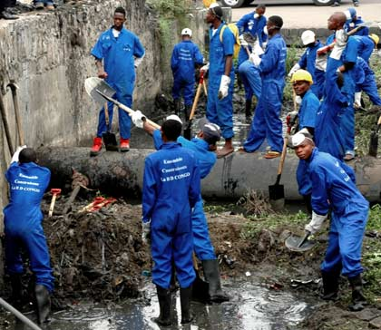
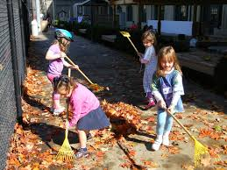
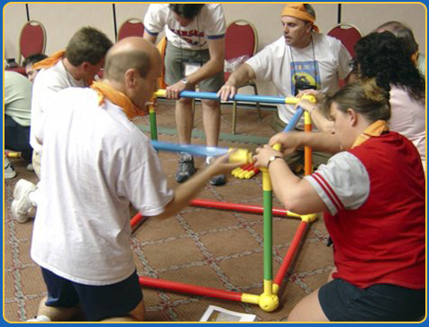
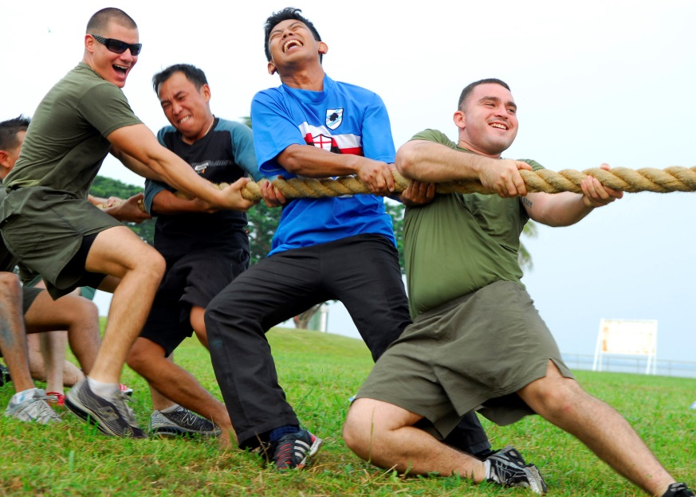

Slide 13
According to Horton and Hunt:-
“Joint activities in pursuit of common goals or shared rewards is called co-operation.”
Hornal Heart:-
“Cooperation is a type of social interaction in which the individuals and groups organize their forces in order to achieve a common goal.”

Slide 14
Persal
Cooperation is a form of social interaction
in which individuals make efforts to get
collective goals.

Slide 15
Types of cooperation:

Slide 16
Direct cooperation: -
Face to face cooperation.
It is a type of cooperation in which the individuals
completes a work or task together but it is not
necessary that its merits, number and standards
are equal for everyone. For example, when the
farmers clean a canal or a sub-canal, they do not
get equal advantages.

Slide 17
Indirect cooperation:-
It is that type of cooperation in which people
cooperate with each other but not face to face.
For example, the members of a party if want to
make a strike in the country, all the members will cooperate with each other. For example, Punjab Professors Association, Traders association, Doctors association.

Slide 18
Formal cooperation: -
In this type of cooperation, individual cooperate with
each other according to certain rules and regulations.
For example members of club cooperate with each others for collective objectives.

Slide 19
Informal cooperation: -
It is a type of cooperation in which people cooperate
with each other for some needs but not according to
rules and regulations. For example, help the people
during accident; help the older while crossing the road.

Slide 20
Antagonistic cooperation: -
This is the negative form of cooperation . Some people Cooperate with each other for their personal benefits But their such cooperation is harmful for the majority of people . For example , the owners of mills cooperate with each other and stop the supply of their Products to increase their prices/profit but creates problems for the society.

Slide 21
Accommodation:

Slide 22
According to Horton and Hunt, “Accommodation is the peaceful adjustment between hostile and competing groups”
The suspension of rivalry between the parties for temporary or permanent period of time.

Slide 23
Types of accommodation

Slide 24
Displacement:-
It is the type of accommodation in which one conflict can displace by an other. If any country suffers from internal problems, it threatens the other country for war to divert the attention of the people from its internal problems. In such circumstances, the people from all sects gather at one platform. In this way brotherhood and solidarity is created in the country. War on terror,

Slide 25
Super-ordination:-
This is an act in which accommodation comes into existence by the complete disaster or the defeat of one party.
One party completely surrenders. The winning party dictates the terms and conditions of the agreement e.g. in the 2nd world war Germany and Japan surrendered themselves to the allies.

Slide 26
Compromise:-
the rival parties agree to surrender some of their claims and demands to bring peace. This is a “give and take process”. Mostly it take place between “equals”
: e.g. Arabs make a compromise with Israel.

Slide 27
Arbitration:-
Conflict is resolved by mediatory efforts of third party.
For example, the role of America as arbitrator between Arabs and Israel. In case of any dispute between the nations UNO mostly play the role of an arbitrator.

Slide 28
Toleration:-
When one party attempts to live peacefully with
others even at the expense of more or less loss
From the opposite side is called toleration.
e.g. Indian Muslims

Slide 29
Truce:-
When the both the parties or individuals do not agree
with each other on an issue and the conversation gets
longer and longer, then the issue is abolished for
undefined time or period and the parties and individuals get accommodation. For example the accommodation between India or Pakistan on Kashmir and Siachin Glacier.
Confidence building measure.

Slide 30
Competition:-

Slide 31
According to Horton and Hunt:-
“ Competition is the process of seeking to obtain a reward by surpassing all rivals.”
Class Competition

Slide 32
Types of competition-

Slide 33
Absolute Competition:-
In this type of competition. All the individuals of
society can take part but only one person can be selected.
For example in the election of president ship, all the
eligible candidates can take part but only one is to be
selected. In the competition of Rustam-e- pakistan
all the individuals can take part but only one is to be
made Rustam-e-pakistan.

Slide 34
Relative Competition:-
It is a process in which people compete with
each other for wealth, reputation and honor.
However, the participants consider themselves
successful to some extent. In simple words, it is
a social process in which people compete with
each other in order to get respect, money and
familiarity in the society but no one can get
Complete Success, but get more or less.

Slide 35
success as compare to others. The best example
of this is Edhi Welfare Trust. Edhi is a rich man
who got reputation by spending his wealth on
welfare tasks in Pakistan and he earned more
reputation as compared to other welfare trusts
such as Ansar brni etc.

Slide 36
Personal Competition:-
In personal competition, the people not only try to
defeat his hostile for personal interests but also work
hard continuously and remain aware about the planning
and techniques of their competitors. For example in
annual sports in colleges etc.
In court against his rival act

Slide 37
Impersonal competition:-
It is that type of competition in which people take part
for common or collective goals. For example, the inter
board matches of colleges.
Feminist movement
Civil rights movement

Slide 38
Conflict:-

Slide 39
According to Horton and Hunt:-
“ The effort to monopolize rewards by eliminating or weakening the competitors is called conflict.”
A.W. Green
Conflict is the deliberate attempt to oppose, resist or coerce the will of other or others.

Slide 40
Objective of conflict
1 power
2 Status
3 wealth

Slide 41
Types of conflict

Slide 42
War:-
It is a social method in which the designs or
goals of enemy are made failed. There are many
forces behind war
e.g. economic achievement, ideology, supremacy.

Slide 43
Civil War:-
In this type of conflict, one country create
sectarianism or terrorism in the other country
which causes disruption in the country. For
example, now – a days, Pakistani society is
suffering from this situation etc.

Slide 44
Litigation:-
it is a type of conflict through which people harm each other with the help of law in order to protect their personal and economic rights. In rural areas, this type of conflict is very common in which many people are getting punishment even they are not indulged in it.
Laws in Fata

Slide 45
Impersonal conflict:-
In this conflict, one country creates prejudice
among the individuals of another country in
order to preach its own ideas or ideology e.g.
America made USSR separated into various
parts etc.

