Slide 1
BIOLOGICAL OXIDATION-PART 3- REDOX POTENTIAL
Dr. Usman ShahNawaz

Slide 2
Redox pairs
Oxidation (loss of electrons) of one compound is always accompanied by reduction (gain of electrons) of a second substance.
A pair of compounds of which one is an electron donor and the other is an electron acceptor is known as redox pair.

Slide 3
Oxidation Reduction reactions
Oxidation involves loss of electrons.
Reduction involves gain of electrons.

Slide 4
.
In reactions involving oxidation and reduction, the free energy change is proportionate to the tendency of reactants to donate or accept electrons.
Thus, in addition to expressing free energy change in terms of ΔG0′ , it is possible, in an analogous manner, to express it numerically as an oxidation-reduction or redox potential (E′0).
The redox potential of a system (E0) is usually compared with the potential of the hydrogen electrode (0.0 volts at pH 0.0).
However, for biologic systems, the redox potential (E′0)is normally expressed at pH 7.0, at which pH the electrode potential of the hydrogen electrode is −0.42 volts.

Slide 5
For example, the oxidation of NADH to NAD⁺ accompanied by the reduction of FMN to FMNH_{2.}
Such oxidation-reduction reactions can be written as the sum of two half-reactions: an isolated oxidation reaction and a separate reduction reaction.

Slide 6
By convention, the redox potential of hydrogen electrode is zero. (0.0 volts at pH 0.0) BUT, in biologic systems, the redox potential (E′0)is normally expressed at pH 7.0, at which pH the electrode potential of the hydrogen electrode is −0.42 volts.
NAD⁺ and NADH form a redox pair, as do FMN and FMNH₂.
Redox pairs differ in their tendency to lose electrons.
The relative tendency of reductants to donate electrons as compared to hydrogen is termed as the redox potential (E_{o}).
This tendency is a characteristic of a particular redox pair, and can be quantitatively specified by a constant, E_{o} (the standard reduction potential), with units in volts.

Slide 7
Standard reduction potential E_{o}
The standard reduction potentials of various redox pairs can be listed to range from the most negative E_{o} to the most positive.
The more negative the standard reduction potential of a redox pair, the greater the tendency of the reductant member of that pair to lose electrons.
The more positive the E_{o} the greater the tendency of the oxidant member of that pair to accept electrons.
Therefore, electrons flow from the pair with the more negative E_{o} to that with the more positive E_{o}

Slide 8
The E_{o} values for some members of the electron transport chain are shown in Figure.

Slide 9
.
Some redox potentials of special interest in mammalian oxidation systems.
System E0 Volts
H+/H2 −0.42
NAD+/NADH −0.32
Lipoate; ox/red −0.29
Acetoacetate/3-hydroxybutyrate −0.27
Pyruvate/lactate −0.19
Oxaloacetate/malate −0.17
Fumarate/succinate +0.03
Cytochrome b; Fe3+/Fe2+ +0.08
Ubiquinone; ox/red +0.10
Cytochrome c1; Fe3+/Fe2+ +0.22
Cytochrome a; Fe3+/Fe2+ +0.29
Oxygen/water +0.82

Slide 10
.
The order of increasing electronegativity is
H _ C _ S _ N _ O
(Towards left)

Slide 11
ΔG° is related to ΔE_{o}
The change in free energy is related directly to the magnitude of the change in E_{o}:
where
n = number of electrons transferred (1 for a cytochrome, 2 for NADH, FADH₂, and coenzyme Q)
F = Faraday constant (23,062 • cal/volt mol)
Δ E_{o} = E_{o} of the electron-accepting pair minus the E_{o} of the electron-donating pair
Δ G° = change in the standard free energy

Slide 13
ΔG° of ATP
The standard free energy of hydrolysis of the terminal phosphate group of ATP is -7300 cal/mol.
The transport of a pair of electrons from NADH to oxygen via the electron transport chain produces 52,580 cal and, therefore, more than sufficient energy is made available to produce 3 ATP from 3 ADP and 3 Pi (3 x 7300 = 21,900 cal).

Slide 14
The remaining calories are released as heat.
The transport of a pair of electrons from FADH₂ or FMNH₂ to oxygen via the electron transport chain produces more than sufficient energy to produce 2 ATP from 2 ADP and 2 P_{i}
The electrons that enter ETC from complex I help in the synthesis of three ATP molecules, whereas those that enter from complex II (FADH₂) result in the synthesis of two molecules of ATP since they bypass complex I.

Slide 15
Transfer of electrons
Directly as electrons
Fe⁺² + Cu⁺² Fe⁺³ + Cu⁺
In the form of hydrogen atoms ( consisting of proton and electron)
AH₂ + B A + BH₂
in the form of hybrid ion ( :H⁻) , which bear two electron
when there is direct combination of an organic reductant with oxygen
R—CH3 +1/2O2 R—CH3—OH

Slide 16
.
The neutral term reducing equivalent is commonly used to designate a single electron equivalent participating in an oxidation-reduction reaction, no matter whether this equivalent is an electron per se, a hydrogen atom, or a hydride
ion, or whether the electron transfer takes place in a reaction with oxygen to yield an oxygenated product.

Slide 17
.
Because biological fuel molecules are usually enzymatically dehydrogenated to lose two reducing equivalents at a time, and because each oxygen atom can accept two reducing equivalents, biochemists by convention regard the
unit of biological oxidations as two reducing equivalents passing from substrate to oxygen.

Slide 18
Release of free energy during electron transport
Free energy is released as electrons are transferred along the electron transport chain from an electron donor (reducing agent or reductant) to an electron acceptor (oxidizing agent or oxidant).
The electrons can be transferred in different forms, for example,
as hydride (:H⁻) ions to NAD⁺
as hydrogen atoms (H) to FMN, coenzyme Q, and FAD
as electrons (e⁻) to cytochromes.

Slide 19
Structure of the mitochondrion
A mitochondrion is the site of eukaryotic oxidative metabolism.
Mitochondria are approximately 0.5 µm in diameter
The outer membrane is smooth
The inner mitochondrial membrane is highly convoluted. The convolutions, called cristae, serve to greatly increase the surface area of the membrane.

Slide 20
A normal 70 kg adult male in a business occupation requires 2800 Kcal/day
384 mole or 190 Kg of ATP
Total amount of ATP in the body is 50 gm
ATP turnover must vary from its minimal level to its maximum
Oxidative phosphorylation is not only vital, continuous process but its rate must be regulated over a very wide range

Slide 21
Electron flow from Substrates to Oxygen is the source of ATP energy
TCA cycle – four pair of H atoms are removed
H-atoms donate their electrons to ETC and become H+ which escape into aqueous medium
Electrons are transported along ETC – then to Oxygen – final electron acceptor
Oxygen takes up electrons and hydrogen – form water

Slide 22
Biochemical anatomy of mitochondria
Enzymes of TCA cycle
Electron transport chain
enzymes for oxidative phosphorylation
Internal pool of coenzymes
Single liver mitochondria may have 10,000 sets of electron transport chains and ATP synthetase molecules
Heart -- three times of liver

Slide 23
Inner membrane
Electron transport chain
Succinate dehydrogenase
ATP- synthesizing enzymes
Several membrane transport system
Impermeable to most small ions

Slide 24
Membrane transport systems
The inner mitochondrial membrane is impermeable to most charged or hydrophilic substances.
However, it contains numerous transport proteins that permit passage of specific molecules from the cytosol (or more correctly, the intermembrane space) to the mitochondrial matrix.

Slide 25
Outer membrane of the mitochondrion
The outer membrane contains special pores, making it freely premeable to most ions and small and large molecules

Slide 26
Inner mitochondrial membrane
The inner mitochondrial membrane is a specialized structure that is impermeable to most small ions, including
H⁺,
Na⁺,
K⁺
small molecules such as ATP
ADP
pyruvate
other metabolites important to mitochondrial function

Slide 27
.
The inner mitochondrial membrane is freely permeable to uncharged small molecules, such as oxygen, water, CO2, and NH3, and to monocarboxylic acids, such as 3-hydroxybutyric, acetoacetic, and acetic.

Slide 28
Inner mitochondrial membrane
Specialized carriers or transport systems are required to move ions or molecules across this membrane.
The inner mitochondrial membrane is unusually rich in protein, that control the passage of metabolites.
This controlled permeability permits generation of ionic gradients across membranes and facilitates compartmentalization of metabolic functions between cytosol and mitochondria.
Half of the proteins in the inner membrane are directly involved in electron transport and oxidative phosphorylation
So that the respiration rate varies with the membrane surface area.

Slide 29
`
Exchange diffusion systems involving transporter proteins that span the membrane are present in the membrane for exchange of anions against OH− ions and cations against H+ ions.
Such systems are necessary for uptake and output of ionized metabolites while preserving preserving electrical and osmotic equilibrium.

Slide 30
.
Long-chain fatty acids are transported into mitochondria via the carnitine system
there is also a special carrier for pyruvate involving a symport that utilizes the H+ gradient from outside to inside the mitochondrion

Slide 31
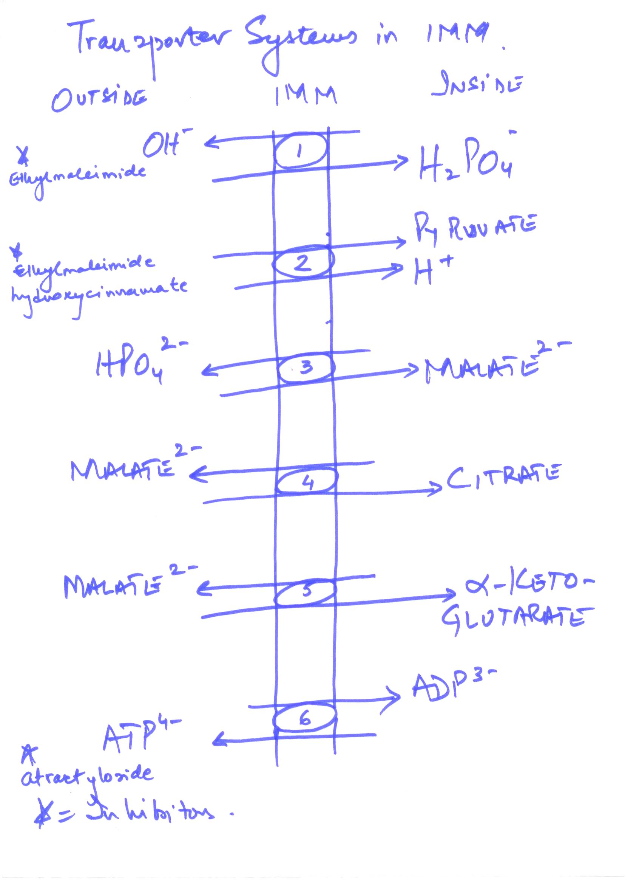

Slide 32
.
However, dicarboxylate (malate) and tri- carboxylate (citrate) anions and amino acids require specific transporter or carrier systems to facilitate their passage across the membrane.
The transport of di- and tricarboxylate anions is closely linked to that of inorganic phosphate, which penetrates readily as the H2PO4 − ion in exchange for OH−.

Slide 33
.
The net uptake of malate by the dicarboxylate transporter requires inorganic phosphate for exchange in the opposite direction.
The net uptake of citrate, isocitrate, or cis-aconitate by the tricarboxylate transporter requires malate in exchange.
α-Ketoglutarate transport also requires an exchange with malate.
The adenine nucleotide transporter allows the exchange of ATP and ADP but not AMP.

Slide 34
Adenine nucleotide transporter
The adenine nucleotide translocase is an antiporter the same protein moves ADP into the matrix from cytosol and ATP out of the matrix to cytosol.
The effect of replacing ATP with ADP in the matrix is the net efflux of one negative charge, which is favored by the charge difference across the inner membrane (outside positive)

Slide 35
.
Since in this translocation 4 negative charges are removed from the matrix for every three taken in, the electrochemical gradient across the membrane (proton motive force) favours the export of ATP
Na+ can be exchanged for H+, driven by the proton gradient.
It is believed that active uptake of Ca2+ by mitochondria occurs with a net charge transfer of 1 (Ca+ uniport), possibly through a Ca2+/H+ antiport.
Calcium release from mitochondria is facilitated by exchange with Na+.

Slide 36
ATP-ADP transport
The inner mitochondrial membrane requires specialized carriers to transport ADP and P_{i} from the cytosol (where ATP is used and converted to ADP in many energy- requiring reactions) into mitochondria, where ATP can be resynthesized.

Slide 37
Transport of Inorganic Phosphate
A phosphate carrier is responsible for transporting inorganic phosphate from the cytosol into mitochondria.
The phosphate translocase is specific for PO⁻. There is no net flow of charge during symport of PO⁻ and H⁺, but the relatively low proton concentration in the matrix favors the inward movement of H⁺.

Slide 38
.
Ionophores Permit Specific Cations to Penetrate Membranes
Ionophores are lipophilic molecules that complex specific cations and facilitate their transport through biologic membranes, eg, valinomycin (K+).
The classic uncouplers such as dinitrophenol are, in fact, proton ionophores.

Slide 39
.
A Proton-Translocating Transhydrogenase Is a Source of Intramitochondrial NADPH
Energy-linked transhydrogenase, a protein in the inner mitochondrial membrane, couples the passage of protons down the electrochemical gradient from outside to inside the mitochondrion with the transfer of H from intramitochondrial NADH to NADPH for intramitochondrial enzymes such as glutamate dehydrogenase and hydroxylases involved in steroid synthesis.

Slide 40
Transport of reducing equivalents
The inner mitochondrial membrane lacks an NADH transport protein, and NADH produced in the cytosol cannot directly penetrate into mitochondria.
However, two electrons of NADH (also called reducing equivalents) are transported from the cytosol into the mitochondria using shuttle mechanisms.

Slide 41
Glycerol-3 Phosphate shuttle
This alternative means of moving reducing equivalents from the cytosol to the mitochondrial matrix operates in skeletal muscle and the brain.
In the cytosol dihydroxyacetone phosphate accepts reducing equivalents from NADH in a reaction catalyzed by cytosolic glycerol 3 –phosphate dehydrogenase.
An isozyme of glycerol 3 –phosphate dehydrogenase bound to the outer face of the inner membrane then transfers two reducing equivalents from glycerol 3 –phosphate in the intermembrane space to ubiquinone.

Slide 42
Glycerophosphate shuttle
In the glycerophosphate shuttle two electrons are transferred from NADH to flavoprotein dehydrogenase within the inner mitochondrial membrane.
The glycerophosphate shuttle, therefore, results in the synthesis of 1.5 ATPs for each cytosolic NADH oxidized.

Slide 43
.
Since the mitochondrial enzyme is linked to the respiratory chain via a flavoprotein rather than NAD, only 1.5 mol rather than 2.5 mol of ATP are formed per atom of oxygen consumed.
Although this shuttle is present in some tissues
(eg, brain, white muscle), in others (eg, heart muscle) it is deficient. It is therefore believed that the malate shuttle system is of more universal utility.

Slide 44
Malate Aspartate Shuttle

Slide 45
Malate-Aspartate Shuttle
Malate-aspartate shuttle produces NADH, rather than FADH₂ in the mitochondrial matrix and, therefore, yields 2.5 ATPs for each cytosolic NADH oxidized.

Slide 46
Malate-aspartate shuttle
Malate-aspartate shuttle This shuttle for transporting reducing equivalents from cytosolic NADH into the mitochondrial matrix is used in liver, kidney, and heart.
NADH in the cytosol (intermembrane space) passes two reducing equivalents to oxaloacetate, producing malate.
Malate crosses the inner membrane via the malate-α-ketoglutarate transporter

Slide 47
In the matrix, malate passes two reducing equivalents to NAD*, and the resulting NADH is oxidized by the respiratory chain; the oxaloacetate formed from malate cannot pass directly into the cytosol.
Oxaloacetate is first transaminated to aspartate and
Aspartate can leave via the glutamate- aspartate transporter
Oxaloacetate is regenerated in the cytosol , completing the cycle.

Slide 48
