Slide 1
Old Bunt of Wheat
Dr. Salman Ahmad
April 17, 2020

Slide 2
History and Importance:
Most serious disease of wheat in Europe in middle ages
Also known covered smut of wheat
Confined to cooler regions
Difficult to threshing & reduce grain quality

Slide 3
Etiology:
Causal organism: Tilletia controversra
Order: Ustilaginales
Family: Tillitiaceae

Slide 4
Symptoms:
Pistil from smutted heads become longer
Stamens reduced in length & breadth
Smutted ears remain dark green for longer time than normal
Soft black pasty mass comes out if the grains are pinched with thumb & forefinger

Slide 5
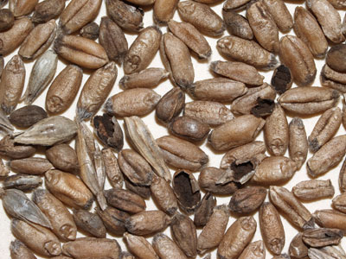
Symptoms:

Slide 6
Disease cycle:
Primary inoculum: spores carried on seed or present in soil
Remain viable in soil for 10 years

Slide 7
Epidemiology:
High relative humidity
Temp 18-20 °C

Slide 8
Management:
Growing of resistant varieties (Perwaz, Watan, Sehar, Shafaq)
Use disease free seed
Seed treatment with Agrosan GN 2%, Benlate o.3%

