Slide 2
Mphil Pharmacology (2nd Sem)
Subject:
Advanced General Pharmacology
Assignment Topic:
Hepatotoxicity
Sumitted By:
Hafiza Sara Afzal
ROLL NO:
PPMS20E007
Submitted To:
Dr Abdul Malik

Slide 3
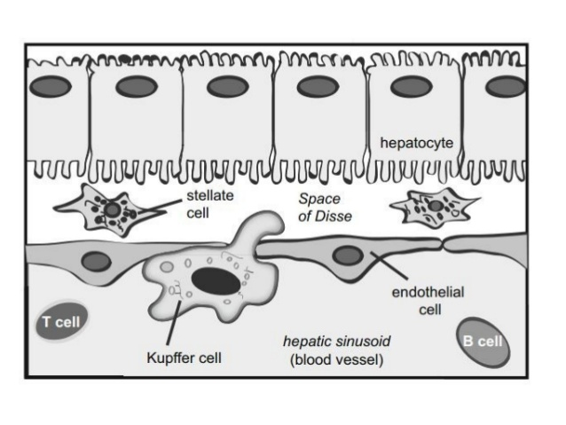
Introduction of Liver
The liver is an organ that is essential for life with unique architecture that is 5% of total body mass.
Liver has storage, filtration, excretory and metabolic functions.
Located In the upper right quadrant of the abdominal cavity.
Blood Supply to The Liver
The venous blood from the majority of the gastrointestinal tract and peritoneum flows to the liver in the portal vein .
Hepatic artery is small and supplies arterial blood to the liver.
Blood from the liver empties into the vena cava below the heart.
Major Cell Types are:
Hepatocytes (parenchymal) :
75% of lobule
Endothelial Cell:
Line sinusoids – 25% of lobule
Stellate Cells:
Store fat and synthesize collagen
Kupffer Cells:
secrete cytokines

Slide 4
Liver Lobules:
Hexagonal in shape and consists of:
Hepatocyte
Central Vein
Hepatic triad
Portal vein Hepatic artery Bile duct
Sinusoid
OXYGENATION ZONE:
Oxygenation Zone:Zone 1 – 9% to 13%
Zone 2 – < zone 1 Zone 3 – 4% to 5%
Zone 3 has most of the biotransformation enzymes especially CYP2E1.Most vulnerable is zone 3

Slide 5
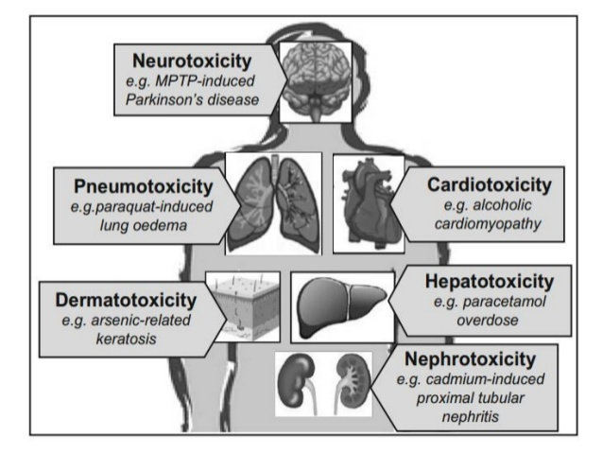
Different types of Organ Toxicity:

Slide 6
Signs and symptoms:
Nausea and vomiting
Pain in the abdomen
Anorexia or loss of appetite
Diarrhea
Fatigue or tiredness
Weakness
Jaundice or yellow discoloration of the skin
Yellow sclera (white part of the eyes’ eyeball)
Liver enlargement
Edema in the feet

Slide 7
CLASSIFICATION:
1.Intrinsic hepatotoxicity is regarded as dose- dependent and predictable above an approximate threshold dose.
2.Whereas idiosyncratic hepatotoxicity occurs without obvious dose-dependency and in an unpredictable fashion.
Allergic idiosyncratic hepatotoxicity is characterized by the presence of typical symptoms and signs of adaptive immune reactions, including fever, skin reactions, eosinophilia, formation of autoantibodies, and a short latency time particularly after re- exposure
Non-allergic idiosyncratic hepatotoxicity have been accompanied by an increased frequency of serum alanine aminotransferase (ALT) abnormalities in clinical trials.

Slide 8
AGENTS WHICH CAUSE OF LIVER DAMAGE:
• Toxins - Drugs, Chemicals, Fe,Cu, alpha-1-AT.
• Ischaemia - venous or arterial thrombosis, hypertension.
• Infection - viral,protozoal, bacterial.
• Immunological - autoimmune, response to infection.
• Cholesterol or triglycerides can accumulate (such as in steatosis; steat=fat + osis=accumulation).
• Obstruction of bile flow (such as in cholestasis: chole=bile + stasis=standing).

Slide 9
Hepatotoxic Drugs:
Drugs causing Hepatotoxicity
1.ANTIBIOTICS -Amoxicillin / clavulanate -Trimethoprim / sulfamethoxazole -Fluoroquinolones -Macrolides -Nitrofurantoin -Minocycline
2.ANTIEPILEPTICS -Phenytoin -Carbamazepine -Lamotrigine –Valproate
3.ANTI-TUBERCULAR-Rifampicin -Isoniazid.
4.NSAID-Acetaminophen -Nimesulide -Diclofenac
5.HYPOLIPIDEMIC DRUGS -STATINS -Niacin -Fibrates

Slide 10
6.ANAESTHETIC AGENTS
–Halothane -Chloroform -Isoflurane, Enflurane & Desflurane -Nitrous oxide.
7.ANTIRHEUMATIC DRUGS
–Sulphasalazine -Gold salt -Azathioprine –Methotrexate
8.ANTIRETROVIRAL DRUGS
Protease inhibitors
Ritonavir,Indinavir,Nelfinavir
NRTI
Lamivudin ,Tenofovir , Zidovudine , Didanosine
NNRTI
Nevirapine, Efavirenz

Slide 11
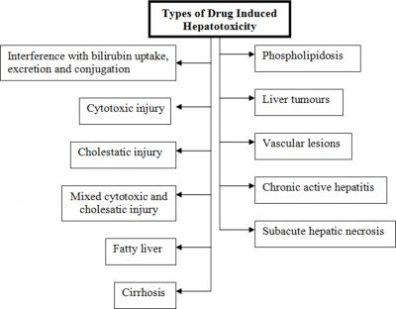

Slide 12
TYPES OF LIVER INJURY:
Fatty degeneration
Increased lipid content of the hepatocytes (liver parenchymal cells).
Cause can be nutritional or it can be due to a toxic substance
Canalicular cholestasis
due to transport mechanism damage.Blocks the flow of bile from liver to duodenum.
Hepatocellular death
due to mitochondrial damage

Slide 13
Bile duct/sinusoidal damage
Alteration of triglyceride cycle
Microtubular “scaffolding” collapse leading to deformation of hepatocyte
Cirrhosis
Decrease apoprotein synthesis
Liver architecture Damage
Irreversible fibrosis of liver Types of liver injury
Phospho
lipidosis
Phospholipidosis is a lysosomal storage disorder characterized by the excess accumulation of phospholipids in tissues.

Slide 14
MARKERS OF HEPATOTOXICITY:
Aspartate Serum Transferase (AST):5-40 units/liter of serum
Alanine Amino Transferase (ALT):7-56 units/liter of serum
Alkaline Phosphatase (ALP):20-140 units/liter of serum
Lactate dehydrogenase (LDH): 140-280units/liter
Total Bilirubin (TB): 0.2 to 1.2 mg/dL
Total protein (TP):
In Adults:6.0 to 8.3 g/dL
In Newborns:4.6 to 7.0 g/dL
Triglycerides (TG): Less than 150mgldl
Gammaglutamyl transferase (GGT) levels: 9–48 units per liter (U/L)

Slide 15
MECHANISM OF LIVER DAMAGE:
• Due to its unique metabolism and close relationship with the gastrointestinal tract, the liver is susceptible to injury from drugs and other substances.
• 75% of blood coming to the liver arrives directly from gastrointestinal organs and then spleen via portal veins which bring drugs and xenobiotics in concentrated form.
• Injury to hepatocyte and bile duct cells lead to accumulation of bile acid inside liver. This promotes further liver damage.
• Several mechanisms are responsible for either inducing hepatic injury or worsening the damage process.
• Many chemicals damage mitochondria, an intracellular organelle that produce energy.
• Its dysfunction releases excessive amount of oxidants which in turn injures hepatic cells.
• Non-parenchymal cells such as Kupffer cells, fat storing stellate cells and leukocytes (i.e. neutrophil and monocyte) also have role in the mechanism.

Slide 16
3 step model of drug induced hepatotoxicity:
Direct cell stress, direct mitochondria impairment and specific immune reactions
Direct and Death receptor mediated pathways leading to MPT
Apoptosis and necrosis

Slide 17
PATHOGENESIS:
Direct cell stress, direct mitochondria impairment and specific immune reactions.
Reactive metabolites depletes GSH, covalently binding to proteins, enzymes, lipids, nucleic acid and other cell structures.
Hepatotoxic Drugs Pathogenesis cause ATP depletion and increase in ROS, inhibits β-oxidation, cause steatosis.
Damage mitochondrial DNA, interfere with the replication process, causes the opening of MPT.
If the drug metabolite acts as a hapten it binds covalently with the liver protein perceived as foreign by the immune system resulting in an autoimmune attack on hepatocytes.

Slide 18
MECHANISMS OF DRUG INDUCED HEPATOTOXICITY:
Acetaminophen: is metabolized in the liver by conjugation to non-toxic glutathione. The conjugated product is eliminated in the urine. But in an acute overdose, the liver's normal glutathione reserves are depleted; the excess acetaminophen is then metabolized to highly toxic metabolite: N-acetyl-p-benzoquinone (NABQI). NABQI is very reactive causing hepatocellular death and subsequent massive liver cell necrosis.
AFLATOXINS: The major target for the toxicity of aflatoxins is the liver. Oxidation by cytochrome P450, aflatoxins then bind to DNA or proteins and impair their functions. Aflatoxins produce necrosis of liver cells, damage to mitochondria, and proliferation of bile ducts. Aflatoxin also suppress the immune system of the body.

Slide 19
Galactosamine: induces liver injury by interfering with the uridine pool in the cell, which is essential for RNA and protein synthesis. Galactosamine is metabolized via the Leloir pathway of galactose metabolism, which leads to the generation of uridine derivatives of galactosamine.
Rifampicin: the antibiotic used in the treatment of tuberculosis inhibits both uptake and excretion of bilirubin in a dose related manner, giving rise to elevated plasma levels of both conjugated and unconjugated bilirubin. This is due to blockade of uptake at the plasma membrane of the hepatocyte.
Carbon tetrachloride: is a potent hepatic and renal toxin. The mechanism is thought to be a result of a toxic free-radical intermediate of metabolism. (CCl4) undergoes hepatic reductive metabolism to CCl3 and CCl3OO free radicals toxic intermediates which may initiate hepatocellular damage.
Chronic use of metabolic enzyme inducers such as phenobarbital and ethanol increase the toxicity of carbon tetrachloride. Carbon tetrachloride is a known animal and suspected human carcinogen.

Slide 20
MECHANISM OF THIOCETAMIDE INDUCED HEPATOTOXICITY:
TAA is a model hepatotoxicant, consumed to induce acute and chronic liver injury due to its effects on protein synthesis, RNA, DNA and Gamma-glutamyl transpeptidase activity.
TAA undergoes a two-step bioactivation to sulfine, and afterward to sulfene, a reactive metabolite.
Sulfine is accountable for the enlargement of nucleoli, increase in nuclear volume and intracellular concentration of Ca++, change in cell permeability, and inhibit mitochondrial activity.
At the same time Sulfene is responsible for the release of nitric oxide synthase and NF-jB directing to centrilobular necrosis, protein denaturation and lipid peroxidation.
Furthermore, it impairs the urea cycle and the activity of ornithine aminotransferase.
Prolonged oral intake of this compound directs to macro liver nodules, liver cell adenomas, cholangiomas and hepatocarcinomas, histologically similar to that caused due to viral hepatitis infection.

Slide 21
Treatment:
No specific treatment exists for most kinds of toxic hepatitis
For most other cases of drug-induced toxic hepatitis, stopping the medication is the only treatment.
Other treatments include:
Supportive therapy. People with severe symptoms are likely to receive supportive therapy in the hospital, including intravenous fluids and medication to relieve nausea and vomiting.
Liver transplant. When liver function is severely impaired, a liver transplant may be the only option for some people

Slide 22
LIST OF HEPATOPROTECTIVE AGENTS:
N acetylcysteine
Penicillamine
Anti oxidants:
Vitamins
Melatonin
Glutathion
Beta-carotene
Cardiotropin 1
Herbal medications e.g. silymarine
S adenosyl methionine (SAM)

Slide 23
METHODS FOR SCREENING OF HEPATOPROTECTIVES:
INVITRO METHODS:
1.primary hepatocyte cell culture
2.Stellate cell culture
3.kupffer cell culture.
4.Liver cirrhosis and necrosis
5.Inhibition of proline hydroxylation
INVIVO METHODS:
1.Hepatitis in Long Evans Cinnamon rats
2.Temporary hepatic ischemia
3.Carbontetrachloride induced liver fibrosis in rats
4.Galactosamine induced liver necrosis
5.Thiocetamide induced necrosis of liver
6.Paracetamol induced liver damage in rats
7.Rifampicin+Isoniazid induced hepatotoxicity in rats
8.Bile duct ligation induced liver fibrosis in rats

Slide 24
INVITRO METHODS:

Slide 25
Overview:
The primary cultured hepatocytes may be exploited to the study.
Hepatocytes are treated with hepatotoxin and the effect of the plant drug on the same is evaluated.
The activities of the transaminases released into the medium are determined.
An augmented activity of marker transaminases in the medium indicates liver damage.
Parameters such as hepatocyte multiplication, morphology, macromolecular synthesis and oxygen consumption are determined.

Slide 26
INVIVO METHODS:

Slide 27
Overview:
Induce liver damage in experimental animals.
The test substance is administered along with, prior to and/or after the toxin treatment.
Liver damage and recovery from damage are assessed by quantifying serum marker(GPT and GOT). Hepatotoxic chemicals like CCl4, paracetamol reduces the level of metabolizing enzymes in liver.
Care has to be taken to see that the drug has no direct effect on drug metabolizing enzymes or necrosis.

Slide 28
CARBON TETRACHLORIDE INDUCED LIVER FIBROSIS IN RATS :
PRINCIPLE:
• In laboratory animals, for experimental study of liver injury, CCl4 is most widely used hepatic toxicant.
• CCl3, a toxic metabolite of CCl4, produced by Cytochrome P-450 2E1 (CYPE2E1) in hepatocytes .
• This free radical then combines with cellular lipids and proteins to form trichloromethylperoxyl radical which induces an acute centrilobular necrosis .
• Histopathology studies showed that signiﬁcant ﬁbrosis occurs after 2–4 weeks, severe bridging ﬁbrosis after 5–7 weeks and cirrhosis after 8–9 weeks
PROCEDURE:
• Rats of either sex were fed with standard diet and water and kept at a temperature (25 ± 2 C) and 12 h light/dark cycle.
• Hepatotoxicity was produced by CCl4
• At the last day of the study the animals were anaesthetized and killed and the biochemical parameter and histopathological studies were performed.
@Tsutomu Fujii 1, Bryan C Fuchs, Suguru Yamada, Gregory Y Lauwers, Yakup Kulu, Jonathan M Goodwin, Michael Lanuti, Kenneth K Tanabe

Slide 29
GALACTOSAMINE INDUCED LIVER NECROSIS:
Single dose or a few repeated doses of D-galactosamine cause acute hepatic necrosis in rats .Prolonged administration leads to cirrhosis.
PROCEDURE:
Divided doses of 100 to 400 mg/kg D-galactosamine are injected to rats i.p. or i.v. during one day.
For induction of liver cirrhosis, male Wistar rats weighing 110–180 g are injected intraperitoneally three times weekly with 500 mg/kg D- galactosamine over a period of one to 3 months.
Potential protective substances are administered orally with the food or by gavages every day.
The rats are sacrificed at various time intervals and the livers obtained by autopsy.
@J A Diaz‐Buxo S Blumenthal D Hayes P Gores B Gordon

Slide 30
THIOCETAMIDE INDUCED HEPATOTOXICITY IN RATS:
Thiocetamide actcs as a hepatocarcinogen and hepatotoxicant .
This action is mediated by formation of S- oxide, which covalently binds with liver cell macromolecules like protein, nucleic acid and lipids.
Procedure:
Wistar/Sprague dowel rats of either sex weighing between 180-250 g are used.
They are maintained on a standard chow diet with water and libitum at 21±2°c room temprature and under 12h dark/12h light cycle .
The food is withdrawn 18h before the experiment but water is allowed ad libitum.
Hepatotoxicity is induced by 200mg/kg body weight of dissolved in saline and administered orally or 100mg/kg given S.C
The serum is used for determination of aminotransferases and the liver is used for histopathological studies.
@Tasleem Akhtar
14.73University of Health Sciences Lahore
Nadeem Sheikh

Slide 31
PARACETAMOL INDUCED LIVER DAMAGE IN RATS:
Paracetamol is one of the most commonly and widely used analgesic anti-pyretic drug used in higher dose lead to hepatic damage.
It gets metabolised to an active metabolite N-acetyl-p-benzoquinone imine by the cytocromeP-450 microsomal enzyme system which results in an oxidative stress producing liver glutathione and glycogen depletion.
Procedure:
Wistar rats of either sex weight(150-200g)are used.Paracetamol 2g/kg body weight is administered orally as a single dose
The animal are given the test drug foe 6 days prior to paracetamol administration and on the seventh day along with paracetamol
The animal are sacrificed after 24h and the blood/serum is used for biochemical analysis and the liver for histopathological studies
@Z. A. Zakaria

Slide 32
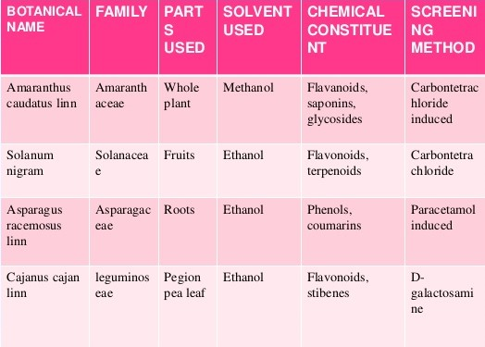
Hepatoprotective Plants:

Slide 33
Boerhavia diffusa:
Boerhavia diffusa Linn.(Nyctaginaceae) commonly called hog weed, is known as also known as Tarvine (which literally means waterfood) and in Sanskrit as “Punarnava” used mostly in treating different ailments like asthma, urinary disorders, leucorrhea, rheumatism, and encephalitis.
The roots of Boerhavia diffusa, are used by a large number of tribes in India for the treatment of various hepatic disorders and for internal inflammation.
Keppler and co-workers demonstrated that Ursolic acid isolated from the leaves showed a dose dependent (5-20 mg/kg) hepatoprotective activity (21-l00%) in rats against thioacetamide, galactosamine and carbon tetrachloride induced hepatotoxicity in rats.
@Giby Abraham

Slide 34
Andrographis peniculata:
Andrographolide is the active constituent of Andrographis peniculata. (ACANTHEACEAE)
The compound illustrates a considerable dose dependent protective activity against paracetamol-induced toxicity on isolated rat hepatocytes upon administration of andrographolide.
The bioactive constitutient also antagonizes toxic effects of CCl4 and acetaminophen on certain enzymes.
Further, it also stimulated immune system to fight against inflammation, is mediated from the release of cytokinin from immunomodulators.
@Arnadi Ramachandrayya Shivashankara

Slide 35
Phyllanthus polyphyllus:
50% extract of Phyllanthus niruri appeared to halt the progression of non-alcoholic fatty liver disease (NAFLD) in mice. Not only was the extract able to normalize liver enzymes, but there was no sign of fibrosis (scarring) in liver tissue samples. These effects were attributed to a plant-based polyphenol called phyllanthin, unique to Phyllanthus genus.
Animal Models:
Methanolic extraction of Phyllanthus polyphyllus
gives hepatoprotection and antioxidant benefits
against acetaminophen-induced hepatotoxicity
Dose:200 and 300 mg/kg, p.o. plant
Extract
@RAJKAPOOR B, VENUGOPAL Y, ANBU J, HARIKRISHNAN N,
GOBINATH M* AND RAVICHANDRAN V

Slide 36
Silymarin Protects Mouse Liver and Kidney from Thioacetamide Induced Toxicity by Scavenging Reactive Oxygen Species and Activating PI3K-Akt Pathway:
To design the in vivo experimental study the mice were randomly assigned to four groups and treated as follows:
Group 1: Normal group: mice received neither TAA nor SMN, received vehicle only.
Group 2: Silymarin group: mice received only SMN (150 mg/kg body weight in olive oil) orally for 8 weeks (simultaneously with Group 4).
Group 3: Thioacetamide group: mice received TAA injection at a dose of 100 mg/Kg body weight twice a week for 56 days (Ansil et al., 2011).
Group 4: TAA and SMN group (post-treatment group): mice received SMN (150 mg/kg body weight in olive oil) orally for 8 weeks after TAA administration twice a week for 56 days.
After the experimental periods animals were sacrificed by cervical dislocation and livers and kidneys were collected.
@Shatadal Ghosh 1, Abhijit Sarkar 1, Sudip Bhattacharyya 1, Parames C Sil 1

Slide 37
REFERENCES:
H. Gerhard Vogel Drug Discovery and Evaluation Pharmacological Assays ,Second Edition .Page no: 936-944
N.S Parmar, Shiv PrakashʻʻScreening methods in pharmacology.”Page No:281-286 30
https://www.intechopen.com/books/pharmacokinetics-and-adverse-effects-of-drugs-mechanisms-and-risks-factors/hepatotoxicity-by-drugs
Wikipedia: http://en.wikipedia.org/wiki/Liver_disease
Medicine Net: http://www.medicinenet.com/liver_disease/article
Robbins Basic Pathology
https://www.slideshare.net/priyankshah965/hepatoprotective
Anthony R, and Jeffery S. Guidelines for the management of Acetaminophen overdose. 2Kent R, and Olson M .Poisoning and Overdose. 3rd Edition. California, San Francisco.
Jerrold B, and Frank P. Poisoning and toxicology handbook. 4th Edition. Newyork, United State America.
. R. P. Tiwari, T. C. Bhalla, S. S. Saini, G. Singh and D. V. Vadehra.
Mechanism of action of aflatoxin. J. Biosci., Vol. 10:1, 1986, pp. 145-151.004.

