Slide 1
Ana Molka Ahmed

Slide 2
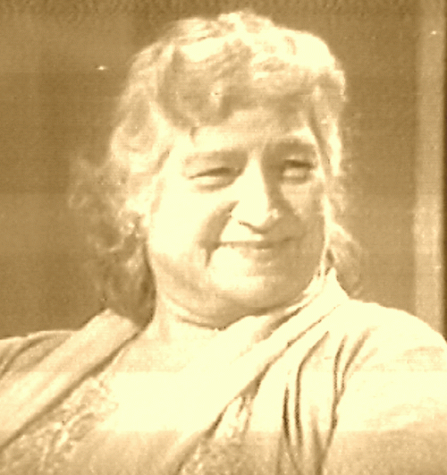

Slide 3
The First Female Painter of Pakistan

Slide 4
Prof Anna Molka Ahmed (1917 - 1994) was a famous Pakistani artist and pioneer of fine arts in the newly born Pakistan in 1947. She was a professor of fine arts at the University of the Punjab in Lahore. She was among the pioneers of women artists in Pakistan and had been a long-time director and moving spirit behind the Fine Arts Department of the Punjab University, Lahore - the first institution that was opened to the women artists in Pakistan.

Slide 5
"In fact she has been the facilitator of a movement that made the proactive role of women artists a possibility". writes Nilofur Farrukh (president of International Art Critics Association, Pakistan Section). It is because of trendsetters like her that the feminist art in Pakistan is gaining strength away from traditional gender discriminatory dominance. In fact these days we are witnessing a gradual dismantling of social and gender classifications. Well this has not been easy, since a lot of women had to struggle hard to bring women atop many a prestigious positions - above men, Ana Molka Ahmed is one such women.

Slide 6
She was born to Jewish parents, in London, UK in 1917. Her mother was Polish and father was a Russian. She studied painting, sculpture and design at St. Martin School of Arts, London. She converted to Islam at the age of 18 in 1935, before marrying Sheikh Ahmed, a would be Pakistani in October 1939. The couple moved to the Indian subcontinent in 1940-41 and settled in Lahore. Although, her marriage was over in 1951, but yet she lived in Pakistan with her two daughters.

Slide 7
She was awarded Tamgha-i-Imtiaz, President’s Pride of Performance Award in 1979, Quaid-e-Azam Award in 1982 and the Khdejatul Kubra Award in 1983 for her services in the field of fine arts education in the country. Professor Emeritus Anna Molka Ahmed set up a department, which has now become a center of excellence for Fine Arts in Pakistan.

Slide 9
At the time of independence, there were only five or six Muslim students in the art department, and Anna Molka Ahmed went from one college to another seeking students for the arts department and thus was able to introduce art courses in the Punjab University. Her students became famous artists in the country and many of them are playing their role globally.

Slide 10
Beside painting, she was an avid gardener. She would wear her trade mark while tending the garden, cutting hedges in new and artistic pattern, and went on painting and gardening till the very last time until she was ordered by the doctors to stop because it was straining her health badly.

Slide 13
Professor Dr. Saadat Saeed Urdu Department Ankara University Turkey writes, “She used to treat her subjects boldly. Her grand paintings contain sparks of her domineering and impressive personality. Her impressionistic technique blended with expressionistic tones and shades made her work unique. The suggestiveness of her knife was creative. She chose knife to paint in preference to smooth brushes and made her style so unique that the audience could do nothing but stand and wonder. The style originated by her was so unusual in its essence that art critics declared her work far better than the work done by most of her contemporary artists. Anna Molka's multi- cultural background made her viewpoint vast and liberal.

Slide 14
Anna Molka used the media of drawing, painting, graphic arts, sculpture and design. She was known as an expert in the domain of still life, animal nature and figures. She used the media of water colour, gouache, fresco, tempera, oil, wax, mosaic to paint and produce unique portraits, still life, landscapes, figure compositions and animal paintings. She loved to paint solitude, loneliness, alienation, mannerism, sufferings and sadness in the perspective of urban landscape. Most of her paintings symbolize materialistic life around us. She painted poetry and wrote sceneries. Her colours were bright and strokes fascinating.”

Slide 16
Anna is part of the beginning of art developments in Pakistan. I am, she said once, "the Mother of all the artists." Recognition of her work is documented through a number of national awards, which include the Tamgha-i-Imtiaz, in 1963, the President's Award for the Pride of Performance in 1969 and also the Khudeja Tul Kubra Medal. A commemorative stamp was also issued a postage stamp in her honour.

