Slide 1
DEPRECIATION
Depreciation is the time based decrease in value of physical properties of different assets like machinery, plant, house, etc.
The determination of its magnitude in advance, is not easy.
In fact, the actual amount of depreciation can never be determined until the asset is retired from service.

Slide 2
TYPES OF DEPRECIATION
1- Physical depreciation:
The everyday wear and tear of operation gradually lessens the physical ability of an asset to perform its intended function.
A good maintenance program retards the rate of decline(کمی)but seldom maintains the precision(صحت سے متعلق )expected from a new machine.
In addition to normal wear, accidental physical damage can impair ability.
Wear and tear is an obvious cost of output.

Slide 3
TYPES OF DEPRECIATION
2- Functional depreciation:
Demands made on an asset may increase beyond its capacity to produce reduces the ability to perform function properly.
A central heating plant unable to meet the increased heat demands of a new building extension, no longer serves its intended function.
On the other extreme, the demand for services may cease to exist, such as with a machine that produces a product no longer in demand.

Slide 4
TYPES OF DEPRECIATION
3- Technological depreciation:
Newly developed means of accomplishing a function may make the present means uneconomical.
Steam locomotives(ریڑھیاں) lost value rapidly as railroads turned to diesel power.
Current product styling, new materials, improved safety, and better quality at lower cost from new developments make old designs obsolete.

Slide 5
TYPES OF DEPRECIATION
4- Sudden failure
This refers to sudden or catastrophic(تباہ کن )loss in value due to technological characteristics inherent in the asset. However, this does include loss due to accident or misuse.
Light bulbs burn out as a natural consequence( نتیجہ) of use and with little loss in operating efficiency up to the point of failure.
Generally this category of asset includes items used in large numbers with a relatively small cast per item.

Slide 6
TYPES OF DEPRECIATION
5- Depletion:
Reduction in number or quantity of something. Consumption of an exhaustible natural resource to produce products or services is termed depletion.
Removal of oil, timber, rock, or minerals from a site decreases the value of the source.
Theoretically, the depletion charge per unit of the resource removed is:
Adjusted basis of resource
Depletion rate (Rs./unit) = Remaining units of resource
Where the adjusted basis is generally the first cost minus the capital recovered from depreciation charges.
Notes:
reduction in the number or quantity of something.

Slide 7
TYPES OF DEPRECIATION
6- Monetary depreciation:
Loss of value of country’s currency with respect to one or more foreign currencies. A change in price levels is a subtle(ٹھیک ٹھیک )but trouble cause of decreases in the value of owned assets.
If prices rise during the life of an asset, as in the case of high inflation rates during the early 1980s, then a comparable replacement becomes more expensive.
This means that the capital recovered will be insufficient to provide an adequate substitute for the worn out asset.
It also suggests that the selling price of the product being produced by the asset does not accurately reflect the cost of production.

Slide 8
VALUE
Because depreciation is defined as decrease in value, the best definition of value is the present worth of all the future profits that are to be received through ownership of a particular property.
This undoubtedly, excellent definition, is difficult to apply in actual practice, inasmuch as we can seldom determine profits far in advance.
Several other measures of value are commonly used, some of which are approximations of the foregoing definition:

Slide 9
VALUE
1 - Market value
This is what will be paid by a willing buyer to a willing seller for a property, where each has equal advantage and is under no compulsion(مجبوری ) to buy or sell. In most matters relating to depreciation, it is market value that is used. For new properties, the cost in the open market is used as the original value.
2 - Use value
This is what the property is worth to the owner as an operating unit. (To fulfill human requirements)
3 - Fair value
Refers to an asset sale price agreed upon by a willing buyer and seller.

Slide 10
VALUE
4- Book value
The total amount a company would be worth if it liquidated its assets. Book value can also represent the value of the asset on the company’s balance sheet after taking depreciation into account. Book value is the worth of a property as shown on the accounting records of a company. It is ordinarily taken to mean the original cost of the property less the amount that have been charged as depreciation expense.
5 - Salvage or resale value
It is the price that can be obtained from the sale of the property second-hand. Salvage value implies that the property has further utility.
6- Scrap value
Scrap value ordinarily is considered to be the amount that the property would bring if sold for junk. The utility of the article is assumed to be zero.

Slide 11
Purposes of Depreciation
To provide for the recovery of capital that has been invested in physical property.
To enable the cost of depreciation to be charged to the cost of producing products or services that result from the use of the property.

Slide 12
BASIC DEPRECIATION METHODS
1 - The Straight Line Method
The straight line method of computing depreciation assumes that the loss in value is directly proportional to the age of the structure. This straight line relationship gives rise to the name of the method. Thus with this formula if :
L = Useful life of the structure in years,
C = The original cost,
d = The annual cost of depreciation,
C_{n} = The book value at the end of n years,
C_{L} = The value at the end of the life of the structure, the scrap value (including gain or loss due to removal), and
D_{n} = Depreciation up to age n years;
d = C – C_{L} / L
D_{n} = n (C – C_{L}) / L
C_{n} = C - n (C – C_{L}) / L
-

Slide 13
BASIC DEPRECIATION METHODS
2 - Declining Balance Method
In this method, sometimes called the constant percentage method or the Matheson formula, it is assumed that the annual cost of depreciation is a fixed percentage of the resale value at the beginning of the year.
The ratio of the depreciation in any one year to the book value at the beginning of that year is constant throughout the life of the asset and is designated by K.

Slide 14
BASIC DEPRECIATION METHODS
Depreciation during the Ist year: d₁ = C x k
Depreciation during the nth year: d_{n} = (C_{n-1} )k
Salvage value at age n years: C_{L} = C(1 – k)^{L}
Book value at age n years: C_{n} = C(1 – k)^{n} = C(C_{L} / C) ^{n / L}
Rate of depreciation:
^{n} Cn ^{L} CL
k = 1 - = 1 -
C C

Slide 15
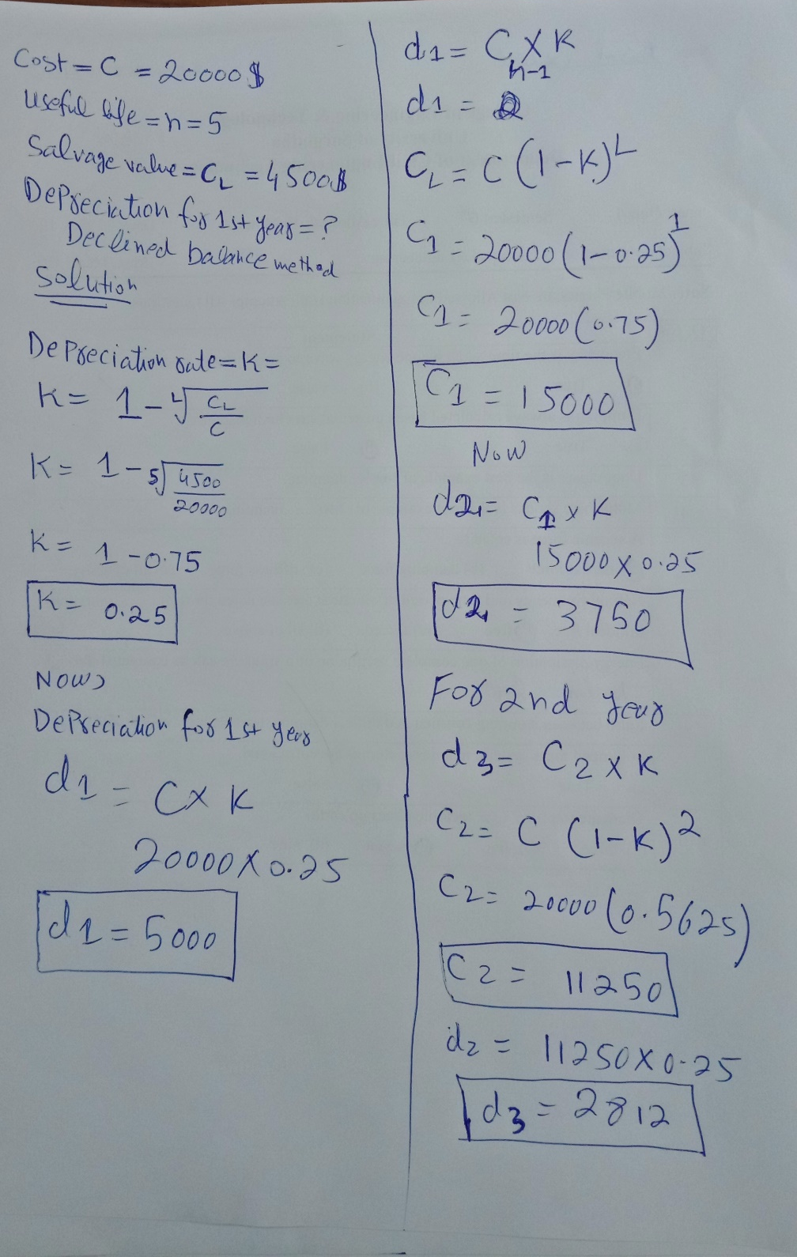
An asset costing $20,000 has estimated useful life of 5 years and salvage value of $4,500. Calculate the depreciation for the first year of its life
using declining balance method.

Slide 16
BASIC DEPRECIATION METHODS
The declining balance procedure, like the straight line method, is simple to apply. However, it has two weaknesses:
1- The annual cost of depreciation is different each year and, from an engineering economy viewpoint, this is inconvenient.
2- With this formula an asset can never depreciate to zero value. This is not a serious difficulty, and in actual practice computation of the theoretical depreciation rate k, seldom is made. Instead, a reasonable value is assumed.
A so-called Double Declining Balance Method also is used. In this procedure the depreciation rate k is computed as 2/L, with any prospective final salvage value being disregarded.

Slide 17
BASIC DEPRECIATION METHODS
3 - The Sum-of-the-Years’ - Digits Method
In order to obtain the depreciation charge in any year of life by the sum-of-the-years’-digits method (commonly designated as SYD), the digits corresponding to the number of each year of life are listed in reverse order.
The sum of these digits then is determined.
The depreciation factor for any year is the reverse digit for that year divided by the sum of the digits.
For example, for a property having a life of 5 years:

Slide 18
BASIC DEPRECIATION METHODS
YEAR | No. of the year in reverse order (digits) | Depreciation Factor
1 | 5 | 5/15
2 | 4 | 4/15
3 | 3 | 3/15
4 | 2 | 2/15
5 | 1 | 1/15
 | Sum of the digits = 15

Slide 19
BASIC DEPRECIATION METHODS
The depreciation for any year is the product of the SYD depreciation factor for that year and the depreciable value, C – C_{L}.
The general expression for the annual cost of depreciation for any year n, when the total life is L, is
Depreciation factor = 2 (L – n + 1) / L (L + 1)
d_{n} = ( C - C_{L} ) x [2 (L – n + 1) / L (L + 1)]
C_{n} = C - [ 2( C - C_{L} ) / L ] n + [(C – C_{L}) / L(L+1) ] n (n+1)

