Slide 1
Storage of Milk: Importance and Methods of Cooling

Slide 2
Storage of Milk: Importance
Milk drawn from a healthy cow is sterile but it contains bacteria that have entered the teat canal through the teat opening. They are pushed out during milking process. The number of bacteria varies from animal to animal. For milk contains greater number of bacteria than stripping (Singh and Prasad, 1987).

Slide 3
Storage of Milk: Importance
Milk gets easily contaminated with dirt, bacteria and odours. Milk furnishes an excellent medium for the growth of bacteria, particularly when not properly cooled. They produce chemical changes rendering it unpalatable.
Pathogenic bacteria can also very well multiply in milk. Therefore, milk may serve as a medium for dissemination of infectious diseases. Hence the quality and conditions of production of milk can be judged on the basis of microbial contents.

Slide 4
Standards for the bacteriological quality of raw milk:
.
Therefore great care in production and handling of milk is necessary to put it in the hands of consumers in a satisfactory condition

Slide 5
Handling the Milk Prior To Storage:
Milk should be removed to the milk house immediately after it is drawn because the contamination may also take place if it is left in the barn, the milk should then be strained into cans. If the cows are carefully milked, straining may not be necessary.
It is impossible to strain bacteria out of milk. However, it is desirable to filter the milk to remove hairs, particles of feed or bedding or dirt, etc. that may have into milk during the production. A single service pad type strainer may be used for this purpose.

Slide 6
Necessity of Cooling Milk before Storage:
It is impossible to produce milk without some bacteria. Therefore efforts should be to prevent multiplication of the bacteria that have gained access.- This can be achieved by cooling the raw milk.

Slide 7
Principles and Practices of Dairy Farm Management:
This is of utmost importance specially when considerable time lapses between production and pasteurization.
Even before it is transported to long distances the rails is cooled.
The influence of temperature of storage on the bacterial density in fresh milk as reported
Table 1 Bacterial Count in Fresh Milk of Storage (Average of 20 Samples from Cows Clean & Bedded, Small Top Pails, Sterile Utensils):

Slide 8
Indigenous method:
Milk should be stored at 4.5°C to arrest the growth of bacteria and milk will not become sour.
Cooling to milk has a special significance in the tropical climate specially in summer.
Therefore milk should be cooled to below 10°C.
Freshly drawn milk is at about 38°C which is highly suited for bacterial growth.

Slide 9
Methods of Cooling:
Indigenous method:
Milk venders who collect milk from villages are issued licence on the agreement that they will put the wet cloth around the can of milk to keep milk cool during the period of transportation by bicycle or cart, etc.

Slide 10
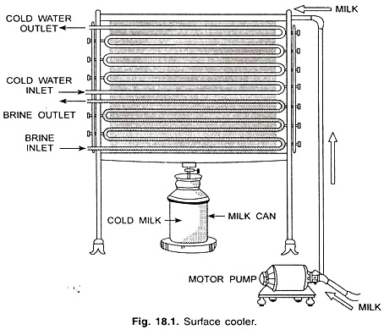
Indigenous method:

Slide 11
2. Scientific method:
There are four methods used under this. These are as follows:
(i) Use of surface coolers/surface tubular coolers. (See Fig. 18.1)
(ii) Cabinet coolers in vertical position.
(iii) Plate type chillers,
(iv) Double tube coolers.

Slide 12
The different cooling media used are as follows:
(a) Cold water to cool down pasteurized milk up to 15.5° to 21.1°C.
(b) Ammonia refrigerant to cool down milk up to 3.3°C to 4.3°C (35° to 40°F).
(c) Brine solution is effective in bringing temperature of milk to 3.3°C (35°F).

Slide 13
Storage of Milk in Tanks:
Modern storage tanks for milk are of two type’s viz. horizontal and vertical cylindrical shape of 10,000 litre capacity.
In countries of temperate climate where milk is not stored for more than 24 hrs. the insulation of tanks is not necessary.
In tropical regions of warmer climate 7 to 10 cm cork insulation is desirable to maintain minimum temperature 4°C.
Milk kept at low temperature will have longer keeping quality suitable for processing in dairy plant.

