Slide 1
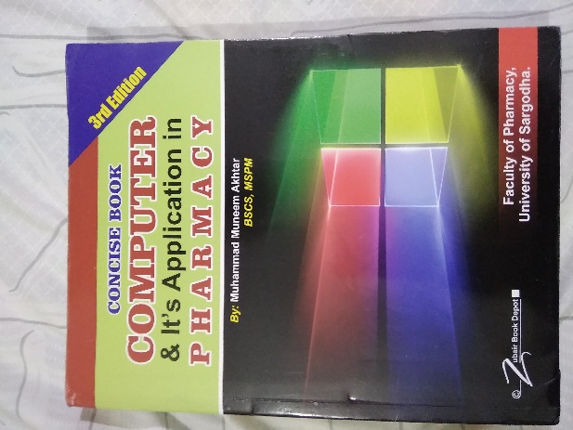
What is Printer
09
Recommended For
Part
Pharmacy Student!
Pharm-D (Doctor of Pharmacy),
DPT (Doctor of Physiotherapy) &
Pharmacy Technician.
Muhammad Munim Akhtar

Slide 2
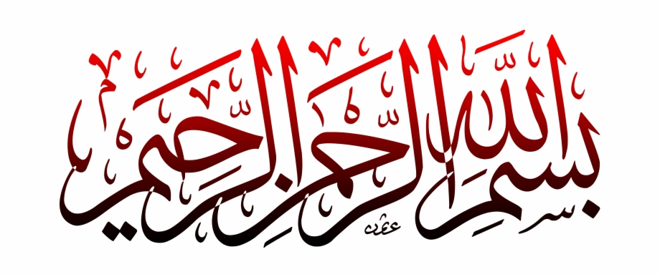

Slide 3
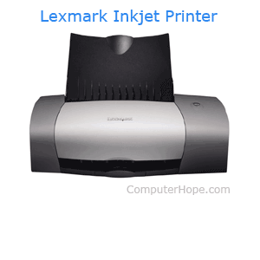
What is PRINTER
A printer is an output device that prints characters, symbols, and graphics on paper.
Your data may be in two form like:
Hardcopy: A touchable form of data is called hardcopy because it is in permanent form.
Softcopy: A non-touchable or temporary images those displayed on a monitor called softcopy.
A printer is an external hardware output device that takes the electronic data stored on a computer,
For example, if you created a report on your computer, you could print several copies to hand out at a staff meeting. Printers are one of the most popular computer peripherals device used to print text and photos.

Slide 4
TYPES OF PRINTER

Slide 5
Difference of Printer
Impact Printer:
Produces characters and graphics on a piece of paper by striking is called impact printer in 1990.
It prints by hammering a set of metal pin or character set.
Example Dot-matrix printers, Daisy-wheel and line printers.
Non-Impact Printer:
A type of printer that produces characters and graphics on a piece of paper without striking.
Printing is done by depositing ink in any form.
Example Inkjet printers and Laser printers.

Slide 6
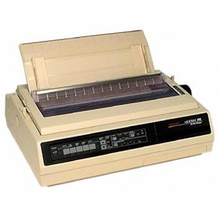
1. Dot-Matrix Printers
A dot matrix printer is a computer printer using a series of pins to stamp ink from a ribbon onto paper to produce words and numbers.
It print character by character
It print about 40-300 characters per second (cps)
Can print some graphics, although the reproduction quality is poor.
Normally black color print used in market
Dot-matrix printers are noisy, inexpensive,
It is just like carbon copy printer
The first dot matrix printer was created by IBM in 1957.

Slide 7
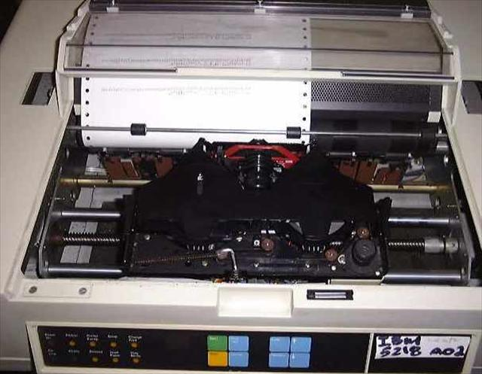
2. Daisy-Wheel Printers
It is just like manual typewriter
These printers have print heads composed of metallic or plastic
Daisy-wheel printers are also loud and slow.
It cannot print graphics
It can support some fonts as well.

Slide 8
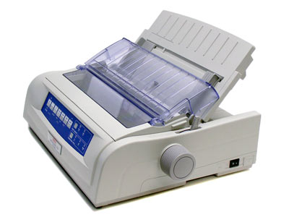
3. Line Printers
It is similar to the daisy-wheel printer.
Line printers allow multiple characters to be simultaneously printed on the same line.
line printers are much faster than dot-matrix or daisy-wheel printers.
It is quite loud,
It can support limited multi-font capability,
It can often produce lower print quality.

Slide 9
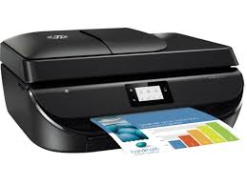
Non-IMPACT PRINTERS
A type of printer that does not operate by striking a head against a ribbon, e,g., laser and ink-jet printers.
Nonimpact printers use methods for creating an image that don't involve actually touching the paper.
These are faster and quieter than impact printers
It can print characters and images without direct physical contact between the printing mechanism and the paper.

Slide 10
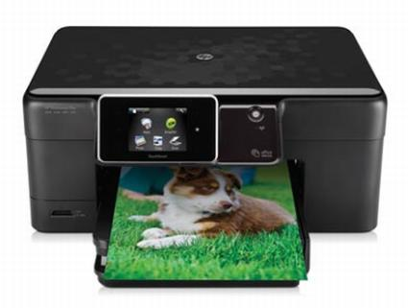
1. Inkjet printers
They work by pushing droplets of ink onto paper with using of printer toner.
Inkjet printers spray tiny drops of ink onto the paper.
These are used mostly for high-volume printing in office settings, e.g.,
Print copy of a document for school.
Print pictures on photo printer.
Print receipts for purchases made online.

Slide 11
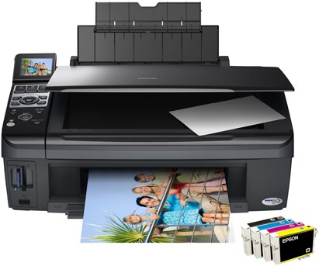
2. Laser printers
A type of printer which use of a laser beam to produce an image on the drum that makes use of a focused beam of light to transfer text and images onto paper.
Laser printers use static electricity to arrange toner on paper to form an image in 1971.
The toner is then bonded to the paper with heat.
Quickly print hundreds of text documents or pages.
Print hard copies of professional or legal documents.

Slide 12
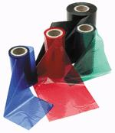
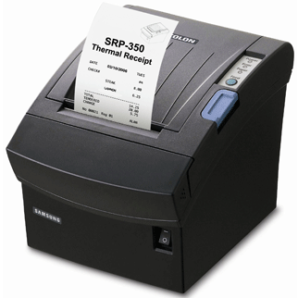
3-Thermal wax printers
It is a printer that uses heated pins to "burn" images onto heat-sensitive paper.
Thermal wax printers use a ribbon Pin passes in front of tiny heated pins that melt the wax from a ribbon onto the paper.
Thermal wax printers can print much faster than ink and laser printers, e.g., , averaging six to 12 inches per second
Advantages: High quality, Fast print runs, Reduced costs, Less maintenance, Nearly unlimited print media choices
Thermal Ribbons

Slide 13
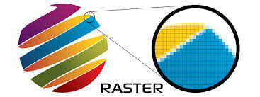
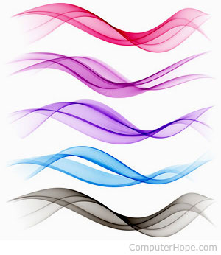
A plotter printer that is used for printing of vector graphics
Vector graphics images in terms of 2D points, which are connected by lines and curves to form polygons and other shapes.
Plotters use a pen, pencil, marker tool to draw multiple, continuous lines onto paper rather than a series of dots like a traditional printer.
A vector graphic or vector image is an image made up paths
(lines with a starting and ending points).
e.g. create layouts, diagrams and banners.
4- Plotter

Slide 14
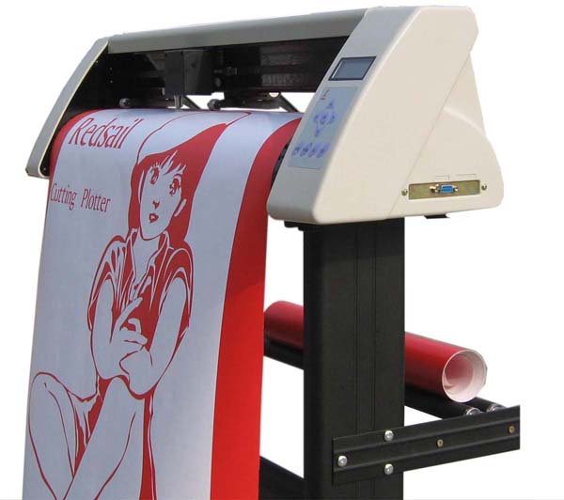
Plotter example

Slide 15
End Note
Every next level of your life will demand a different you.

