Slide 1
HORT 308
MEDICINAL AND AROMATIC PLANTS

Slide 2
Avocado

Slide 3
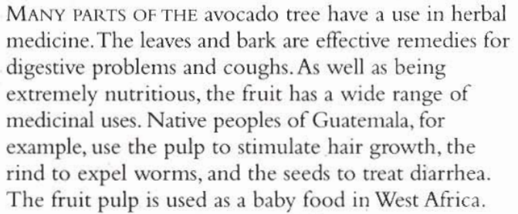
B.N Persea americana Family: Lauraceae

Slide 4
Habitat & Cultivation
Native to Central USA
Cultivated in tropical & subtropical areas of Israel
Spain
South Africa

Slide 5
Key Constituents
Volatile Oil (methylchavicol, alpha-pinene)
Flavonoids
Tannins
Fruit Pulp:
Unsaturated fats
Protein (25%)
Sesquiterpenes
Vitamins A, B₁, B₂

Slide 6
Key Actions
Leaves & Bark:
Astringent, carminative, relive coughs, promote menstrual flow
Fruit Pulp:
Emollient, carminative
Rind:
Eliminate worms

Slide 7
Research
Lowers cholesterol level

Slide 8
Tradition & Current Uses
Leaves & Bark:
Stimulate menstruation & induce abortion, diarrhea, gas, bloating, relieving cough, liver obstruction, clearing high uric acid
Fruit:
Rind to expel worms, pulp as food, aphrodisiac properties, soothing to skin, stimulate hair growth
Oil:
For skin, softens rough, improves hair growth

Slide 9
Parts Used
Dried & Fresh Leaves
Fruit
Bark
Seed

Slide 10
Key Preparations
Decoction
Mashed Pulp
Oil

Slide 11
Damiana

Slide 12
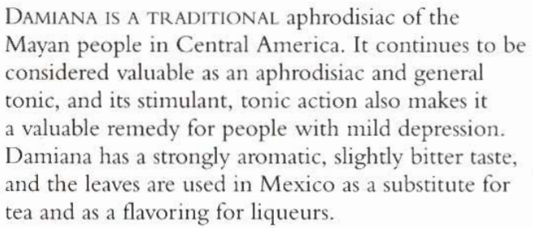
B.N Turnera diffusa Family: Turneraceae

Slide 13
Habitat & Cultivation
Native to gulf of Mexico
Southern California
Caribbean Island
Nambia
Wild & Cultivated
Prefers hot & humid climate

Slide 14
Key Constituents
Arbutin (7%)
Volatile oil (0.5%)
Cyanogenic glycoside
Resin
Gums

Slide 15
Key Actions
Tonic
Stimulant
Mild laxative
Diuretic
Antidepressant
Testosterogenic
Reputed aphrodisiac

Slide 16
Traditional & Current Uses
Tonic, Antidepressant
Sexual restorative: Due to testosterogenic quality, helpful in premature ejaculation & impotency. Benefical for both men & women being restorative to the reproductive organs
Gynecological Problems: For painful & delayed periods, specially headaches connected to menstruation
Urinary antiseptic, laxative, constipation.

Slide 17
Parts Used
Leave (Fresh & Dry)

Slide 18
Key Preparations
Tablets
Tincture
Infusion

