Slide 1
Population and Sample
A population is the set of all the individuals of interest in a particular study.
The numbers of observations in a finite population is called the size of population and denoted by N
Example of population is over eight million people living in New York City.

Slide 2
Sample
A sample is a part or subset of a population
Or
A set of individuals selected from a population to represent the population. The numbers of observations in a sample is called the size of sample and denoted by n.
For example:
Lets say your population was every Pakistani and you wanted to find out how much the average person earns. Time and finances stop you from knocking on every door in Pakistan , so you choose to ask 2,000 random people.

Slide 3
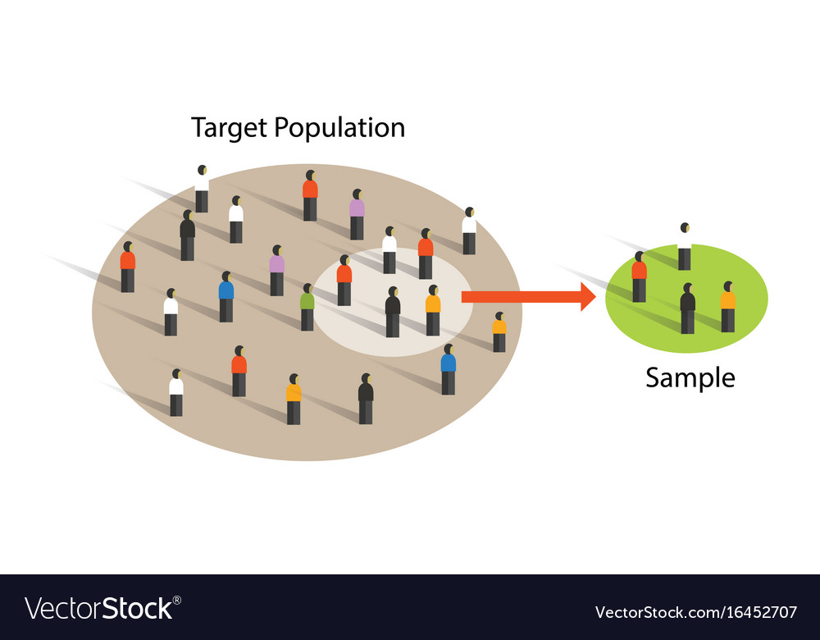
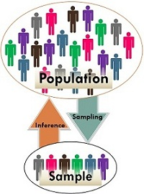
Population and Sample

Slide 4
Why sample?
Population tend to be very large, it usually impossible for a researcher to examine every individual in the population of interest therefore, we select a smaller ,more manageable group from the population and limit the studies.

Slide 5
Parameter and Statistic:
Parameter:
Numerical quantities describing a population are called parameters.
Or
It is a value that describe population.
Statistic:
A numerical quantity that describe sample.
For example:50% of people living in the U.S. agree with the latest health care proposal. Researchers can’t ask hundreds of millions of people if they agree, so they take samples, or part of the population and calculate the rest.

Slide 6
Variables and Types of variables

Slide 7
Variable
A characteristics that varies with an individual or an object is called variable.
For example :
Age, weight and blood pressure.

Slide 8
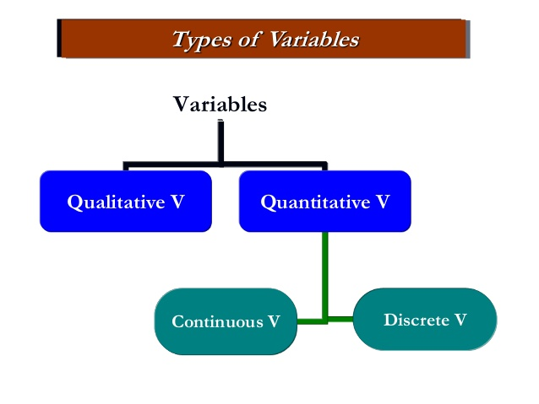
Types of variables

Slide 9
Quantitative variable
A variable is called a quantitative variable when a characteristics can be expressed numerically.
For example:
Income ,number of stars , &number of children.

Slide 10
Qualitative Variable
If a characteristics cannot be expressed numerically then it is called qualitative variable . It is also called attribute.
For example:
Gender , eye color and hair color

Slide 11
Types of quantitative Variable
There are two types quantitative variable
Discrete variable
Continuous variable

Slide 12
Discrete variable
A discrete variable is one that can take only a discrete set of integers or whole numbers.
For example :
Number of admissions
test questions answered correctly
Number of students in a Class.

Slide 13
Continuous variable
A variable is called a continuous if it can take on any fractional value or integer with in a range or given interval.
For example:
Blood sugar
Height
weight

