Slide 1
Chapter 10 Designing and Producing
By
Khansa Saleem

Slide 2
Overview
Design the structure and user interface for a multimedia project
How to produce a successful multimedia project and work with clients

Slide 3
Designing
Design is thinking, choosing, making, and doing.
It is shaping, smoothing, reworking, polishing, testing, and editing.
When you design your project, your ideas and concepts are moved one step closer to reality.
You can spend great effort on the storyboards, or graphic outlines, describing the project in exact detail

Slide 4
Designing the Structure
arrangement of text, graphic, sound, and video elements (or objects).
The way you compose these elements into interactive experiences is shaped by your purpose and messages.
On some projects, you may be both the designer and the programmer. This can work well because you will understand how the design features you choose will actually be implemented

Slide 5
Navigation
A navigation map (or site map) provides you with a table of contents as well as a chart of the logical flow of the interactive interface.
Linear navigation,
Hierarchical navigation,
Nonlinear navigation
Composite navigation

Slide 6
Navigation
Linear Users navigate sequentially, from one frame or bite of information to another.
Hierarchical Also called “linear with branching” since users navigate along the branches of a tree structure that is shaped by the natural logic of the content.
Nonlinear Users navigate freely through the content of the project, unbound by predetermined routes.
Composite Users may navigate freely (nonlinearly) but are occasionally constrained to linear presentations of movies or critical information and/or to data that is most logically organized in a hierarchy.

Slide 7
Navigation Many navigation maps are essentially nonlinear. In these navigational systems, viewers are always free to jump to an index, a glossary, various menus, Help or About . . . sections, or even to a rendering of the map itself.

Slide 8
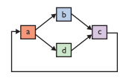
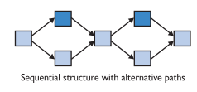
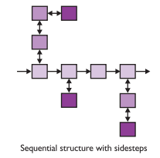
Structural Depth
Surface structure
Depth structure
represents the structures actually realized by a user while navigating the depth structure. Some surface structures generated by users might look like this:
represents the complete navigation map and describes all the links between all the components of your project. Thus the following depth structure
might be realized as the following surface structure:

Slide 9
Hot Spots, Hyperlinks, and Buttons
Hot spots can be given more specific names based upon either their function or form. For example, if clicking the hot spot connects the user to another part of the document or program or to a different program or web site, it is referred to as a link or hyperlink.
If the hot spot is a graphic image designed to look like a push button or toggle switch, it is called a button, more formally defined as a meaningful graphic image that you click or “touch” to make something happen. Hot spots can be text or graphic images

Slide 10
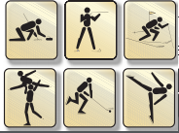
Icons
Icons are graphic objects designed specifically to be meaningful as buttons and are usually small.
Icons are fundamental graphic objects symbolic of an activity or concept:

Slide 11
Image Maps
Larger images may be sectioned into hot areas with associated links; these are called image maps.

Slide 12
Icons
On the Macintosh, icon image files (.icns) can contain one or more images of 16 × 16, 32 × 32, 48 × 48, 128 × 128, 256 × 256, and 512 × 512 pixels as well as alpha channels for transparency masking.
Windows 7 icons are 256 × 256 pixels and are scaled to Extra Large, Large, Medium, or Small sizes in the Views menu.
Building and saving icon files is simpler using an icon editor such as IcoFX or the ICOformat plugin for Photoshop.

Slide 13
Designing the User Interface
The user interface of your multimedia product is a blend of its graphic elements and its navigation system.
Poor graphics can cause boredom.
Poor navigational aids can make viewers feel lost and unconnected to the content.

Slide 14
Novice/Expert Modes
The simplest solution for handling varied levels of user expertise is to provide a modal interface, where the viewer can simply click a Novice/ Expert button and change the approach of the whole interface—to be either more or less detailed or complex.
keep the interface simple!

Slide 15
GUIs
The Macintosh and Windows graphical user interfaces (GUI, pronounced “gooey”) are successful partly because their basic point-and-click style is simple, consistent, and quickly mastered.

Slide 16
Graphical Approaches
Things That Work Here are some graphical approaches that get good results:
Neatly executed contrasts: big/small, heavy/light, bright/dark, thin/thick,
Simple and clean screens with lots of white space (see Figure 10-9)
Eye-grabbers such as drop caps, or a single brightly colored object alone on a gray-scale screen
Shadows and drop shadows in various shades
Gradients
Reversed graphics to emphasize important text or images
Shaded objects and text in 2-D and 3-D

Slide 17
Graphical Approaches
Things to Avoid Here are some mistakes you will want to avoid in creating computer graphics:
Clashes of color
Busy screens (too much stuff )
Using a picture with a lot of contrast in color or brightness as a background
Trite humor in oft-repeated animations
Clanging bells or squeaks when a button is clicked
Frilly pattern borders
Cute one-liners from famous movies
Requiring more than two button clicks to quit
Too many numbers (limit charts to about 25 numbers; if you can, just show totals)
Too many words (don’t crowd them; split your information into bite-sized chunks)
Too many substantive elements presented too quickly.

Slide 18
Audio Interfaces
A multimedia user interface may include important sound elements that reflect the rhythm of a project and may affect the attitude of your audience. Sounds can be background music, special effects for button clicks, voice-overs, effects synced to animation, or they may be buried in the audio track of a video clip. The tempo and style of background music can set the “tone” of a project
Always provide a toggle switch to disable sound.

Slide 19
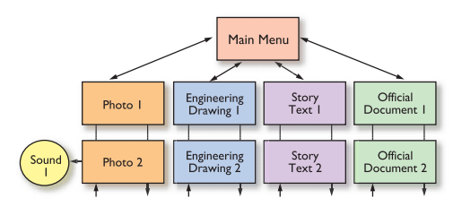
A Multimedia Design Case History
Storyboarding a Project
The first storyboard was a simple hierarchical structure with branches to each subject area

Slide 20
Putting It Together
The most eye-catching photograph was chosen as a background for the main menu
the main menu was planned to contain clearly labeled buttons navigating to linear presentations of each topic area.
From every screen in the project, users would be able to return to the main menu. Where sound bites were appropriate, clicking buttons on screens would play sounds

Slide 21
Producing
Production is the phase when your multimedia project is actually rendered. During this phase you will contend with important and continuous organizing tasks.
So it’s important to start out on the right foot, with good organization, and to maintain detailed management oversight during the entire construction process.

Slide 22
Starting Up
Before you begin your multimedia project, it’s important to check your development hardware and software and review your organizational and administrative setup, even if you are working alone.

Slide 23
Working with Clients
Be sure that the organization of your project incorporates a system for good communication between you and the client as well as among the people actually building the project. Many projects have turned out unhappily because of communication breakdowns.

Slide 24
Client Approval Cycles
Develop a scheme that specifies the number and duration of client approval cycles, and then provide a mechanism for change orders when changes are requested after sign-off. For change orders, remember that the client should pay extra and the changes should be costly.

Slide 25
Data Storage Media and Transportation
multimedia files are large, your means of transporting the project to distant clients is particularly important. Typically, both you and the client will have access to the Internet at high bandwidth. If not, the most cost- and time-effective method for transporting your files is on DVD-ROM by an overnight courier service

Slide 26
Tracking
Develop a file-naming convention specific to your project’s structure. Store the files in directories or folders with logical names. Version control of your files (tracking editing changes) is critically important, too, especially in large projects.

Slide 27
Copyrights
You can insert a copyright statement in your project that clearly (and legally) designates the code as your intellectual, but the code tricks, and programming techniques remain accessible for study, learning

Slide 28
Hazards and Annoyances
Expect problems beyond your control, and be prepared to accept them and solve them.
If your project is a team effort, then it is critical that everyone works well together—or can at least tolerate one another’s differences—especially when the going gets tough.

