Slide 2
CONTENTS
Introduction to Cereals
Production and importance
Structure and composition
Nutrition
Grain grades and grading

Slide 3
INTRODUCTION TO CEREALS
A cereal is any grass that is grown for the edible components of its grain
Grain is single fruit or seed of a cereal
A number of cereals are grown in different countries
Wheat
Rice
Barley
Oats
Maize
Rye

Slide 4
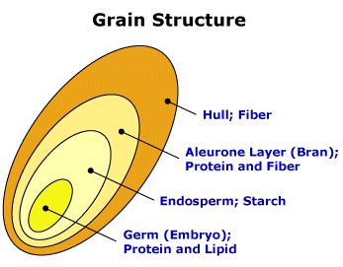
STUCTURE AND COMPOSITION OF CEREAL GRAIN
All of the cereals share some structural similarities and consist of
Bran
It constitutes 14% of the total grain and it is rich in fiber, calcium, iron and Vit B
Endosperm
It is 84% of the total grain and it is packed with starch
3. Germ
It is only 2% of the total grain which contains fat and Vit E
And is the genetic material for a new plant

Slide 5
STUCTURE AND COMPOSITION OF CEREAL GRAIN
Water | Carbohydrate | Fat | Protein | Vitamins | Minerals
12% | 72-77% | 2-7% | 7-14% | 0.5%(Vit B) | 1% (Calcium,Iron)

Slide 6
NUTRITIVE VALUE OF CEREALS
Cereals are staple foods, and are important sources of nutrients in both developed and developing countries. Cereals and cereal products are an important source of energy such as
Protein
Fat, polyunsaturated, essential fatty acids
Carbohydrate, starch mostly, the rest is fiber
Vitamin B especially B1, B2, niacin, also Vitamin E
Minerals: Calcium Iron, Phosphorous

Slide 7
PRODUCTION OF CEREALS
In 2017, cereal production for Pakistan was 44.1 million metric tons. Between 1968 and 2017, cereal production of Pakistan grew substantially from 10.8 million to 44.1 million metric tons
Globally the cereals production rate is in following order
Cereal | Pakistan production in 2019
Maize | 6,100 1000 tonnes
Wheat | 25,600 1000 tonnes
Rice | 11.2 million tonnes
Barley | 63 1000 tonnes
Oats | 20 0000 tonnes

Slide 8
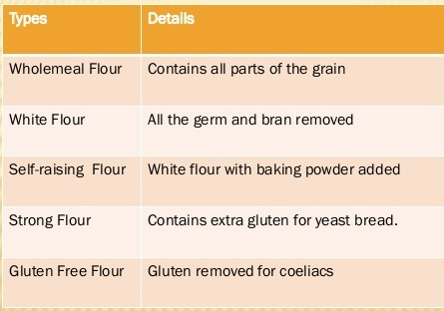
INTRODUCTION TO CEREALS…
1.WHEAT
a cereal which is the most important kind grown in temperate countries
the grain which is easy to digest and low in fat

Slide 9
INTRODUCTION TO CEREALS…

Slide 10
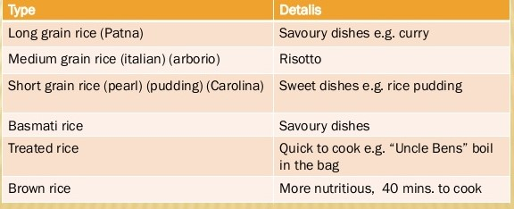
INTRODUCTION TO CEREALS….
2. RICE
swamp grass which is widely cultivated as a source of food, especially in Asia
It has high carbohydrate content

Slide 11
INTRODUCTION TO CEREALS…

Slide 12
INTRODUCTION TO CEREALS…
3.OATS
Popular worldwide as a breakfast food and livestock feed
It is known as queen of cereals
It is purifying
Helps the central nervous system
Improves digestion
Prevents osteoporosis

Slide 14
INTRODUCTION TO CEREALS…
4.MAIZE
a Central American cereal plant that yields large grains (corn or sweetcorn) set in rows on a cob
Natural source of selenium
Antioxidants production
Regulation of metabolism of thyroid hormones

Slide 15
INTRODUCTION TO CEREALS…

Slide 16
INTRODUCTION TO CEREALS…
5.BARLEY
Cereal with excellent therapeutic and nutritional properties
Relaxes liver and gallbladder
Good source of inositol
Highest amount of fiber(17%)
Rich source of VitB complex
Rich in traces like iron, iodine etc

Slide 17
INTRODUCTION TO CEREALS…

Slide 18
INTRODUCTION TO CEREALS…
6.RYE
Important in cold climates

Slide 19
IMPORTANCE OF CEREALS…
Cereals are one of the most important things that you can include in your daily diet
Cereals contain an enormous amount of nutrients that the body needs to stay strong and healthy and of course to function properly
Consuming whole grain cereal is one of the best things that you can do for your body

Slide 20
IMPORTANCE OF CEREALS…
1.Cereals and heart health
Regularly consuming diets that contain lots of whole grains help in significantly reducing cholesterol levels in your system, and with that comes a lower risk of suffering from heart disease
Whole grains provide you with major nutrients like dietary fiber, minerals such as iron and magnesium that are all good for the heart and body

Slide 21
IMPORTANCE OF CEREALS…
2. Cereals help in the prevention of cancer
Several scientific studies have proven that regularly eating cereals indeed helps us to fight cancer
Since whole grains contain high amounts of fiber, they help in making food digest easily through your digestive tract and in so doing they easily remove cancer-causing compounds from your system
A cancer such as colon cancer can therefore be easily avoided if we eat more whole grain cereals such as whole wheat
Other studies have shown that breast cancer can also be prevented when we eat more whole wheat products because these products are capable of preventing the development of oestrogen

Slide 22
IMPORTANCE OF CEREALS…
4. Cereals fight constipation
Since whole grain cereals contain lots of fiber they can significantly help you in your constipation problem
Fiber aids in bowel movements, so by consuming more whole grain cereals like barley and oats, constipation can be treated

Slide 23
IMPORTANCE OF CEREALS…
4. Cereals help us lose weight
Consuming whole grains can significantly help you in reducing a few pounds because of the fact that the fiber found in whole grains makes you feel full all the time and that will prevent you from frequently eating
5. Cereals help in the fight against diabetes
Eating whole grains can also help you to fight diabetes. Research has showed that one major importance of whole grains is the fact that they can help in maintaining a person’s blood sugar level

Slide 24
PROPERTIES OF GRAIN
The properties of grain quality can be summarized into following main factors
Uniform moisture contents
High test weight
No foreign material
Low percentage of discolored, broken and damaged kernels
Low breakability
High milling quality
High protein and oil content
No afaltoxin (mycotoxin)
No presence of insects and molds

Slide 25
GRAIN GRADE QUALITY
Grain grading and specification system assures that a particular lot of grain meets the required set standards
1.Test weight
Test (bushel) weight also known as volumetric weight
It is an indicator of general grain quality and primary grain specification normally the higher the test weight the higher the quality, and the lower the test weight the lower the quality, and grain quality decreases dramatically as grain deteriorates

Slide 26
GRAIN GRADE QUALITY…
2.Moisture contents
The moisture content is one among important factors in grains quality. It denotes as the quality of water per unit mass of grain and expressed on a percentage basis (i.e. wet basis or dry basis)
Moisture content does not directly affect grain quality but can indirectly affect quality since grain will spoil at moisture contents above that recommended for storage

Slide 27
GRAIN GRADE QUALITY…
3.Foreign material (FM)
Broken foreign material is an important factor in grading and classification of grains
It is described as foreign material other than grains such as sands, pieces of rocks, plastics particles, metals and pieces of glass, contaminating a particular lot of grain
In the grains trade presences of more than set percentage of FM results either low grades, price discount or lot rejection, because the higher the FM the more the cost to clean before uses

Slide 28
GRAIN GRADE QUALITY…
4.Damaged kernel (DK)
Damaged Kernels are considered those that have an evident visual damaged and negatively affect their value of the grains
It is usually recommended to remove damaged kernels by hand
Grain grades contain a limit of damage kernels for each grade, for instance for wheat to be grade one must contain no more than 0.4% of the total weight
Main types of damaged are due to insects, heat, molds, and weathering, sprouted, frost, diseases, non-uniform maturity and lack of/partial grain filling

Slide 29
GRAIN GRADE QUALITY…
5.Discoloration
Grain color is an important characteristic in grain grading
One form of color deterioration which is common is milled rice discoloration. Rice whiteness changes to different classes of milled rice discoloration if stored improperly
Rice discoloration has been shown to be due to microbial and chemical reactions depending on storage temperature, moisture content, and duration

Slide 30
GRAIN GRADE QUALITY…
6.Non-grain-standards properties
Important non-grain chemical standards in U.S. grain standards includes
(i) breakage susceptibility
(ii) milling quality
(iii) seed viability
(iv) nutritive value
(v) mold count and carcinogen content
(vi) insect infestation and damage

Slide 31
Thank You ☺

