Slide 1
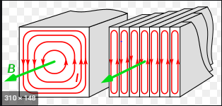
Eddy currents

Slide 2
Eddy currents are the currents induced in body of the conductor when the amount of magnetic flux linked with the conductor changes.
Discovered by →Foucault →in 1895 and they are also called Foucault currents.
The magnitude of eddy current is
i = induced emf/resistance = e/R
While ,
e = – dϕ/dt
i = – dϕ/dt /R
The direction of eddy currents is given by Lenz’s law or Fleming’s right hand rule
Eddy currents are basically the currents induced in the body of a conductor due to change in magnetic flux linked with the conductor.

Slide 4
Experimental Demonstration
Experiment #1:
Hold light metallic disc D atop the cross-section of an electromagnet connected to a source of a.c. When a.c. is switched on, the disc is thrown up into the air.
This is due to eddy currents developed in the disc. As current through the solenoid increases, the magnetic flux along the axis of the solenoid increases. Therefore, magnetic flux linked with the disc increases. Induced currents or eddy currents develop in the disc and magnetize it. If upper end of solenoid initially acquires north polarity, the lower face of disc also acquires north polarity in accordance with the Lenz’s law. The force of repulsion between the two throws the disc up in the air.

Slide 5
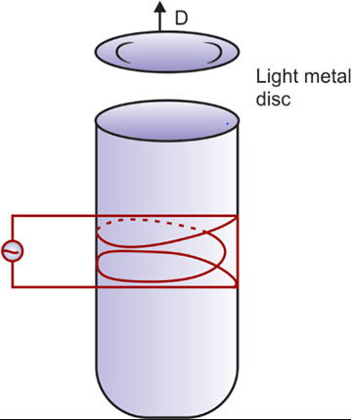

Slide 6
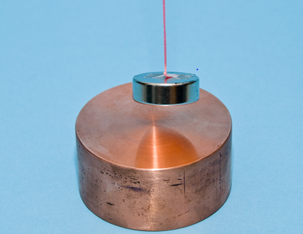

Slide 7
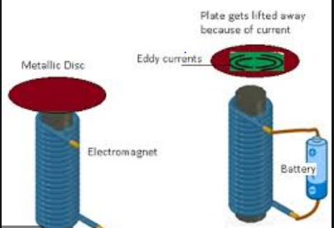

Slide 8
Experiment # 2
Suspend a flat metallic plate between pole pieces N and S of an electromagnet When the magnetic field is off, the metallic plate disturbed once from its equilibrium position and left, oscillates freely for a longer time. But when the electromagnet is switched on, the vibrations of the plate are damped. This is because of eddy currents developed in the vibrating plate, In the normal position of rest of the plate, magnetic flux linked with the plate is maximum. When it is displaced toward any one extreme position, area of plate in the field decreases. Therefore, magnetic flux through the plate decreases

Slide 9
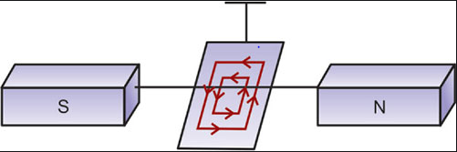

Slide 10
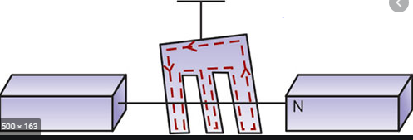

Slide 11
Lenz’s law
Eddy currents develop in the plate which, according to Lenz’s law, opposes the motion of the plate toward extreme position. Similarly, when plate returns from extreme position to mean position, area of plate in the field increases, magnetic flux linked with the plate increases. Eddy currents are developed which oppose the motion of the plate toward the mean position.
In either case, vibrations of the plate are damped. When such a plate is made to oscillate in the magnetic field, the damping effect is there, but it is much smaller compared to the case when no slots were cut.
This means eddy currents are reduced. This is because closed loop of a given area now has a much longer path. As longer path means more resistance, eddy currents will reduce. We can only minimize eddy currents but cannot reduce such currents to zero.

Slide 12
Applications of eddy currents
Some of the applications of eddy currents are:
Electromagnetic damping: This is used in designing dead beat galvanometers. When a steady current is passed through the coil of a galvanometer, it is deflected. Normally, the coil oscillates about its equilibrium position for some time before coming to rest.
To avoid delay due to these oscillations, the coil is wound over a metallic frame. As the coil is deflected, eddy currents set up in the metallic frame oppose its motion.Therefore, the coil attains its equilibrium position almost instantly. Thus, the motion of coil is damped. This is called electromagnetic damping.
Induction furnace: It makes use of the heating effect of eddy currents. The substance to be heated/melted is placed in a high frequency magnetic field. The large eddy currents developed in the substance produce so much heat that it melts. Such an arrangement is called induction furnace. It is used for extracting a metal from its ore and also in the preparation of certain alloys.

Slide 14
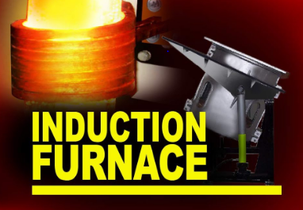

Slide 15
Electromagnetic brakes: They are used in controlling the speed of electric trains. A strong magnetic field is applied to a metallic drum rotating with the axle connecting the wheels. Large eddy currents set up in the rotating drum oppose the motion of the drum and tend to stop the train.
Induction motor: A induction motor or a.c. motor is another important application of eddy currents. A rotating magnetic field produces strong eddy currents in a rotor, which starts rotating in the direction of the rotating magnetic field.
Speedometers: In speedometers of automobiles and energy meters.
Eddy currents: They are also used in diathermy, i.e. in deep heat treatment of the human body.

Slide 16
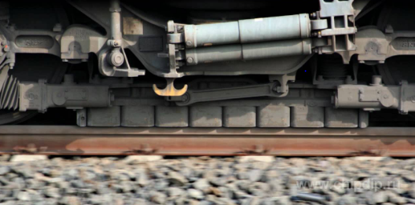

Slide 19
Some of the undesirable effects of eddy currents are:
They oppose the relative motion.
They involve loss of energy in the form of heat.
The excessive heating may break the insulation in the appliances and reduce their life.
To minimize the eddy currents, the metal core to be used in an appliance like dynamo, transformer, choke coil, etc. is taken in the form of thin sheets. Each sheet is electrically insulated from the other by insulating varnish. Such a core is called a laminated core. The planes of these sheets are arranged parallel to the magnetic flux.
Large resistance between the thin sheets confines the eddy currents to the individual sheets. so, the eddy currents are reduced to a large extent

Slide 21
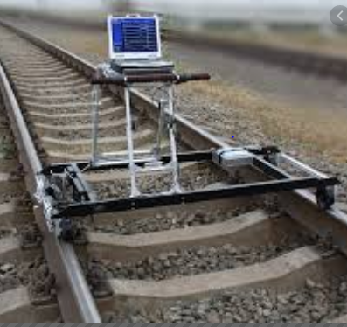

Slide 22
