Slide 1
Burial and Cremation Feces , Urine and Rural waste

Slide 2
Learning Outcomes: The learner is able to:
Describe the documentation procedures and legal requirements for a burial to take place and a client’s entitlement to a grave space
Identify the correct documents and certificates required by a burial authority in a range of circumstances
Describe the documentation procedures and legal requirements for a cremation to take place
Arrange an interment or scattering of cremated remains

Slide 3
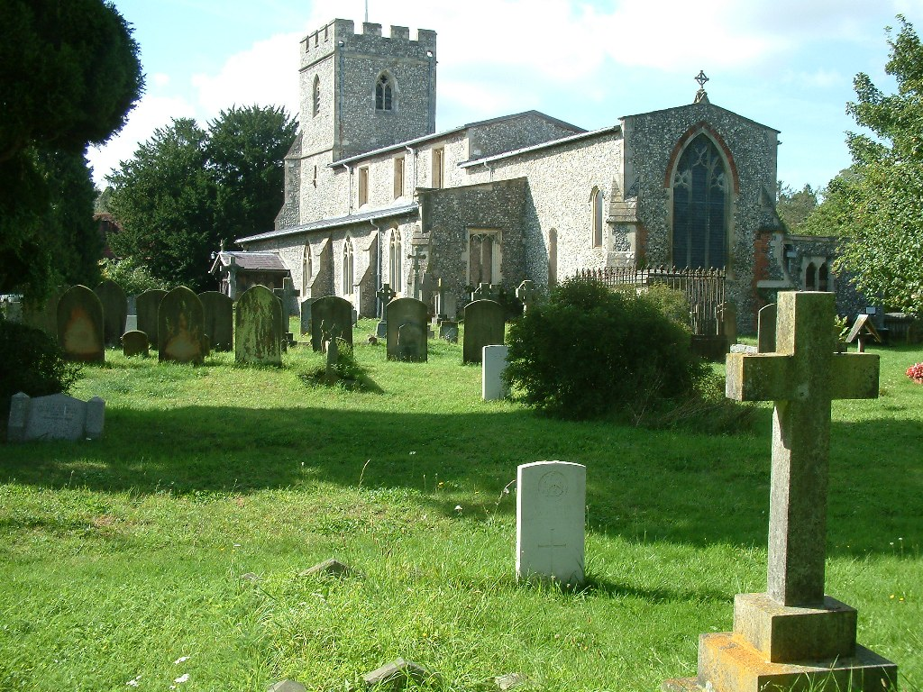
Types of Burial Ground
Churchyards
Usually administered by the incumbent or PCC for those living in the Parish

Slide 4
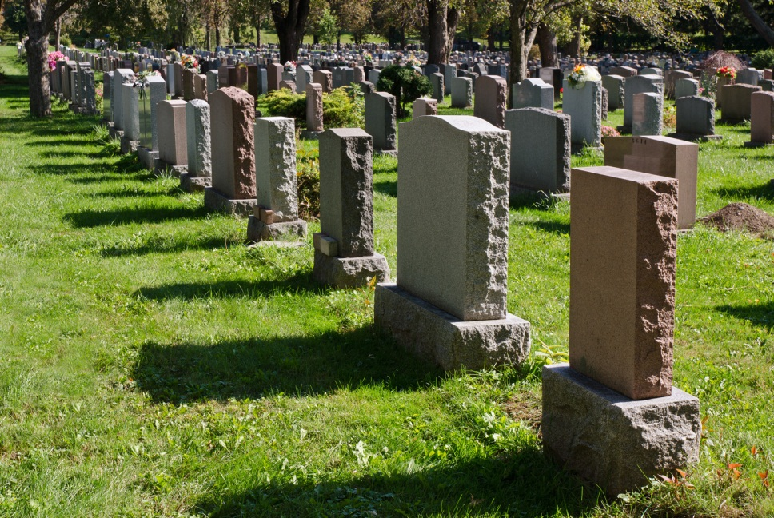
Types of Burial Ground
Cemeteries
Those administered by Borough authorities for those dying in their area
Those administered by Parish Councils for those living in the Parish and may also allow non-parishioners
Privately owned Cemeteries

Slide 5
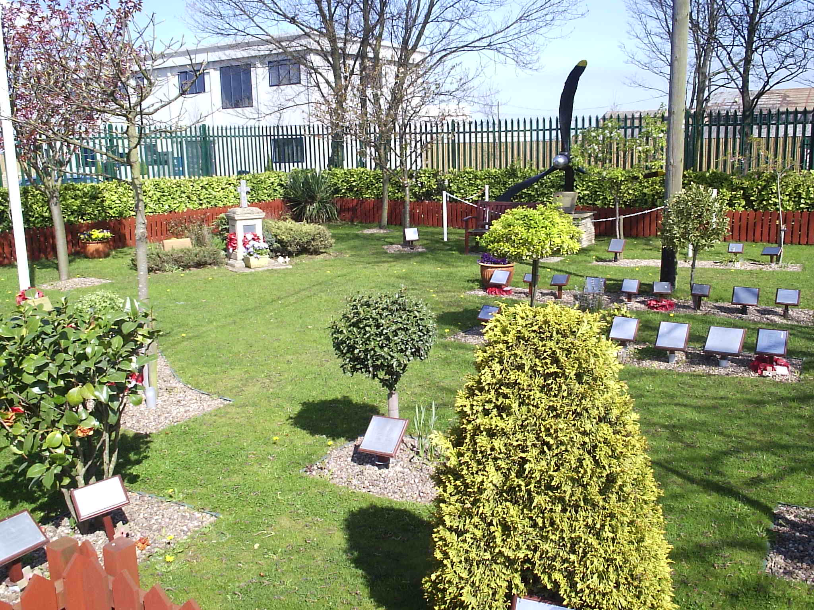
Types of Burial Ground
Memorial Gardens
Reserved for the interment or scattering or cremated remains
War Memorial

Slide 6
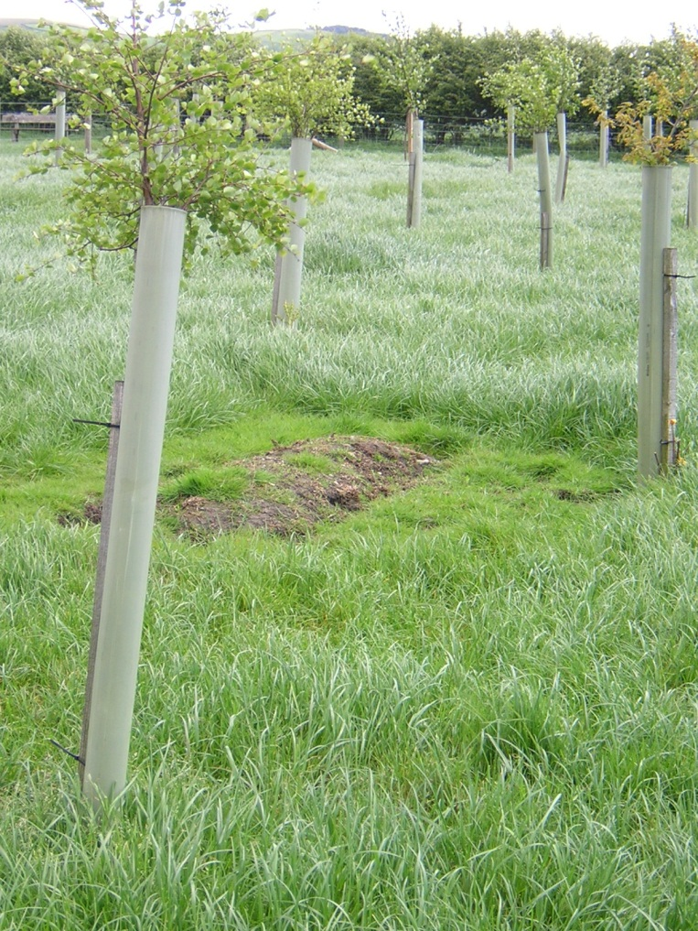
Types of Burial Ground
Natural Burial
No headstones
Restrictions on coffins
Very often commercially owned for profit
Not all are “Woodland” Burial Grounds

Slide 7
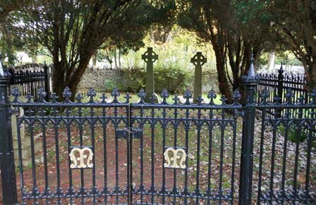
Types of Burial Ground
Family Vaults
Separate marked area in local cemetery or designated area of private estate for burials of a particular family

Slide 8
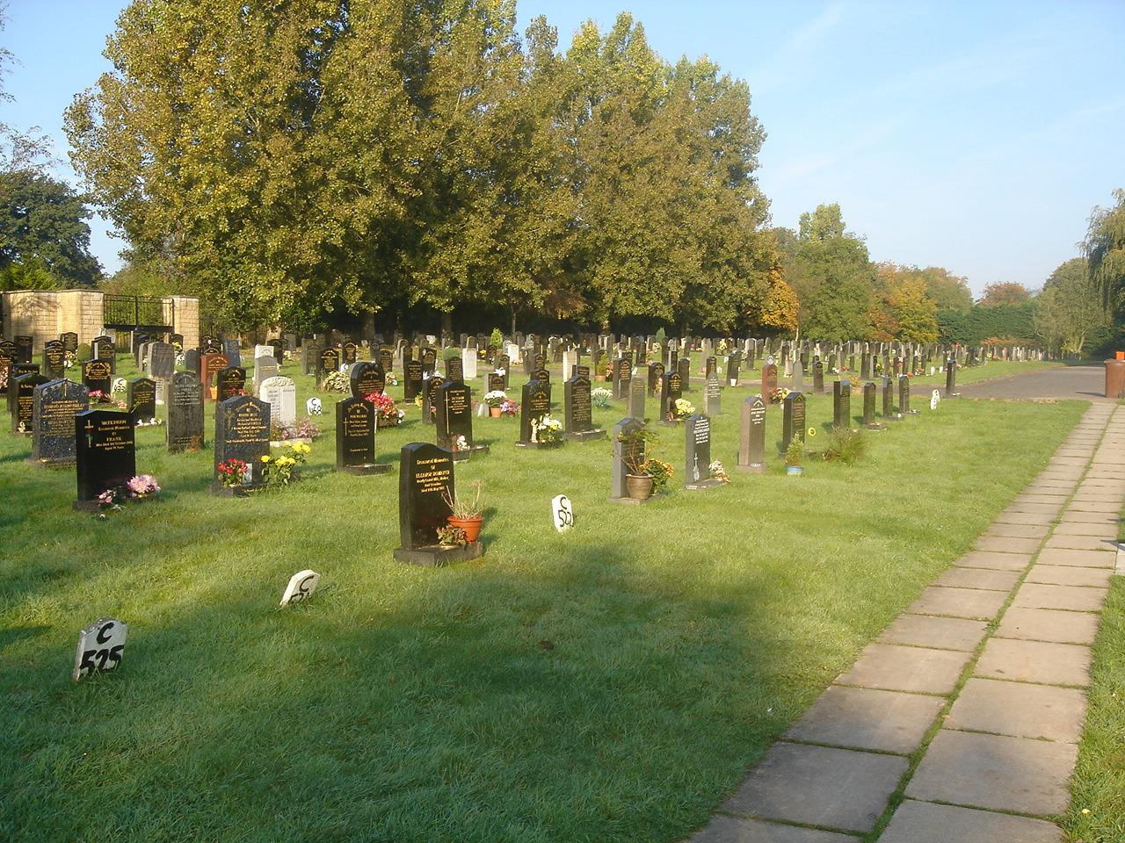
Types of Grave
Lawn Graves
So called, because the ground around the grave space can be kept mown and looking tidy
Usually restrictions on size & type of memorial
May allow small area in front of memorial for planting

Slide 9
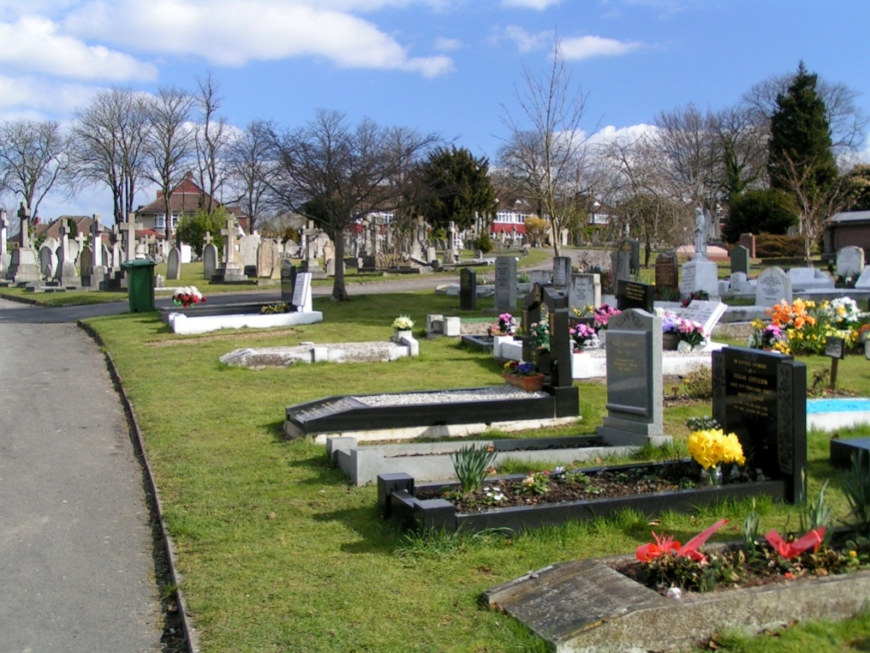
Types of Grave
Traditional Graves
So called, because they reflect the traditional style of grave space
Difficult to mow
Less restrictions on size & type of memorial
Usually an additional fee to purchase

Slide 10
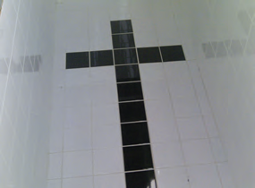
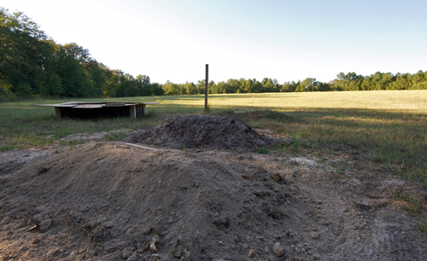
Types of Grave
Common Grave
Grave owned by the local authority
No ownership rights
Other interments may take place of no relation to the others
No memorial permitted

Slide 11
Types of Grave
Underground Chamber
Where cemetery rules permit you can build and seal an underground chamber
These are constructed from Fibrelite or concrete blocks or engineering bricks and can be simply pointed or tiled

Slide 12
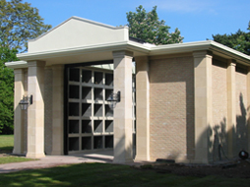
Types of Grave
Mausoleum
is an external free-standing building constructed as a monument enclosing the interment space or burial chamber of a deceased person or persons

Slide 13
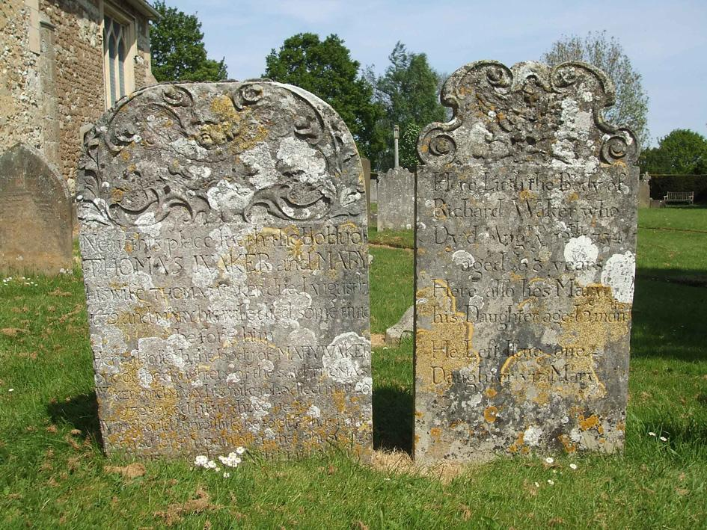
Memorials
Churchyards
A Parishioner’s right of burial in a churchyard does not include an automatic right to erect a memorial
Any restrictions will be the decision of the incumbent who will follow guidelines set by the local Diocese

Slide 14
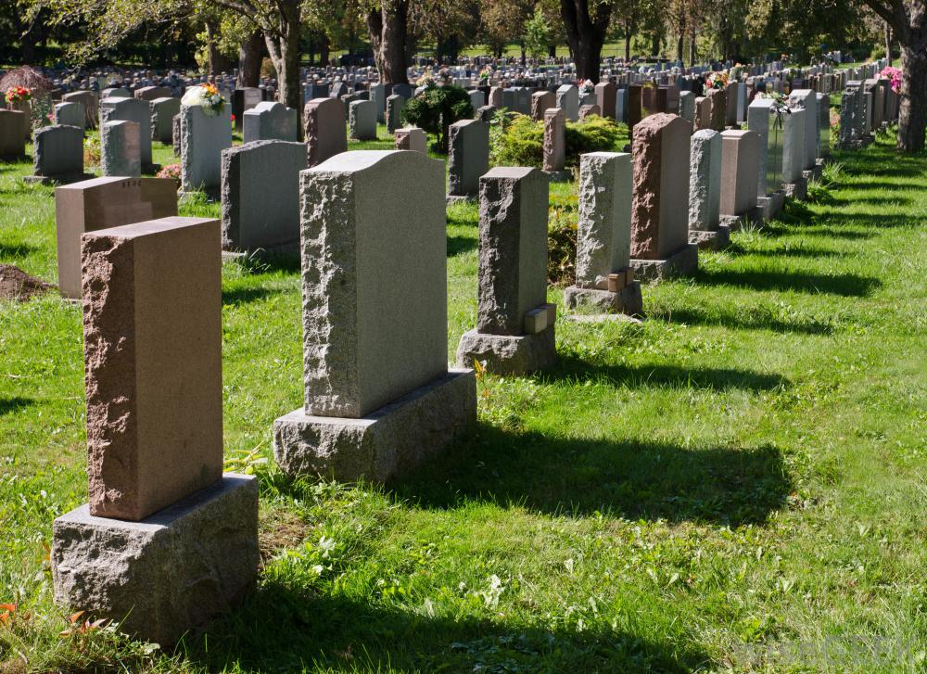
Memorials
Cemeteries
Most will have some kind of restrictions
e.g. height, material, colour
Clients must be made aware of any such restrictions at the time of arranging the funeral

Slide 15
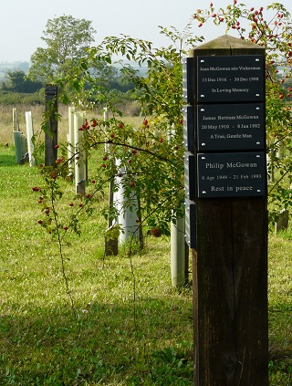
Memorials
Natural Burial
Most natural burial grounds will have a memorial option
Usually a slate plaque on a wooden post in an area close to the burial
Other options like bird boxes and benches may be available

Slide 16
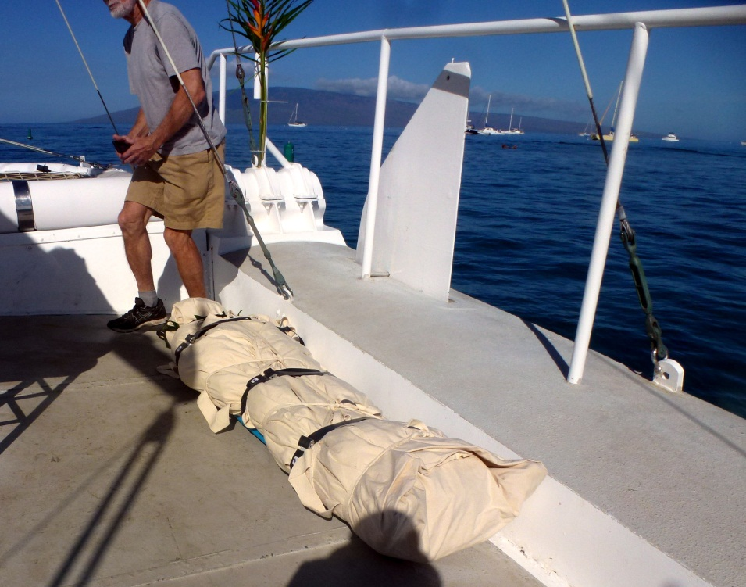
Burials at Sea
The tradition of burial at sea is an ancient one
As far as anyone knows this has been a practice as long as people have gone to sea
In earlier times, the body was sewn into a weighted shroud, usually sailcloth. The body was then sent over the side, usually with an appropriate religious ceremony

Slide 17
Burials at Sea
Many burials at sea took place as recently as World War II when naval forces operated at sea for weeks, and months at a time
Since World War II many service members, veterans, and family members have chosen to be buried at sea

Slide 18
Burials at Sea
A licence needs to be obtained from the Marine Management Organisation for burial at sea at the cost of £175.00
Sea burials are not particularly encouraged and there are complex guidelines which include finding a vessel from which the burial can take place and suitably weighting and drilling the casket
Currently there are only three places around the coast where sea burials are allowed, off The Needles, Isle of Wight, between Hastings and Newhaven and off Tynemouth, North Tyneside
There is a specialist company that deals with sea burials: Britannia Shipping Company in Sidmouth

Slide 19
If you care for the environment, should you choose cremation?

Slide 20
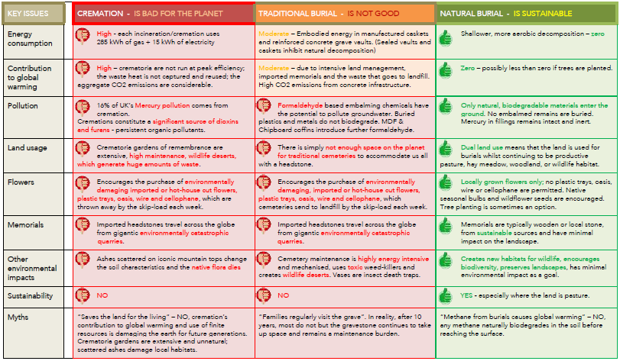

Slide 21
Discussion time:
three
Burial scenarios

Slide 22
SCENARIO 1
Mr Brown has died. He was divorced and was living with his daughter. He is Roman Catholic
There are two options – burial in the local cemetery in a grave with his deceased sister who owned the grave rights or burial 20 miles away in a new grave in the town cemetery where his son lives.
What would you advise the family regarding options and costs?
What forms would need to be completed and signed by whom?
SCENARIO 2
Mrs Smith (a Mormon) has died and her family want her buried in the local C of E churchyard. He husband says that he wants the grave next to her reserved for him.
What would you advise the family? And what documentation would be needed? And what cost would be incurred for this burial?
SCENARIO 3
Miss Jones has died and left instructions for a “green funeral” but doesn’t specify anything particular regarding this. She didn’t approve of cremation but also wanted to remain near her family.
With no green burial site within 30 miles what measures can you take to make this funeral as green as possible?

Slide 23
Learning Outcome 1: Describe the documentation procedures and legal requirements for a burial to take place and a client’s entitlement to a grave space
Evidence required:
Explain to a client the different types of burial grounds, grave and permitted memorials
Identify the different sections of a [local] cemetery and the permitted memorials in each
Identify environmentally friendly burial options
Explain the key principles of Parishioner’s Rights and grave deeds
Explain the key environmental issues relating to burial
Explain the requirements for a burial at sea

Slide 24
Learning Outcome 2: Identify the correct documents and certificates required by a burial authority in a range of circumstances
Evidence required:
Read, understand and complete an interment application
Identify the statutory documents required from Registrar and Coroner for a burial to take place with and without an inquest
Provide the correct documents to a Burial Authority in order to arrange the burial of cremated remains

Slide 25
Cremation
Cremation is chosen by more than 70 per cent of the population in Britain
Cremation was actually illegal in Britain before 1884
On 26th March 1885 the first official cremation at Woking took place
In 1940 there were still only 9 per cent of funerals that ended in cremation

Slide 26
Cremation
After the Second World War, government and local authorities encouraged cremation as an efficient and convenient method of disposing of the dead and avoiding the need to provide and maintain cemeteries
The cremation movement's campaign slogan was 'Save the land for the living'

Slide 27
Cremation
Cremation is governed by the Cremation Acts of 1902, 1952 and 2008 (amended in 2017 which came into effect April 2018), and the Cremation Regulations 1930 (as amended)
Most crematoria are run by local authorities, although a number are operated by private companies

Slide 28
Cremation
Completion of forms and certificates
Form 1 (N.B. 2017 amendment)
Forms 4 and 5
Form 10
Funeral Director’s statement
(Disposal of cremated remains on Form 1 since April 2018)
Stillborn Child
Form 3 (replaces form 1)
Form 9 (replaces forms 4 & 5)
Form 13 (replaces form 10)
Funeral Director’s statement
(Disposal of cremated remains on Form 1 since April 2018)

Slide 29
Cremation
Cremation and the Environment
EU laws governing emissions from crematoriums during the last ten years have led to most being updated
Since carbon particles are outlawed, crematorium now emit only invisible gases
Contained within these are dangerous pollutants, including dioxins

Slide 30
Cremation
Crematoriums are thought to be responsible for approximately
12% of atmospheric dioxins, pollutants linked with cancer and other illnesses, and emissions of the chloride and formaldehyde used in the embalming process
9% of airborne mercury emissions, caused by the combustion of dental amalgam

Slide 31
Cremation
Services
All crematoria will have a set service time usually 30 – 45 minutes
Arrangements for own music e.g. CD, Wesley Music
Opening hours
Hymn Books & Service Books
Deadline for paperwork – usually 48 hours before
(since April 2018 cremation forms can be completed online)

Slide 32
Cremated Remains
Kept
Scatter them in a spot of special significance
Inter in a vault or grave, ashes plot or alternative place
At sea
Into the air via a firework
Into space (American company)
Made into a gemstone/glass

Slide 33
Memorials
Books
Rose bushes
Trees
Plaques
Benches
Endowments or awards (e.g. education or sport)

Slide 34
Learning Outcome 3: Describe the documentation procedures and legal requirements for a cremation to take place
Evidence required:
Identify the information, documents and certificates legally required by a Crematorium in a range of situations
Read, understand and assist a client to complete a Crematorium application Form 1
Read, understand and complete a Crematorium ‘Prelim’
Read, understand and assist a client to complete a Crematorium ‘Disposal of Cremated Remains Form’ (from April 2018 on Form 1)
Explain the key environmental issues relating to cremation
Demonstrate knowledge of the cremation process

Slide 35
Learning Outcome 4: Arrange an interment or scattering of cremated remains
Evidence required:
Describe the methods of disposal of cremated remains
List those which are available locally

Slide 36
References
https://www.google.com/search?q=burial+and+cremation+ppt&tbm=isch&source=iu&ictx=1&fi =myMztvqf_gGtCM%253A%252CJn85Yk4lokbyfM%252C_&vet=1&usg=AI4_-kQb7qxSIMGFu2hHGauQCfzTD7UkwQ&sa=X&ved=2ahUKEwiMquqUs-roAhUFilwKHUiLAkoQ9QEwB3oECAoQHg#imgrc=myMztvqf_gGtCM:
https://www.powershow.com/view0/8eaa91-MzEyY/How_to_Make_Funeral_Memorable_powerpoint_ppt_presentation
https://www.everplans.com/articles/funeral-traditions-of-different-religions
https://www.thelancet.com/journals/lancet/article/PIIS0140-6736(01)75976-4/fulltext

Slide 37
Feces , Urine and Rural waste
SUBMITTED TO:
DR. ABDUL GHANI
AAMIR IQBAL
M.PHIL. BOT 2nd
ROLL NO: 06

Slide 38
Objectives
Defintion of waste.
Types and composition of waste.
Public health importance.
Treatment of waste.
Situation in Sudan.

Slide 39
What is waste?
§ A substance or object that is disposed, intended to be disposed or required to be disposed.
Types:
§ Human waste, municipal waste, hazardous waste, biomedical waste.

Slide 40
Classification of waste:
1. Biodegradable wastes:
Those that can be decomposed by the natural processes and converted into the elemental form.
e.g. kitchen garbage, animal dung, etc.
2. Non-biodegradable Wastes:
Those that cannot be decomposed and remain as such in the
environment, persistent,can cause various problems. e.g.plastics, nuclear wastes, glass, etc.

Slide 41
Domestic waste
Is a waste that is generated as a result of the ordinary day-to-day
consumptions of households.
Includes:
Remains of food, plastics , bottles, papers......

Slide 42
Domestic waste
Output of daily waste depends on:
Dietary habits.
life style,living standards.
Degree of urbanization and industrialization.

Slide 43
Municipal wastes
Also known as trash, garbage, refuse or rubbish.
Is a waste type consisting of everyday items that are discarded by the public.

Slide 44
Municipal waste - composition
Composition varies according to consumption nature, municipality.
It includes:
Food wastes, market wastes, plastic containers, product packaging materials.
Does not include:
Industrial wastes, agricultural wastes, medical wastes.

Slide 45
Solid wastes-public health importance
Health hazards: diarrheal diseases, typhoid fever...
Soil and water pollution.
Unpleasant odors.
Propagation of flies, insects..

Slide 46
Solid waste management
Storage.
Collection.
Separation.
Transport.
Disposal.

Slide 47
Solid waste management
1. Storage:
Proper storage while awaiting collection.
Steel dust bin with close fitting cover.
Public bins.
2. Collection:
Gathering of solid wastes & recyclable materials.
Transport after collection to the location where the vehicle is emptied.
2. Separation:
Separation of different types of waste components.

Slide 48
Solid waste management
3. Transport:
From smaller collection vehicle to larger transport equipment.
Then transported over a long distance to processing or disposal site.
4. Disposal:
Getting rid of waste.

Slide 49
Disposal of solid waste

Slide 50
Disposal of waste-Land spreading and dumping
Easy, in low lying areas.
But have many disadvantages:
Exposure to flies and rodents.
Unpleasant smell and appearance.
Dispersion by the action of wind.
Pollution to ground water.
Most insanitary method.

Slide 51
Disposal of waste-Sanitary landfill
An engineered facility used for disposing of solid wastes on land without harming public health.
Involves mass dumping of waste into designated area, a hole.
Then compacted by large machines.
When full, it is sealed with a plastic sheet.
Threat to pollution , can intoxicate ground water.

Slide 52
Disposal of waste-Sanitary landfill
Chemical , bacteriological and physical changes occur in the buried wastes.
It takes 4 - 6 months for complete decomposition.

Slide 53
Disposal of waste-Incineration
Where suitable land is not available.
Using large incinerators.
Separation of substances that hinder fire.

Slide 54
Disposal of waste-Manure pits
In rural areas.
Dug by individual households.
Two pits -alternating.
Simple, relatively effective.

Slide 55
Further management:
Recycling.
Energy production.

Slide 56
In Sudan:
All wastes 5,282,000 tons yearly, only 10 % is transported.
In Khartoum state:
About 4000-6000 tons daily by more than 6 million people.
About 540 vehicles, collected twice per week.
Formerly burning wastes in outskirts, but now population size increases...
Khartoum state cleansing project, processing is by dumping.

Slide 57
Problems with waste management in Sudan
Negative behaviour of people... Burning produces sulphur oxide gas.
Accumulation of wastes in water trenches.
Cost of collection, transport and landfill.
Administrative constraints.

Slide 58
Human waste

Slide 59
What is human waste?
Human Excreta
Refers to byproducts of digestion, such as faces and urine.

Slide 60
Public health importance
Health hazards including:
Soil pollution.
Water pollution .
Contamination of food.
Propagation of flies.

Slide 61
Public health importance
Diseases include:
Typhoid and paratyphoid fever.
Dysenteries.
Diarrheal diseases.. Cholera.
Hook worms, Ascariasis.
Viral hepatitis.

Slide 62
Faecal borne transmission

Slide 63
Methods of human waste disposal
Classification:
1.Unsewered areas:
Service type laterine.
Non-service type laterine.
2. Sewered areas:
Water carriage system and sewage treatment.

Slide 64
Service type laterine
Collection and removal of human waste from bucket latrines by human agency.
Transported in carts to the place of final disposal.
Disadvantages: inadequate emptying, insanitation , water and soil pollution , human labour.
Replaced by non service type latrines.

Slide 66
Sanitary latrines : Criteria
Excreta should not contaminate ground or surface water.
Excreta should not pollute the soil.
Excreta should not be accessible to vehicles of transmission.
Excreta should not create unpleasant smell or appearance.

Slide 67
Bore hole latrine
Circular hole dug vertically by an equipment into ground.
Concrete squatting plate is placed over the hole.
For limited number of people, limited time period ( one yr).
Filled, plate removed, hole closed with earth, new one dug.
Purification by anaerobic bacteria.

Slide 68
Bore hole latrine
Advantages:
No daily removal.
No flies.
No water pollution.
Disadvantages:
Fills rapidly.
Needs special equipment, auger.

Slide 70
Dug well laterine
Easy to construct, no special equipment.
Longer life.

Slide 71
Dug well laterine

Slide 72
Water seal latrine
Water fit with a squatting plate or a seat.
Water: prevents flies, prevents gases and odors.

Slide 73
Water seal latrine - Features
Location:
Should not located within 15 m from water supply.
Squatting plate / seat:
Impervious material.
Pan:
Receives faeces, urine and wash water. Uniform slope from front to back.
Trap:
Bent pipe connected with pan.
Holds water and provides water seal.

Slide 74
Water seal latrine - Features
Connecting pipe:
About 1 m in length.
Dug well:
When filled; a new one dug nearby and pipe direction changed.
Superstructure:
For privacy and shelter.
Maintenance:
Health education about usage.

Slide 76
Septic tank
The septic tank is water-tight tank into which household sewage is admitted for treatment.
It is a satisfactory means of disposing excreta and liquid wastes.
Individual dwellings, small groups of houses and institutions
which have adequate water supply but do not have access to a public sewerage system.

Slide 77
Septic tank
Features:
Air space.
Inlet and outlet pipe.
Cover.
Retention period 24 hrs.

Slide 78
Septic tank

Slide 79
Septic tank
Work:
Solids settle down-sludge.
Grease and fat up-scum.
Solids.. Anerobic bacteria (anaerobic digestion), some transformed to liquids and gases.
Liquid flow through pipe from time to time (effluent) to subsoil.
In subsoil, aerobic oxidation to stable end products,, nitrates , carbon dioxide and water.

Slide 80
Sewered areas-water carriage system
Called Sewerage system.
Collecting & transporting of human Excreta & waste water from residential, commercial and industrial areas, by a network of underground pipes "sewers" to the place of ultimate disposal.

Slide 81
What is Sewerage ?
Waste water (form 99.9%).
Solid and liquid Excreta.
From houses, streets, factories,..
Needs proper disposal.

Slide 82
Sewerage system -Types
Combined Sewerage system:
Sewers carry both sewage and surface water.
Separate Sewerage system: Surface water not admitted to sewers. Is the system of choice.

Slide 83
Sewerage system- Composition
1. Household sanitary fittings
water closet (squatting, seat).
flushing system.
2. House chain:
Empties sewage into main public drain.

Slide 84
Sewerage system-composition
Public sewers:
Collect sewage from several houses & transport to the place of final disposal.
Sewer appurtenances:
Manholes: openings built into the Sewerage system.
Traps:devices designed to prevent foul gases from entering houses & remove sand, grease from sewage.

Slide 85
Pretreatment
Screening
Grit removal (hard small materials).
Flow equalization (fluctuating input, constant output).
Fat and grease removal

Slide 86
Primary treatment
Consists of temporarily holding the sewage in a quiescent basin where heavy solids can settle to the bottom while oil, grease and lighter solids float to the surface. The settled and floating materials are removed and the remaining liquid may be discharged or subjected to secondary treatment

Slide 87
Secondary treatment
Removes dissolved and suspended biological matter. Secondary treatment is typically performed by indigenous, water-borne micro-organisms in a managed habitat. Secondary treatment may require a separation process to remove the micro-organisms from the treated water prior to discharge or tertiary treatment.

Slide 88
Tertiary treatment
Is sometimes defined as anything more than primary and secondary treatment in order to allow rejection into a highly sensitive or fragile ecosystem like low-flow rivers. Treated water is sometimes disinfected chemically or physically for example, by microfiltration prior to discharge into a stream, river or it can be used for the irrigation of a green way or park. If it is sufficiently clean, it can also be used for groundwater recharge or agricultural purposes.

Slide 89
In Sudan
Still "going to the field".
Dug wells.
Septic tanks:restricted, universities, hotels.

Slide 90
Khartoum state
Khartoum :
In 1939, idea of sewerage system, by an English company.
Postponed due to first world war.
In 1954, recontiuation and excusion of project.
Khartoum bahri:
Sewerage project planned in 1961 by American company.
Stopped due to political issues.
Confined to industrial area, never extended to residential areas.

Slide 91
Two projects joined.
In 1992, Khartoum company for Sewerage founded.
Now, Khartoum company for water and services.
Sewerage coverage:
Khartoum : 10 %
Bahri : 1%
Omdurman : none
Now, ongoing project (Khartoum Sewerage Project).

Slide 92
Thank you

