Slide 1
Tobacco as a minor crop

Slide 2
Taxonomy classification:
Kingdom Plantae
Class Magnoliospsida
Family Solanaceae
Genus Nicotiana
Species tabacum

Slide 3
Tobacco

Slide 4
introduction
Tobacco is only commercial non food crop that enters the world trade as a leaf.
It priced for its aroma , taste and flavor.
Tobacco is important commercial crop in view of revenue generation , export , earning and employment potential.
It is aptly called as the golden leaf of India.
Crop directly or indirectly supports about 30 million people.

Slide 5
Cont.
Native to central and south America.
High valued cash crop.
Chromosome no is 2n=4x=48

Slide 6
Production and its economy importance:
Tobacco is grown on around 0.2% of total irrigated land of Pakistan.
A work force of 350,000 is directly and indirectly employed in the tobacco industry which generate annual income of around 300 million and a source of livelihood for 1.2 million people.
There are 75,000 tobacco growers producing tobacco all over Pakistan. More than 45,000 growers are located in Pakhtunkhwa producing 95% , over an area 30,000 growers in the districts of Swabi, Mardan , Buner and Mansehra .
On average 80-85 million kg of FCV which is main ingredient of cigarettes.

Slide 7
Cont:
A source of employment for thousands of people who are involved with:
Producing
Curing
Marketing
Cigarette manufacturing
Next to sugarcane, tobacco is the most important cash crop in irrigated areas of KPK.
In Punjab , cigarette tobacco is gaining popularity with the farmers.
In Sindh , it has not yet received much encouragement and is grown on a limited area in Tharparker,

Slide 8
cont:
Dadu .
Board set up stations at Mardan , Mansehra , Gujrat , Okara and Sahiwal with a zonal office at Lahore and head office is Peshawar.
Main focus of this board is to conduct research , solve local problems and convey information to growers.
Production is 30 mounds/acre.

Slide 9
Cont.
World production 6.2 million Mt(2007).
Extent 3.7 million ha.
Major production countries
China (39.6%)
Brazil (7.0%)
India (8.3%)
USA (4.6%)

Slide 10
FLORAL BIOLOGY:
Plant normally grows to one or two feet high.
The inflorescence of tobacco is terminal raceme.
The flowers are pedicellate and hermaphrodite.
Calyx contain five sepals.
Corolla contain five petals and colored white, yellow, pink or red.
Stamens are five in number.
It has superior ovary.

Slide 11
Cont:
It is self pollinated crop,4-10% cross pollinated occurs due to insects.
Pollens are viable for 24hrs.
Stigma is receptive one day before and after flower opening.
Leaf shape can be ovate or elliptic.
On the stem, the leaves appear alternately, with one leaf per node along the stem.
Underside of the leaf is fuzzy or hairy.
Tobacco fruit measure at 1.5-2mm and consist of a capsule containing two seeds.

Slide 13
Why tobacco leaves Important:
Leaves are the plant part containing the nicotine.
The nicotine is manufactured in the plant roots, not the leaves.
The nicotine is transported to the leaves via the xylem.
Some specie of Nicotiana are very high in nicotine content.

Slide 14
Nutrition value
Calories calories from fat 0
Total fat 0%
Sodium 1%
Carbohydrates 0%
Protein 0%

Slide 15
Types of tobacco:
Fire –cured: used for snuff and chewing tobacco.
Dark air cure: used for chewing tobacco.
Air –cured tobacco: used for cigarettes.
Air cured cigar tobacco: used for cigar wrappers and fillers.
Flue-cured: used for cigarette , pipe and chewing tobacco.
Burely: used for cigarette, pipe and chewing tobacco.

Slide 16
Chemical composition:
Important chemicals are:
Nicotine
Nornic
Nicotine is a stimulant drug that speed up the messages travelling between the brain and body.
It may be more addictive than heroin.
Tar and carbon monoxide are also released when tobacco is burned or smoked.
Nicotine concentration approximately 0.6-3% of the dry weight of tobacco.

Slide 17
Cont:
Nicotine concentration about 2mg in average cigarette yield.
High amounts can be harmful.
Nicotine dependency causes distress and withdrawal symptoms include:
Coughing
Fast heart beat
Stress
Sleep disturbance
irritability

Slide 18
Agronomy characteristics:
Climatic conditions:
tropical crop in origin but can be grown in subtropical and temperate regions
Temperature 15-35C
Relative humidity 85-90%
Rain 500-1250mm
Well distributed rainfall through out the year.
Crop cannot withstand frost and start wilting at temperature above 35C.

Slide 19
Cont:
Suitable soil:
Sandy surface soil 15-25cm depth
A yellowish/ reddish sandy clay sub soil depth of 150cm.
PH 5.5-6.5
Very low chloride content .

Slide 20
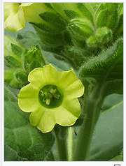
Cultivated species
more than 70 species of tobacco are known
Chief commercial crop is N tabacum
Other is N rustia also used around the world

Slide 22
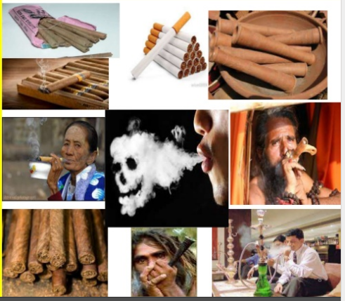
Tobacco products:
Cigar
Cigarettes
Cheroots
Snuff
Chewing tobacco
Loose leaf
Dipping tobacco
Cigarillos
Tobacco water

Slide 23
Medicinal uses:
Tobacco was used to dress wound as well as a pain killer.
It is used as a sedative, diuretic and internally only as an emetic, when all other emetic fail.
A cataplasm of the leaves may be used as ointment for cutaneous diseases.
Externally nicotine is an antiseptic.

Slide 24
Other uses:
An alternative use of tobacco is needed, such as biofuel or biomass.
Tobacco is indeed an oil seed crop with an oil yield ranging from 30-40% of seed dry weight.

Slide 25
Breeding objectives:
Improve the yield
Improve its quality
Disease resistance varieties
Ease of handling and curing

Slide 26
Breeding method:
Pedigree method
Backcross method used for disease resistance

Slide 27
Gmo plants:
Through molecular breeding, the plants were genetically modifies to increase their production of starch and sugars which contribute to the increase in ethanol production.
However ,if the plants are used for producing biofuel , when the plant has grown to a height 50cm, it is cut and the output is taken to the biomass processing factory.
If the plants are used for producing biofuel, the researchers go for a high density crop similar to that of forage crops.

Slide 28
Harmful effects
Tobacco use a risk for health diseases especially those affecting the heart, liver and lungs as well as many cancers due to inhalation of poisonous chemicals in tobacco.
In united states , about 3,ooo adults die each year due to lung cancer .
Thousands of different substances in cigarette smoke , including polycyclic aromatic hydrocarbons , formaldehyde , cadmium , nickel and phenols contribute to the harmful effects of smoking.
Smokers have to maintain a level of nicotine in the blood
for normal working.

Slide 29
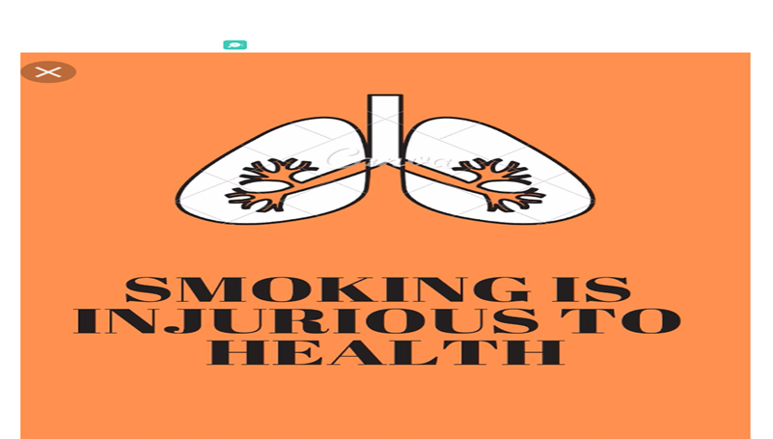
Cont:
Tobacco is the only legally available consumer product that kills people when it is use.
55% of Pakistan households have at least one smoker.

Slide 30
Annual death rate

