Slide 1
“Minimum & Zero Tillage”

Slide 2
Tillage
The preparation of land for growing crops.

Slide 3
Conventional Tillage
It involves applying power to break up and rearrange the entire top soil structure.
In conventional tillage, energy is often wasted and sometimes, soil structure is destroyed.

Slide 4
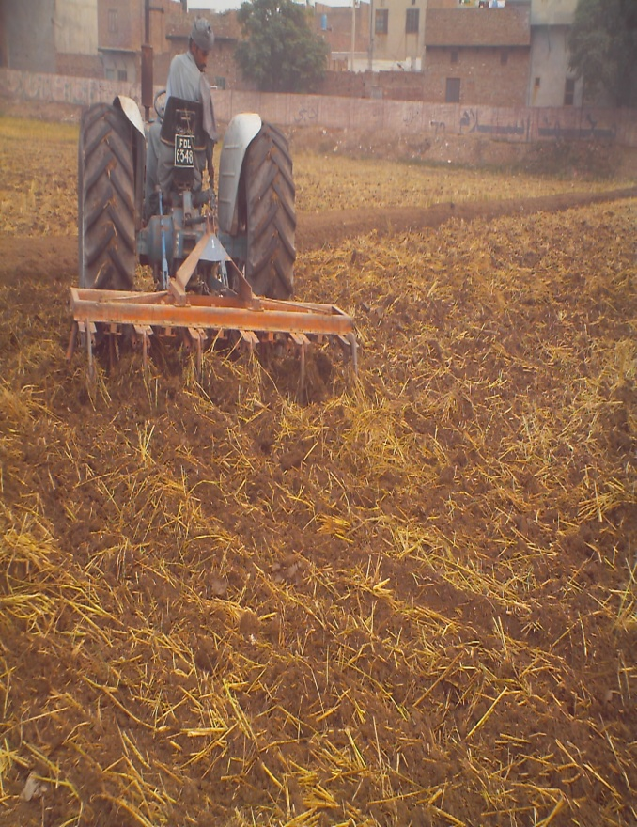
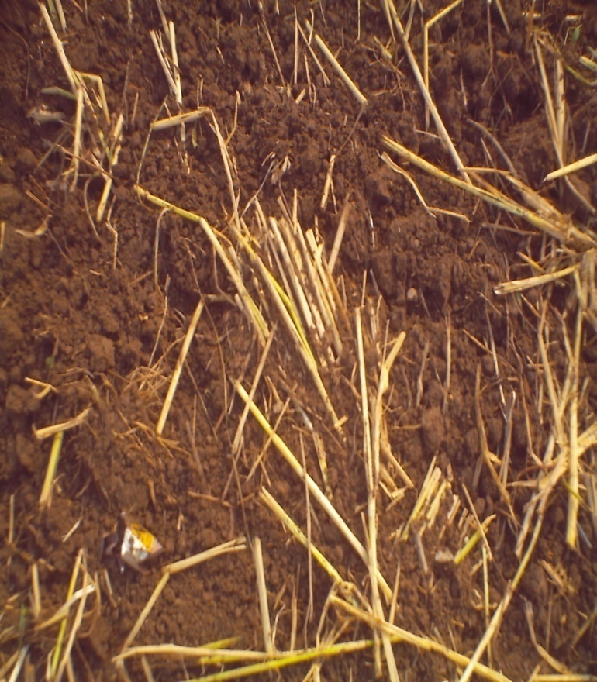
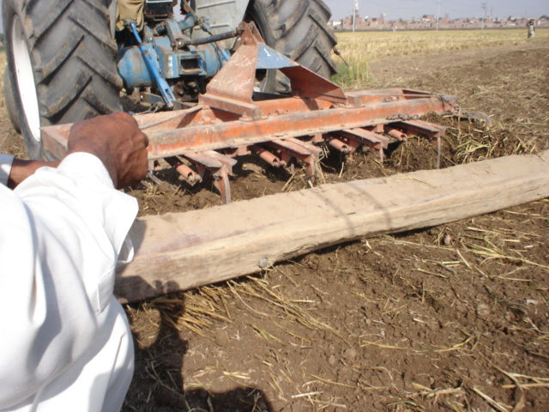

Slide 5
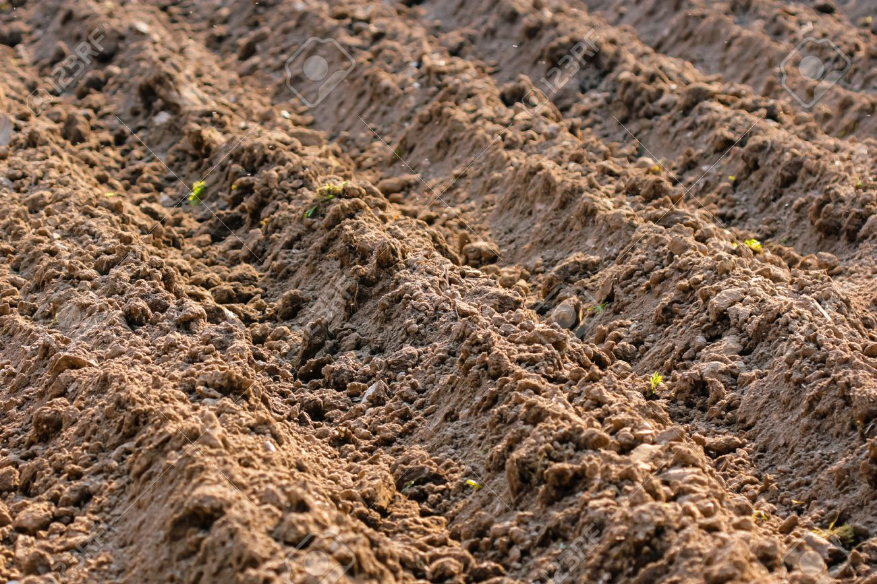

Slide 6
Advantages
Destroys pests shelters and disturbs their lifecycles.
Exposes pests to predators and unfavorable conditions.
Controls weeds.

Slide 7
Disadvantages
Destroys soil structure.
Enhances soil erosion.
High moisture loss.
Disturbs the lifecycle of beneficial soil organisms.
Needs more machinery for the soil preparation.

Slide 8
Conservation Tillage
Any tillage in which at least 30% of the soil surface is covered by plant residues after planting to reduce erosion.

Slide 9
Why, Conservation Tillage
When fertile soil is used, when crops are grown on them, the fertility is drawn out.
Nutrient levels reduces.
Moisture levels decline.
Repeated plowing and cultivating causes erosion from wind and water.

Slide 10
Advantages
Conserves water through mulches and reduces water to evaporate.
Reduces erosion and topsoil is protected.
Reduces soil compaction.

Slide 11
Advantages
Protects from rain and wind.
Improves the soil condition with the increased organic matter content.
Lessens the overall production cost.

Slide 12
Disadvantages
Needs best understanding.
Requires careful farm management practices.
Soil pests population are increased from the crop residues.

Slide 13
Minimum Tillage?
It involves considerable soil disturbance, in lesser extent than that associated with conventional tillage.

Slide 14
History of Minimum Tillage
Minimum-tillage have been used since ancient times so-called “primitive cultures” for the production of crops, simply because man has not the muscle force to till any significant area of land to a significant depth by hand.

Slide 15
History of Minimum Tillage
Used a stick to make a hole in the ground, put seeds in the soil by hand, and covered the seeds with the foot.

Slide 16
Principles of Minimum Tillage
Reduce the cost of production e.g. machinery and labor.
Rethink crop production systems e.g. keep crop residues on the soil surface, improving biological activity.
Make environmental improvements e.g. reduce erosion, and loss of nutrients.

Slide 17
Objectives of Minimum Tillage
Reducing energy input and labour required.
Conserving soil moisture and reducing erosion.
Increase infiltration of water.
Soil compaction is reduced.

Slide 18
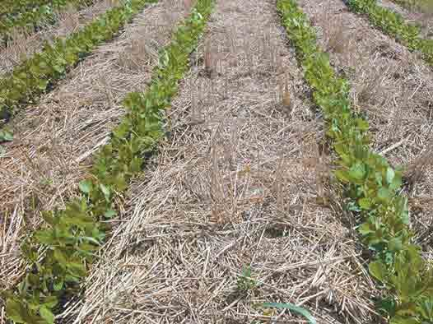
Minimum Tillage tillage for soybean

Slide 19
Advantages of Minimum Tillage
High infiltration.
Reduce energy consumption.
Reduced soil erosion.
Less soil compaction.
Reduced tillage works best in dry conditions.

Slide 20
Disadvantages of Minimum Tillage
Pest attack is more.
Minimum tillage practices require more pesticides.
Requires careful farm management practices.

Slide 21
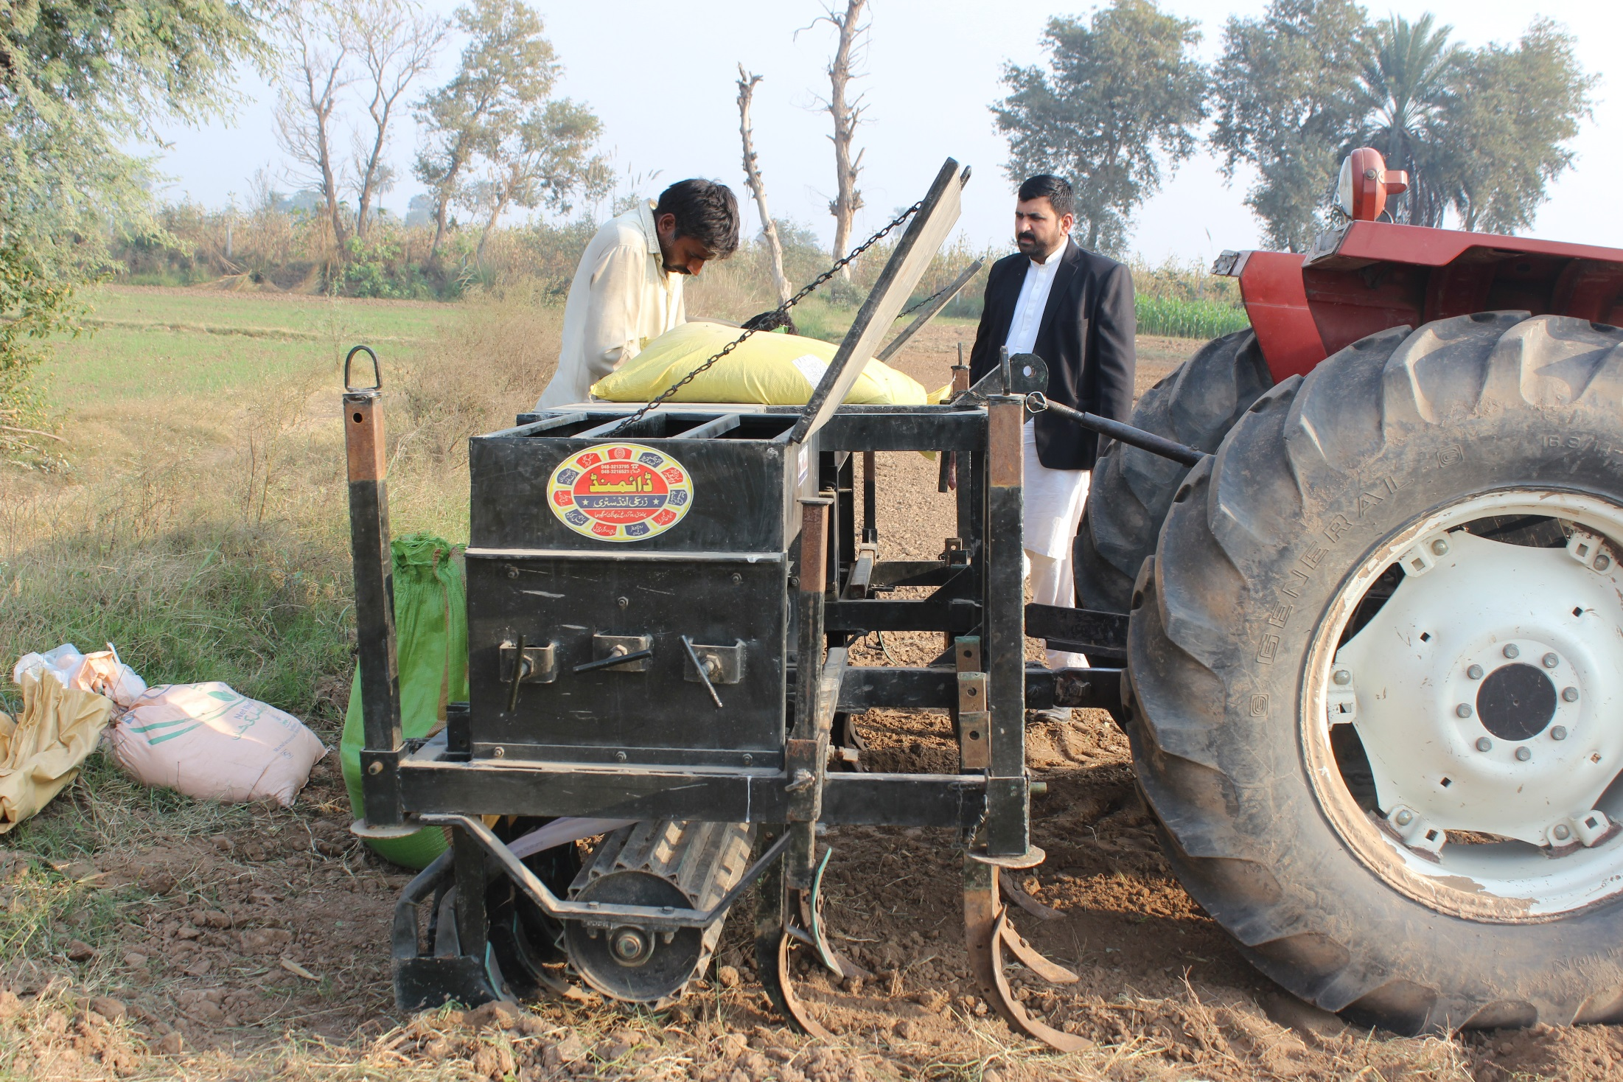
Zero Tillage
Placement of seed in to soil without soil preparation.
It is direct sowing of seed in the field without any disturbance to soil.

Slide 24
History of Zero Tillage System
No-tillage started in the USA in the 1930s.
Recent studies estimate that there are about 111 million hectares of farmland under no-till worldwide.

Slide 25
Zero Tillage in Pakistan
Zero Tillage technology, first introduced amongst the farmers during 1980.
The technology was rapidly accepted by the farmers due to its reducing cost of production, conservation of resources, and improving yield.

Slide 26
Zero Tillage in Pakistan
Wheat was grown with this technique on an area of about one million acres in Pakistan during 2003-04.
Now there are more than 5,000 Zero Tillage drills owned by farmers.
Now in Pakistan this system consumes around 1.7 million hectares.

Slide 27
Principles of Zero Tillage system
Maintaining soil cover with plant residues.
Elimination of mechanical soil tillage.
Weed control.
Direct seeding with special instrument.
(Prabhakar et al., 2002)

Slide 28
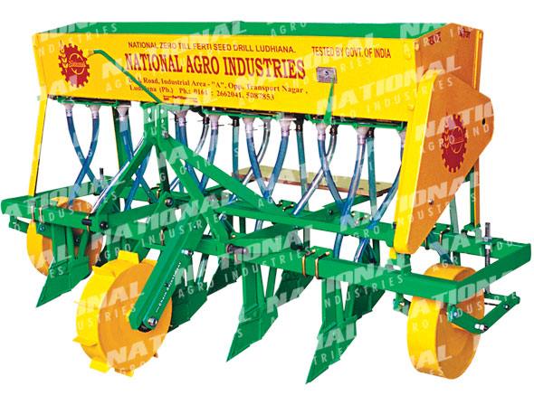
NATIONAL ZERO TILL FERTI SEED DRILL

Slide 29
ZERO TILLAGE FERTILIZER, SEED DRILL

Slide 30
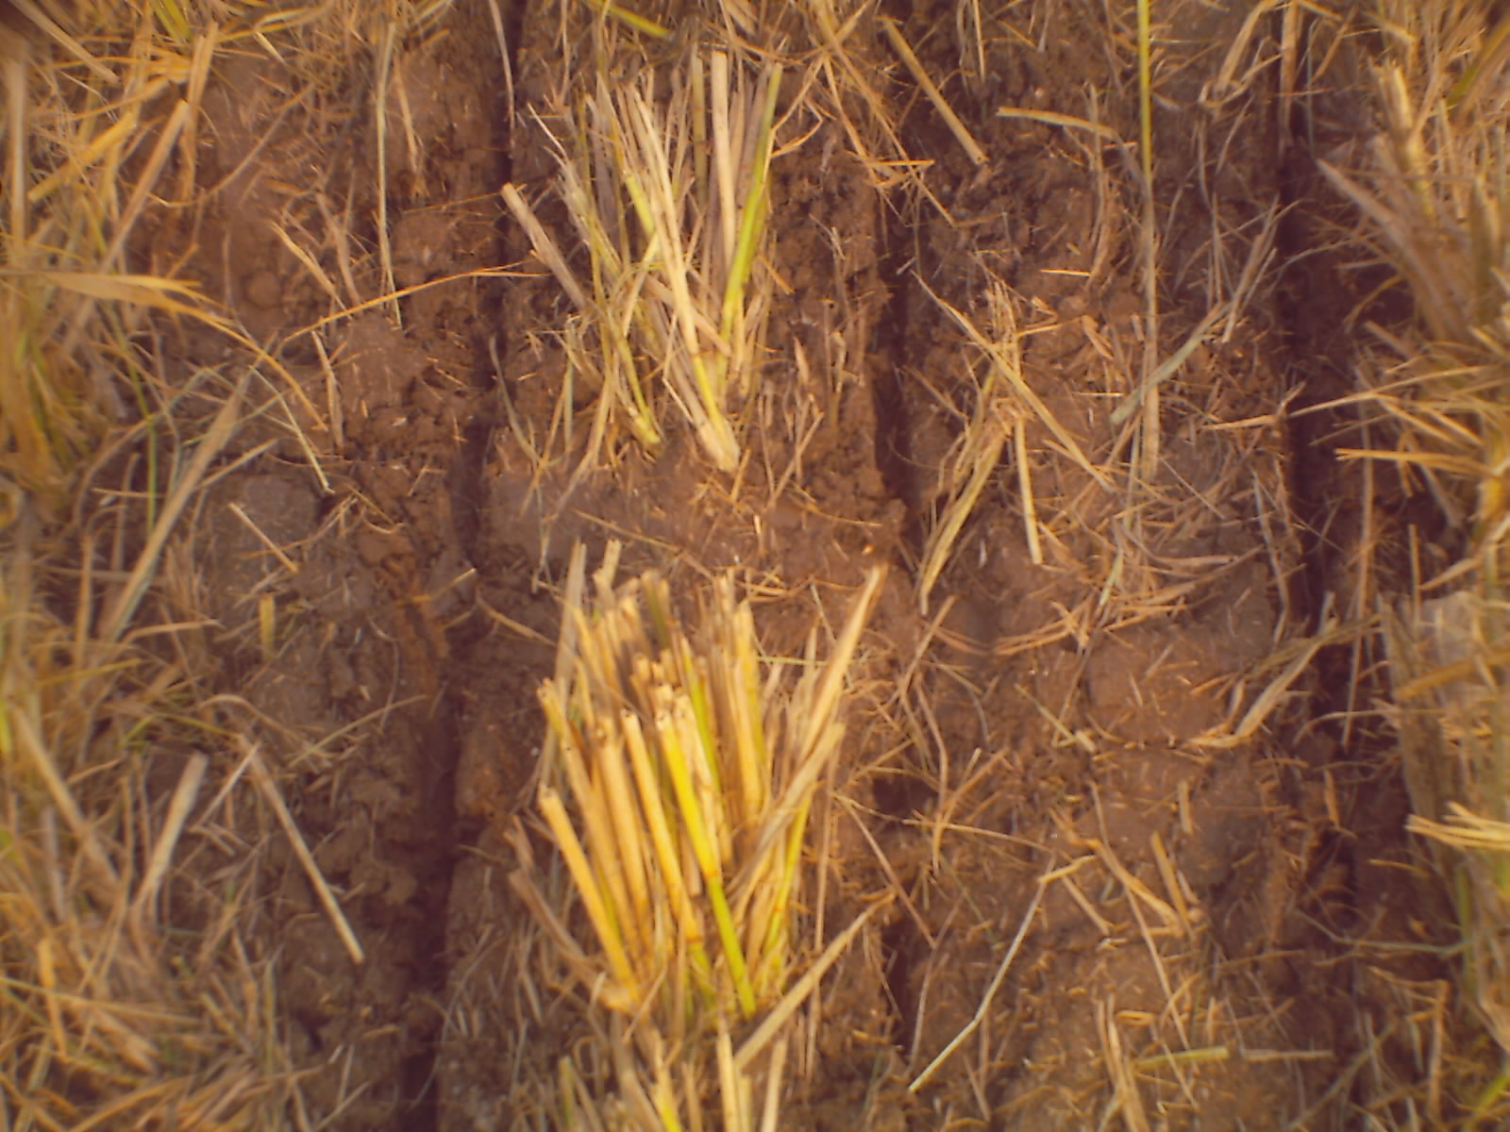

Slide 31
Importance of Zero Tillage
In recent years , drought has become a limiting factor in crop production , and farmers are facing problems of soil erosion.
Conventional tillage completely inverts the soil, while no-till causes only negligible soil disturbance.

Slide 32
Importance of Zero Tillage
The residues from previous crops remain largely undisturbed at the soil surface as mulch.
There is a great saving of time, irrigation, and monetary costs.
Zero-tillage is the most conservative and suitable system for wheat in Pakistan.

Slide 33
Yield of wheat
Farmers remain busy in harvesting, thrashing and handling of rice straw until early December.
Land preparation delays wheat sowing.
The best time to plant wheat after rice is November. Thereafter, delay results in yield reduction by 30-35kg per hectare.

Slide 34
Yield of wheat
After rice harvest, sufficient residual moisture is generally available to establish new crop.
Conventional tillage accelerates soil moisture evaporation and requires extra irrigation water. This causes major delays in wheat sowing, which ultimately affects final crop yields.

Slide 35
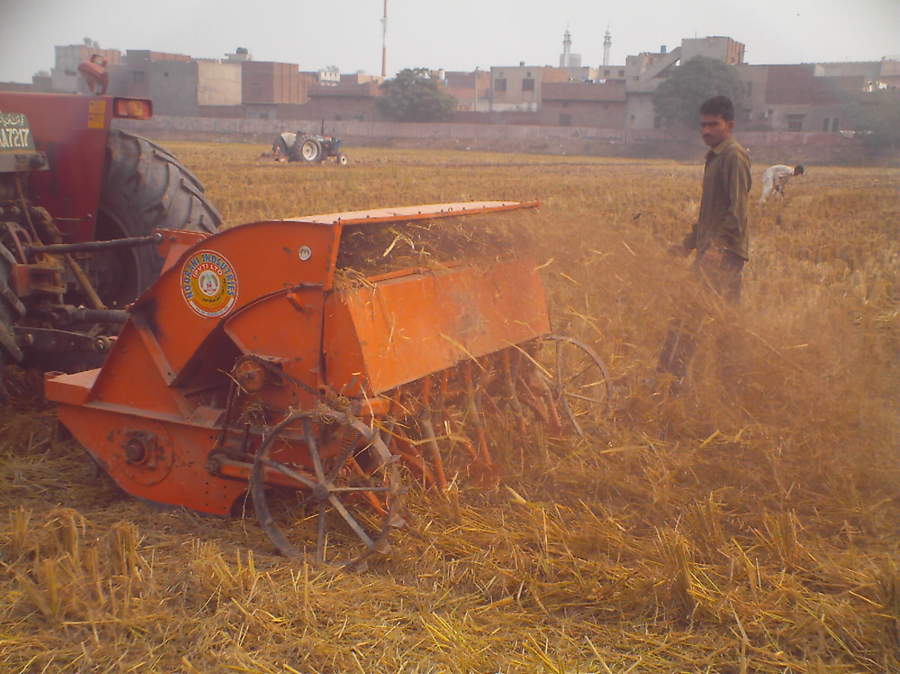
Residue management
One completely new feature of zero-tillage cropping systems compared to conventional farming is the management of cover crop residues where applicable

Slide 36
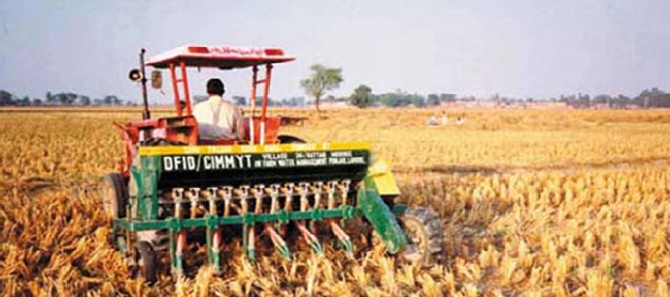

Slide 37
Limitations of Zero Tillage
Planting: The main challenge for the engineers was difficulty in penetrating hard setting soils might be overcome by heavy seed-drills to ensure an accurate depth placement.

Slide 38
Limitations of Zero Tillage
Weed control: For weed control, different approaches are required. Some suggested approaches to weed control could be, depending on the type of weed problem, cutting and mulching.

Slide 39
Advantages of Zero Tillage
Reduced wind.
Reduced water erosion.
Reduce energy requirement.
Less preparation and plating time is required.

Slide 40
Advantages of Zero Tillage
Decreased evaporation and increase infiltration.
Improves soil structure.
Better rainwater use.

Slide 41
Disadvantages of Zero Tillage
Crop residue at the soil surface reduces the effectiveness of seed delivery systems and results in poor seed soil contact.
Special Machinery is Required.
Involves more management.
Risk of Diseases.

Slide 42
