Slide 1
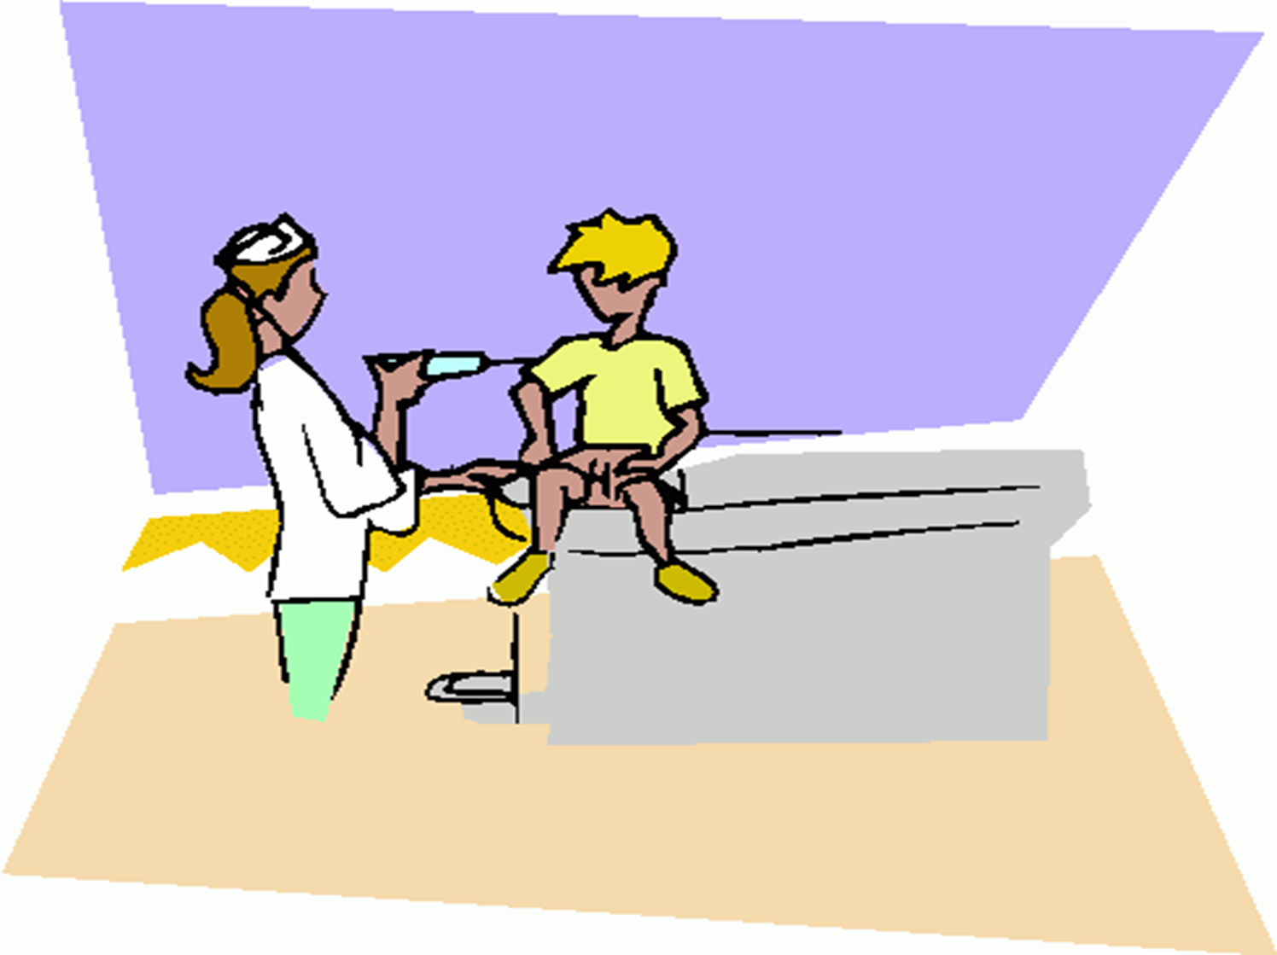
Expended Program of immunization(EPI)

Slide 2
The cold chain:
It is the system of storage and transportation of the vaccine at low temperature (cold condition) from the manufacture till it is consumed.
Polio vaccine is the most sensitive vaccine to heat.
Live attenuated vaccines are allowed to be frozen (OPV, Measles, MMR and BCG).
Inactivated vaccines must not be frozen ( DPT, DT, dT , TT and HB) .

Slide 3
The levels of cold chain

Slide 4
The administrative levels of cold chain according to the duration of the storage and the temperature required to keep the vaccine potent
The administrative level | Storage period | Temperature | The vaccines
Central & regional stores | Maximum three months | - 20° to- 30°C | OPV, Measles, MMR,BCG
 |  | +2° to +8°C | DPT, DT, dT, TT& HB,Hib
Districts stores& local immunization centers | Maximum one month | 0°C to+8°C | OPV, Measles, MMR, BCG
 |  | +2° to +8°C | DPT, DT, dT, TT& HB,Hib

Slide 5
The components of the cold chain :
The equipment and tools
The health staff
The procedures

Slide 6
Tools for monitoring the cold chain:
1- Cold Chain Monitor Card.
2- Freeze Watch Indicator
3- Cold Chain Refrigerator Graph
4- Vaccine Vial Monitors
5- Shake Test

Slide 7
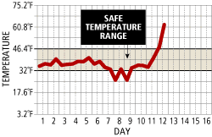
+8°C
+2°C
Cold Chain Refrigerator Graph
The vaccines are stored in refrigerators, they are monitored twice a day and readings are recorded on a chart to ensure a safe temperature is maintained. Emergency provisions made. Vaccines moved to cold storage for 48 hours.

Slide 8
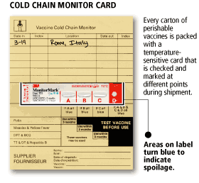
2-Cold Chain Monitor Card: is used to show cumulative exposure to Temp. above the safe range during storage& transportation . It has an indicator that responds to two different Temps: the first part marked as ABC, responds to Temp above +10ºC; the 2nd part marked as D responds to Temps. above +34ºC.

Slide 9
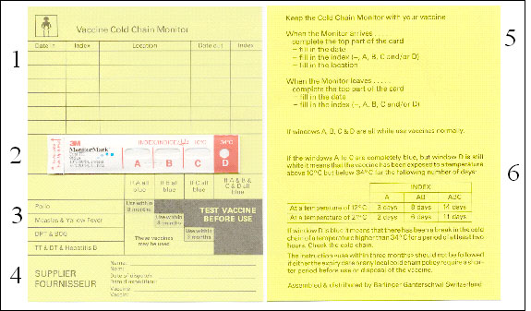
2-Cold Chain Monitor Card:

Slide 10
The front of the cold chain monitor has:
A record form that health workers fill in to show when vaccines are received.
(2) An indicator that is a heat-sensitive strip with four windows, marked A, B, C and D.
(3) An interpretation guide explaining what to do with vaccines that have been exposed to high temperatures.
(4) A space for filling in the following information: name of supplier/manufacturer, type of vaccine.
The back of the cold chain monitor has:
Instructions on use.
A table giving information on the time and temperature characteristics of the Monitor.

Slide 11
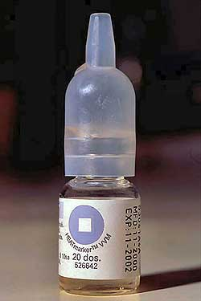
3-Vaccine vial monitors:
Every vial is also shipped with a temperature-sensitive label, that health workers monitor during vaccination sessions.

Slide 12
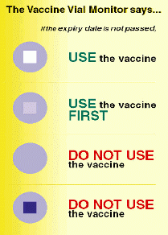
SAFE If the inner square is lighter than the outer ring and the expiration date is valid, the vaccine is
usable
SPOILED If the inner square matches or is darker than the outer ring, the vaccine must be discarded.

Slide 13
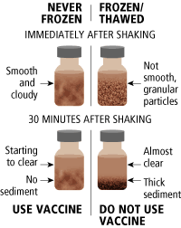
4-The shake test DPT, hepatitis B and tetanus toxoid vaccines can all be damaged by freezing. By shaking two vials, side-by-side, one that might have been frozen and one that has never been frozen, health workers can determine if a vaccine has spoiled.

Slide 14
What damage the Vaccines?
1. Any defect in the cold chain.
2. Out date expiry.
3. Using skin antiseptic at the site of injection (e.g. BCG).
4. Using the reconstituted vaccine (MMR, measles, BCG)
after the recommended period ( 6 hours).
5. Exposure of the vaccine to unacceptable temperature
during the immunization session.
6. Exposure of the vaccine to direct sunlight (BCG)

