Slide 1
THE OCULAR MOTILITY AND STRABISMUS(SQUINT)

Slide 2
Visual axis(line of vision).Passes from fovea, through the nodal point of the eye to the point of fixation(object of regard)
Anatomical axis-Passes from the posterior pole through the centre of the cornea.

Slide 6
Binocular single vision Ability to fuse the images from the two eyes and perceive binocular depth.
The two visual axes intersect at the point of fixation.
Images of the two eyes are aligned by fusion reflex.
Effect of binocular response cells in the visual cortex.

Slide 7
Binocular movements

Slide 8
Orthophoria Perfect ocular alignment in the absence of any stimulus for fusion.
Hetrophoria(Phoria)Tendency of the eye to deviate when the fusion is blocked(latent squint).
Esophoria--Inward imbalance
Exophoria –Otward imbalance

Slide 9
Hyperphoria--upward imbalance
Hypophoria– downward imbalance

Slide 10
Hetrotropia(tropia)manifest deviation in which the visual axis do not intersect at the point of fixation. Esotropia(convergent squint)-inward deviation
Exotropia(divergent squint)-outward devation
Hypertropia-upward deviation
Hypotropia -downward deviation

Slide 11
Applied anatomy of EOMs
Principles
Medial and lateral orbital walls –angle of 45 degree with each other
Orbital axis forms –angle of 22.5 degree with both lateral and medial walls
Primary position of gaze-Eye is looking ahead at a fixed point on the horizon with the head erect.

Slide 12
Subsidary actions -Additional effects which depend on the position of the eye.
Listing plane-Imaginary plane passing through the centre of rotation of the globe.
Globe rotates left & right-vertical Z axis

Slide 13
Globe moves up & down- horizontal X axis.
Torsional movements—anteroposterior Y axis
Intostion- superior limbus rotates nasally
Extorsion- superior limbus rotates temporally

Slide 14
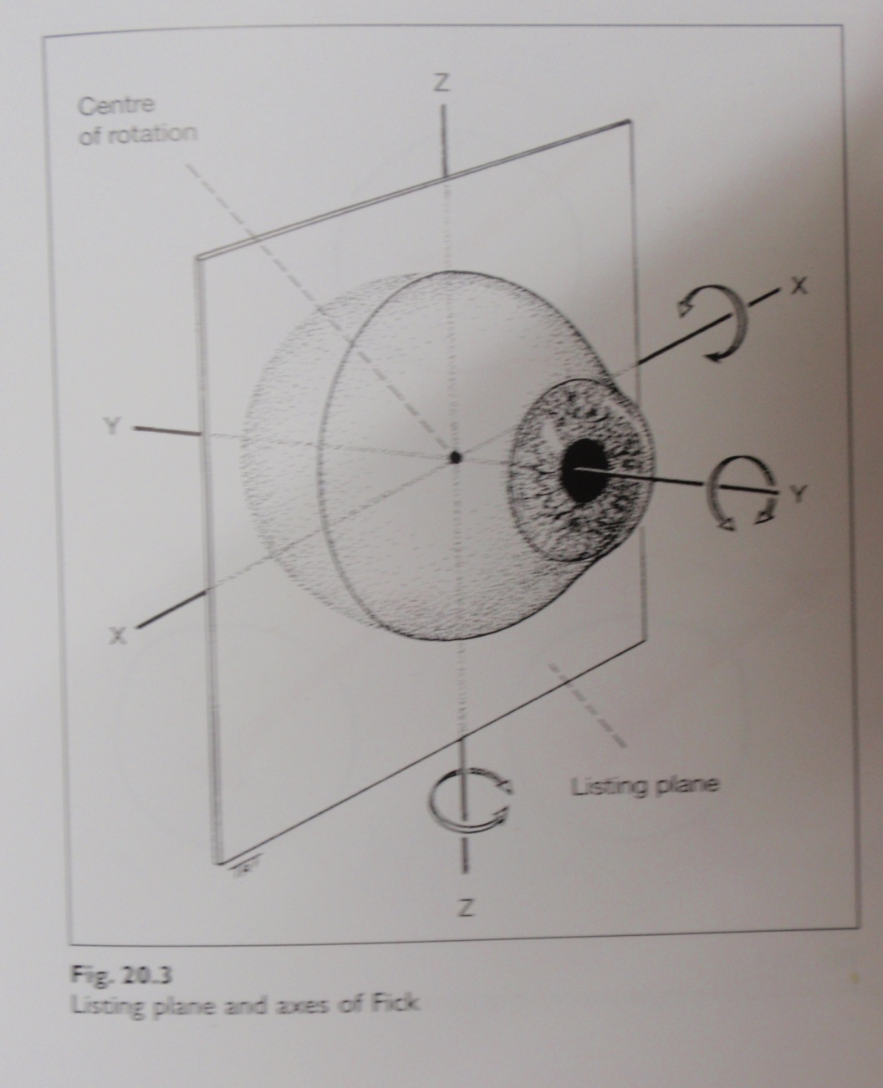

Slide 15
Ocular movements
Ductions –Monocular movements around the axis of Ficks
Adduction Intorsion
Abduction Extorsion
Elevation
Depression

Slide 16
Versions– Binocular,simultaneous,conjugate movements– same direction
Dextroversion(right gaze)
Laevoversion(left gaze)
Elevation(up gaze)
Depression(down gaze)

Slide 17
Dextroelevation(gaze up and right)
Dextrodepression(gaze down and right)
Laevoelevation(gaze up and left)
Laevodepression(gaze down and left)

Slide 18
Vergences
Binocular,simultaneous,disjunctate movements(in opposite direction)
Convergence(inward turning)
Divergence(outward movements)

Slide 19
Binocular movements

Slide 20
Laws of ocular motility
Agonist-antagonist- muscles of the same eye that move the eye in the opposite directions.
RLR antagonist to RMR
Synergists - muscles of the same eye that move the eye in the same directions.
RSR synergistic in elevation RIO

Slide 21
Yoke muscles(contralateral synergistics)
muscles ,one in each eye that produce conjugate ocular movements.
LSO yoke muscle is RIR

Slide 22
Positions of gaze
Six cardinal positions of gaze – one muscle in each eye move the eye into that position.
Dextroversion(RLR and LMR )
Laevoversion(LLR and RMR )
Dextroelevation(RSR and LIO )
Laevoelevation(LSR and RIO )

Slide 23
Dextrodepression (RIR and LSO )
Laevodepression (LIR and RSO )

Slide 24
Nine diagnostic positions of gaze- deviations are measured.
Six cardinal positions
Elevation
Depressions
Primary position

Slide 25
Diagnostic positions of gaze

Slide 26
Thanks

