Slide 1
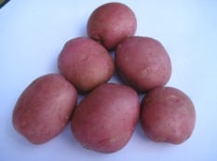
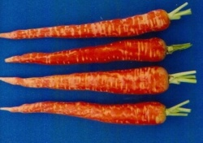
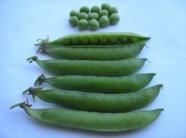
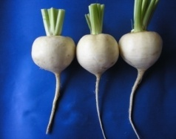
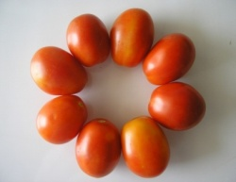
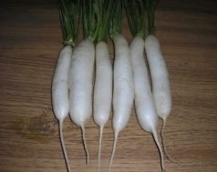
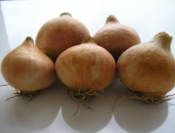
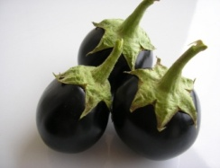
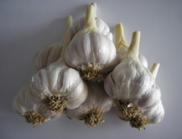
Horticulture?
HORT-201
University College of Agriculture,
University of Sargodha

Slide 2
DIVISIONS OF HORTICULTURE
Horticulture
Pomology
Olericulture
Floriculture

Slide 3
DIVISIONS OF HORTICULTURE
Pomology
Practical
Pomology
Systematic
Pomology
Commercial
Pomology

Slide 4
POMOLOGY
Derived from Latin words
Pomum____________ Fruit
Logos/Logy_________ Study
The study of fruits is called pomology.

Slide 5
POMOLOGY
1. Practical Pomology
It deals with the practice of growing fruits and is often considered under the title of fruit production

Slide 6
POMOLOGY
2. Systematic Pomology
It describes fruits according to their structural development, distribution and habitat along with their classification.

Slide 7
POMOLOGY
3. Commercial Pomology
It deals with the marketing and character of fruits.
Its phases are
Preparation for market
Storage of fruits
Transportation to consumers

Slide 8
All major fruits are clonally propagated.
In most cases, the commercial varieties are used as scion, and the rootstock is of a different species or variety.
Farm operations like pruning and training of trees and thinning of fruits are unique to pomology

Slide 9
Post-harvest handling of fruits is itself a specialized discipline, dealing with grading, packing, storing, processing, and shipping operations.
Similarly, Marketing of fruits requires special attention to take advantage
of seasonal markets and to avoid losses due to perishability.

Slide 10
Olericulture
It is composed of two Latin words
Oleris ----- a herb
Culture ----- to cultivate
The study of vegetable production is called Olericulture.
The science and practice of growing, harvesting, storing, processing and marketing vegetables.

Slide 11
Vegetable:
It is defined as the edible portion of an herbaceous plant used as fresh or processed.
The edible portion may be:
Fruit tomato, cucumber
Foliage lettuce, cabbage
Tuber potato
Roots sweet potato, radish, carrot
Seeds peas, beans

Slide 12
TYPES OF VEGETABLE PRODUCTION
Home or kitchen gardening
Market gardening
Truck gardening
Vegetable forcing
Vegetable production for processing
Vegetable seed production
Mushroom culture

Slide 13
HOME GARDENING
It is source of fresh food supply for an average family of 6-8 members.
Definition: “vegetable growing at home on small scale for self consumption is known as home gardening or kitchen gardening”
Features
Size of garden 10-20 marla in backyard.
Only domestic use
Choice of family members.
Organic gardening
Short duration vegetables.
For example: coriander, mint, lettuce, radish, carrot, turnip.

Slide 14
MARKET GARDENING
Near large centers of population, many kinds of perishable vegetables are grown for sale in local markets
This type of market gardening has developed to meet the
requirements of people with no land, time, or interest to
grow their own vegetables.
Improved roads and transport facilities have made it possible to serve distant areas of 70-100 Km
Planning
Important is the selection of right time of sowing & varieties to avoid glut seasons & wastage of produce and loss of income.
Hazards
Market gardeners in the vicinity of big cities utilize city sewerage water as a source of fertilizer and irrigation.
This sewerage water has heavy load of chemicals that are injurious to humans.

Slide 15
TRUCK GARDENING
It is the production of special vegetables in relatively large quantities for distant market.
The usual choices are less or non-perishable crops.
Examples.
Potatoes Okara
Melons and peas Guranwala
Winter muskmelon lower Sindh
Summer crops of onion Baluchistan & Swat
Chillies Multan
Watermelon Layyah

Slide 16
VEGETABLE FORCING
“Production of vegetables out of their normal season of out door production is known as vegetable forcing”
Great demand by the consumers
Early or late production of summer vegetables
Limitations:
Vegetables like tomato, cucumber, eggplant, peppers, melons and gourds are frost sensitive
Hence greenhouses, tunnels, lath houses are used
So initial cost of production is high.

Slide 17
VEGETABLE PRODUCTION FOR PROCESSING
“Processing refer to ways and means by which vegetables or their products are preserved for future use instead of fresh consumption.”
Not so developed in Pakistan
Avoid glut in season and stabilize prices
Important processing means include:
Canning Peas, beans, mushrooms
Freezing Spinach, Peas, Sweet corn
Dehydration Onion, Garlic
Industrial products Tomato ketchup, Potato chips, juices

Slide 18
Vegetable Seed production
Vegetables are grown especially for good quality seeds production.
Important steps are:
Breeding
Selection
Rogging off
Mushroom culture
It is branch of Olericulture which has the potential for expansion.
It is high priced vegetable.

Slide 19
ORNAMENTAL HORTICULTURE
“It is branch of horticulture which deals with plants & their layout for beautification of the environment or for aesthetic look.”
Flowering plants Chrysanthemum, roses, carnation.
Foliage plants Achlypha, dranta, syngonium
Lawn grasses Dhaka, American, tiffiny, Korean
Bulbs Canna, amaryllis, lily, narcissus
Shrubs Shoe flower, marva, flowering peach, jatropha
Ornamental Horticulture
Floriculture
The science and practice of growing,
harvesting, storing and
Marketing flowering plants
Landscape
Designing + Layout + Planting

Slide 20
Other Areas
Landscape Designing
Formal: Traditional of Indo-pak
Informal: Japanese or naturalistic nature
Horticultural Therapy
Psychological impact
Mental illness for indoor patients
Cut flower industry:
Bi-products like extraction of essential oil.
Medicinal purposes: Peppermint, calendula

Slide 21
The Future of the Horticulture Industry
Currently in a state of rapid growth
People are becoming more concerned about their surroundings, world resources
Conservation, and controlling pollution

Slide 22
In the Future:
More plants will be used to:
Beautify surroundings
Conserve soil and control pollutants
Protect and feed wildlife

Slide 23
The Future
Looks exceptionally good for those involved in working with plants and providing goods and services related to Horticulture.

Slide 24
Production of Horticulture Crops
Population increases and people have more leisure time, more gardening of all types will be done.
Demand for fruits, vegetables, ornamentals and landscaping plants will increase.
Increase in demand will result in substantial increase in production business.

Slide 25
Service Industries
Increased need for fertilizers, pesticides, seeds, chemicals, tools and equipments.

Slide 26
Marketing
More people are employed in marketing than production.
If marketing increases all other areas will as well.

Slide 27
Teaching and Extension Work
More students need training, requiring more teachers.
Quickly changing technology requires specialists and professionals.

Slide 28
Research
To increase production, researchers must:
Develop better varieties
Improve insect and disease resistance

Slide 29
Opportunities for Horticulture Graduates
Each year, there are about 14% more jobs in agriculture than there are graduates to fill these.

Slide 30
What Are Typical Jobs?
• Landscape managers
• Garden center operators
• Greenhouse growers
• Nursery managers
• Golf course superintendents
• Plant, seed, chemical, and equipment sales

Slide 31
What Are Typical Jobs?
Extension agents
Horticultural Agriculture
and Vo-Tech teachers
Public garden horticulturists
Orchard managers
Vegetable growers
Plant or produce inspectors

Slide 32
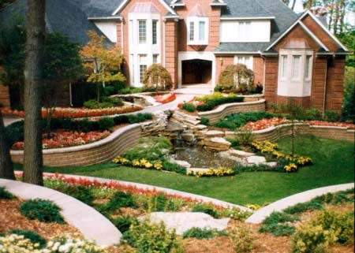
What Does the Future Hold for Horticulture Majors?
• Horticulture is a recession-proof industry.
• Good landscaping increases home sales, apartment occupancy rates, and employee productivity. This, in turn, increases demand.

Slide 33
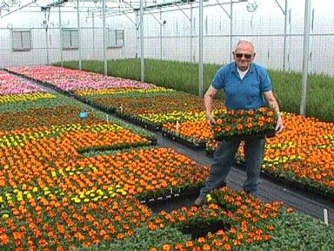
Why Do Most People Become Horticulturists?
• Job satisfaction--they love working with plants.
• It’s the fastest-growing agricultural commodity in the state.

