Slide 1
COLLEGE OF ENGINEERING AND TECHNOLOGY UNIVERSITY OF SARGODHA DESIGN OF STRUCTURES (CE-409) 01-Credit Hour
LECTURE-2
SPECIFICATIONS AND CODES OF PRACTICE

Slide 4
BUILDING CODES
Buildings must be designed and constructed according to the provision of Building Code, which is a legal document containing requirements to such things as structural safety, fire safety, plumbing, ventilation and accessibility to the physically disabled.
A Building code has the force of law and is administrated by a governmental entity such as city or for some large metropolitan areas, a consolidated government.
Building Codes do not give design procedures, but they do specify the design requirements and constraints that must be satisfied.
Important information to Structural Engineer is the prescription of minimum live loads for buildings.

Slide 5
BUILDING CODES
Although the Engineer is encouraged to investigate the actual loading conditions and attempt to determine realistic values, the structure must be able to support these specified minimum loads.
Most codes specify design loads, allowable stresses, material quality, construction types and other requirements for building construction.
The most significant code for structural concrete design in the united states is the Building Code requirements for Structural Concrete, ACI 318, or the ACI Code.
Other codes of practice in usa include the International Code, the Uniform Building Code, Standard Building Code, National Building Code, Basic Building Code, South Florida Building Code.
Different codes other than those of the united states include the British Standard (BS) Code of Practice for Reinforced Concrete, CP 110 and BS 8110, the National Building Code of Canada and the German Code of Practice for Reinforced Concrete, DIN 1045.

Slide 7
ALLOWABLE STRESS DESIGN (ASD)/ WORKING STRESS DESIGN / ELASTIC DESIGN / Straight-Line Design
In this method, a member is selected that has cross-sectional properties such as area and moment of inertia that are large enough to prevent the maximum applied axial force, shear or bending moment from exceeding an allowable or permissible value.
This allowable value is obtained by dividing the nominal or theoretical strength by a favor of safety. This can be expressed as
required strength < allowable strength ……………… (A)
Where,
allowable strength = $\frac{nominal strength}{safety factor}$
Strength can be an axial force strength (as in tension or compression members), flexural strength (moment strength) or a shear strength.
If stresses are used instead of forces or moments the relationship of equation ------ (A) becomes
maximum applied stress < allowable stress
This approach is called allowable stress design. The allowable stress will be in the elastic range of material (See Figure-1.3 in next slide). This approach to design also called elastic design or working stress design.
Working stresses are those resulting from the working loads, which are the applied loads. Working loads are also known as service loads.

Slide 8
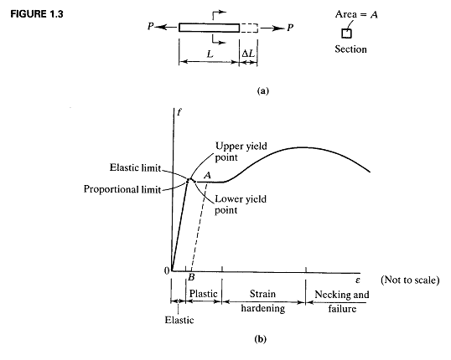

Slide 10
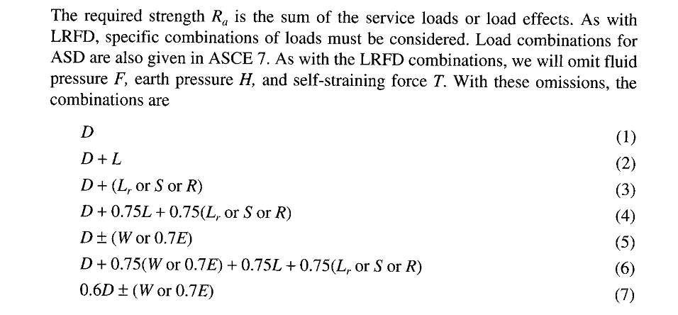

Slide 14
PLASTIC DESIGN
Plastic design is based on a consideration of failure conditions rather than working load conditions.
Plastic design, also referred to as limit design (not to be confused with limit- states design) or capacity design, is a design process that considers the redistribution of moments as successive cross-sections yield, thereby forming plastic hinges that lead to a plastic mechanism.
These concepts are of considerable importance design, where the amount of ductility expected from a specific structural system leads to a decrease in the forces that must be resisted by the structure.

Slide 18
LOAD AND RESISTANCE FACTOR DESIGN (LRFD)/ ULTIMATE STRENGTH DESIGN/
STRENGTH DESIGN METHOD………………
The factored load is a failure load greater than the total actual service load, so the load factors are usually greater than the unity.
However, the factored strength is reduced, useable strength and the resistance factor is usually less than unity.
Limit State Design is a further step in the Strength Design Method.
It indicates the state of the member in which it cease to meet the service requirements such as loosing its ability to withstand external loads or suffering excessive deformation, cracking, or local damage.

Slide 19
LOAD AND RESISTANCE FACTOR DESIGN (LRFD)/ ULTIMATE STRENGTH DESIGN/
STRENGTH DESIGN METHOD
According to the limit state design, reinforced concrete members have to be analyzed with regard to three limiting states
Load Carrying Capacity (safety, stability and durability)
Deformations (deflections, vibrations and impact)
The formation of cracks.
The aim of this analysis is to ensure that no limiting state will appear in the structural member during its service life.
In terms of safety, this limit state can be fracture, yielding, or buckling and the factored resistance is the useful strength of the member, reduced from the theoretical value by the resistance factor.
The limit state can also be one of the serviceability such as maximum acceptable deflection.

Slide 22
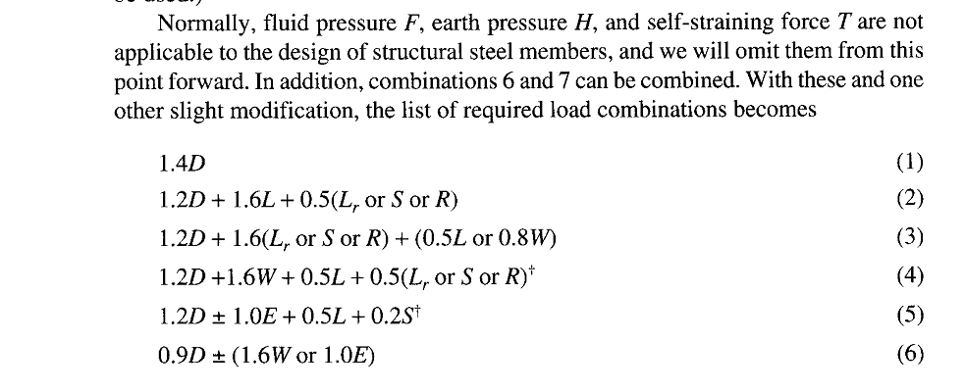

Slide 24
