Slide 2
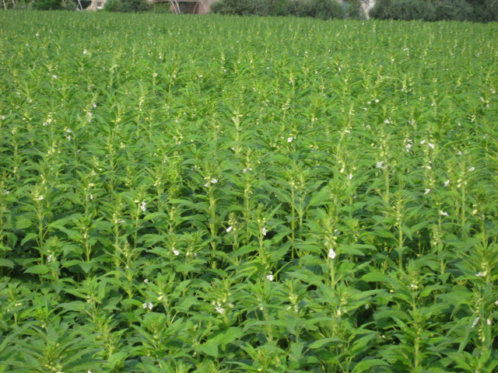
Sesame (Sesamum indicum)

Slide 3
Introduction
Common Name is Til, Gingilli.
B.N Sesamum indicum .
2n=26.
It is self-pollinated crop.
Crossing is 5 % due to insects.
Oil contents 40-60 %.
Meal has 40 % proteins .
Contains amino acid methionine & cysteine but little deficient in lysine.

Slide 4
Origin & Cultivation
It originated in Ethiopia & India.
It is grown in tropical & sub-tropical throughout the world.
It is grown in India, USA, China, Sudan, Egypt, Turkey, Burma, Mexico, Venezvela & Pakistan.
India is major exporting country.
In Pakistan mostly used for cakes cookies & bread. Oil & leaves have medicinal values.

Slide 5
Prospects In Pakistan
In Pakistan it can be easily grown as cultivated in June-July & harvested in the month of October so short duration & not competing with cereals. Oil is high quality, most ancient crop of the area; scope for export of oil is there.

Slide 6
World Sesame Production
 | Country | Yield Kg/ ha
1 | Egypt | 955
2 | China | 768
3 | USA | 730
4 | Mexico | 528
5 | Pakistan | 396
6 | India | 205
In Egypt highest potential was recorded i.e. 2200 Kg/ha.

Slide 7
Export of sesame seed
YEAR | VALUE (RS. IN MILLIONS)
2005-06 | 664.9
2006-07 | 1074.2
2007-08 | 2460.7
2008-09 | 3317.8
2009-10 | 1599.6
Source: Govt. of Pakistan, Federal Bureau of Statistics, Karachi

Slide 8
Sesame Situation In Pakistan
Total 90700 hectares with 41000 tons seed Area under cultivation in Pakistan.
Punjab 59.7 %
Sindh 31 %
KPK 6.7 %
NWFP 2.6 %.
In Punjab Gujraat, Bhakkar, Attock, Leiah, Bahawal Nagar.
62 % of total production in Punjab comes from Gujraat & Sialkot.
9 % of Sindh in Tharparker & Sangher,
76 % of KPK from Nasirabad.

Slide 9
Oil Composition & Properties
45-49% oleic acid.
37-41% linoleic acid.
It does not contain linolenic acid.
The oil has long shelf life as it contain antioxidant called sesamol which is derived from sesamolin during processing of seed.

Slide 10
Seed & Meal Composition
 | Protein% | Oil% | Carbohydrate% | Ash%& H2O
Whole seed | 22 | 43 | 11 | 24
Meal | 43 | 9 | 23 | 25

Slide 11
Mineral elemental Composition of Sesamum indicum L. seeds
Mineral elements | Composition (mg/100g) of Seed
Calcium, Ca | 415.38 ± 3.14
Phosphorus , P | 647.25± 3.52
Magnesium, Mg | 579.53 ± 0.42
Potassium , K | 851. 35 ± 3.44
Sodium, Na | 122.50 ± 4.21

Slide 12
Constraints
Shattering losses due to splitting of capsules.
Uneven maturity of the pods of the plant.
Lack of improved varieties.
Use of inferior quality seed as certified seed is not available.
Low level of fertilizer use.
No potential buyer/uncertain marketing system.
Damage by disease & insects.

Slide 13
Botany
Annual plant of the Pedaliaceae Family up to 1.5 meters height.
Flower: hermaphrodite, solitary at the end of short stalk that arise from the axils of the leaves, with tubular 4-lobed mouth. Flowers are pink to red, white and yellow in color and up to 5 cm in length. It’s flowering during July.
Leaves: opposite with three well defined lobed nerves. leaves are up to 14 cm in length and about 5 cm in width. Upper leaves are alternate.
Flower symmetry: there is only one way to evenly divide the flower (the flower is bilaterally symmetrical)
Fusion of petals: the petals are fused into a corolla tube
Stamen number: 4
Fruit: is a capsule having 15-20 seed. Seeds are flattened, oval, black and white or yellow, very oily and sticky.

Slide 14
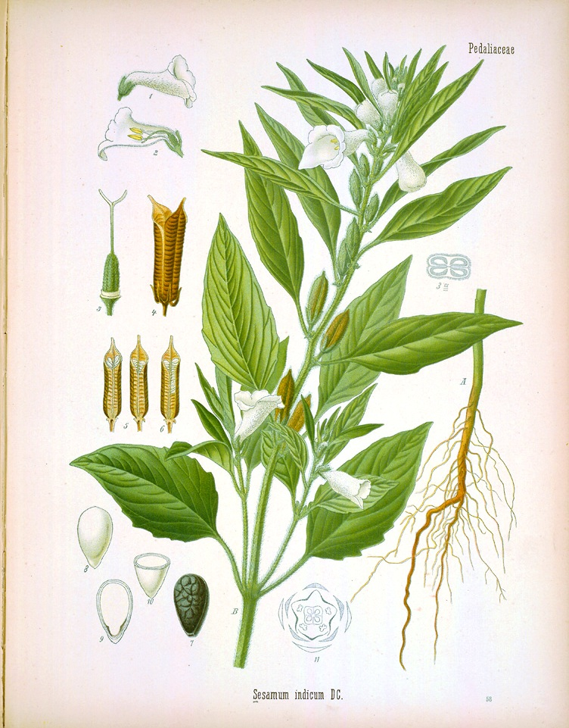

Slide 15
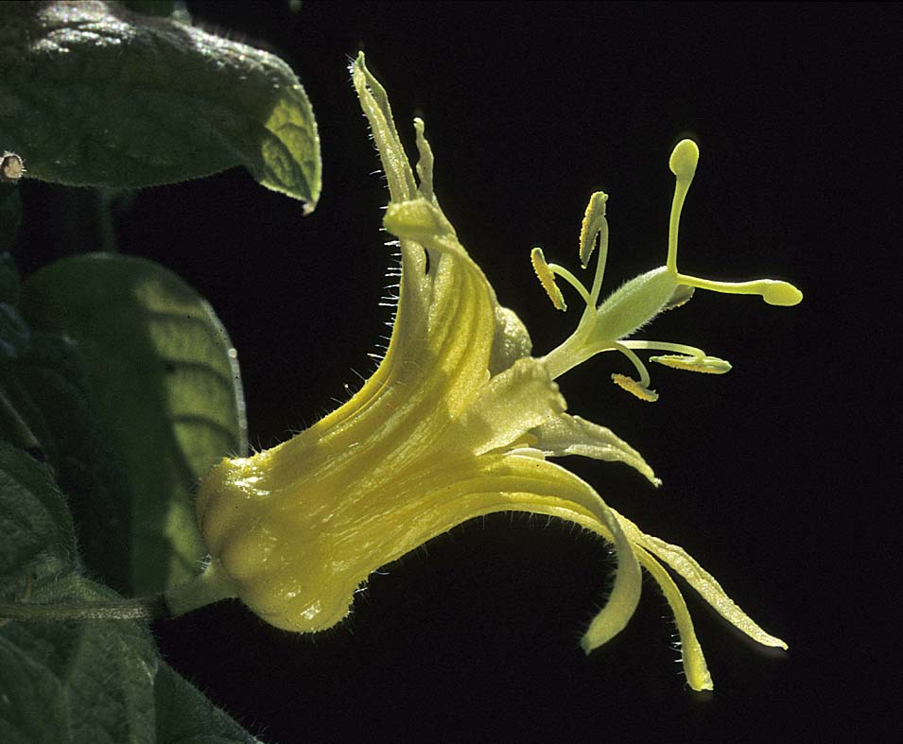
FLOWER

Slide 16
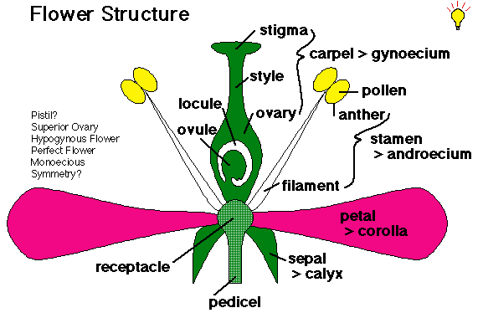

Slide 17
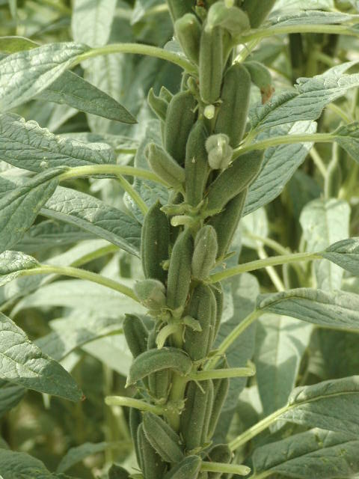
Pods

Slide 18
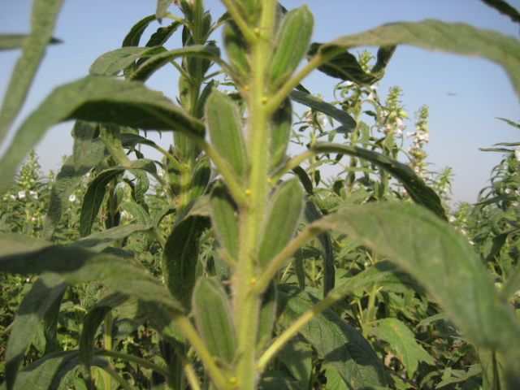
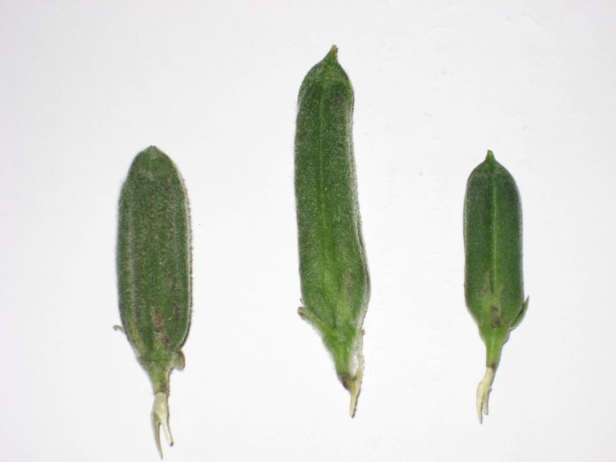
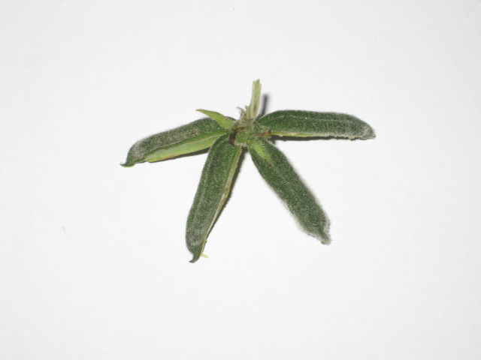
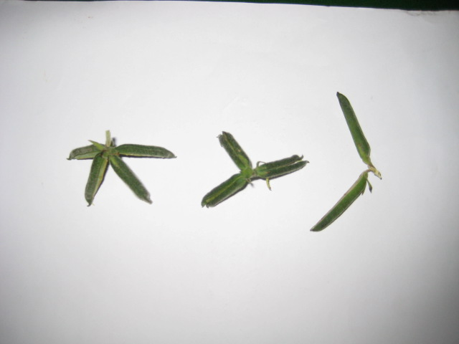
Pod Variations
(8 L)
(New line)
(TH-6)
(TS-3)
(8 L)
(8 L)
(6 L)
(4 L)

Slide 19
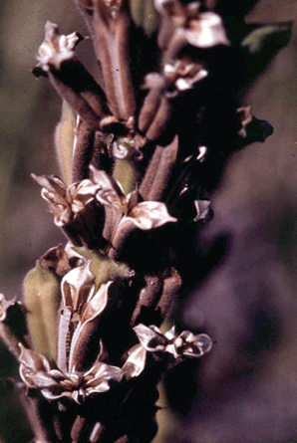
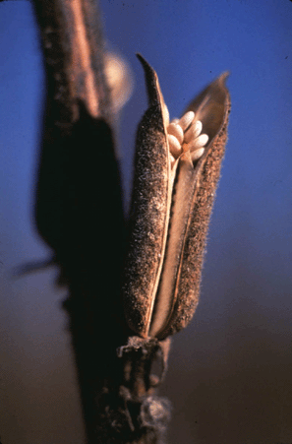
Dehiscent Sesame
Non-Dehiscent Sesame

Slide 20
Future Strategies
Non dehiscent type capsules. It may be possible through mutation breeding
Uniformly maturing plant types.
Plants with large no. of fertile capsule.
Varieties resistant of diseases and insect pests.
Development of production technology suitable for different areas.

Slide 21
Flower and Selfing Crossing techniques:
SESAME is a self pollinated (Autogamous) crop. In some varieties cross pollination also takes place to a limited extend of 5-6 per cent. Very high cross pollination between 14 and 65 per cent has been recorded in a few varieties in India. Hence, the crop can be classified as often cross pollinated. Cross pollination may occur due to wind and bee activities. On a bright clear day, the flowers open between 5 and 7 am. In the mature flower bud, just before the flower opens, the four unripe anthers are much below the stigma which at this stage is not receptive. The anthers begin to burst longitudinally after 4am in the next day and commence to liberate their pollen. At this time, the stigma becomes receptive. The plant comes to flowering 4 weeks after sowing

Slide 22
Selfing
Tieing with thread: Selfing can be effected by tieing the corolla of the unopened flower which is selected in the previous day evening itself.
Smearing of semi-solid clay: Selfing can be done by smearing a speck of semi-solid clay, on the upper portion of tubular petals of unopened flowers. The clay while on drying does not allow the tubular petals to open and hence self pollination is the rule. This method is cheap and less time consuming one. This method is noat effective during rainy days. During rainy days, fevicol may be applied on young flower bud to ensure selfing.

Slide 23
Crossing
Soda- straw method
The emasculation technique in sesame is easy for crossing due to epipetalous nature of the stamens. The flower bud which is expected to open in the next day morning is selected in the previous day evening between 3 P.M. and 6 P.M. and emasculated by just removing the corolla tube in which the stamens are attached. Then, the emasculated flower buds are covered with a piece of soda-straw tube, bent at the top in order to avoid contamination from foreign pollens. During the next day morning, between 7 A.M. and 9.A.M., pollen from the desired male parents were dusted gently on the surface of the stigmas of the emasculated flower buds after removing the soda-straw and again covered. The unemasculated flowers are removed in the female parent.
Individual crossed flowers are tagged with coloured thread for the identification of crossed capsules. Different coloured threads are used for different type of crosses.

Slide 24
Approved Verities
Variety | Institute | Year of release | Yield Potential (kg/ha)
Til-89 | ORI, Faisalabad | 1990 | 500-600
TS-3 | ORI, Faisalabad | 2000 | 700-800
TH-6 | ORI, Faisalabad | 2009 | 800-900
TS-5 | ORI, Faisalabad | 2011 | 850-950

Slide 25
Uses
In most of Asia the primary use of sesame is as a cooking oil.
The oil is very stable oil is known as the King of the vegetables oils in the east and Queen of the vegetable oils in the west.
Foods fried in sesame oil have longer shelf-life.
In Japan the seed is toasted prior to oil extraction resulting in a toasted oil that is extremely stable and provides flavor to the foods.
As with other vegetable oils, sesame oil has been used to make soap and margarine

Slide 26
Uses
In the past sesame oil was used in lanterns.
The oil is used in many intra-muscular injections as a carrier to spread the medicine faster.
Many insecticides use sesame oil as a synergist for the active agent.
Sesame is used as a garnish with black sesame decorating light foods such as fish and light sesame decorating dark foods.
In Japan sesame sits on most tables and is used as a flavoring much as salt and pepper are used in the West.
In the Middle East the sesame is ground into a paste known as tahini.

Slide 27
Uses
In Saudi Arabia in the desert the tahini is very stable and is a staple in the diet.
Sesame paste is mixed with peanut butter to enhance the flavor and the extend the shelf-life.
Sesame is made into a sweet known as halva, which is considered as a high energy food. Similarly, sesame is used in many sweets throughout Asia.
In the western world sesame is primarily used as a confectionary. The seed is dehulled and placed on top of buns and breads

Slide 28
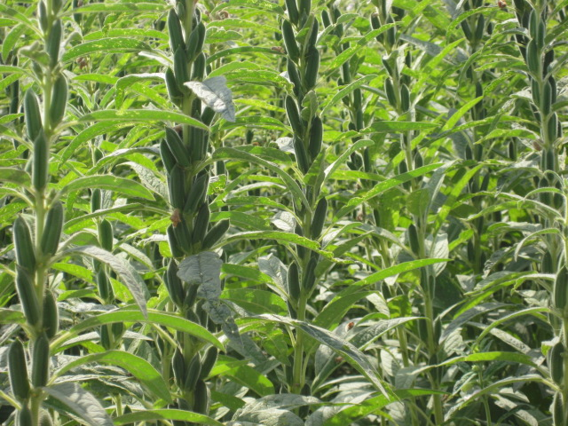
Uses
Sesame oil is further refined and used extensively in cosmetics. In looking at labels, particularly on facial crèmes, sesame oil is one of the ingredients.
One Japanese company puts the sesamin in pills and markets them for reducing hangovers after drinking alcohol.
In India sesame is used in religious ceremonies and is used in festivals. In the Sandarn Koil Tapasu Festival, sesame seeds are cooked very slowly in sugar creating a sugar coating around the individual seed.
In China sesame is sprinkled over rice and red beans and served at the exchange of wedding presents.
Sesame is used in flower gardens because they provide flowers over a 30-40 day period.
In the US sesame is used to attract and feed game birds.
Thank You

