Slide 1
Chapter No 1
Introduction

Slide 2
Lecture Contents
Course Outline
What is an Operating System?
Computer System Structure
Computer System Structure
Interrupts and Interrupt Handling
Storage Structure.
History of Operating Systems

Slide 3
Lecture Objectives
Describe the general organization of a computer system and the role of interrupts
Describe the components in a modern, multiprocessor computer system.
History of Operating Systems

Slide 4
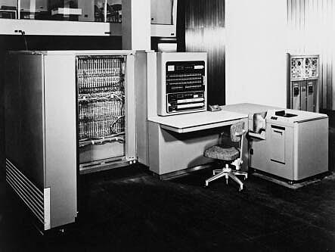
IBM Model 701 (Early 1950's)

Slide 5
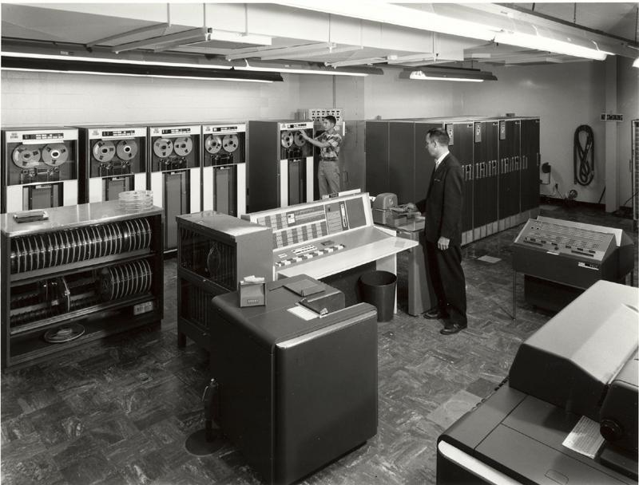
IBM 7094 (Early 1960's)

Slide 6
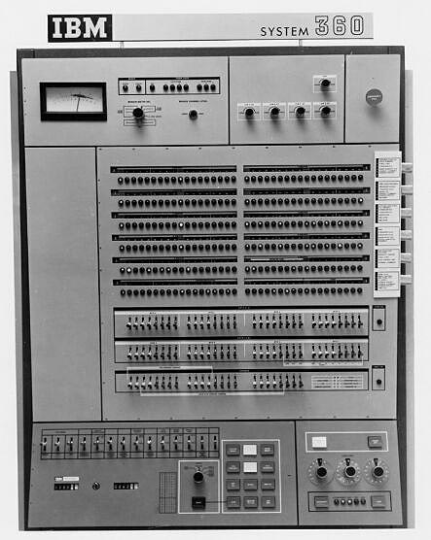
IBM System 360 Console

Slide 7
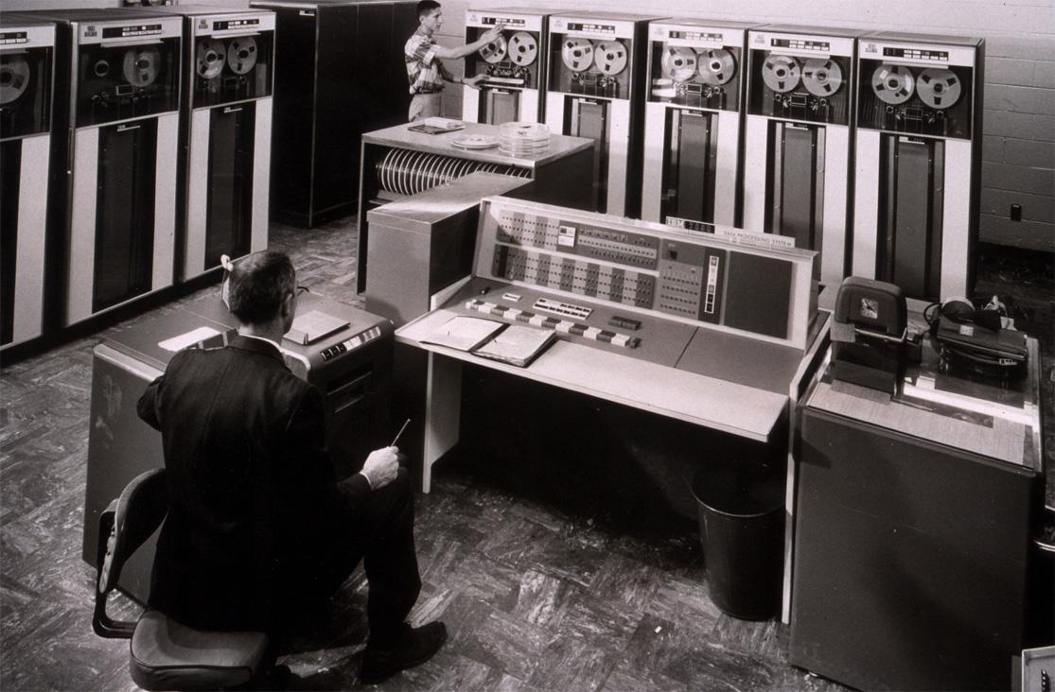
IBM 7094 (Early 1960's)

Slide 8
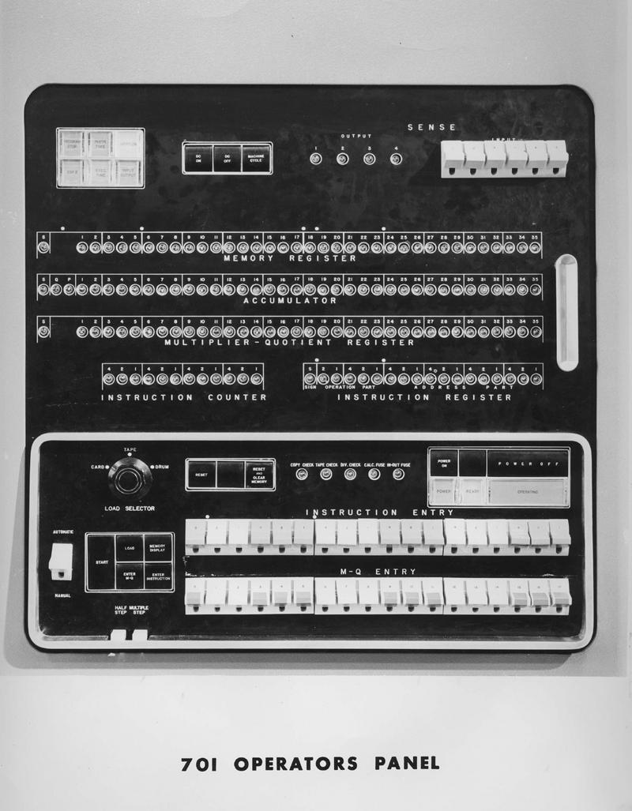
IBM 701 Console

Slide 9
History
Batch Systems
Multiprogramming
Time Sharing

Slide 10
Lecture Material
Slides of chapter 1 can be found from the given link
https://codex.cs.yale.edu/avi/os-book/OS10/slide-dir/index.html

