Slide 1
Presentation-2
PBG-308

Slide 2
Presentation Topic
01
02
Principle of germplasm collection.
Stretagies of germplasm collection.

Slide 3
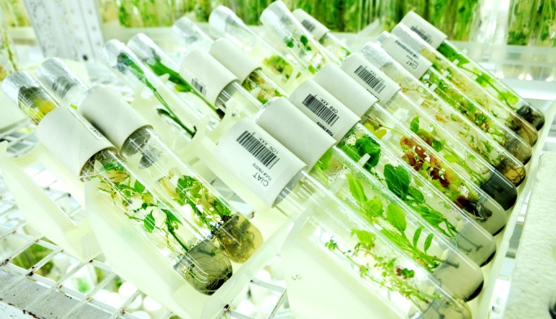
Definition;
What is germplasm?
“The sum total of hereditary material, i.e, all the alleles of various genes present in a crop species and its wild relatives”.

Slide 4
Germplasm consists of the following five types of materials;
Land races
Obsolete varieties
Varieties in cultivation
Breeding lines
Wild forms and wild relatives

Slide 6
Types of collection

Slide 7
Germplasm collection

Slide 8
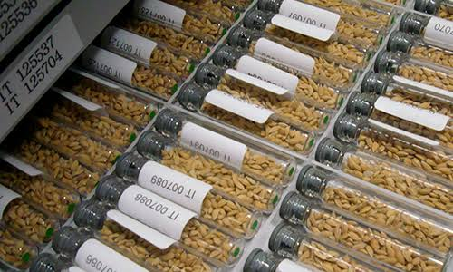
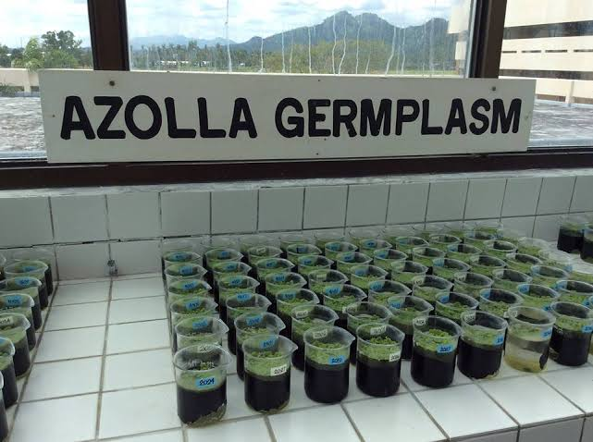
Collection of germplasm
“The process of obtaining the various germplasm accessions for a germplasm collection is known as collection of germplasm”.
This can be done in two chief ways;
Exploration and collection
Procurement from other agencies, individuals, companies, etc.

Slide 9
Objectives of germplasm collection.
Collection of germplasm needed by breeders. The germplasm accessions collected for this purpose possess the specific traits that are required by breeders either in the immediate future or in the foreseable future.
Collection of the variability remaining in the crop plants and their relatives for its conservation. For this purpose, germplasm samples are collected without any reference to the process of specific traits; the consideration for collection is that as many diverse types are are collected as possible

Slide 10
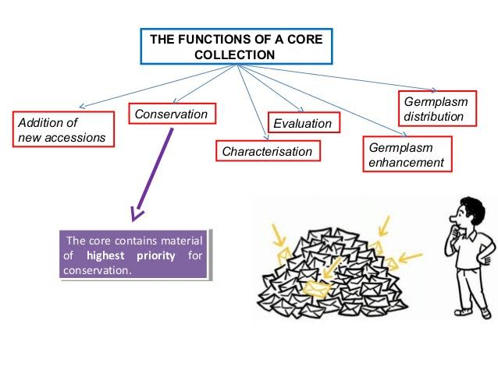

Slide 11
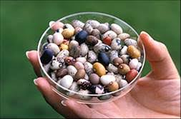
Exploration and Collection.
Explorations are trips for collection of various forms of crop plants and their related species. Therefore, cultivated forms like land races, open pollinated varieties, etc., wild forms and wild relatives are also collected.
Exploration are the primary source of all the germplasm present in the various germplasm collections.

Slide 12
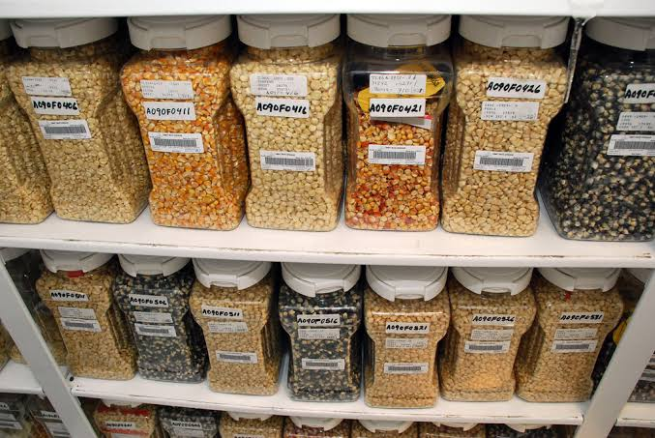

Slide 13
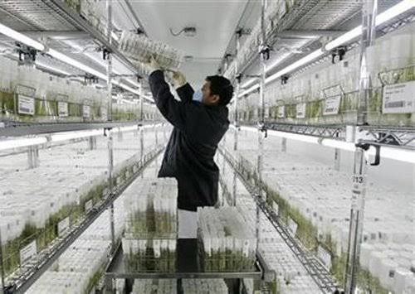
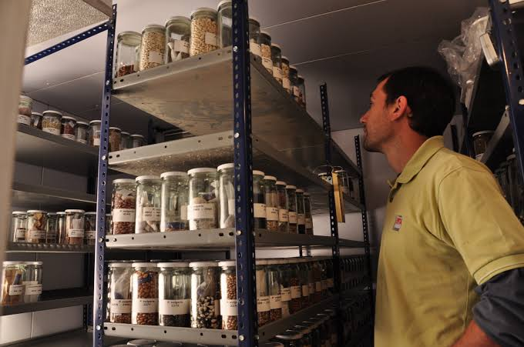

Slide 14
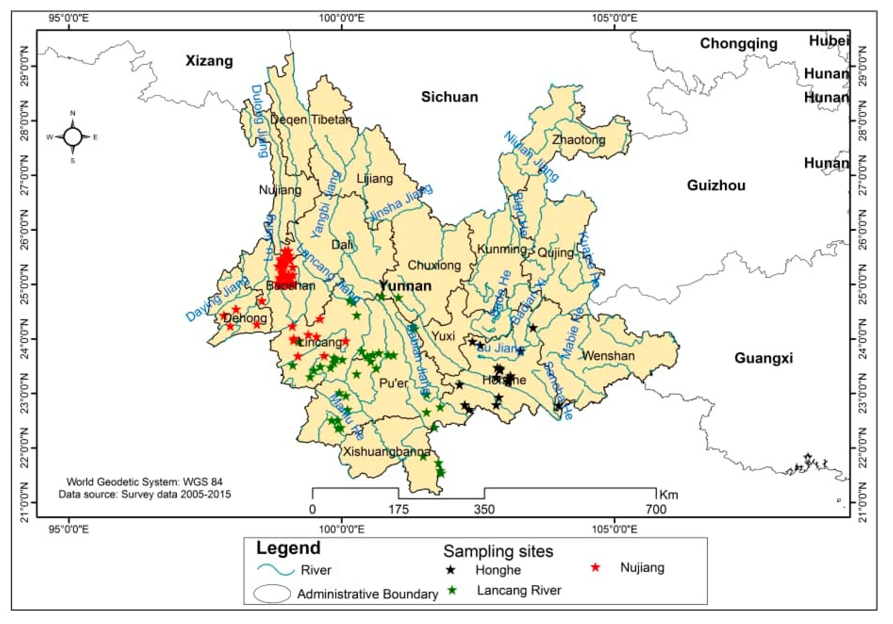
Areas of collection.
The areas to be covered by explorations are usually the centres of origin of the concerned crops. In addition, collections should also be made from the peripheal regions of species distribution, and even in areas where it was introduced in comparatively recent times.
This is because in these areas the crops are exposed to environmental stresses, and special mutations may have been selected for.

Slide 15
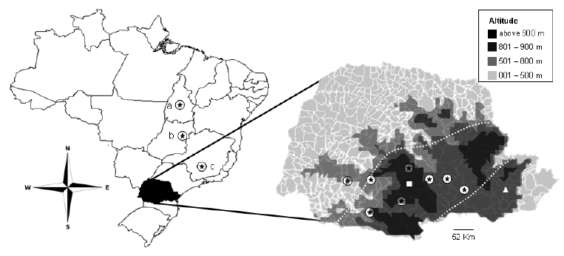
Sampling Sites.
The locations of sampling sites within the collection area should be carefully planned in advance. This should be based on a consideration of the changes in ecological agricultural and social conditions in the area; soil pattern and changes in agricultural practices should also be considered. If there is considerable variation for these factors, the sampling sites should be closer, otherwise they should be relatively farther apart.
Generally, sites for cultivated material would be scattered over the entire area, while those for wild materials would occur in clusters. A preliminary survey of the area may be done before the actual collection.

Slide 16
Collection Priorities.
The species for which collection is to be done will be determined by the needs of the breeders, and by the level of threat to the concerned species.
Thus the need-based priorities will depend on the country in question, while the threat-based priorities have been developed by FAO: the emergency situations are indicated by ‘E’, and the lower level priorities are donated by I, II, III.

Slide 18
SAMPLING PROCEDURE
RANDOM SAMPLING
SELECTIVE SAMPLING
In Random sampling, samples are collected without considering their distinctiveness.
Random sampling is most suited for conservative efforts and is expected to collect the whole range of variability present in a species
In Selective sampling, distinct forms of sample are collected.
Selective sampling may pick out morphological variants only, and may miss entirely such gene as those for adaptation, resistance to biotic and abiotic stresses, etc.

Slide 19
SAMPLE SIZE
It has been suggested that 50- 100 plants should be collected
50 seed should be collected from each plant
Thus each sample should of 2500 to 5000 seeds

Slide 20
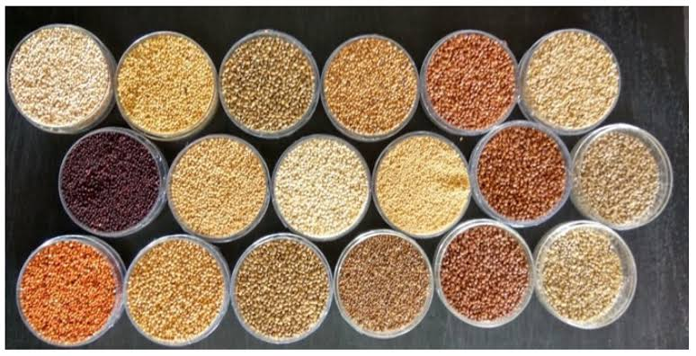

Slide 21
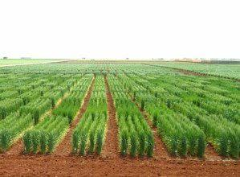
Field Record.
Adequate feild record should be maintained during sampling
Indian scientist have undertaken several exploration.In 1955 ,the Botanic Survey of India sent team to Bomdila,NEFA
In 1961,an expedition to central Nepal;collection include cultivar of cereal, millet,pulses,mustard etc

Slide 22
Merits of exploration.
The merit are listed below;
It is the source of virtually all genetic diversity stored in gene banks
It is the only mean of collecting and conserving the threatened genetic diversity
It provide access to material of special onterest e.g new genes

Slide 23
Limitations of plant explorations.
The limitation are listed below;
It is tedius, time-taking and expensive
It posses hardship to collectors e.g; in boarding etc.
They may even threat to life especially wild animal.

Slide 24
Procurement From Other Agencies.
Germplasm can be obtained from other agencies concerned with germplasm conservation from research institutions, individuals or companies.Generally,this involve an import germplasm.

Slide 25
Reference.
Allard,R.W.1970.Population structure and sampling method.In:”Genetic resources in plants-Their exploraion and conservation,”O.H Frankel & E Bennett
Bogyo,T.P,E.Porceddu &P.Perrino.1980.Analysis of sampling for collecting genetic material.Econ.Bot 34
https://www.nap.edu/read/2116/chapter/8
https://journals.plos.org/plosone/article?id=10.1371/journal.pone.0063107
https://www.bioversityinternational.org/fileadmin/bioversity/publications/Web_version/510/ch05.htm

Slide 26
THANK YOU

